Slide 1
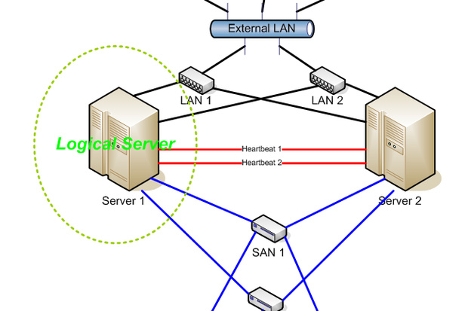
PC2 HA Cluster
1
Notes:
1

Slide 2
Linux HA Clusters
1-Introduction
2-HA Cluster components
3-pacemaker architecture.
4-Clustering Resources.
5-Constraints.
6-Working with DRBD.
7-PC2 with pacemaker
2
Notes:
2

Slide 3
1-Introduction
What is cluster?
Group of Servers, resources (Storage, Network, Services).
Acts like a single system.
Type of clusters?
High performance.
Load balancing.
High Availability.
3
Notes:
3

Slide 4
1-Introduction
High availability cluster
Make sure the critical resources have the maximum possible availability.
Install the cluster software on the member servers.
S/W monitors the availability of the resources
If the resources or server goes down, the cluster will notice and restart the resource else where in the cluster
A user request
Request a resource
High availability cluster
Server 1
Server 2
Server 3
4
Heart beat
Notes:
4

Slide 5
2-HA cluster components
A Typical system has Server
Storage
Network devices
Network cables
Cables
Every component has a single point of failure.
HA Cluster eliminates SPF.
HA Cluster complicate the topology.
Network switch
Server
Fiber/Ethernet
Storage
5
Notes:
5

Slide 6
2-HA cluster components
External Network switch
Different Networks.
External network carries out the users traffic
Cluster network carries out cluster replication, heart beat traffic.
Can be one network.
User traffic may saturates cluster network, brings the cluster network down.
Separate each network to a dedicated network.
Server
Cluster
network
Server
Fiber/Ethernet
Fiber/Ethernet
Storage
6
Notes:
6

Slide 7
3-Pacemaker architecture
Pacemaker architecture
A Cluster resource manager.
Has the control over, deployed s/w, system, interconnections.
Achieves maximum availability for cluster services.
Detecting, and recovering failures.
Node failure.
Resource level failure.
Use of message and membership (corosync, or heartbeat).
7
Notes:
7

Slide 8
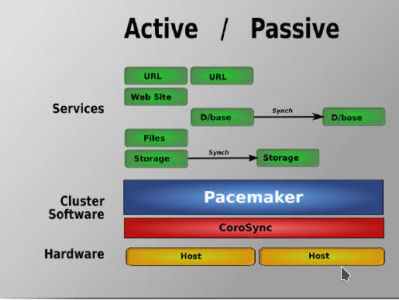
3-Pacemaker architecture
Types of Pacemaker clusters.
Active/Passive.
8
Notes:
8

Slide 9
4-Clustering resources
The main purpose of the cluster is to make the resource available at all times.
The resources must not controlled by the system init system.
Must be managed by the cluster it self.
Must take the service out of systemd.
To create a resource, we need a resource agent (RA).
RA is like a service control script.
RA contains a cluster parameter.
LSB :Linux Standard Base.
OCF:Open Cluster Framework.
Heartbeat, linbit, lvm2, OCFS2, pacemaker, Other.
Service.
stonith
9
Notes:
9

Slide 10
4-Clustering resources
Defining operations:
To add a resource to a cluster, must define
How to start the service.
How to stop the service.
How to monitor the service.
Op start interval=”0” timeout=60
Op stop interval=”0” timeout=60
Start outside the cluster as standalone to measure the timeout
Stop outside the cluster as standalone to measure the timeout
Then make sure the cluster has more time than the timeout.
Interval defines how many time unit to check for the service.
10
Notes:
10

Slide 11
4-Clustering resources
Resource grouping:
There is a situation that resources should always be together.
If the cluster has no knowledge, it will load balance the resources, and distribute them to all nodes.
For example, for Apache web server, the IP, File system, and Apache service must be grouped together.
11
Notes:
11

Slide 12
5-Constraints.
A Set of rules that define how resources should be loaded.
A resource grouping is a convenient way of keeping resources together.
Situation of a complex dependencies.
Location:
On which server the service should start, or should not.
Colocation:
Define what resources should be loaded together, or should not be loaded together.
Order:
In which order should services loaded.
12
Notes:
12

Slide 13
6-Working with DRBD.
Distributed Replicated Block Device.
Is a kernel driver with user space for management.
Used in HA, Computer Clusters, Storage pools in cloud.
Mirroring content of (HDD, Partitions, Logical volumes).
Mirrors data over network (RAID-1).
In real time
Transparently
Synchronously or Asynchronously
13
Notes:
13

Slide 14
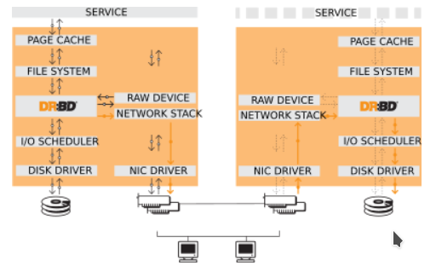
6-Working with DRBD.
14
Notes:
14

Slide 15
6-Working with DRBD.
Resources roles:
Primary:
A device can be used for read/write.
Creating, mount file systems.
File systems can be row, direct I/O, and block device.
Secondary:
Receives all updates from other peers.
Disallows any kind of access.
Why disallow read? To maintain cache coherency.
15
Notes:
15

Slide 16
6-Working with DRBD.
DRBD features:
Single-Primary mode: As in H/A clusters. Does not need a special file system.
Dual-Primary mode: As in load-balancer clusters. Needs a special file system as (GFS.OCFS) for distributed lock manager.
Replication mode:
Protocol A:Async replication, write ops considered done after written to local disk, and packets are send queue. used in long distance repl. Failure and data loss?
Protocol B:Memory Sync, write ops considered done after written to local disk, and packets are send to the peer. What about failure for both nodes?.
Protocol C:Most commonly used. write ops considered done after written to local and remote disks.
16
Notes:
16

Slide 17
7-PC2 with pacemaker
Pacemaker as HA Cluster software
DRBD as infrastructure storage
PC2 with PC2 RA
Resources:
VIP
DRBD raw storage
File system mount
PC2
Constraints:
Colocation
VIP, PC2, File system mount
File system mount, and DRBD Raw storage
Order
VIP, DRBD, File system mount, and then PC2
17
Notes:
17

