Slide 1



Inside Firefox OS
A look to the HTML5 device
Albert Crespell Perez
acperez@tid.es
May 2013

Slide 2







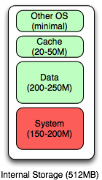
What is Firefox OS
Firefox OS internal storage map
Firefox OS 1.0 is designed for devices with at least 512MB of storage for the OS and apps, as well as an external storage (SD card) for media and updates.
The 512MB of storage is partitioned for the system files (Gonk, Gecko, and Gaia), data files (app & user), an HTTP data cache for storage of cached objects, and a small amount of storage for OS usage.

Slide 3



How it looks like
“TYPICAL “ SMARTPHONE
NEW HTML5-PHONE
Web Apps
Fully Web Based:
Simple UX
creation process
Web Apps and
Web Based UX
Browser
Native
Apps and UX
Based in open
standards (No
proprietary API)
Browser + WebAPIs
Execution Environment
Middleware Framework
Thinner stack:
Improves
scalability across
different device
tiers
DIRECT
ACCESS
Libraries
Re-Using already
existing software
(e.g. Drivers for
Android) = Low
Porting Effort
System Service
System Service
Kernel
Drivers
Kernel
Drivers
Hardware Platform
Hardware Platform

Slide 4
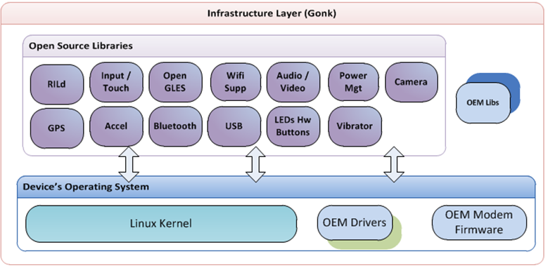
Architecture: GONK layer

Slide 5
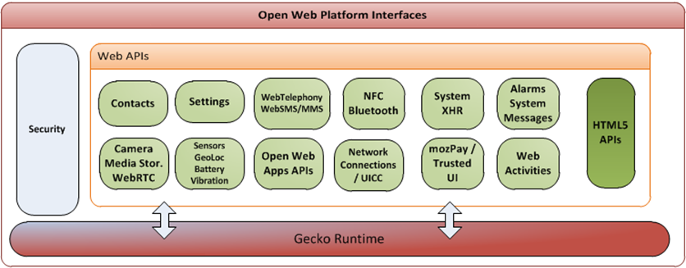
Architecture: GECKO layer
“TYPICAL “ SMARTPHONE
NEW HTML5-PHONE

Slide 6
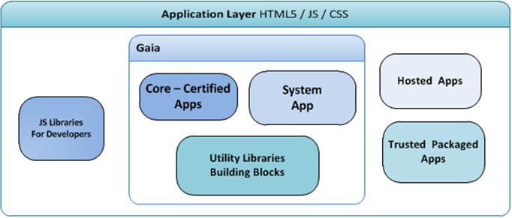
Architecture: GAIA layer
“TYPICAL “ SMARTPHONE
NEW HTML5-PHONE

Slide 7
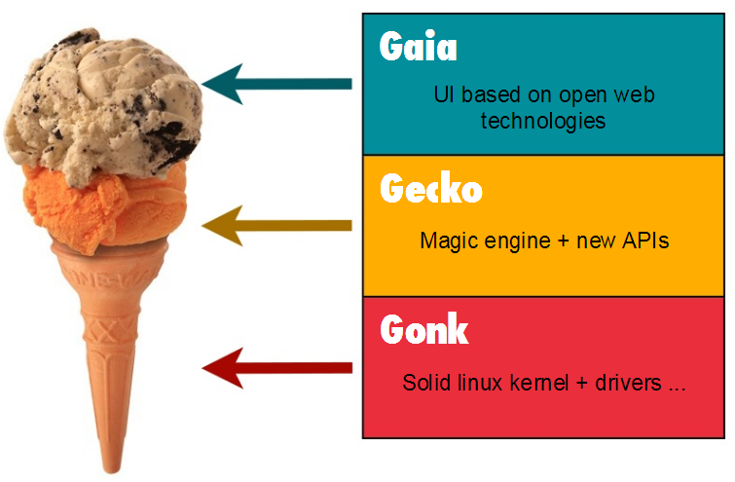
Architecture
“TYPICAL “ SMARTPHONE
NEW HTML5-PHONE

Slide 8
From web content to linux system
“TYPICAL “ SMARTPHONE
Device
NEW HTML5-PHONE
B2G Main process
Gecko
Gonk
HW
<< Gecko server >>
<< HAL >>
IPDL-based
communication
mechanism
Web content
IPDL-based communication
mechanism
B2G content process
<< low-privileged process >>
Web content
B2G content process
<< low-privileged process >>

Slide 9
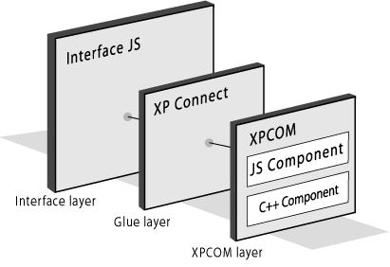

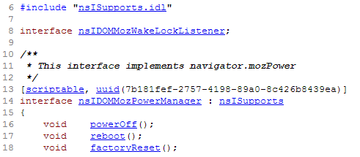
GECKO
Manager
Service
Database
WebApp
(JS)
XPIDL
h
js
cpp
XPT

Slide 10
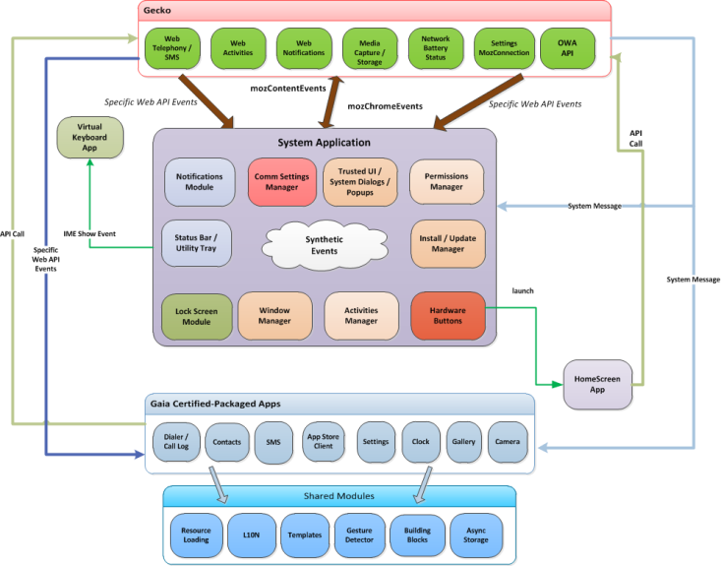
GAIA

Slide 11
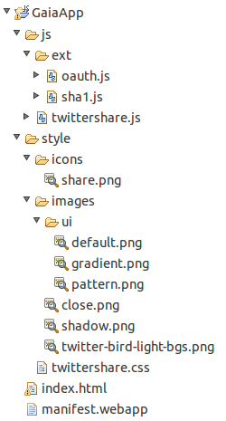
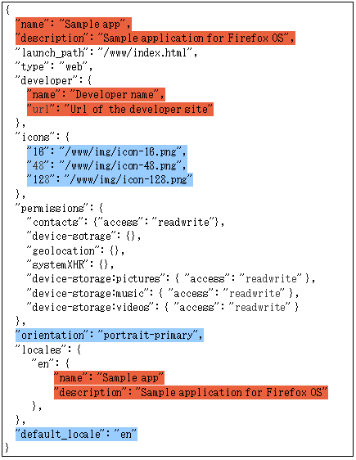

GAIA

Slide 12
Updates: FOTA vs OTA
https://updates.b2g.com/release/unagi1/18.0/20121203123456/update.xml
<?xml version="1.0"?>
<updates>
<update type="major" appVersion="19.0" version="19.0" extensionVersion="19.0“
buildID="20121210123456" licenseURL=“http://www.mozilla.com/test/sample-eula.html”
detailsURL="http://www.mozilla.com/test/sample-details.html">
<patch type="partial" URL="https://updates.b2g.com/release/unagi1/18.0/20121203123456/update.mar"
hashFunction="SHA512“ hashValue="5111e033875752b7d9b32b4795152dea5e7dcb3edea18c1f2c8f3bd89e17d103d6f“
size="41901319"/>
</update>
</updates>
FOTA | OTA
Gonk & Gecko & Gaia updates | Gecko & Gaia updates
Applies to the whole filesystem | Applies to /system/b2g
Update via recovery mode | Update via atomic swap of files
Android + Firefox update system | Firefox update system
System must be stopped | System can keep running
Device specific | Multi-device

Slide 13


