Slide 1
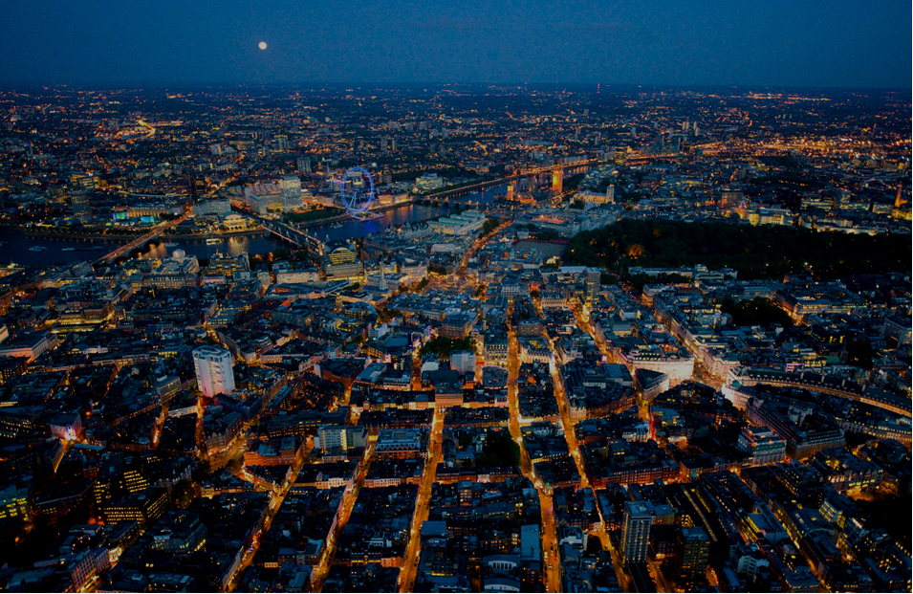


Inside Firefox OS
A look to the HTML5 device
Albert Crespell Perez
acperez@tid.es
February 2013

Slide 2


Lets go back in time

Slide 3
A bit of history
Telefonica market insights:
Still more users with feature phones than smartphones.
4 billons feature phones will be sold between 2011 and 2015.
First approach to internet through mobile devices.
Telefonica is big in LATAM.
What Telefonica can do:
Create a smartphone to cover their needs.
Able to give a high end user experience.
Don’t compete with the current market players.
How to proceed:
Work in a web based solution.
Open.
Using standard technologies.
Notes:
Why people have still feature phones

Slide 4

A bit of history
And Mozilla appeared with B2G:
Satisfy Telefonica needs.
Best technological partner.

Slide 5
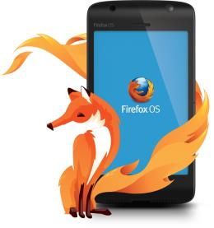






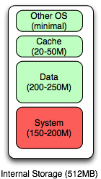
What is Firefox OS
Firefox OS internal storage map
Firefox OS 1.0 is designed for devices with at least 512MB of storage for the OS and apps, as well as an external storage (SD card) for media and updates.
The 512MB of storage is partitioned for the system files (Gonk, Gecko, and Gaia), data files (app & user), an HTTP data cache for storage of cached objects, and a small amount of storage for OS usage.

Slide 6



How it looks like
“TYPICAL “ SMARTPHONE
NEW HTML5-PHONE
Web Apps
Fully Web Based:
Simple UX
creation process
Web Apps and
Web Based UX
Browser
Native
Apps and UX
Based in open
standards (No
proprietary API)
Browser + WebAPIs
Execution Environment
Middleware Framework
Thinner stack:
Improves
scalability across
different device
tiers
DIRECT
ACCESS
Libraries
Re-Using already
existing software
(e.g. Drivers for
Android) = Low
Porting Effort
System Service
System Service
Kernel
Drivers
Kernel
Drivers
Hardware Platform
Hardware Platform

Slide 7
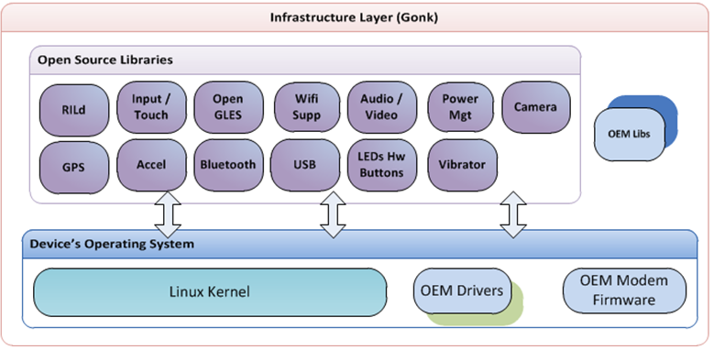
Architecture: GONK layer
“TYPICAL “ SMARTPHONE
NEW HTML5-PHONE

Slide 8
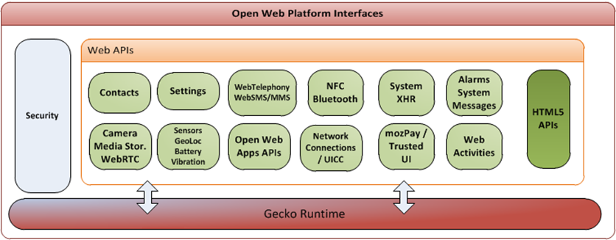
Architecture: GECKO layer
“TYPICAL “ SMARTPHONE
NEW HTML5-PHONE

Slide 9
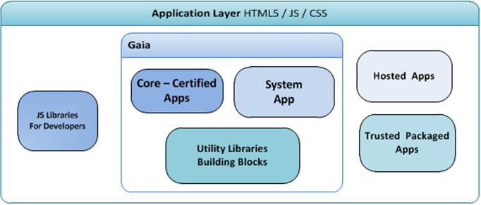
Architecture: GAIA layer
“TYPICAL “ SMARTPHONE
NEW HTML5-PHONE

Slide 10
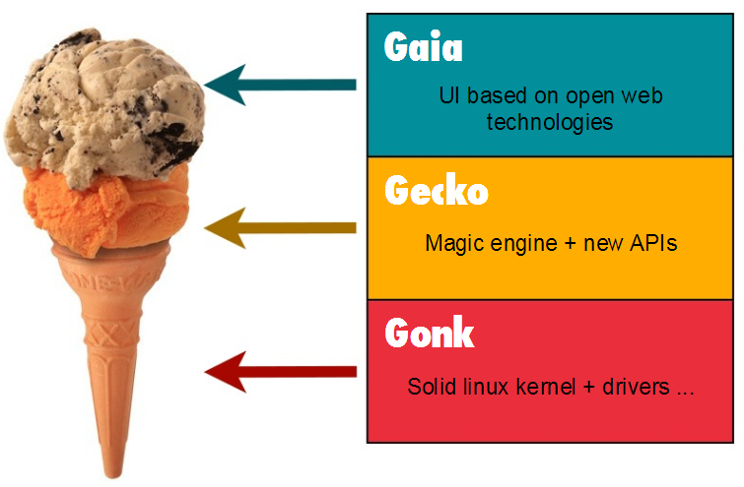
Architecture
“TYPICAL “ SMARTPHONE
NEW HTML5-PHONE

Slide 11
From web content to linux system
“TYPICAL “ SMARTPHONE
Device
NEW HTML5-PHONE
B2G Main process
Gecko
Gonk
HW
<< Gecko server >>
<< HAL >>
IPDL-based
communication
mechanism
Web content
IPDL-based communication
mechanism
B2G content process
<< low-privileged process >>
Web content
B2G content process
<< low-privileged process >>

Slide 12
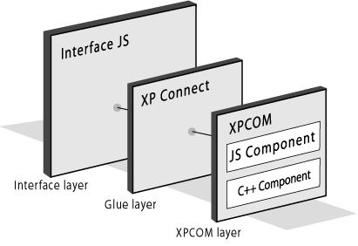

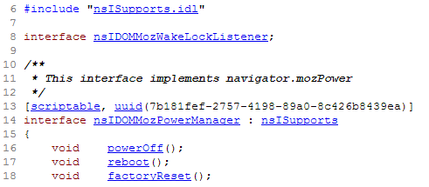
GECKO (Backend)
Manager
Service
Database
WebApp
(JS)
XPIDL
h
js
cpp
XPT

Slide 13
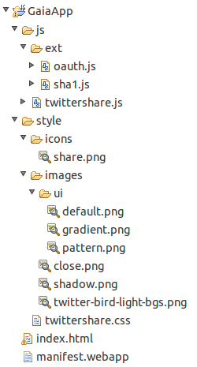
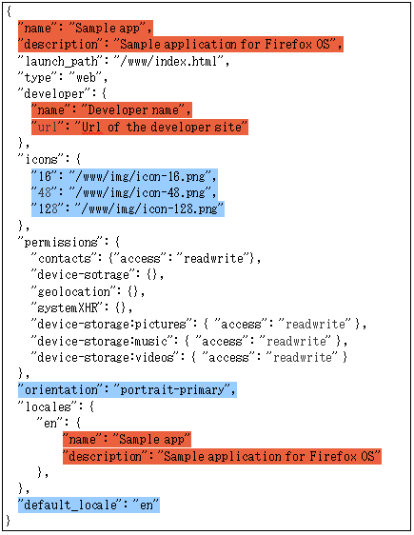

GAIA (Frontend)

Slide 14
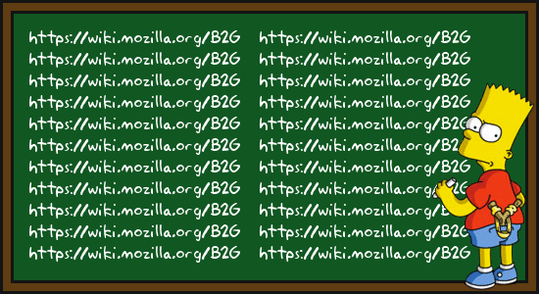
Hands on the code
Let’s take a quick overview of all the technologies
Two projects, both of then 100% free
B2G, what we call the backend
… and Gaia, guess what, the frontend

Slide 15
Collaborate
IRC, Mailing list, Repo, Bugs …
Everything on how to collaborate:
https://etherpad.mozilla.org/b2g-bootstrap
Keep an eye on us:
http://www.openwebdevice.com

Slide 16
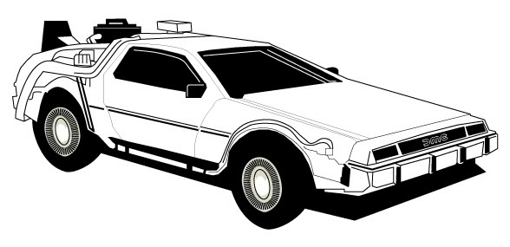
Thanks a lot!
… and welcome to the future.

