Slide 1

Industrial Data Space Business Architecture
PD Dr. Christoph Quix IDS e.V. AG Architektur – November 8, 2016 – Frankfurt

Slide 2
AGenda
Motivation and Methodology
Current Status
Next Steps

Slide 3
Motivation
Structured, formal modeling of processes in the IDS
Alignment of
(Reference) Use cases
Architecture
Implementations of IDS components
Certification
Not in the focus
Internal processes of a company to administrate/organize the participation in the IDS network and to exchange data

Slide 4
Methodology for the Business Architecture
Analysis of IDS processes (whitepaper, architecture, …)
Identify roles
Assign roles to processes
Modeling of single processes
Develop complete process model for IDS
Modeling uses BPMN as modeling language
Formalization of IDS processes should help to identify interfaces of IDS components

Slide 5
AGenda
Motivation and Methodology
Current Status
Next Steps

Slide 6
Current Status
Draft of business architecture has been developed
Roles have been identified
Processes have been described and modeled
Feedback has been integrated

Slide 7
Overview
Connector Service Provider
receive data
transfer data
Data
Consumer
exchange data
Data Provider
Data Owner
authorise
search metadata
publish metadata
Broker
log transaction
log transaction
Clearing House
use data apps
use data apps
AppStore
publish app
App
Developer
Certification Body
certify software

Slide 8
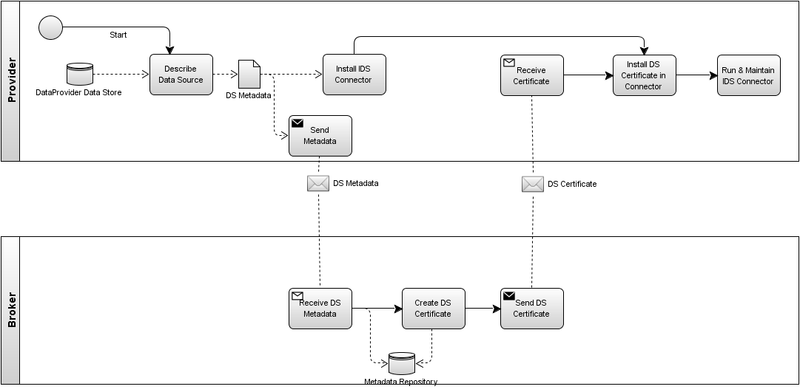
Process: Provide Data

Slide 9
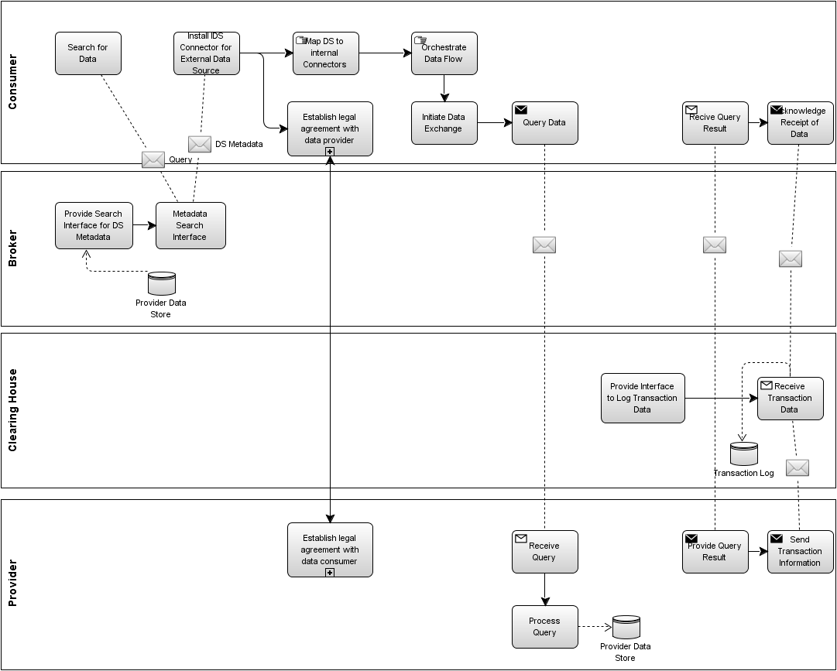
Process: Exchange Data

Slide 10
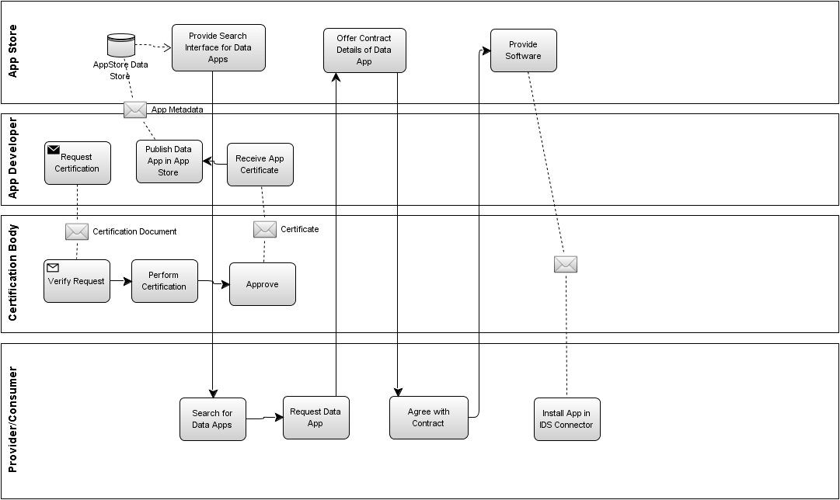
Process: Publish & Usage of Data Apps

Slide 11
AGenda
Motivation and Methodology
Current Status
Next Steps

Slide 12
Next (on-going) steps
Alignment with certification
Which components/roles need to be certified?
Certification of components vs. Certification of participants
Verify definitions of roles in certification and business architecture
Clarify definition of roles/terminology
Transaction
Clearing House
Broker
Check consistency with architecture documents
Model reference use cases to verify business architecture

Slide 13
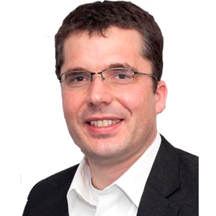

Contact
 | PD Dr. Christoph Quix Fraunhofer FIT
 | Christoph.Quix@fit.fraunhofer.de

