Slide 1

Team #5
Project 2
Robotics Calculator
Ameya Shahane, Ashish Bhogate, Darren Val Dcunha,
Rahul Thorat, Tanvi Baranwal
MAE 547 Modelling and control of robots
Arizona State University, MS Robotics

Slide 2
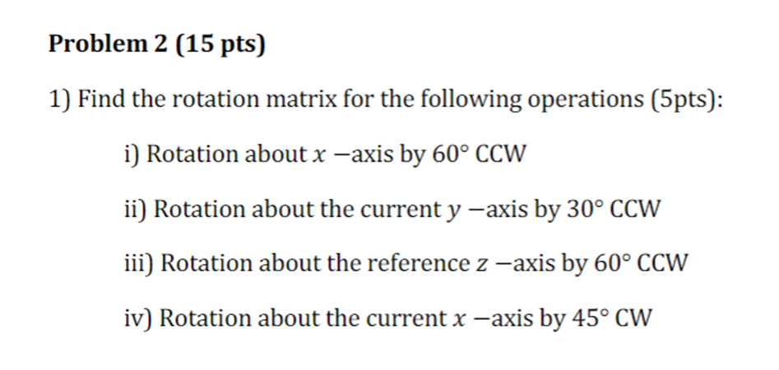
Do you remember this Problem?
Although we all had answers but there was no way to verify it!
We have worked out a solution for you!
MAE 547 Modelling and control of robots
Arizona State University, MS Robotics

Slide 3
Problem Statement
To develop a calculator that students can use to perform robotics calculations such as
finding degrees of freedom, transformation matrices
calculating Jacobian parameters etc.
It should have a user-friendly interface.
It should be fast and reliable.
MAE 547 Modelling and control of robots
Arizona State University, MS Robotics

Slide 4
Approach
The requirement was of an environment capable of doing robotics computation and have UI integration.
Because of its simple interface and user-friendly GUI, we chose MATLAB to generate all the needed functions.
All the routines were written in MATLAB using Peter Corke's Toolbox and the Robotics System Toolbox.
To execute our function files, we used callback functions, and we took user input by manipulating tables.
The output indicates precisely what the user is asking for, and numerous values can be evaluated at the same time.
MAE 547 Modelling and control of robots
Arizona State University, MS Robotics

Slide 5
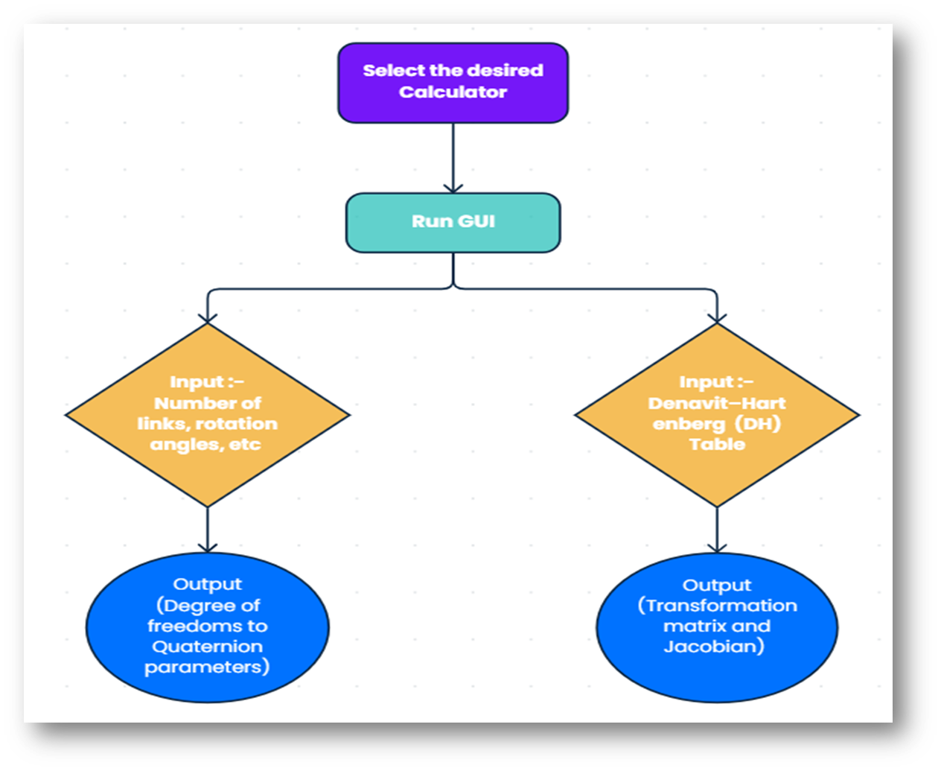
Approach
MAE 547 Modelling and control of robots
Arizona State University, MS Robotics

Slide 6
Methodology
Euler Angles to Rotation Matrix:
The user invokes the Euler Angle to Rotation matrix calculator's graphical user interface.
The user enters the three angles, angle rotation type, and frame type.
The calculator computes all the input parameters in order to compute the appropriate rotation matrix.
Unit Quaternion to Rotation matrix
The GUI for the Quaternion calculator is launched by the user.
The user enters the quaternion's scalar and vector parts, which are necessary to construct the rotation matrix.
The calculator computes the quaternion parameters and outputs a rotation matrix.
MAE 547 Modelling and control of robots
Arizona State University, MS Robotics

Slide 7
Methodology
Angle-axis representation to rotation matrix
The user launches the GUI for the angle axis representation calculator.
To calculate the rotation matrix, the user enters the unit vector of a rotation axis with respect to the reference frame (o-xyz) and the angle (theta).
The calculator computes the input data and returns the required rotation matrix.
Rotation matrix to Unit Quaternion
The GUI for the Quaternion Calculator is launched by the user.
The user enters the rotation matrix for which the unit quaternion parameters, eta (scalar component of the quaternion) and Epsilon (vector part of the quaternion), are desired
The rotation matrix data is computed by the calculator, and the results are Ex, Ey, Ez, and eta.
MAE 547 Modelling and control of robots
Arizona State University, MS Robotics

Slide 8
Methodology
Rotation matrix to Angle-axis representation
The GUI for angle axis representation calculator is launched by the user.
The user enters the rotation matrix for which the unit vector of a rotation axis with respect to the reference frame (o-xyz) and angle are required (theta).
The calculator computes the input data and returns R(theta,r), that is, rx, ry, rz, and theta.
Rotation Matrix to Euler Angles:
The GUI for Rotation matrix to Euler angle calculator is launched by the user.
The user enters the rotation matrix for which the set of Euler Angles is desired, with each set consisting of "3 angles" describing the orientation of a rigid body. phi, theta, and psi are the three angles.
The rotation matrix data is computed by the calculator, and two sets of Euler angles are output.
MAE 547 Modelling and control of robots
Arizona State University, MS Robotics

Slide 9
Methodology
Transformation matrix:
Before launching the Forward Kinematics GUI, the user must be aware of the robot's DH Table.
After running the GUI, the user has to enter number of links which is case sensitive and then must enter the DH table parameters.
After defining all the parameters, click “Compute Final transformation”. The final transformation matrix will be generated as the output.
Geometric Jacobian:
Before running the GUI of Geometric Jacobian, the user needs to ensure that they know the correct DH setting of the robot.
After launching the GUI, the user has to input number of links present in the robot.
Enter the DH table parameters manually.
Specify the kind of each robot joint. The user needs to enter 1 for prismatic joint and 2 for revolute joint.
After accurately entering all the information, click "Compute Jacobian." The output will show the Jacobian matrix, which contains the joint variables created for all joints from joint 1 to joint n.
MAE 547 Modelling and control of robots
Arizona State University, MS Robotics

Slide 10
Methodology
Elementary rotations
The multi rotations calculator interface will be started by the user.
The rotation angle, axis around which the rotation must be made, and type of frame—reference or current frame—must all be entered by the user.
The result produced after entering the correct data will display the final rotation matrix, with a focus on the pre- and post-multiplication of the rotation matrices based on their frame of reference.
MAE 547 Modelling and control of robots
Arizona State University, MS Robotics

Slide 11
Methodology
DOF
The user will launch the Degree of Freedom calculator interface.
Following launch, the user must enter the number of joints, links, degrees of freedom (DOF) of the rigid body, and number of freedoms offered by the joint.
Following accurate data input, Grubler's Formula will be used to provide an output that includes the robot's degree of freedom.
Rotation matrix
The interface for the Rotation Matrix Calculator will be launched by the user.
The user must enter both the rotation angle and the axis around which the rotation should be made.
When all the necessary information has been entered, the rotation matrix will be displayed in the output.
MAE 547 Modelling and control of robots
Arizona State University, MS Robotics

Slide 12

Results
MAE 547 Modelling and control of robots
Arizona State University, MS Robotics

Slide 13
Discussions
MAE 547 Modelling and control of robots
Arizona State University, MS Robotics

Slide 14
Discussion
Throughout the project, the team faced various obstacles in merging multiple functionalities into a single user-friendly interface.
The limits arose from the need to make the functions concise and relevant over the complete spectrum of its usefulness. Because some of us were inexperienced programmers, implementing and integrating the functionalities with the GUI proved difficult.
The team worked to reduce the individual function code in order to make it quicker and more efficient. We collaborated to assist each other grasp MATLAB coding approaches and methodology.
MAE 547 Modelling and control of robots
Arizona State University, MS Robotics

Slide 15
Discussion
The team noticed a few concerns with the code's integrity when paired with other defined functions that needed the same input arguments for other functions. In order to overcome this, we employed independent variables while sacrificing RAM to make the system more robust.
Due to the duration and complexity of the duties, we were unable to add some functionalities such as Inverse kinematics, Workspace, and Analytical Jacobian . We encountered difficulties producing this robotics calculator project because to our lack of expertise of the MATLAB environment and coding.
However, future work will entail implementing the other functionalities to improve and expand its functionality. The remaining functionalities will be incorporated in the future to make it better and more useful.
MAE 547 Modelling and control of robots
Arizona State University, MS Robotics

Slide 16
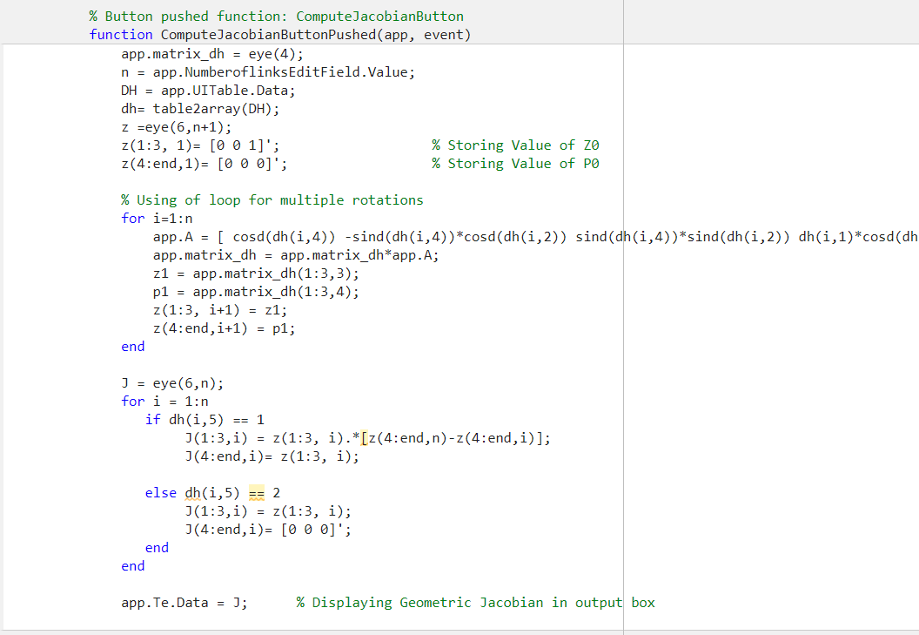
Code Overview
MAE 547 Modelling and control of robots
Arizona State University, MS Robotics

Slide 17
Contribution
Read and Signed by
Ameya Shahane 20%
Percentage of Contribution
Coding of functions
Ashish Bhogate 20%
Percentage of Contribution
Coding, GUI and testing
Darren Val D’cunha 20%
Percentage of Contribution
Coding of functions
Rahul Thorat 20%
Percentage of Contribution
Coding, GUI and testing
Tanvi Baranwal 20%
Percentage of Contribution
Theory, Presentation and Video editing
100%
MAE 547 Modelling and control of robots
Arizona State University, MS Robotics

Slide 18
References
Peter Corke Robotics Toolbox 9.10
MathWorks’s Robotics System Toolbox
MATLAB R2022a
MAE 547 Modelling and control of robots
Arizona State University, MS Robotics

