Slide 1

Faculty of Computer Science, AQL Project.
VEHICLE ROUting Problem
Capacitated Green Vehicle Routing Problem (CGVRP)
Moscow, 2018

Slide 2

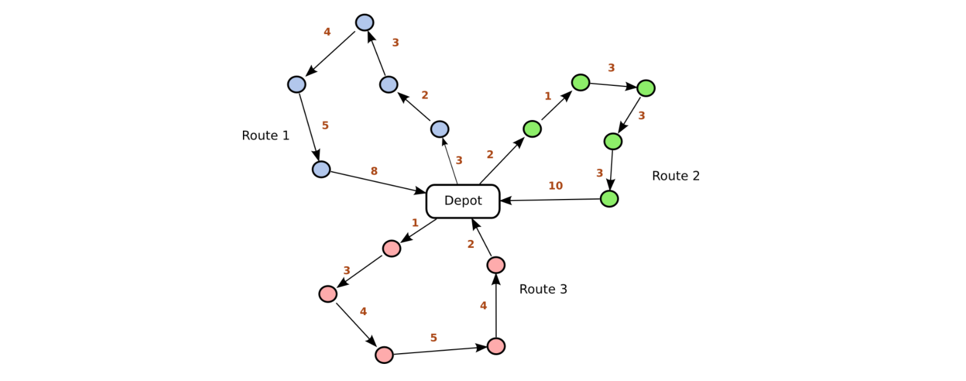
Faculty of Computer Science, AQL
VEHICLE ROUting Problem
Capacitated Green Vehicle Routing Problem (CGVRP)
What is VRP more importantly what is CGVRP

Slide 3
Faculty of Computer Science, AQL
VEHICLE ROUting Problem
Capacitated Green Vehicle Routing Problem (CGVRP)
Our Problem
We present a situation where a distributor has to manage multiple fleets, comprising of green vehicles and conventional vehicles with the goal of maximising the use of green vehicles and minimising the use of conventional vehicles.

Slide 4
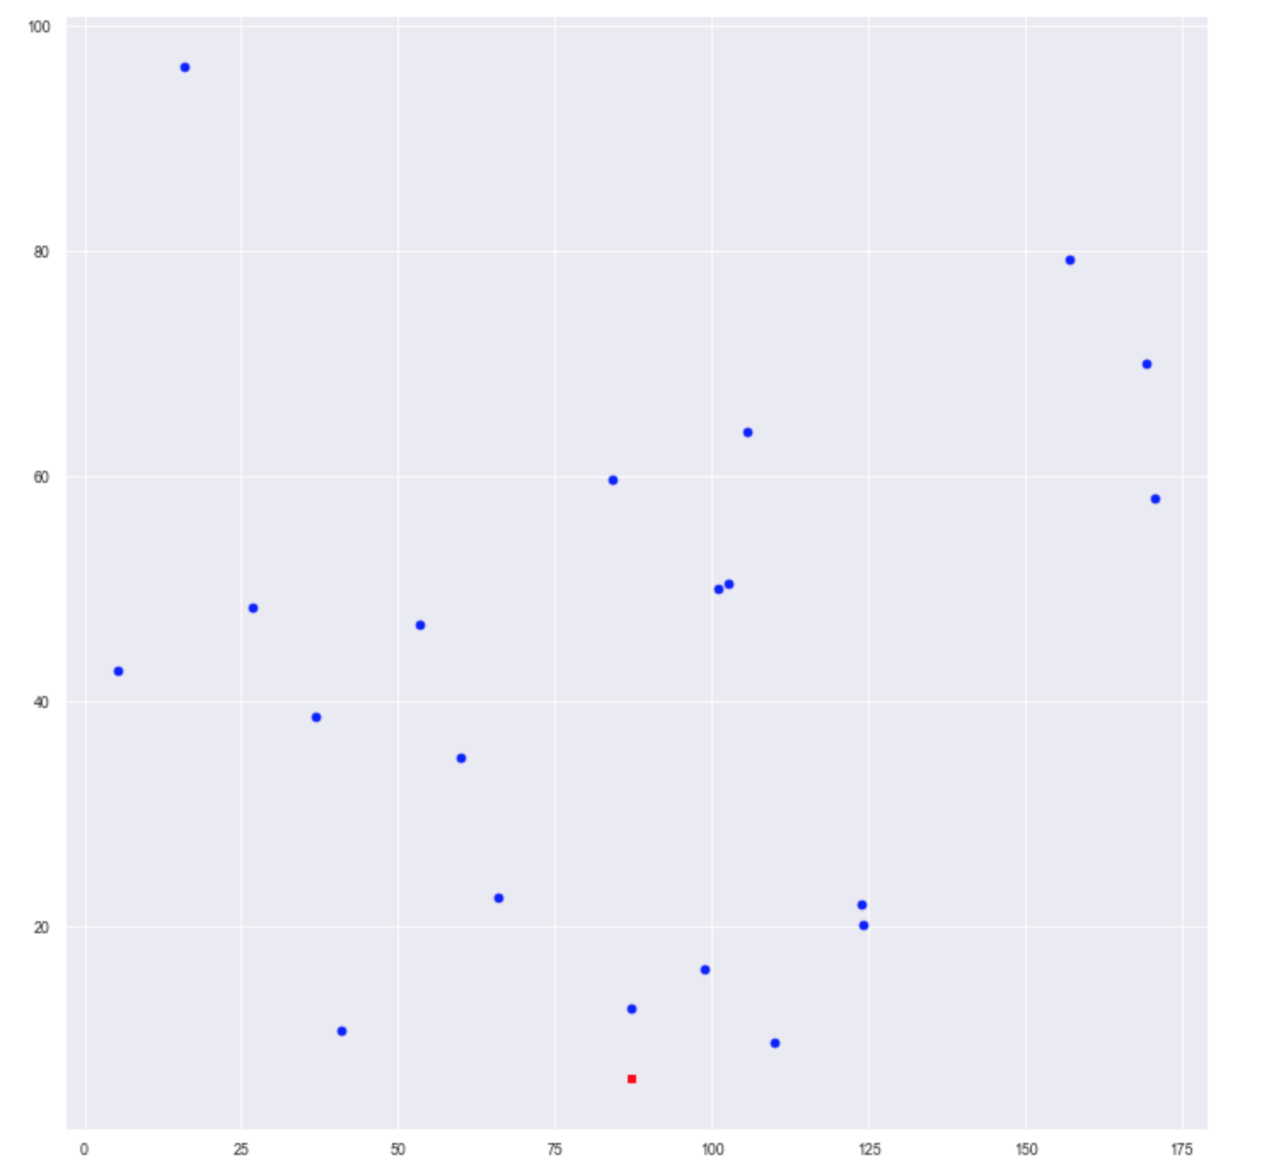
The name of the unit, laboratory, faculty, etc.
VEHICLE ROUting Problem
Capacitated Green Vehicle Routing Problem (CGVRP)
Solving for single instance depot
$n$ = the number of clients
$N$ = set of clients, with $N=\{1,2,...,n\}$
$V$ = set of vertices (or nodes), with $V=\{0\}∪N$
$A$ = set of arcs, with $A=\{(i,j)∈V^{2}:i≠j\}$
$c_{ij}$ = cost of travel over arc $(i,j)∈A$
$Q$ = the vehicle capacity
$q_{i}$ = the amount that has to be delivered to customer $i∈N$
$GVs$ = set of Green Vehicles, with $GVs=\{1,2,...,n\}$
$CVs$ = set of Green Vehicles, with $CVs=\{1,2,...,n\}$

Slide 5
The name of the unit, laboratory, faculty, etc.
VEHICLE ROUting Problem
Capacitated Green Vehicle Routing Problem (CGVRP)
Our Algorithm - Partition Method
Define a threshold distance which is equal to (maximum travel distance of the green vehicle)/2
Compute the euclidean distance for all arcs and sort in ascending order
From each node naively select the minimum arc, starting from the depot (node 0)
Continue with step 3 as long as the total distance covered is less than the threshold
All nodes accumulated in step 3 are removed from the main graph thereby creating two graphs. One for GVP and another for CVP
Solve each graph a CVRP

Slide 6
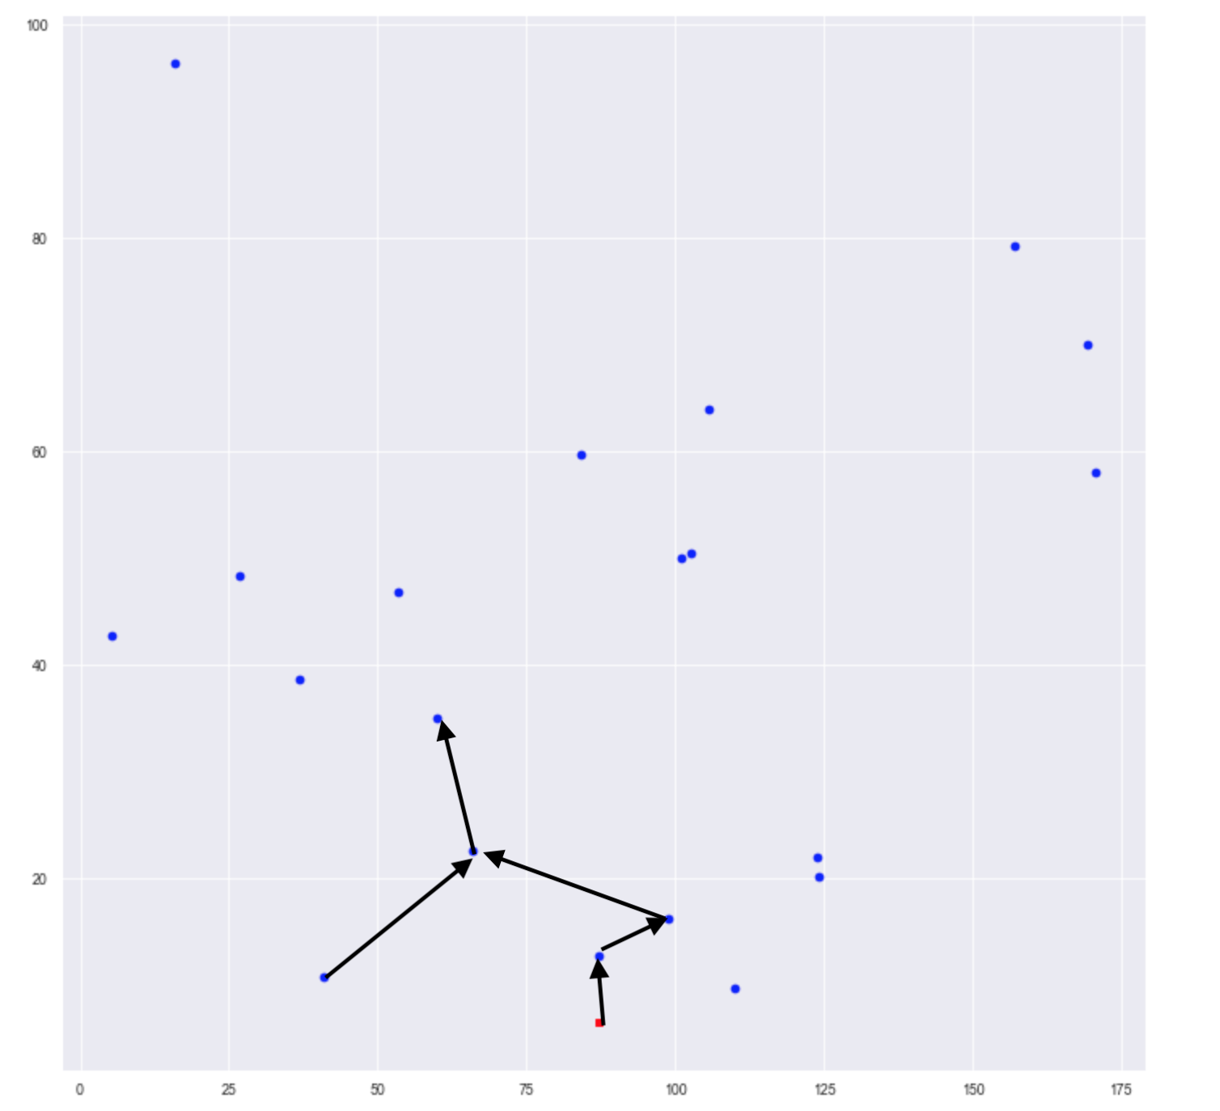
The name of the unit, laboratory, faculty, etc.
VEHICLE ROUting Problem
Capacitated Green Vehicle Routing Problem (CGVRP)
Our Algorithm - Partition Method

Slide 7
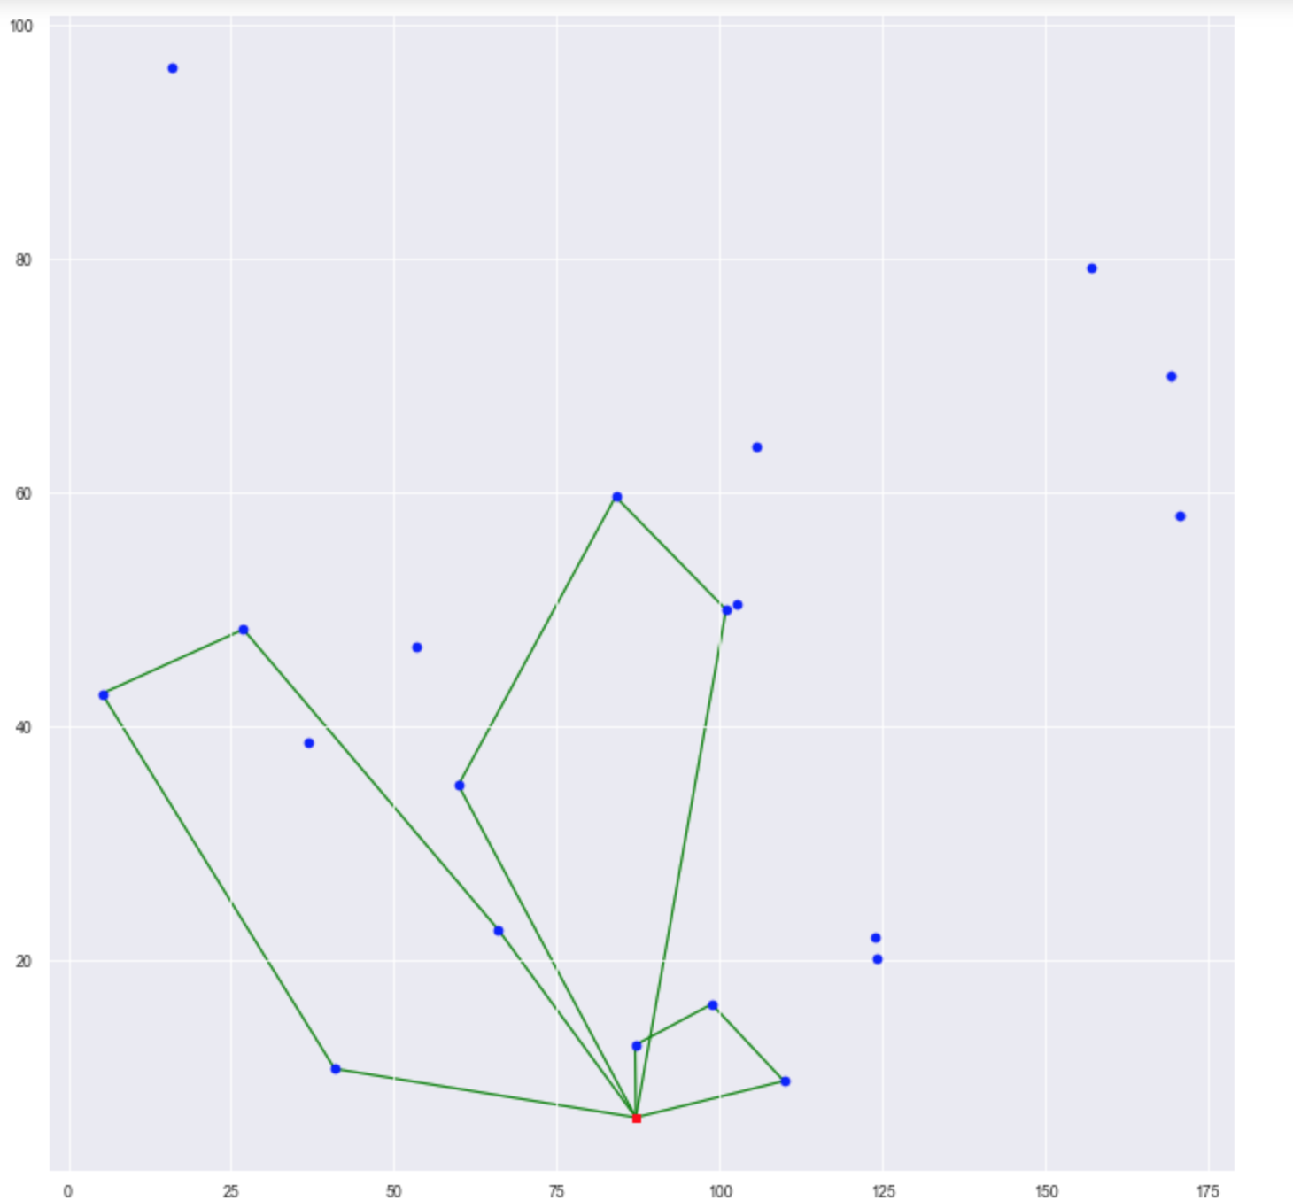
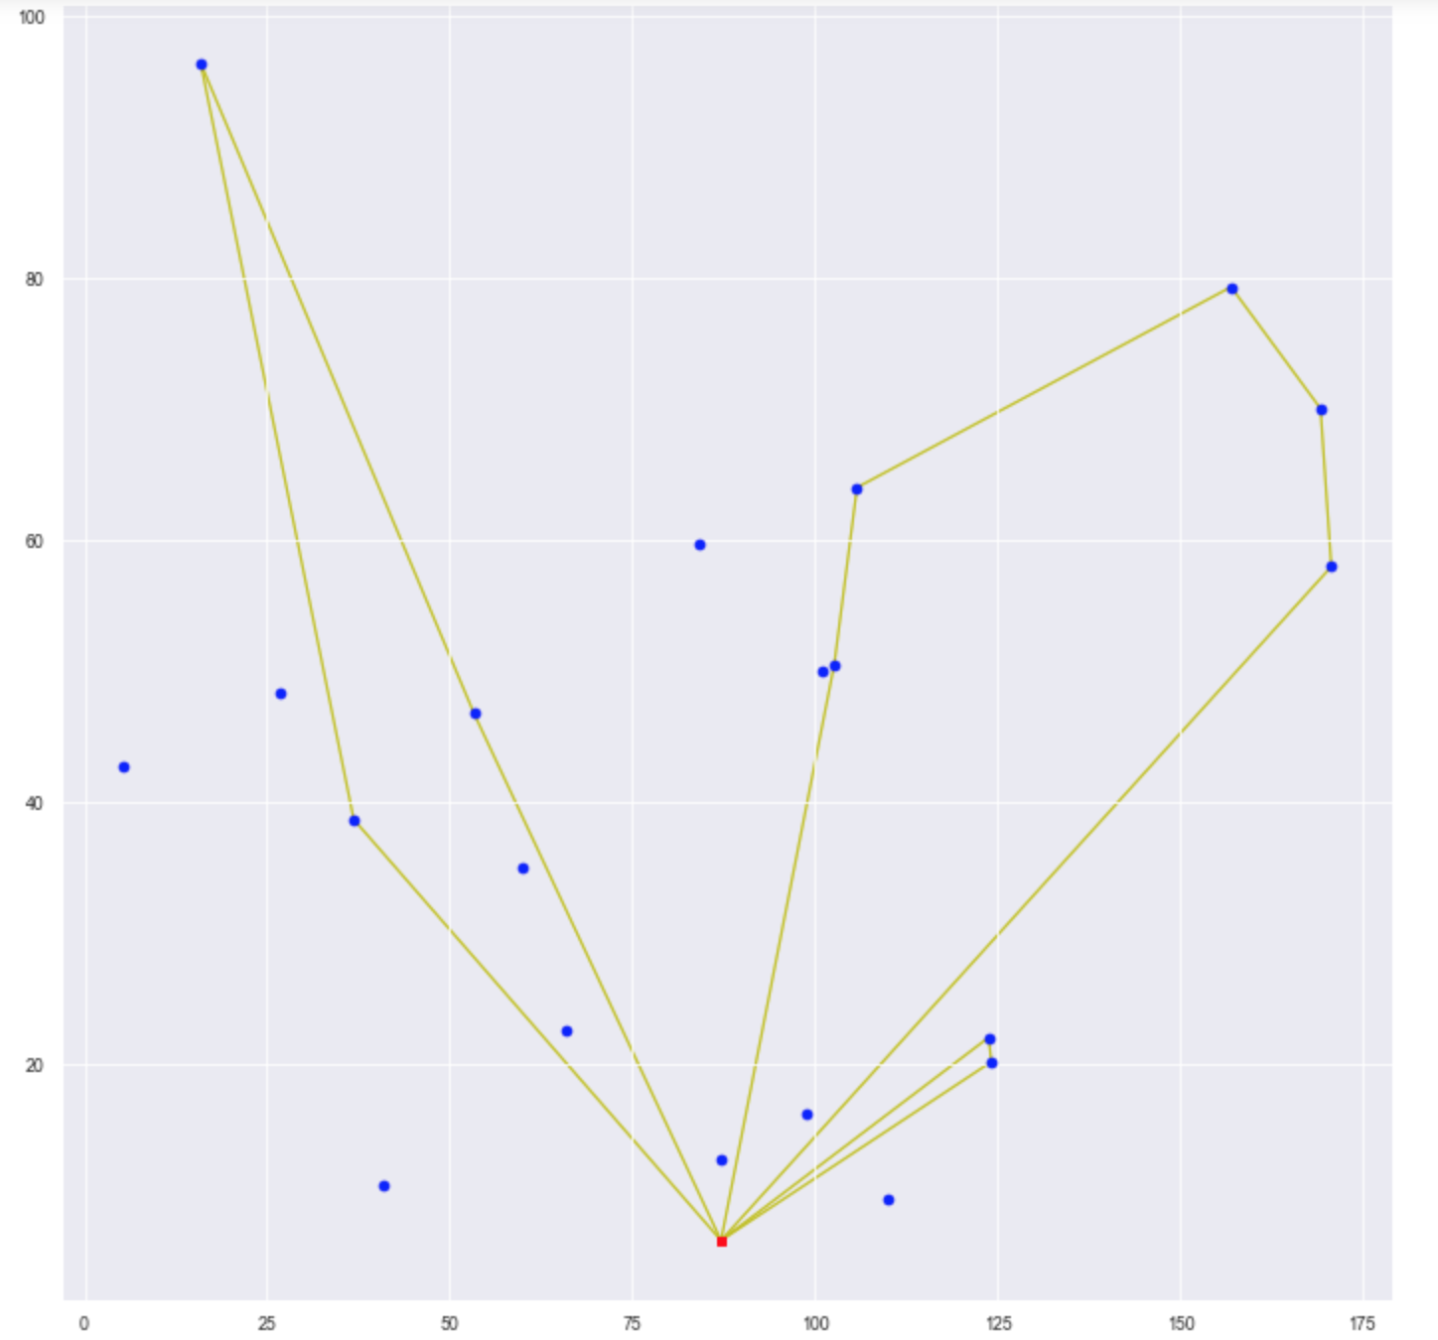
The name of the unit, laboratory, faculty, etc.
VEHICLE ROUting Problem
Capacitated Green Vehicle Routing Problem (CGVRP)
Results for 20 clients
GV
CV

Slide 8
The name of the unit, laboratory, faculty, etc.
VEHICLE ROUting Problem
Capacitated Green Vehicle Routing Problem (CGVRP)
Next Steps
Testing the limitations of the algorithm
Extending to Multiple Depots

