Slide 1


Here's your outline to get started
Key facts about your topic
New York City, also known as the City of New York or simply New York, is the most populous city in the United States. With an estimated 2018 population of 8,398,748 distributed over a land area of about 302.6 square miles, New York is also the most densely populated major city in the United States. Located at the southern tip of the state of New York, the city is the center of the New York metropolitan area, the largest metropolitan area in the world by urban landmass and one of the world's most populous megacities, with an estimated 19,979,477 people in its 2018 Metropolitan Statist...
Local time: Turks And Caicos Standard Time
Population: 8.54 Million (2016)
Area: 468.48 sq miles (1,213.37 km²)
Mayor: Bill de Blasio
Nearby airport: John F. Kennedy International Airport, LaGuardia Airport, Newark Liberty International Airport
Colleges and universities: Columbia University, New York University, Rockefeller University, Fordham University, Juilliard School, New Yo...
Awards: Top Intelligent Community of the Year
See more: Open the Notes below for more information.
Notes:
QuickStarter has created an outline to help you get started on your presentation. Some slides include information here in the notes to provide additional topics for you to research.
Summary:
New York City, also known as the City of New York or simply New York, is the most populous city in the United States. With an estimated 2018 population of 8,398,748 distributed over a land area of about 302.6 square miles, New York is also the most densely populated major city in the United States. Located at the southern tip of the state of New York, the city is the center of the New York metropolitan area, the largest metropolitan area in the world by urban landmass and one of the world's most populous megacities, with an estimated 19,979,477 people in its 2018 Metropolitan Statistical Area and 22,679,948 residents in its Combined Statistical Area. A global power city, New York City has been described as the cultural, financial, and media capital of the world, and exerts a significant impact upon commerce, entertainment, research, technology, education, politics, tourism, art, fashion, and sports. The city's fast pace has inspired the term New York minute. Home to the headquarters of the United Nations, New York is an important center for international diplomacy.
More key facts:
Colleges and universities: Columbia University, New York University, Rockefeller University, Fordham University, Juilliard School, New York City College of Technology, New York Institute of Technology, St. John's University, Vassar College, United States Merchant Marine Academy, Pace University, Hunter College, Bard College, Cooper Union, Marist College, Baruch College, The New School, The City College of New York, Pratt Institute, Yeshiva University, College of New Rochelle, Manhattan College, Skidmore College, Union Theological Seminary, SUNY Downstate Medical Center, Phillips Beth Israel School of Nursing, Lehman College, Hostos Community College, Queensborough Community College, Empire State College, Borough of Manhattan Community College, John Jay College of Criminal Justice, Dutchess Community College, Bronx Community College, St. Joseph's College, Monroe College, LaGuardia Community College, York College, City University of New York, Queens College, City University of New York, State University of New York Maritime College, Kingsborough Community College, Brooklyn College, Fashion Institute of Technology, College of Staten Island, Medgar Evers College, ASA College, Touro College, Weill Cornell Medicine, College of Mount Saint Vincent, Wagner College

Slide 2

New York city car crash ANALYTICS
Data Engineering Project
Notes:
Hello, my name is Emeka, so my teammates, which comprise of Alex, Dimas and Larry worked on a data engineering project where we built a prototype analytics dashboard for analysts in the mayor's office. During our presentation we would talk about the various stages we went through before developing our prototype.
NB// Talk about some facts about New York City and why this would be important and useful to the people of new York especially analysts in the mayors office.

Slide 3
Contents
Data Engineering Stages
BPM Diagrams that informed our decisions
Schema Diagrams that informed our decisions
Data Flow Diagrams
Demo of Prototype
Demo of our predictive model
Project Phases
Security Concerns
Questions Time
Notes:
During our presentation we would talk about the following this.
Data Engineering stages --- Emeka
BPM Diagrams --- Alex
Schema Diagrams --- Dimas
Data Flow Diagrams – Dimas
Demo of Prototype – Larry
Demo of Predictive Model --- Alex
Project Phases --- Larry
Security Concerns --- Emeka
Questions and Answers

Slide 4

Data Engineering Stages
In order to design our prototype, we went through the data engineering stages from conceptual, logical etc.
Notes:
Please don’t just read this, understand what each stage is and talk about it.
Stages:
Goal
To provide an interactive means for the mayors office and other stakeholders from New York City (NYC) to easily access motor vehicle collision information in an interactive manner thereby aiding them to make informed decisions.
System Description
Stakeholders
Mayors office
Ordinary citizens (secondary stakeholder)
Main Systems of Interest
A Power BI Dashboard that allows analysts in the mayors office to visualize number of crashes by time period and location.
In addition our Power BI Dashbaord should provide some statistical information about crashes in New York City.
Finally our Power BI Dashbaord will show the closest police station as well as closeset hospitals to crashes.
Enabling Systems
Systems that will enable us build our primary system are automated cron jobs or schedulers that will fetch, clean and store data from the sources listed below
Data Sources
Motor Vehicle Collisions: https://data.cityofnewyork.us/Public-Safety/Motor-Vehicle-Collisions-Crashes/h9gi-nx95
Historical Traffic Data https://data.cityofnewyork.us/Transportation/Traffic-Volume-Counts-2012-2013-/p424-amsu
List of hospitals as of 2011 https://data.cityofnewyork.us/Health/NYC-Health-Hospitals-Facilities-2011/ymhw-9cz9
List of police departments https://www1.nyc.gov/site/nypd/bureaus/patrol/precincts-landing.page
ETL
Azure Data Factory
Storage
Azure Data Lake Storage
Dashboards/Reports
Azure Power BI
Azure Synapse Analytics
System Boundaries
Roles and Responsibilities
Automated Software i.e Background Processes
Data Owners:
Police Department (NYPD): Motor Vehicle Collisions
Department of Transportation (DOT): Historical Traffic Data
NYC Health + Hospitals: List of hospitals
Department of City Planning (DCP): List of police stations
Data Analysts in Mayors office
Developers/System Administrators
General Public
Functionalities of System
Easily query data about crushes with little to no technical knowlegde
Easily create and share informative visualizations with people
Access to basic informative visualizations:
Visualize places where accidents happened for last several days
Visualize nearest hospitals to the places of accidents
Provide statistics and predictions:
Get information about what are the districts / crossroads where accidents occured most frequently for last week / month
Predict districts where an accident is more likely to occur for the next week
Get information about how often does crashes take place on a specific street / crossroad
Easily export data, visualizations or reports in some desired format
Easily import current information about accidents
SRS

Slide 5
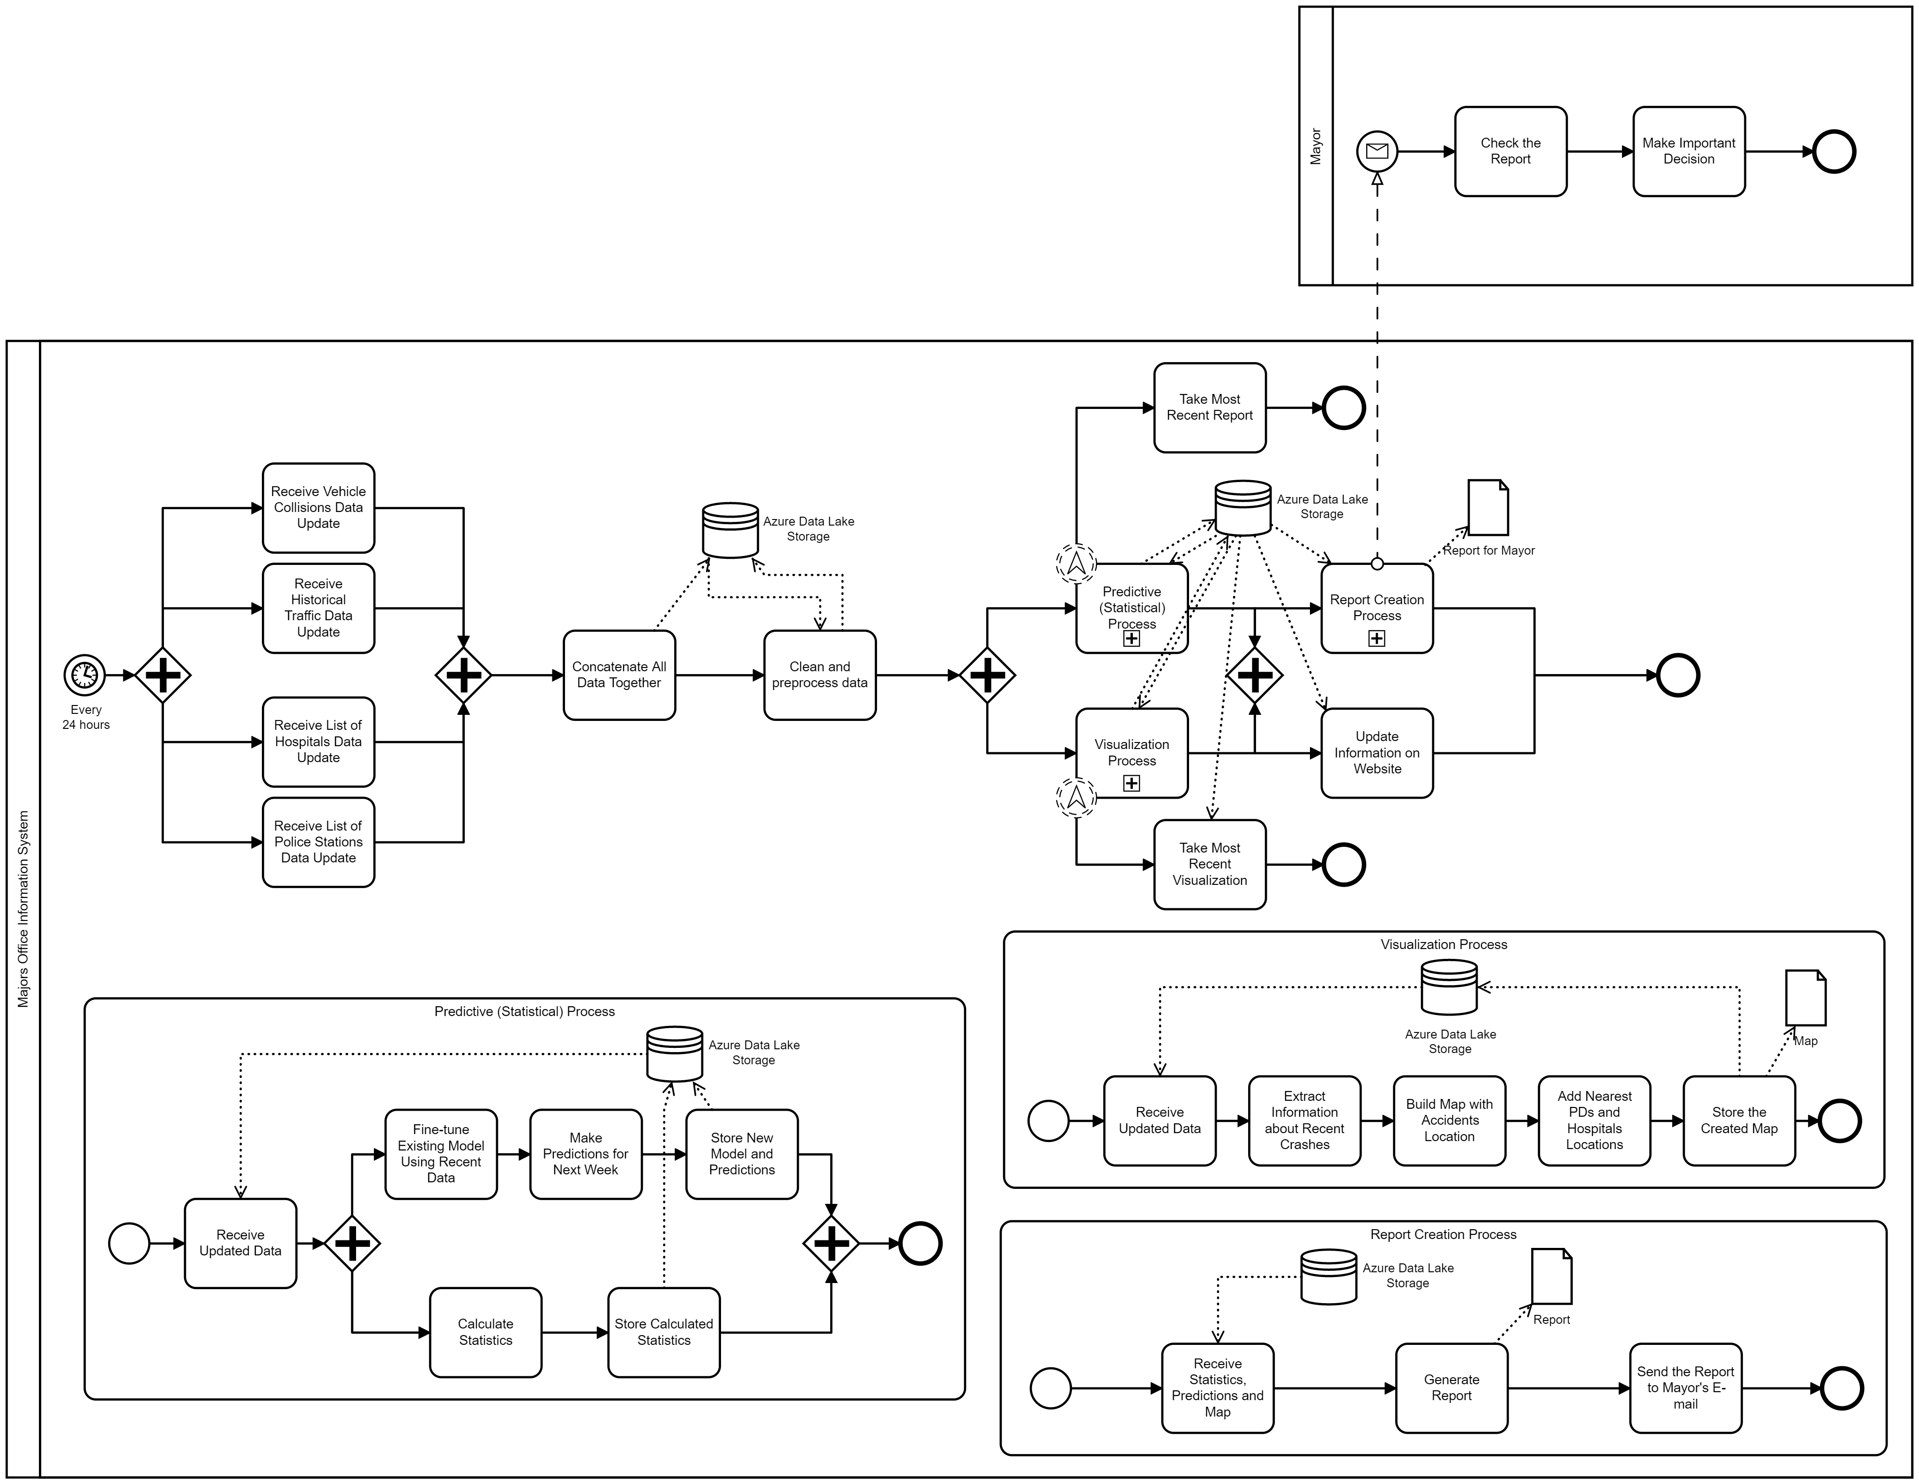
BPM Diagram

Slide 6
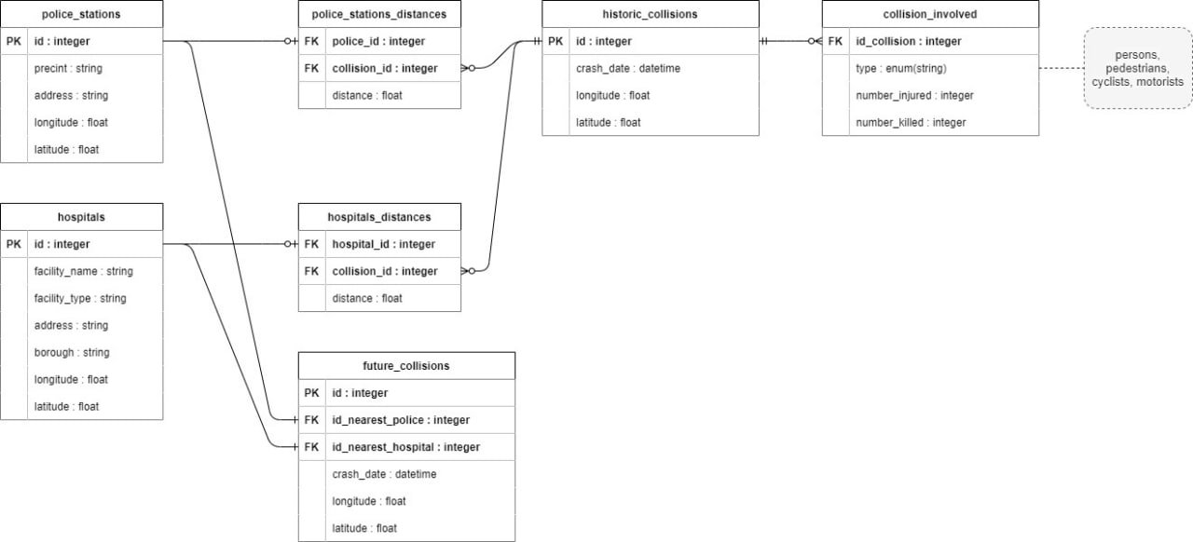
schema Diagram

Slide 7
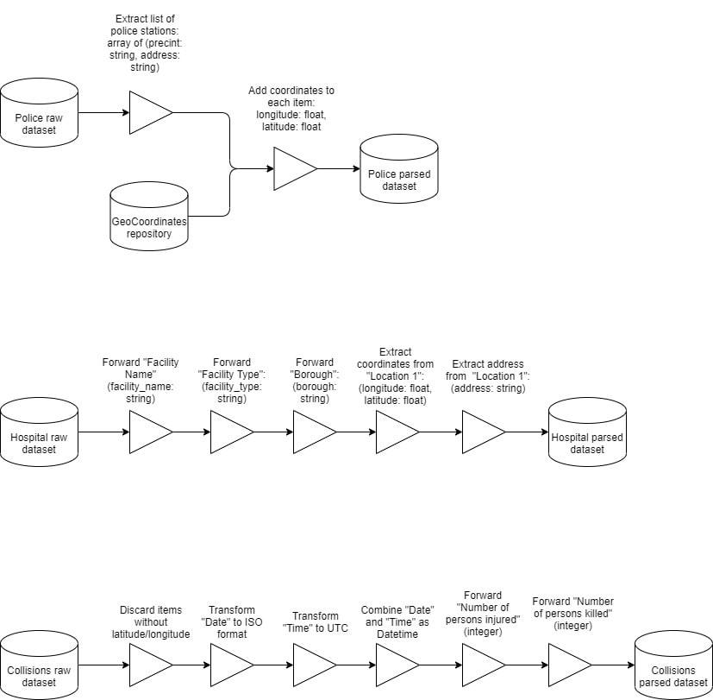
DATA FLOW DIAGRAM

Slide 8
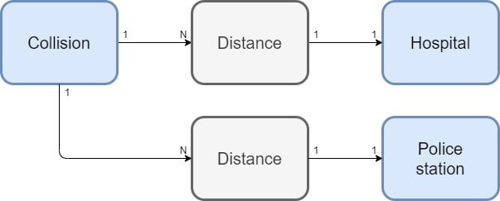
Analytical Model

Slide 9
DEMO

Slide 10
Project Phases
Deploy
Deploy Prototype
Iterate
Iterate on Recommendations
Final Solution
Deploy final solution to Azure
Notes:
We decide to complete a prototype which solves our needs using a docker image. This can easily be deployed on an azure vm.
We would then collect feedback from users iterate on the requirements and develop a final solution on Microsoft azure I will hand over to Ibe who would talk about security concerns.

Slide 11

Security Concerns
Data Privacy
Invalid Data --- Each csv file
Securing Docker container from possible cyber attacks as well as azure platform
This Photo by Unknown Author is licensed under CC BY-SA-NC
Notes:
In this slide read about data privacy and how it concerns our project. Also focus on the fact that each csv is saved as it’s own table in order to ensure that if we have corrupted data it does not affect the whole system. Each data is manually verified before being added as it’s own table
Kindly research the last point

Slide 12

Questions?

