Slide 1


Here's your outline to get started
Key facts about your topic
New York City, also known as the City of New York or simply New York, is the most populous city in the United States. With an estimated 2018 population of 8,398,748 distributed over a land area of about 302.6 square miles, New York is also the most densely populated major city in the United States. Located at the southern tip of the state of New York, the city is the center of the New York metropolitan area, the largest metropolitan area in the world by urban landmass and one of the world's most populous megacities, with an estimated 19,979,477 people in its 2018 Metropolitan Statist...
Local time: Turks And Caicos Standard Time
Population: 8.54 Million (2016)
Area: 468.48 sq miles (1,213.37 km²)
Mayor: Bill de Blasio
Nearby airport: John F. Kennedy International Airport, LaGuardia Airport, Newark Liberty International Airport
Colleges and universities: Columbia University, New York University, Rockefeller University, Fordham University, Juilliard School, New Yo...
Awards: Top Intelligent Community of the Year
See more: Open the Notes below for more information.
Notes:
QuickStarter has created an outline to help you get started on your presentation. Some slides include information here in the notes to provide additional topics for you to research.
Summary:
New York City, also known as the City of New York or simply New York, is the most populous city in the United States. With an estimated 2018 population of 8,398,748 distributed over a land area of about 302.6 square miles, New York is also the most densely populated major city in the United States. Located at the southern tip of the state of New York, the city is the center of the New York metropolitan area, the largest metropolitan area in the world by urban landmass and one of the world's most populous megacities, with an estimated 19,979,477 people in its 2018 Metropolitan Statistical Area and 22,679,948 residents in its Combined Statistical Area. A global power city, New York City has been described as the cultural, financial, and media capital of the world, and exerts a significant impact upon commerce, entertainment, research, technology, education, politics, tourism, art, fashion, and sports. The city's fast pace has inspired the term New York minute. Home to the headquarters of the United Nations, New York is an important center for international diplomacy.
More key facts:
Colleges and universities: Columbia University, New York University, Rockefeller University, Fordham University, Juilliard School, New York City College of Technology, New York Institute of Technology, St. John's University, Vassar College, United States Merchant Marine Academy, Pace University, Hunter College, Bard College, Cooper Union, Marist College, Baruch College, The New School, The City College of New York, Pratt Institute, Yeshiva University, College of New Rochelle, Manhattan College, Skidmore College, Union Theological Seminary, SUNY Downstate Medical Center, Phillips Beth Israel School of Nursing, Lehman College, Hostos Community College, Queensborough Community College, Empire State College, Borough of Manhattan Community College, John Jay College of Criminal Justice, Dutchess Community College, Bronx Community College, St. Joseph's College, Monroe College, LaGuardia Community College, York College, City University of New York, Queens College, City University of New York, State University of New York Maritime College, Kingsborough Community College, Brooklyn College, Fashion Institute of Technology, College of Staten Island, Medgar Evers College, ASA College, Touro College, Weill Cornell Medicine, College of Mount Saint Vincent, Wagner College

Slide 2
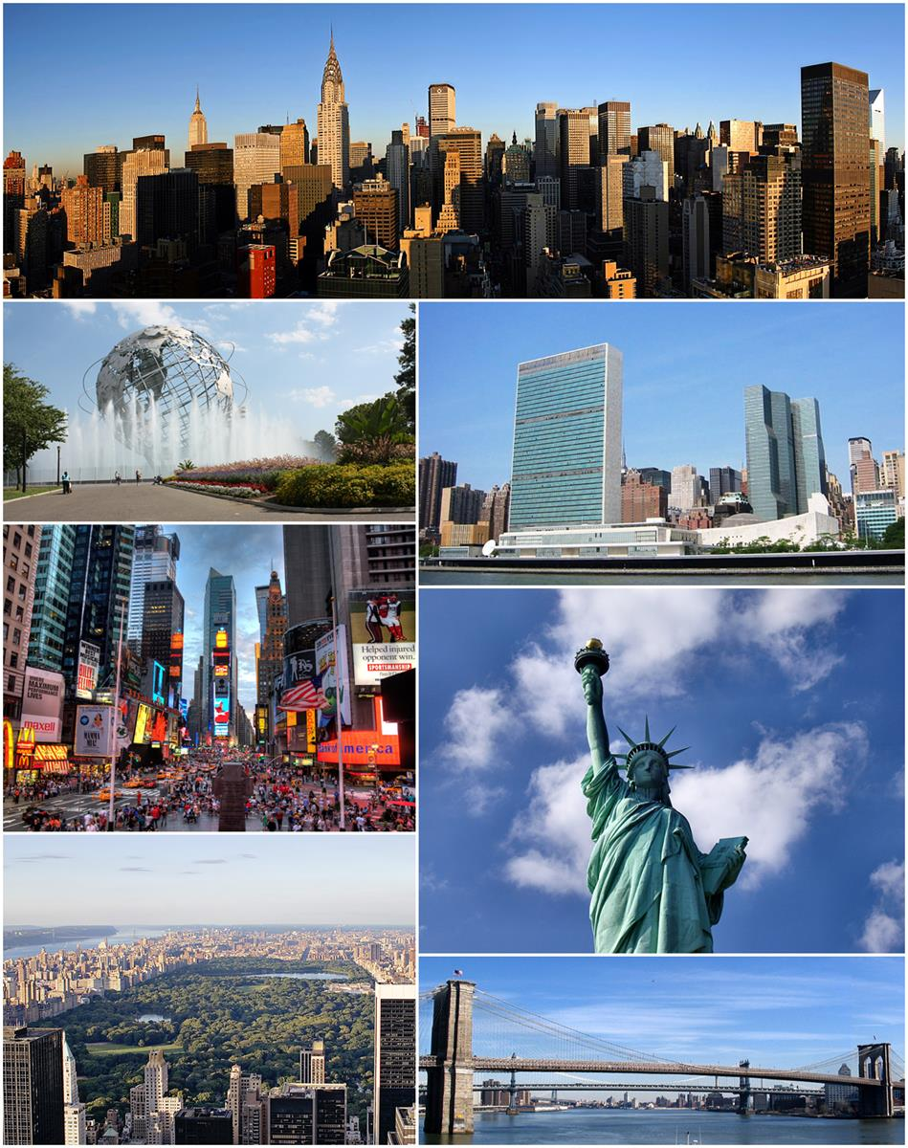
New York city car crash ANALYTICS
Data Engineering Project
Notes:
Hello, my name is Emeka, so my teammates, which comprise of Alex, Dimas and Larry worked on a data engineering project where we built a prototype analytics dashboard for analysts in the mayor's office. During our presentation we would talk about the various stages we went through before developing our prototype.
NB// Talk about some facts about New York City and why this would be important and useful to the people of new York especially analysts in the mayors office.

Slide 3
Contents
Data Engineering Stages
BPM Diagrams that informed our decisions
Schema Diagrams that informed our decisions
Data Flow Diagrams
Demo of Prototype
Demo of our predictive model
Project Phases
Security Concerns
Questions Time
Notes:
During our presentation we would talk about the following this.
Data Engineering stages --- Emeka
BPM Diagrams --- Alex
Schema Diagrams --- Dimas
Data Flow Diagrams – Dimas
Demo of Prototype – Larry
Demo of Predictive Model --- Alex
Project Phases --- Larry
Security Concerns --- Emeka
Questions and Answers

Slide 4
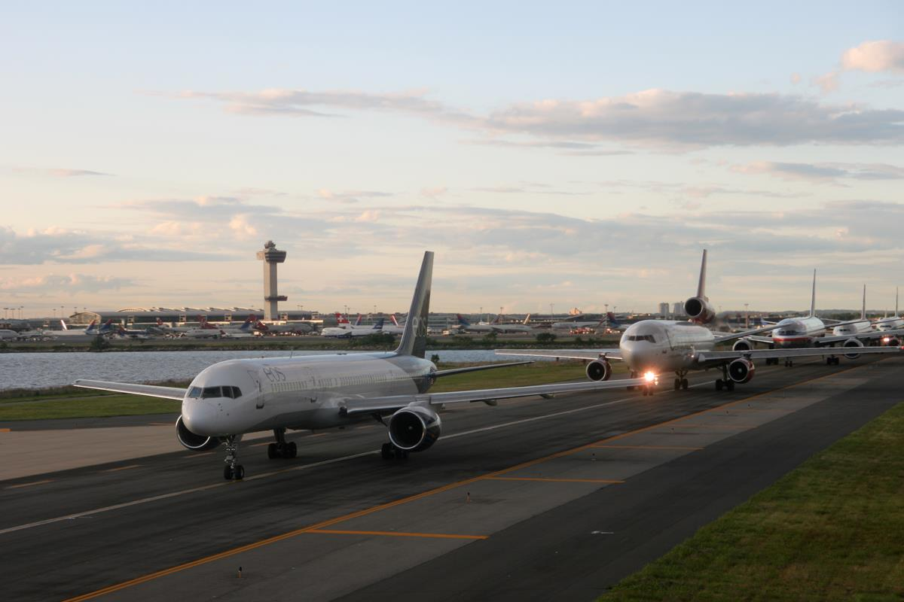
Transportation
Look in the slide notes below for topics to consider talking about
Notes:
Consider talking about:
Rapid transit
Air
Ferries
Taxis, transport startups, and trams
Streets and highways
Cycling network

Slide 5
Works cited

