Slide 1

UE19CS204 – Web Technologies Mini Project
EXERCISE TRACKER
Section - A
Ajay Prem- PES2UG19CS020
Akarsh Siwach-PES2UG19CS022
Anirudh Manoj-PES2UG19CS043
Aparna Kalla-PES2UG19CS059
GITHUB Link - project_github_link

Slide 2
Abstract
We have a fully functional exercise tracker app made using MERN and mongoDB atlas. We have hosted our database in the cloud using MongoDB Atlas and Google Cloud Platform. To test our server API we have used Insomnia. For the front end part we have used react and bootstrap for the styling part.
Our app will allow people to keep a track of different exercises done by them. We can add or remove exercises and users, and this updated in our database.
We have connected the frontend to backend using axios library.

Slide 3
Technologies Used
nodemon: tool that helps develop node.js applications by automatically restarting the application when file changes in the directory are detected
Axios: to send HTTP requests to our backend
Datepicker:flexible widget to pick a date

Slide 4
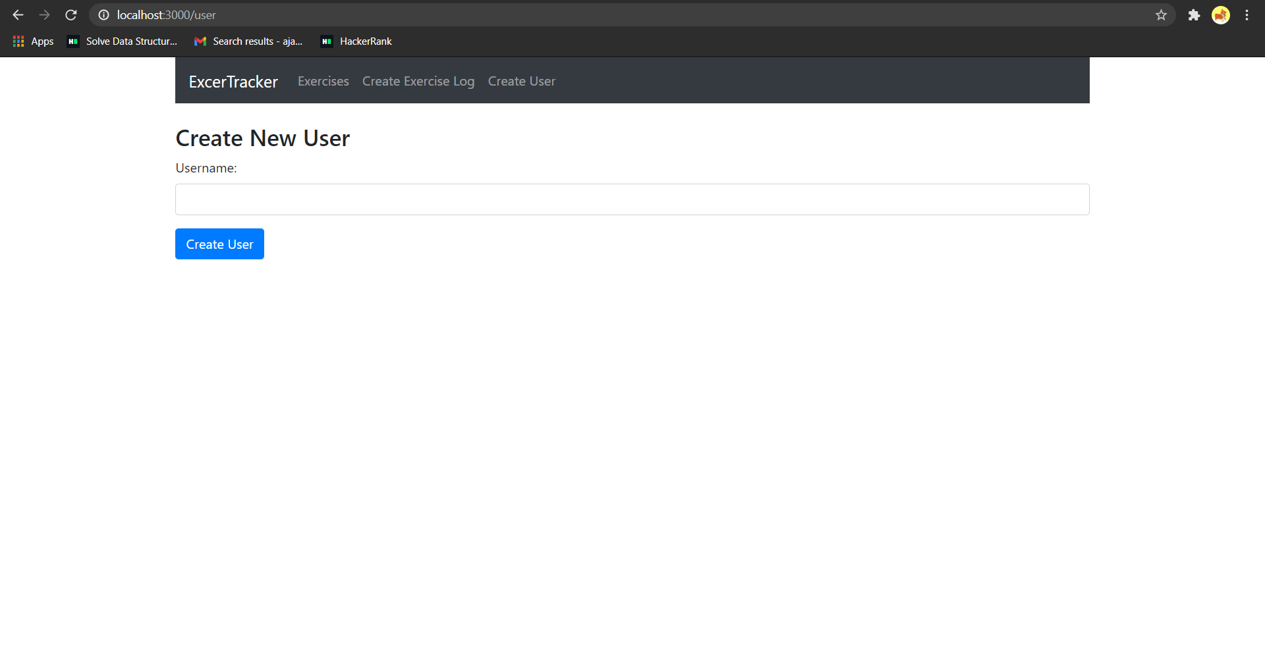
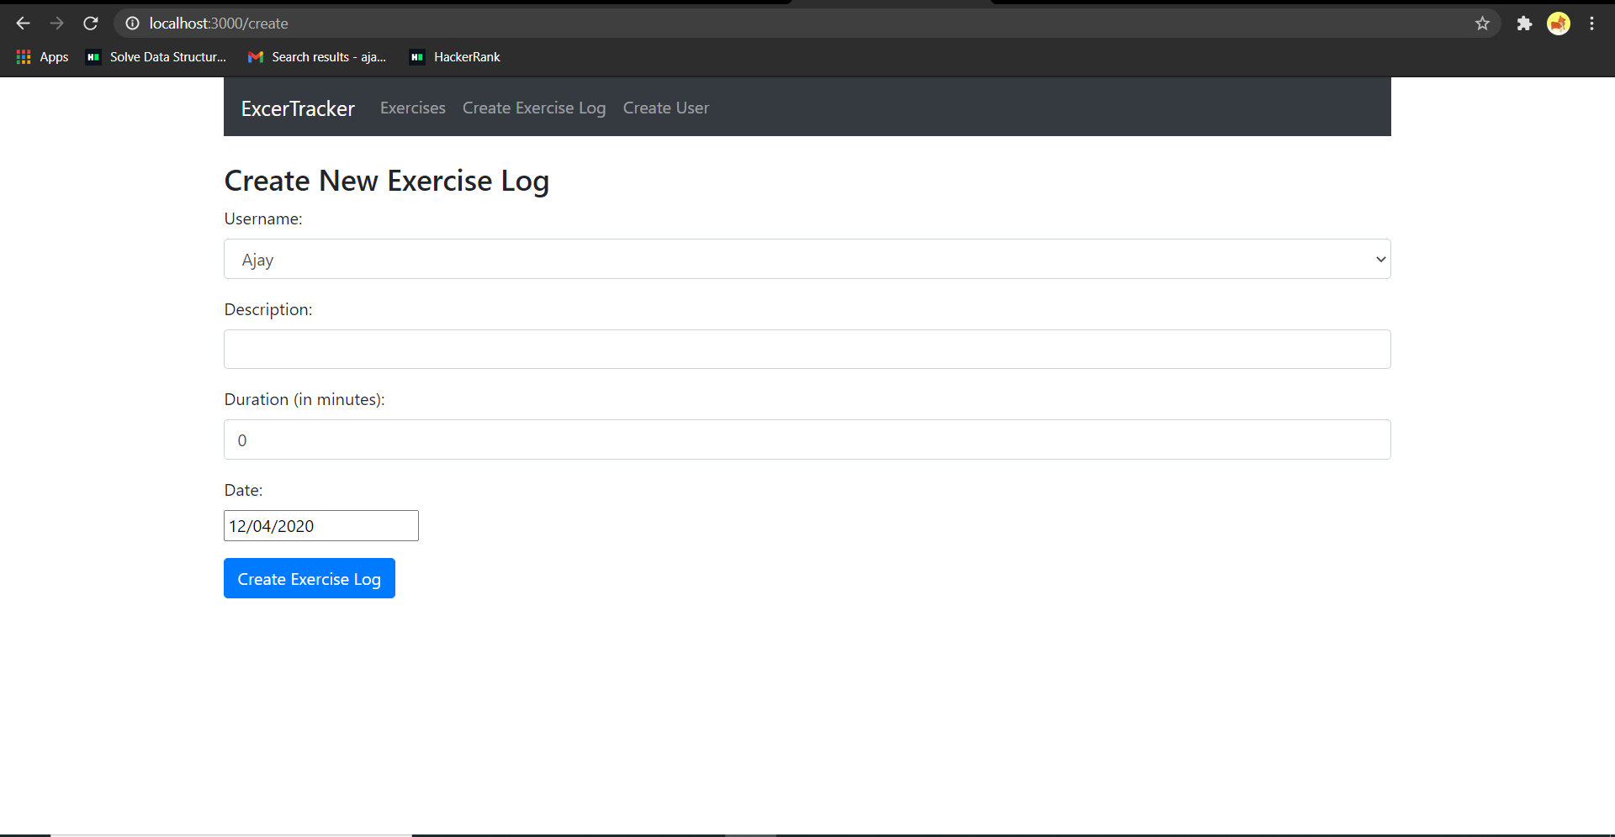
Snapshot from the project showing the create user option
Displaying the new exercise log option

Slide 5
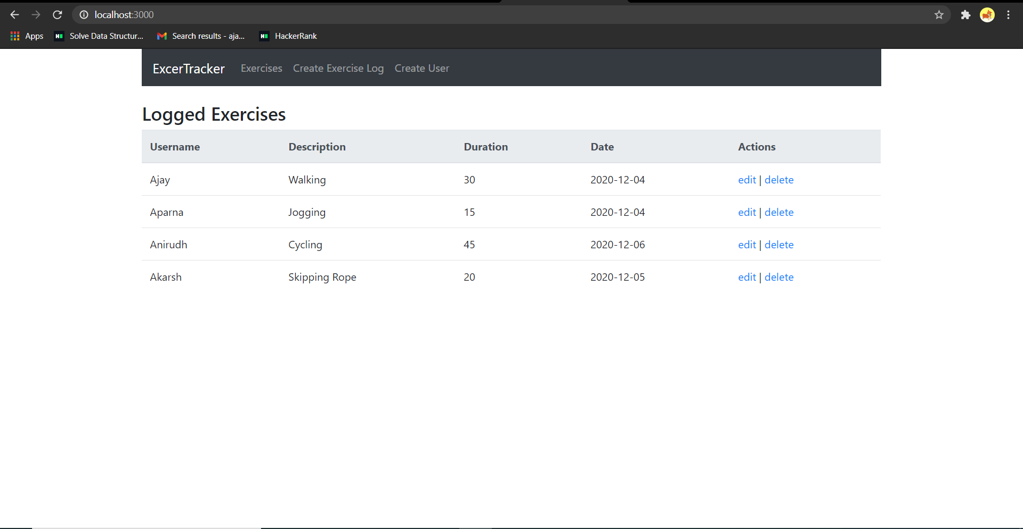
Screenshot from the app showing the logged exercises and users with the edit and delete options.

Slide 6
Member Contributions
Ajay Prem: backend(exercise.js) +frontend(index.html,app.css,index.js, create-exercise.components.js )
Akarsh Siwach: backend(models and server.js)
Anirudh Manoj: frontend(exercise-list.component.js and navbar.component.js)
Aparna Kalla: frontend(create-user.component.js and edit-exercise.component.js)+backend(users.js)

