Slide 1

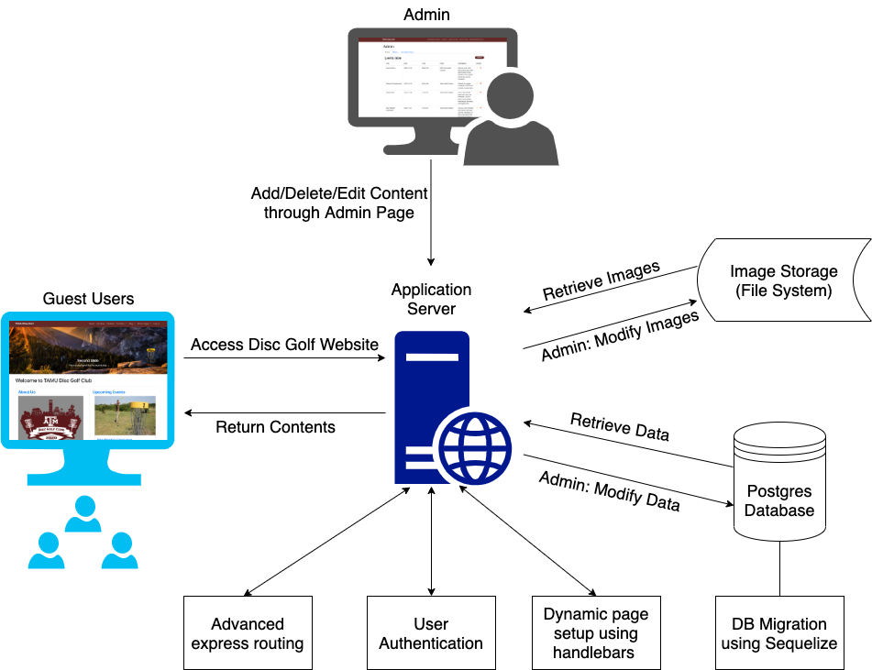
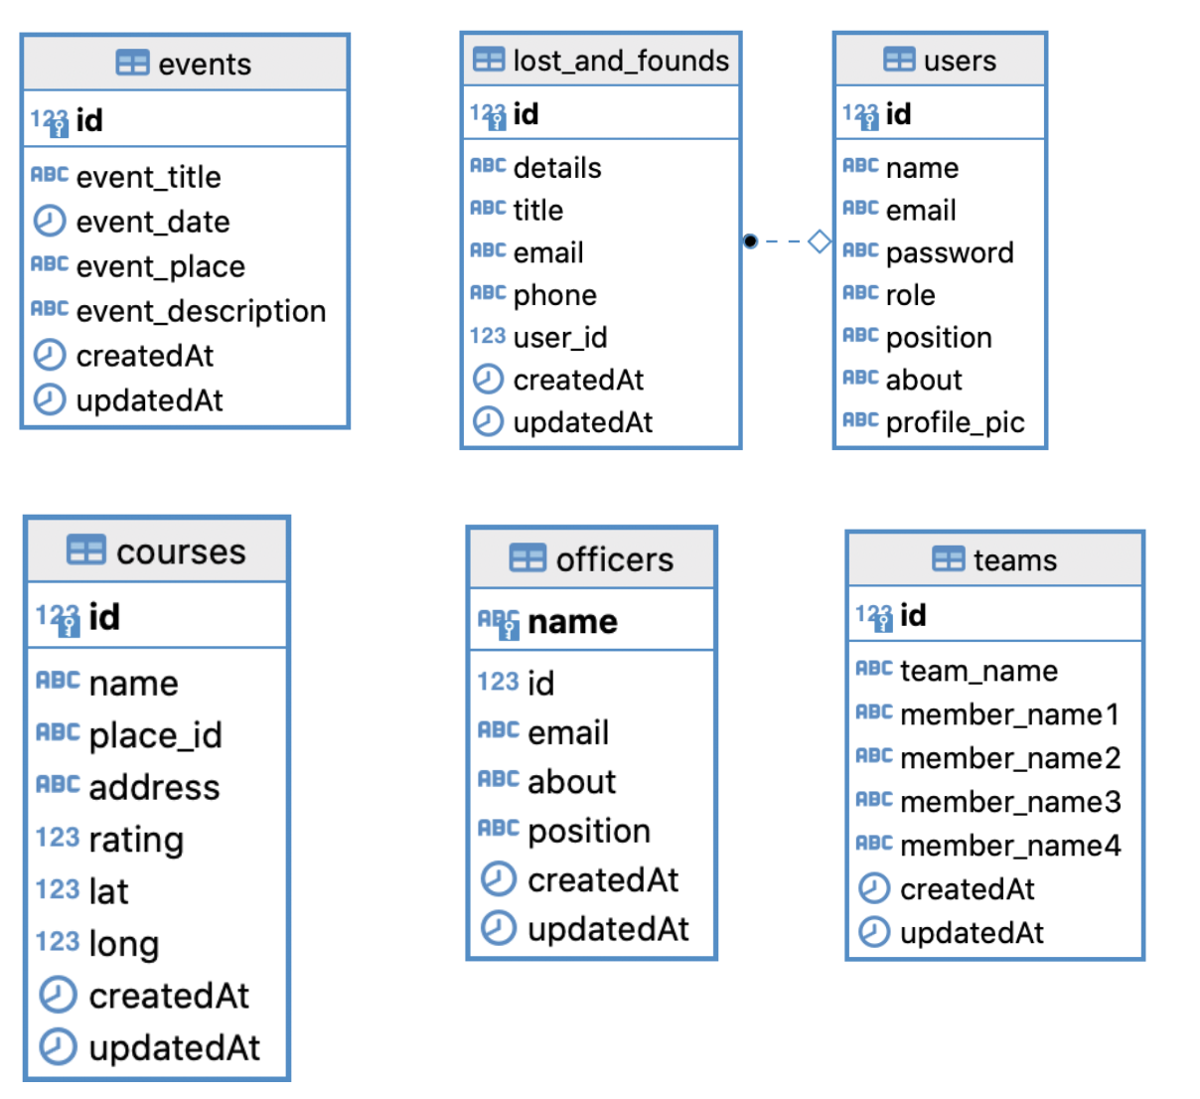
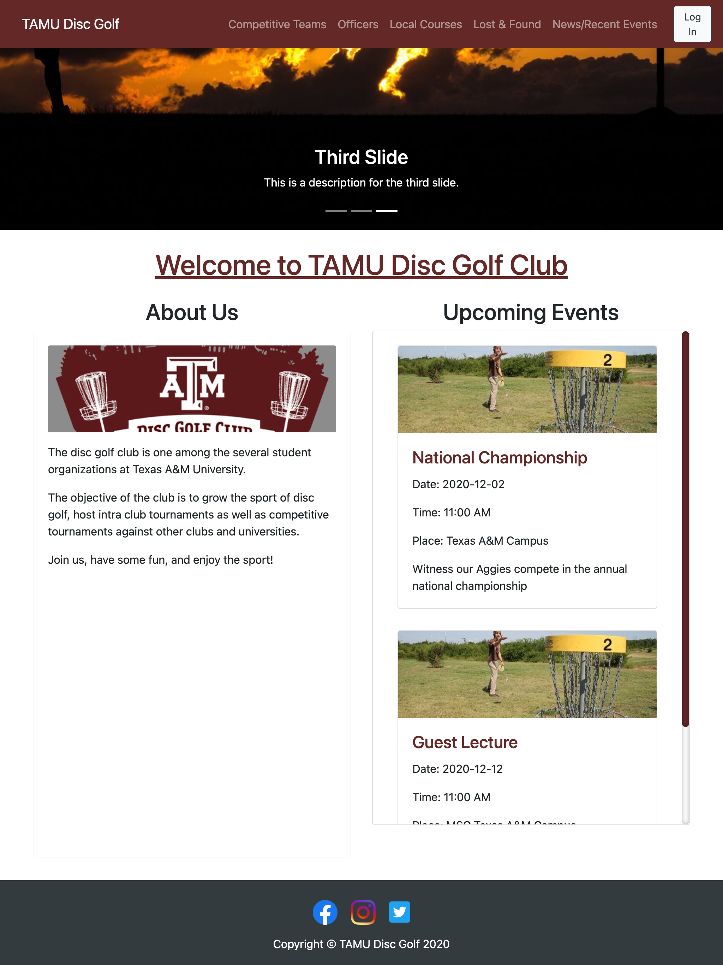
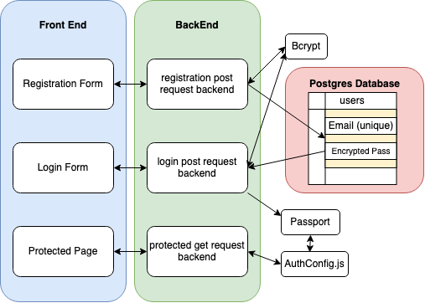
Texas A&M Disc Golf Website
Prathiksha Prasad, Chandler Ochs, Andrew Cramer, Snehasish Sen, Alok Chandrawal, Vignesh Gandudi
Dept. of Computer Science and Engineering, Texas A&M University
Introduction
System Design
The disc golf club is one of the several student organizations at Texas A&M University.
The objective of the club is to grow the sport of disc golf, host intra club tournaments, as well as competitive tournaments against other clubs and universities.
The platform includes two major functionalities: 1. New members’ ability to join the club and manage their profiles, 2. Admin users managing events, officers and teams in the club.
Developed several modules including ‘Local Courses’ to view courses on the google maps and ‘Lost & Found‘ section to advertise lost items.
Frontend: Based on Javascript. Users can view while admins can modify the data.
Backend: ExpressJS based server. Handles routing, user authentication, and database interactions.
Database: Postgres database for data storage. Migrations are handled using Sequelize.
Database Design
Dynamic Pages
User Authentication
The website pages have been designed to be hierarchical and dynamic. Only subsections load on loading a page.
The integration with database has also been made seamless using Express Handlebars. DOM updates need not be handled using Javascript. We can use simple programming constructs like loops and if-else conditions in the HTML pages to make DOM updates.
Here we have a visual representation of how the Home page is rendered by handlebar. On deployment, handlebar combines the common layout and the page specific contents by understanding the hierarchy of HTML elements.
Registration: We first verify the form of the fields submitted (password matching etc.). We then, check if the email already exists in the database. Then we encrypt the password using Bcrypt and store values in a new record in the database.
Login: We first verify the form of the fields submitted. Then we compare the passwords using Bcrypt. Then we update the cookies using passport.
Protected pages: In the get request, a call is made to AuthConfig, which checks passport to see if the user is logged or not, and what role they have. If this doesn’t match the request permissions, the user is redirected to login.
Conclusion
Acknowledgement
The application developed meets the scope of user stories that were decided for the project duration.
Key features implemented include:
Authentication of users and enabling role-based access.
to various sections of the website.
Local Courses with redirections to the actual course website.
Lost and Found.
Admin page allowing modification of website contents.
We would like to thank Prof. Hank Walker for giving us the opportunity to enhance our practical skills in Software Engineering and for his support throughout the project. We would also like to thank our friend and customer for this project, Benjamin Mueck, for trusting us and providing his valuable feedback throughout.
Future Scope of the project:
Ability to sort the Local Courses
based on Ratings and Distance
from a User’s location
- Optimize the backend to handle
more traffic.

