Slide 1

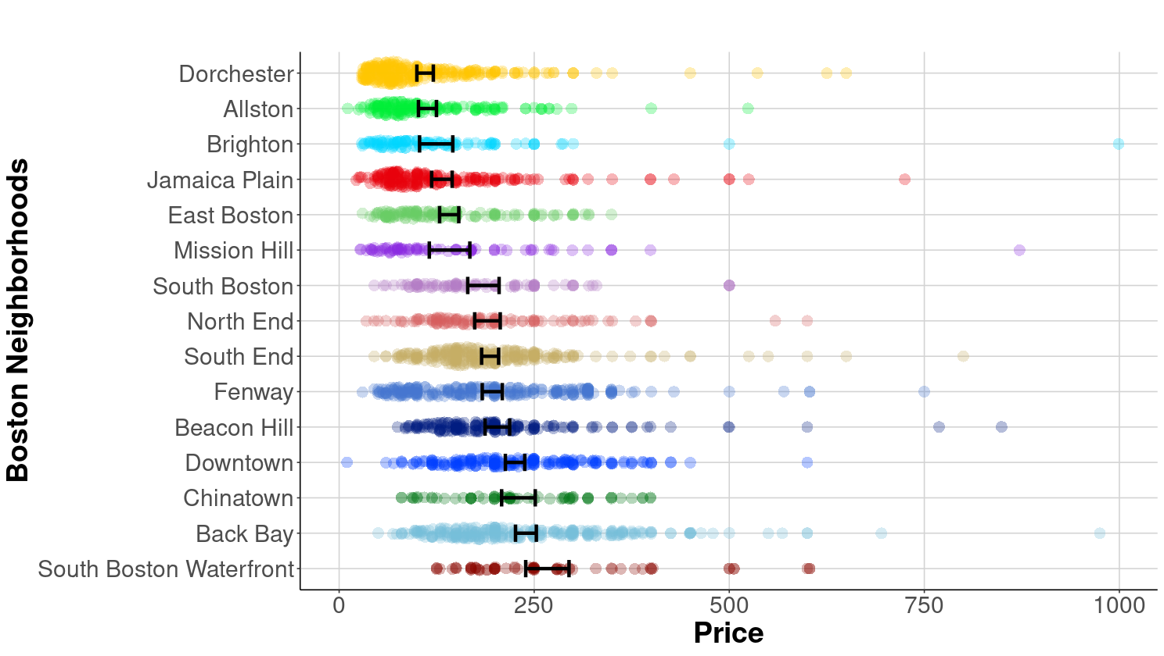
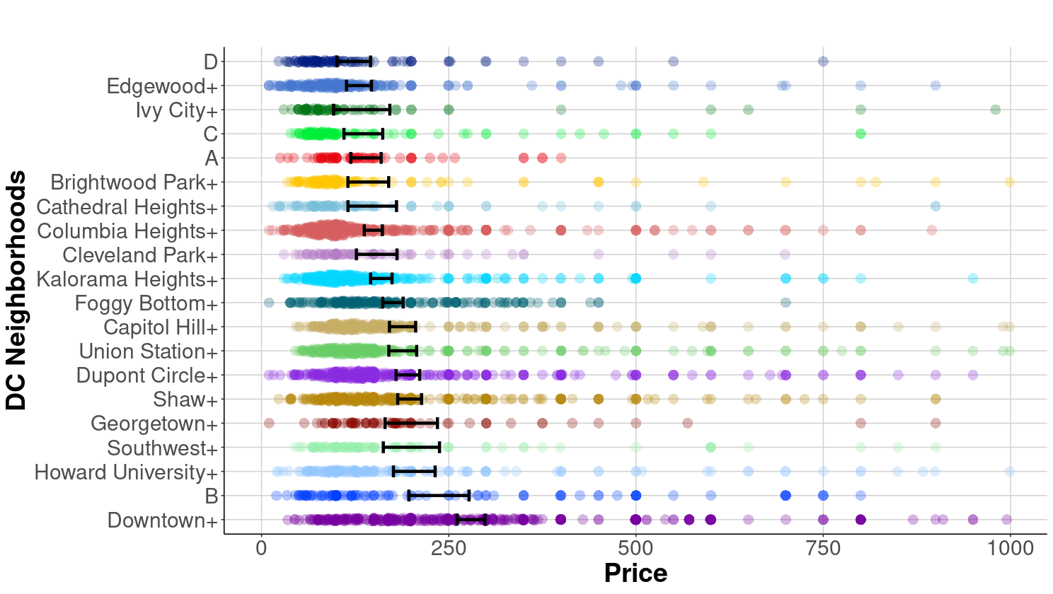
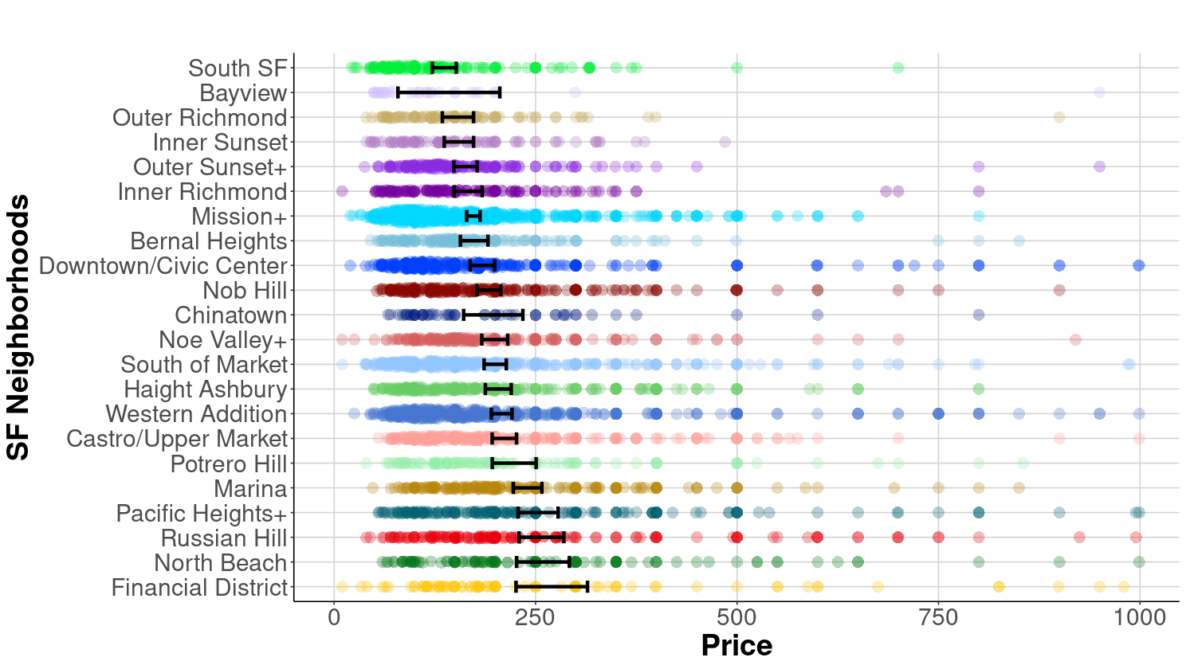
The Importance of Neighborhood when Predicting Airbnb Prices
Ashton Craycraft ‘23
Data Science Major Capstone
Research Question
Average Airbnb Price per Night by Neighborhood
Comparing Models with and Without Neighborhood
How strongly does the neighborhood impact or correlate with Airbnb prices in Boston, San Francisco, and Washington D.C.?
Models with neighborhood were more predictive of Airbnb price.
Background
City | Adj. R² With Neighborhood | Adj. R² Without Neighborhood
Boston | 0.6634 | 0.5669
Washington D.C. | 0.3723 | 0.3052
San Francisco | 0.487 | 0.4381
Exploring Airbnb prices is a great way to understand equity issues within the current market for rental spaces. Airbnb can contribute to local renting markets by investment into homes and the neighborhood (Xu, 2021). Unfortunately, in the long-term the over-tourism that companies like Airbnb facilitate can push out residents, in a process similar to gentrification (Bivens, 2019). Furthermore, research has shown that Airbnb can contribute to neighborhood gentrification and a widening of the rent gap (Wachsmuth 2018). The goal of this research is to highlight the differences in pricing for Airbnb apartments based on neighborhood, providing concrete evidence of gentrification-in-progress.
Fig 3. Table comparing adjusted R² with neighborhood as a model variable to adjusted R² without neighborhood in the model for each city. Data from Airbnb.
Methods
I first consolidated neighborhoods into levels based on socioeconomic characteristics, then used multiple imputation package to deal with missingness. The initial models were produced by applying AIC and BIC to determine the best single-order models. Then, of the models identified, I chose the most useful using 5-fold cross-validation. Finally, I produced the presented model for each city after checking regression assumptions, applying a Box-Cox transformation to the price variable, and removing influential outliers.
Data
Data for this project was pulled from Inside Airbnb’s dataset of Airbnb listings from October 2020. This project focuses specifically on apartment listings in Boston, Washington D.C., and San Francisco.
Data Ethics and Limitations
The main ethical issue with this data is that some neighborhoods had to be consolidated into levels with other neighborhoods during the data cleaning process, due to low levels of Airbnb rentals in those neighborhoods. While socioeconomic characteristics were the main method for finding appropriate groupings, consolidation necessarily may include the obfuscation of demographic trends. A major limitation is that this data did not include socioeconomic characteristics by neighborhood, which is thus an opportunity for expansion in future research.
Sources
Bivens, Josh. (2019). The economic costs and benefits of Airbnb: No reason for local policymakers to let Airbnb bypass tax or regulatory obligations. Economic Policy Institute, https://www.epi.org/publication/the-economic-costs-and-benefits-of-airbnb-no-reason-for-local-policymakers-to-let-airbnb-bypass-tax-or-regulatory-obligations/
Wachsmuth, D., & Weisler, A. (2018). Airbnb and the rent gap: Gentrification through the sharing economy. Environment and Planning A: Economy and Space, 50(6), 1147–1170. https://doi.org/10.1177/0308518X18778038
Xu, Minhong & Xu, Yilan. (2021). What happens when Airbnb comes to the neighborhood: The impact of home-sharing on neighborhood investment. Regional Science and Urban Economics, 88. https://doi.org/10.1016/j.regsciurbeco.2021.103670
Fig 1. Average Boston Neighborhood Airbnb Price by Racial Population Race Percentages. Data from Airbnb and ACS.
Fig 2. Forest Plots of Airbnb Prices by Neighborhood, least to greatest, for Boston, Washington D.C. and San Francisco in that order. Data from Airbnb.

