Slide 2
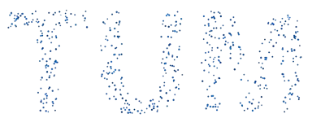

FlowR — Flowing from Sparse to Dense 3D Reconstructions
Seminar: 3D Computer Vision
Alexander Cornett

Slide 3
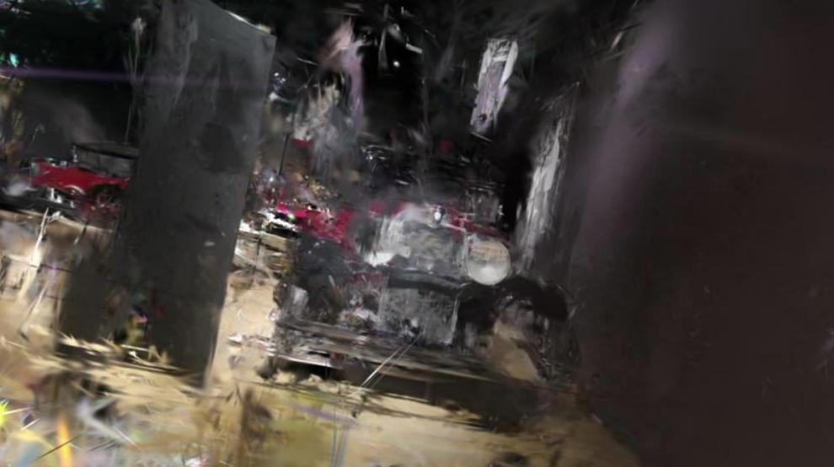
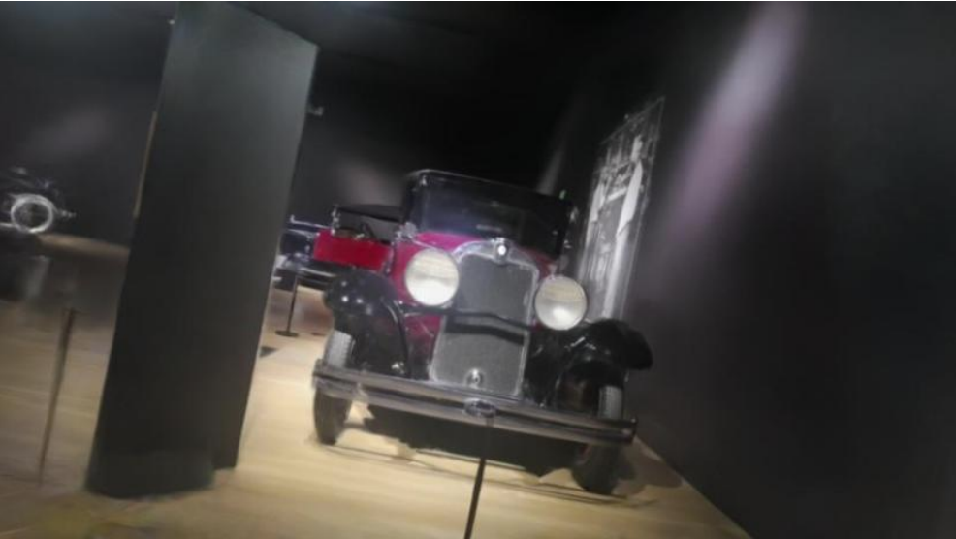
The problem
The challenge
Novel view synthesis struggles when point clouds are sparse since quality collapses wherever input views are missing.
Splatfacto
Input
A sparse 3D Gaussian splat with 12 or 24 views
flowR
Output
The unknown views as pictures, generated using the represented neural network flowR.

Slide 4
Why flowR is important
Missing reality
Real captures are never dense enough and often miss crucial features. flowR provides a method to generate these crucial views.
Applications in VR/AR
The paper focuses on AR and VR, where you need a fully reconstructed environment to deliver a truly immersive experience.

Slide 5
Problems with existing methods
Base
Generative
Sparse
Dense
Scalable
Splatfacto
3DGS
InstantSplat
3DGS
ViewCrafter
Diffusion
GANeRF
NeRF
Nerfbusters
NeRF
FlowR
3DGS
Yes
Partial
No

Slide 6
Datasets & Evaluation
 | DL3DV-140 | ScanNet++ | Nerfbusters
Scenes | Outdoor + indoor, very diverse | Indoor, high-res detailed | Casual phone captures
Input | Sparse (12 / 24 views) | Dense, many views | Separate train/test paths
Test setup | Interpolation between views | Far out-of-distribution views | Different camera trajectories + coverage
Challenge | Too few views to cover scene | Reconstruct unseen angles | Ghosting artifacts

Slide 7
Where FlowR sits
In the generative-priors cluster — but different
FlowR lives in the generative-priors cluster but replaces the noise source distribution with renderings of the initial reconstruction.
Only corrects what is wrong
The flow model only changes the regions that are off — if a rendering is already good, nothing changes. This makes generation faster, more consistent, and artifact-free.

Slide 8
Related Work
Geometric Priors ^{1,2}
Tackle sparse views via geometry regularization — depth smoothness, ray entropy, monocular depth priors. Improve stability but cannot synthesize missing content: unobserved regions stay empty or blurry.
Feed-Forward Methods ^{3,4}
Predict 3D representations directly from image pairs in a single forward pass. Extremely fast, but without per-scene optimization they lose fine detail and struggle with complex scenes.
Generative Priors ^{5,6,7} — most related
Use diffusion or flow models to hallucinate missing views (CAT3D, ReconFusion, ViewCrafter). All start from pure noise → ignore existing geometry → hallucinate even where reconstruction is correct → inconsistency and artifacts.
References [1] Niemeyer et al., RegNeRF, CVPR 2022 [2] Leroy et al., MASt3R, ECCV 2024 [3] Charatan et al., pixelSplat, CVPR 2024 [4] Chen et al., MVSplat, ECCV 2024
[5] Gao et al., CAT3D, NeurIPS 2024 [6] Wu et al., ReconFusion, CVPR 2024 [7] Yu et al., ViewCrafter, arXiv 2024

Slide 9
Method Idea
The core idea: improve a 3D Gaussian reconstruction by generating its missing views with an image model.
1
2
3
Robust 3D Reconstruction
Build a dataset of 3D Gaussian reconstructions paired with ground-truth views for later fine-tuning.
Flow Matching Model
Fine-tune an image model that learns to turn rough reconstruction views into real ground-truth views.
Improved 3D Reconstruction
Re-render the scene with the newly generated target poses added, yielding a denser, cleaner result.

Slide 10
Dataset Generation Pipeline (1/2)
Co-visibility Graph
From the known camera poses we pick √N spread-out keyframes and connect only overlapping image pairs, cutting comparisons from 342 to 129.
MASt3R on View Pairs
A learned model predicts 3D points and descriptors for each pair, from which feature matches are extracted and subsampled to the view density.
Feature Tracks & Triangulation
Matches are linked into tracks across images; COLMAP triangulates globally consistent 3D points, scaled to metric size via monocular depth.

Slide 11
Dataset Generation Pipeline (2/2)
Fitting 3D Gaussians
The triangulated points initialize a 3DGS reconstruction (5k steps). Track constraints prune duplicates, shrinking the model from 2M to 244K Gaussians for better geometry and scalability.
Dataset Generation
Each scene is rendered at varying view sparsity (k ∈ [6, 36]), with remaining photos as ground truth. Pairing rough renderings with real photos yields 3.6M image pairs from 10.3k scenes.

Slide 12
Flow Matching Model
Training
Both images are encoded into latents by a VAE. At a random time, the model learns to predict the velocity vector that carries the rough rendering toward the real photo — across all 3.6M image pairs.
Inference
Starting from a fresh rendering at the target pose, the model takes 20 Euler steps following the predicted velocity, and the VAE decoder turns the result into a refined photo.

Slide 13
Improving 3D Reconstruction
Selecting Target Poses
New viewpoints are sampled along a B-spline for ordered views, or via Farthest Point Sampling on a sphere for unordered ones — then filtered to drop redundant or empty frames.
Applying the Flow Model
The 3DGS is rendered at each target pose, and the flow model turns those rough renderings into refined images I_tgt.
New Reconstruction
A fresh 3DGS is fit on I_src ∪ I_tgt using tailored losses (L2 + SSIM, plus LPIPS on target views), giving the final improved reconstruction.

Slide 14
Experiment Setup
The Model
FlowR builds on a 2.7B parameter text-to-image model, fine-tuned down to 1.75B parameters after dropping the text-conditioning layers.
Benchmarks
DL3DV140 — large-scale outdoor/indoor scenes; sparse setting with 12 and 24 equally spaced training views
ScanNet++ — high-fidelity indoor scenes; dense setting with out-of-distribution test views
Nerfbusters — casually captured scenes; training and test trajectories fully disjoint
Metrics
PSNR and SSIM measure low-level pixel similarity, while LPIPS captures perceptual similarity closer to human vision. Nerfbusters additionally reports Coverage — the share of scene points reconstructed.
Baselines
Sparse — InstantSplat, ViewCrafter
Dense — GANeRF, Nerfbusters method

Slide 15
Results
We evaluate across three benchmarks covering sparse captures, dense out-of-distribution views, and casual recordings.
DL3DV140
SPARSE INPUT
“Can you handle sparse input?”
Strong LPIPS gains over InstantSplat and ViewCrafter.
↓ LPIPS best vs. sparse baselines
ScanNet++
DENSE · OUT-OF-DISTRIBUTION
“Can you handle unseen viewpoints?”
Clear improvement over GANeRF, especially in LPIPS.
↓ LPIPS best vs. GANeRF
Nerfbusters
CASUAL CAPTURES
“Can you handle messy recordings?”
Higher PSNR / SSIM than the Nerfbusters method while holding Coverage.
↑ PSNR / SSIM Coverage maintained
Qualitative comparison — Fig. 3 (DL3DV) / Fig. 4 (ScanNet++): artifact reduction vs. baselines

