Slide 1
How to make R fast(er)

Slide 2
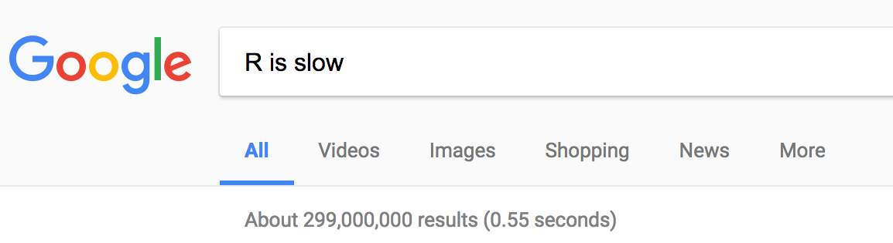
R is slow

Slide 3
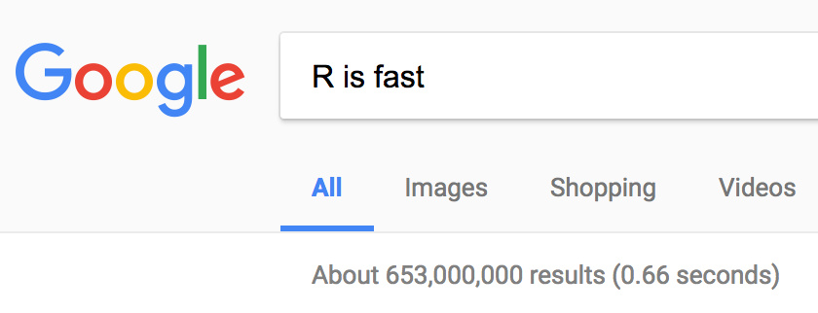
R is slow

Slide 4
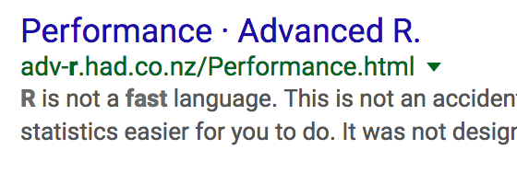
R is slow

Slide 5

R is slow

Slide 6
R is slow (on purpose)
R was designed to make the computer do extra work so that the human can do less work
Practicality at the expense of speed
Extremely Dynamic
Name lookup + mutable environments
Lazy evaluation
Notes:
Unpredictability = R must search for the right method every time a generic method is called
Dynamic -> executes everything at runtime (not compiled)
Lazy evaluation: the calculation is done when the result is needed

Slide 7
R is slow (on purpose)
Practicality at the expense of speed
Extremely Dynamic
You can change your mind about what things should be
Functions and methods are super versatile
Which means that R needs to “find” the appropriate thing to do, and that takes time
Notes:
Unpredictability = R must search for the right method every time a generic method is called

Slide 8
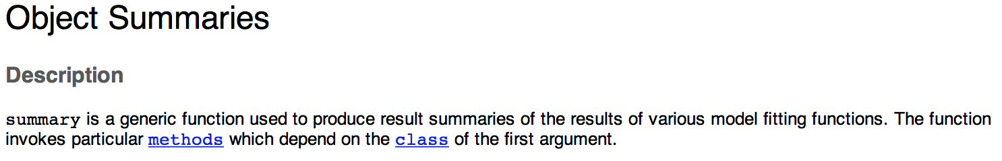
R is slow (on purpose)
Practicality at the expense of speed
Extremely Dynamic
You can change your mind about what things should be
Functions and methods are super versatile
Which means that R needs to “find” the appropriate thing to do, and that takes time
Notes:
Unpredictability = R must search for the right method every time a generic method is called

Slide 9
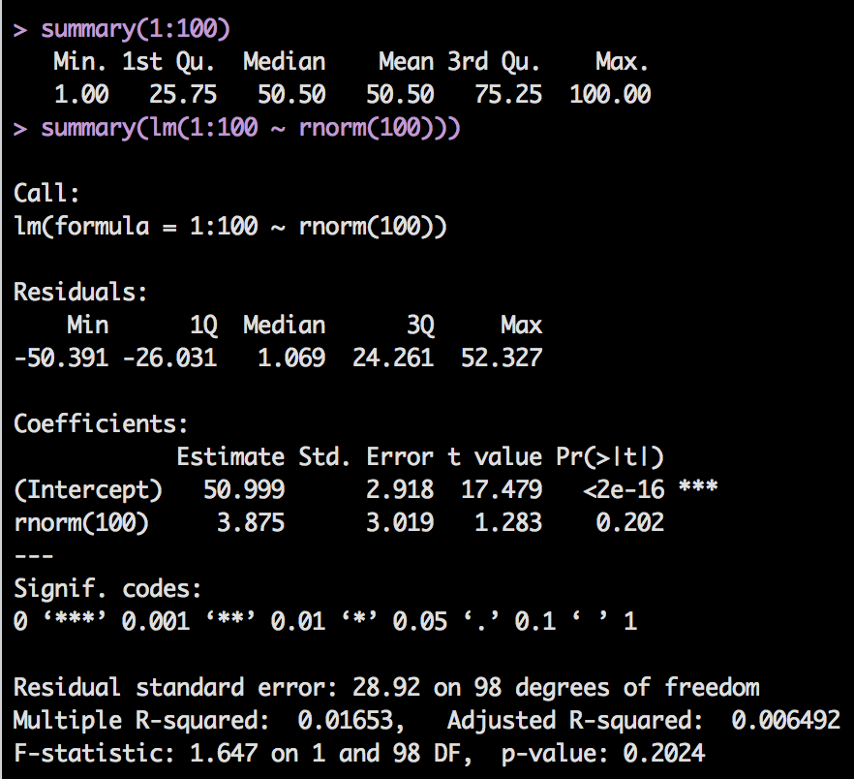
R is slow (on purpose)
Practicality at the expense of speed
Extremely Dynamic
You can change your mind about what things should be
Functions and methods are super versatile
Which means that R needs to “find” the appropriate thing to do, and that takes time
Notes:
Unpredictability = R must search for the right method every time a generic method is called

Slide 10
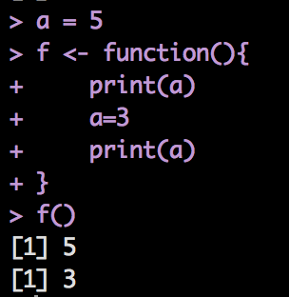
R is slow (on purpose)
Practicality at the expense of speed
Name lookup + mutable environments
*Every time* you use a variable R needs to look for it in many different places
Notes:
Unpredictability = R must search for the right method every time a generic method is called

Slide 11
R is slow (on purpose)
Practicality at the expense of speed
Lazy evaluations
Objects are only evaluated when they are needed
Which sounds great but…
Notes:
Unpredictability = R must search for the right method every time a generic method is called

Slide 12
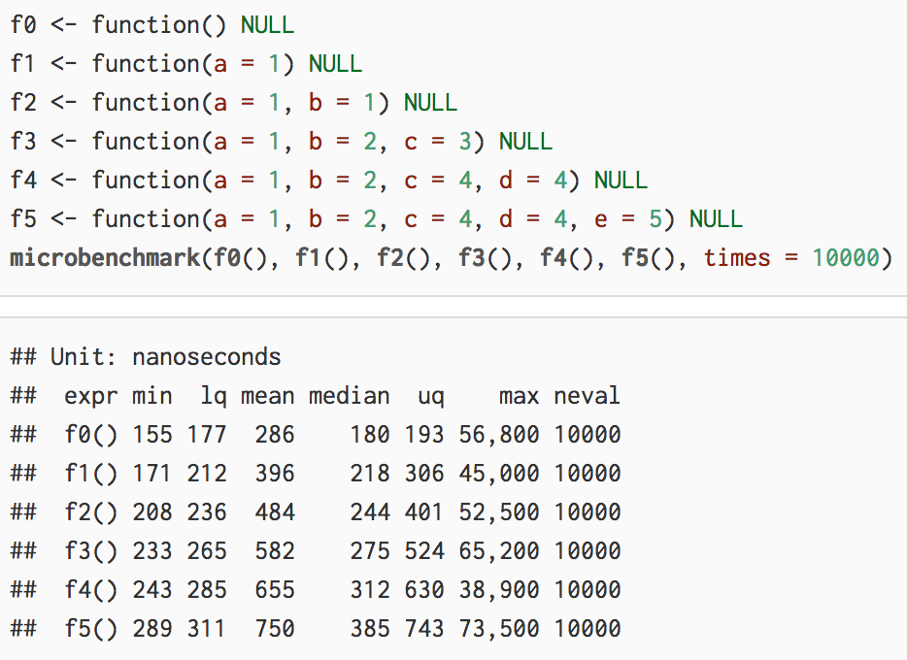
Lazy evaluations
None of these functions do anything but f5 takes twice as much time to run as f0
Notes:
Unpredictability = R must search for the right method every time a generic method is called

Slide 13
R is slow (on purpose)
Can we change any of these things?
No. They are intrinsic to the implementation of the language
Even R developers could not fix it without breaking the one thing that makes R awesome (CRAN)

Slide 14
R is slow (on purpose)
Can we change any of these things?
No. They are intrinsic to the implementation of the language
Even R developers could not fix it without breaking the one thing that makes R awesome (CRAN)
The end.

Slide 15
R is slow (on purpose)
All of those choices were made to make R more flexible and useful, but we don’t always need all of that flexibility. With a small amount of planning and good choices, you can write faster code!

Slide 16
Avoid flexibility if you don’t need it
Use matrixes instead of data frames to do number crunching
Data frames are super powerful, which makes them super slow
Matrixes can only have one type of data, so they are much faster if you’re just using numbers

Slide 17
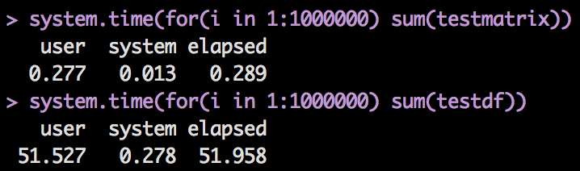
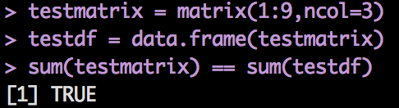
Avoid flexibility if you don’t need it
Use matrixes instead of data frames to do number crunching
Data frames are super powerful, which makes them super slow
Matrixes can only have one type of data, so they are much faster if you’re just using numbers
Notes:
Almost 200x more time to do the exact same thing!!

Slide 18
Avoid for loops
Common knowledge: for loops in R are super slow and should be avoided (use apply instead)

Slide 19
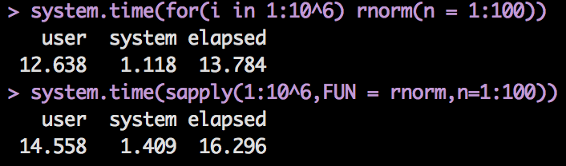
Avoid for loops
Common knowledge: for loops in R are super slow and should be avoided (use apply instead)
This is actually NOT true!
Apply *is* a loop!

Slide 20
Avoid doing *certain* things inside a for loop
Never ever grow an object inside the loop
ie don’t use c(), paste(), append(), rbind() inside the loop
Vectorize
ie think about what you want to do with the whole object rather than its parts
apply() often forces vectorization but apply() is just a loop

Slide 21
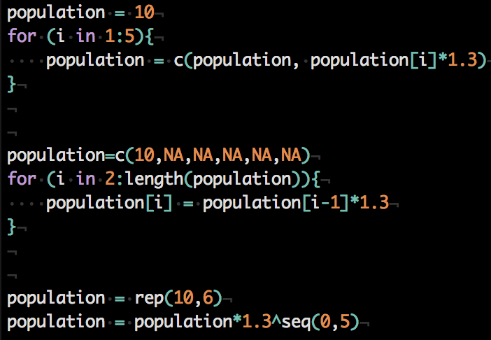
Avoid doing *certain* things inside a for loop

Slide 22
Vectorization is key
Using vectorized functions such as colSums(), rowSums(), rowMeans(), will almost always be faster than writing your own code with apply()

Slide 23
Byte code compilation
Sounds complicated but really isn’t
If you wrote an important function that is impacting performance, you can compile it with one line of code to make it significantly faster
Doesn’t always make a difference, but it’s not hard to do
compiledfunction = compiler::cmpfun(yourfunction)

Slide 24
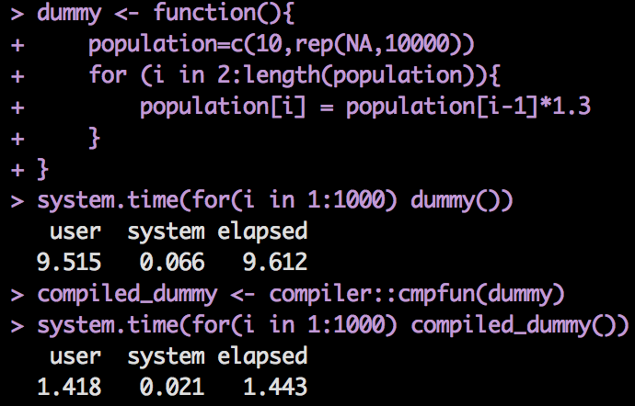
Byte code compilation

Slide 25
Parallelization
Using different cores of your computer to do each part of a task
Very powerful in supercomputers, still significantly better in most modern computers
You don’t have to know everything about it to take advantage of simple features
Use package parallel
Replace lapply() with the equivalent but parallel parallel::mclapply()

Slide 26
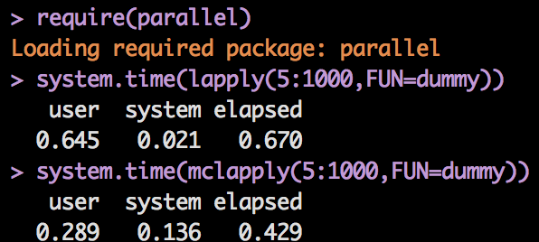
Parallelization

Slide 27
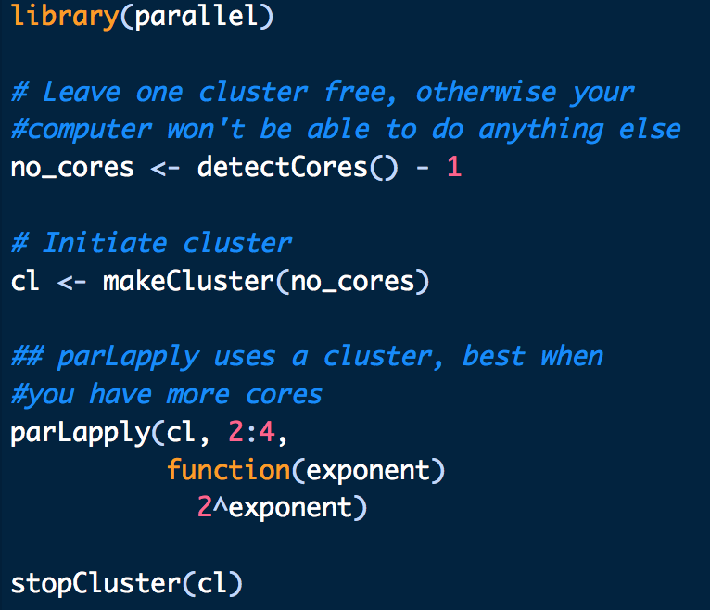
Parallelization

Slide 28
Summary
R is slow mainly because it is constantly doing extra work to figure out what it is supposed to do while most other languages rely on the human to tell them that
Using data formats and functions that are not as flexible is much faster
Vectorization avoids function calls that inevitably do extra work
There are very simple ways to take advantage of parallelization and byte code compilation

Slide 29
refs
Advanced R by Hadley Wickham http://adv-r.had.co.nz/
Stackoverflow
R inferno
Morandat et al, Evaluating the design of the R language

