Slide 1



for research and teaching
By Ana C.R. Gomez
@anacrgomez
April 2020

Slide 2
What you’ll need
github.com/acrgomez/RladiesShiny
Rstudio
A web browser (such as Firefox or Chrome)

Slide 3
Please use the chat to ask questions any time, or to let me know if I am going too fast
Please keep your microphone muted

Slide 4
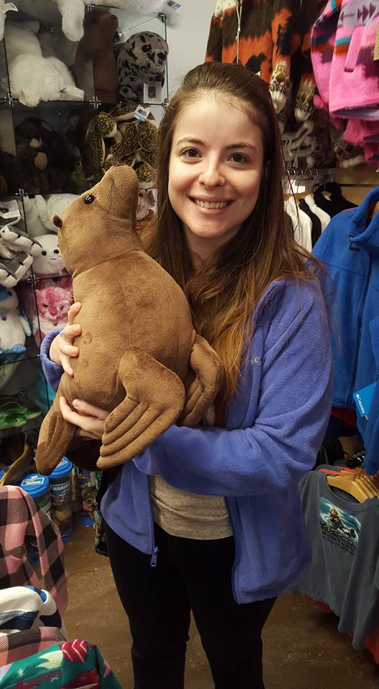
Hi! I’m Ana
PhD Candidate at UCLA, originally from São Paulo, Brazil
Work with California sea lion disease, focusing on mathematical modeling and serology (antibodies)
Have been using R and Rstudio since 2010
Cried the first time I tried to write useful code
But now I teach it!

Slide 5
Hi! I’m Ana
PhD Candidate at UCLA, originally from São Paulo, Brazil
Work with California sea lion disease, focusing on mathematical modeling and serology (antibodies)
Have been using R and Rstudio since 2010
Cried the first time I tried to write useful code
But now I teach it!

Slide 6
Hi! I’m Ana
PhD Candidate at UCLA, originally from São Paulo, Brazil
Work with California sea lion disease, focusing on mathematical modeling and serology (antibodies)
Have been using R and Rstudio since 2010
Cried the first time I tried to write useful code
But now I teach it!

Slide 7
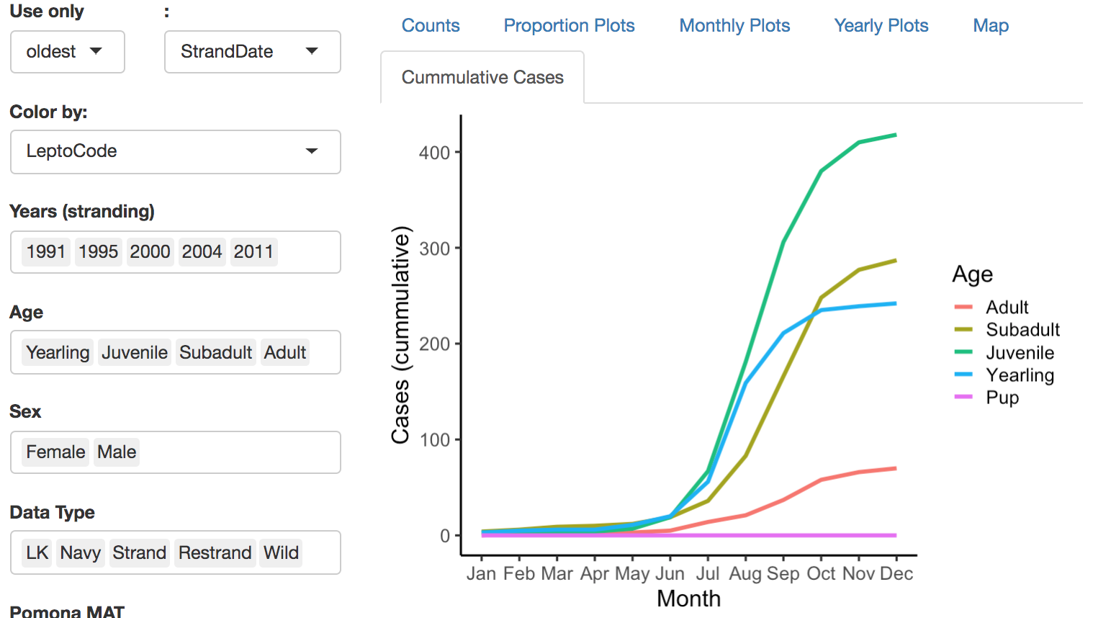
Shiny
My first ever shiny project was an interface to help collaborators explore our sea lion data

Slide 8
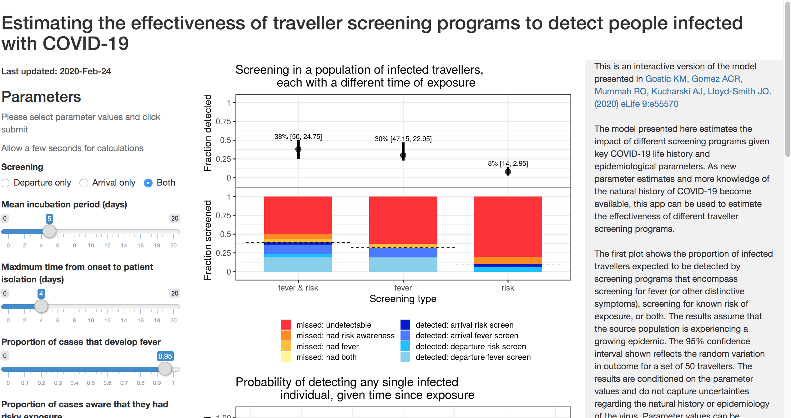
More recently, I worked on a shiny app to help explore a model of travel screening effectiveness for COVID-19:
https://faculty.eeb.ucla.edu/lloydsmith/screeningmodel
Code for app: github.com/acrgomez/TravelScreenShiny
Publication: Gostic et al 2020 eLife elifesciences.org/articles/55570

Slide 9
So what is shiny?
It’s an R package that will help you build interactive web applications (without requiring web development skills)
Users can interact with your data and your analysis
You can find examples, tutorials and further information at shiny.rstudio.com

Slide 10
Let’s look at an example
This example takes the dataset WorldPhones, which we all have, and shows a histogram of the number of telephone numbers by region

Slide 11
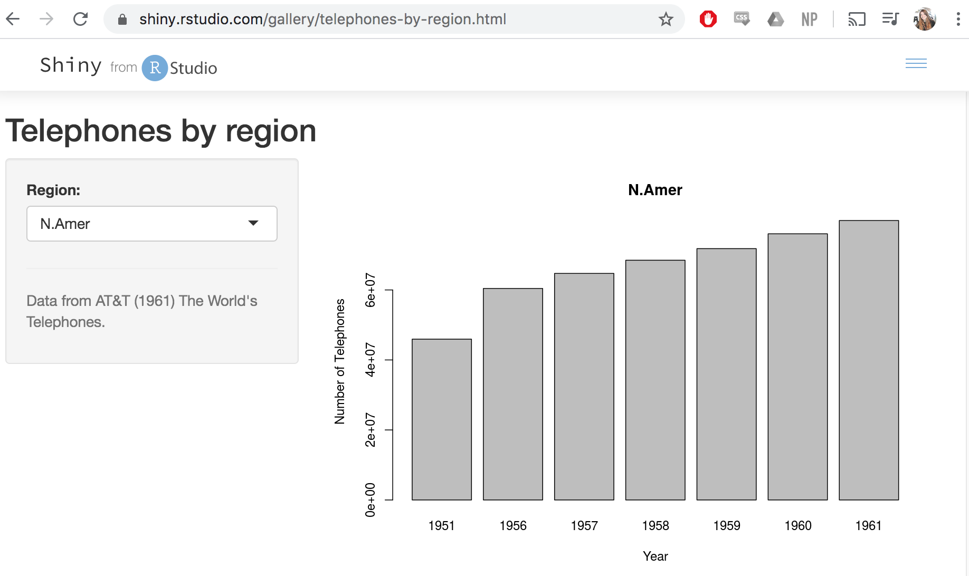
WorldPhones example
Let’s go toshiny.rstudio.com/gallery/telephones-by-region.html together

Slide 12
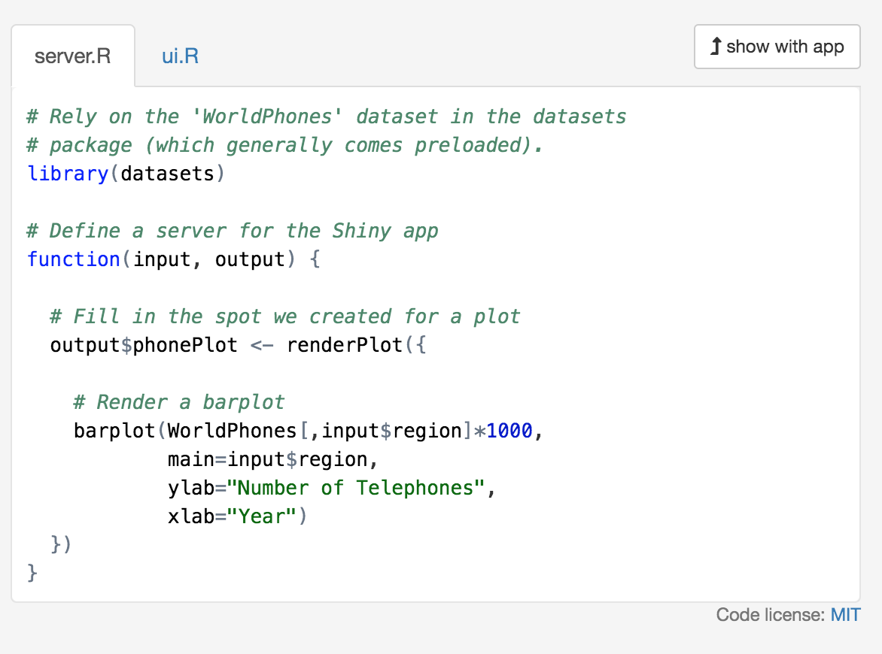
Let’s look at an example
So how does it work? Shiny apps have two sides: server.R and ui.R
ui.R is the User Interface. It generates a webpage
server.R is the code that runs your analyses, gathers your data, and generates your plots
Always keep those two files together in the same folder in your computer

Slide 13
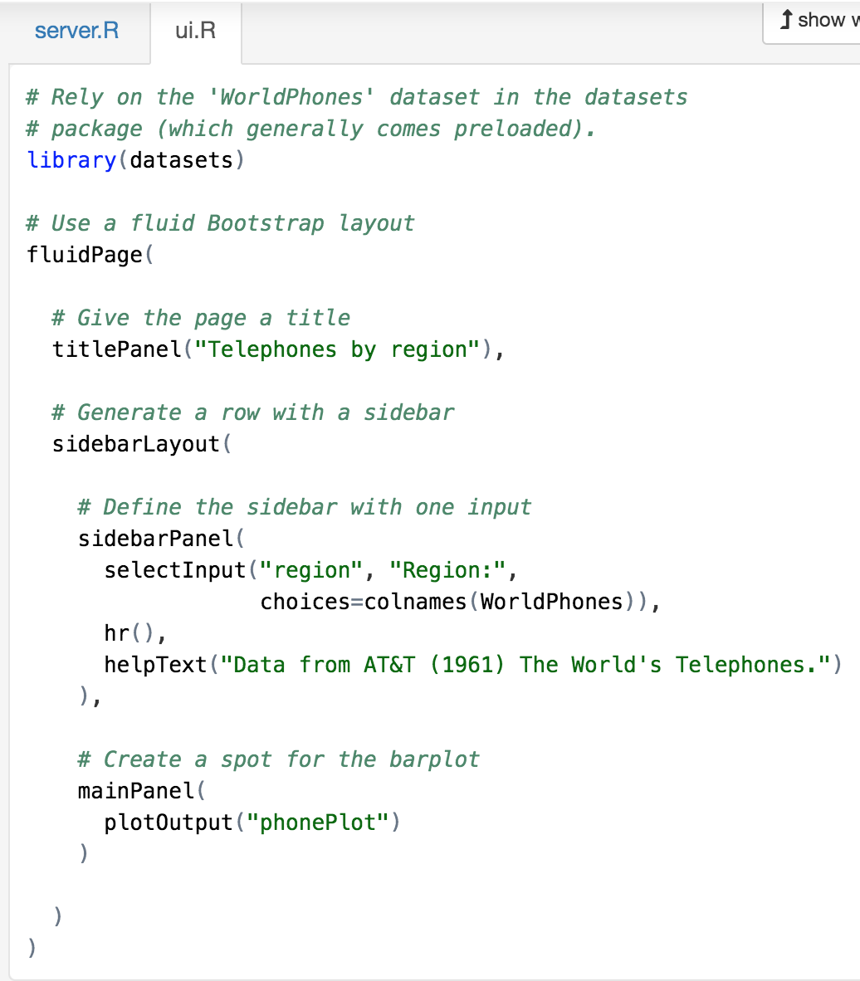
Let’s look at an example
server.R generates the output
ui.R reads the input

Slide 14
Let’s look at an example
So how does it work? Shiny apps have two sides: server.R and ui.R
ui.R is the User Interface. It generates a webpage
server.R is the code that runs your analyses, gathers your data, and generates your plots
Always keep those two files together in the same folder in your computer
Always keep those two files together in the same folder in your computer

Slide 15
Now let’s work on this example
Open Rstudio (or a fresh session)
Make sure to install package shiny if you haven’t
Create a folder for your app
Create files server.R and ui.R
Copy and paste the code from the example
Run the app
Interact with it

Slide 16
Let’s look at an example
server.R generates the output
ui.R reads the input

Slide 17
Let’s look at an example
Outputs and inputs have names, which you can pick. You can then refer to them with output$name_of_your_plot and input$name_of_input

Slide 18
Modify the example
Where would you go to change the look of the plot?
The code that generates the plot is in server.R
Exercise
Try to modify the barplot (for example, change the color, border, or axes)
Add another plot to your app (you must create the plot on server.R and tell ui.R to display it somewhere)
For example, let’s do a scatter plot of North America versus selected region

Slide 19
Modify the example
How would you change the drop-down menu or the text?
Always on ui.R
Exercise
Change the code so that the regions are not abbreviated
Add a tick box that makes the barplot blue or orange

Slide 20
What if I don’t want a drop-down menu?
The little bits you can click on are called Widgets
You can look at all sorts of widgets and get example code on the Shiny widget library at http://shiny.rstudio.com/gallery/widget-gallery.html
Find the tick box
Copy the code to your ui
Modify the server code to match it

Slide 21
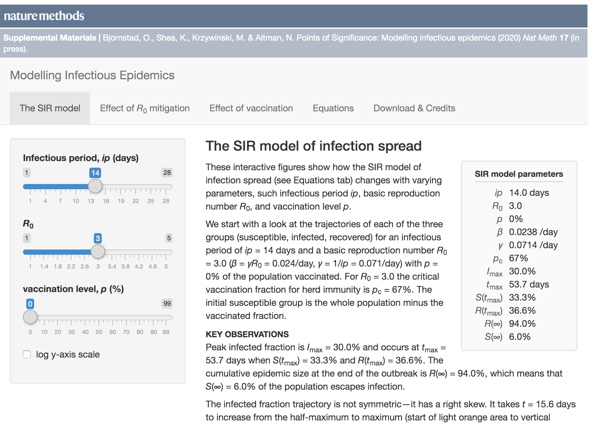
Example for education
Understanding the SIR model and flattening the curve shiny.bcgsc.ca/posepi1

Slide 22
How do I make my Shiny app available to others?
If they are R users you can share the code with them
But, if they are not or if you want to use this in class for example, you can host your app for free on shinyapps.io
We will not go through how to do it step by step today but this tutorial will get you there https://shiny.rstudio.com/articles/shinyapps.html

Slide 23
What is next?
Think of a shiny app you would like to work on. It is easier if it’s something you already have code for (e.g. a figure for a paper)
For inspiration and code always go to shiny.rstudio.com/gallery/ and copy as much as possible!
Look up shinyapps.io to create an account and learn how to host your app on the internet

Slide 24
Happy coding!
for research and teaching
By Ana C.R. Gomez
@anacrgomez
April 2020
Special thanks to Marilia and Dani for inviting me and organizing this!

