Slide 1
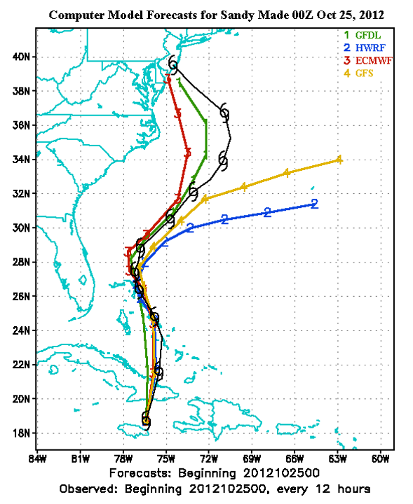
Geophysical Fluid Dynamic Laboratory hurricane model (NOAA)
Hurricane Weather Research and Forecasting model (NOAA/NRL/FSU)
European Centre for Medium-Range Weather Forecast model
Global Forecast model (National Weather Service)

