Slide 1
Happiness.
😉

Slide 2


Hello!
Team Members:
Noa Ecker
Yossi Tamarov
Avi Caciularu

Slide 3

“Happiness is when what you think, what you say, and what you do are in harmony.”
Mahatma Gandhi

Slide 4
Which one is the happiest ?
1. Spain
2. Vietnam
3. Thailand
4. Pakistan

Slide 5
Which one is the happiest?
1. Mexico
2. Netherlands
3. USA
4. Yemen

Slide 6
Which one is the happiest?
1. Egypt
2. Syria
3. Israel
4. Palestinian Authority
5. Lebanon
6. Jordan

Slide 7
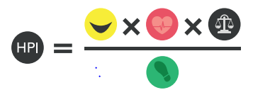
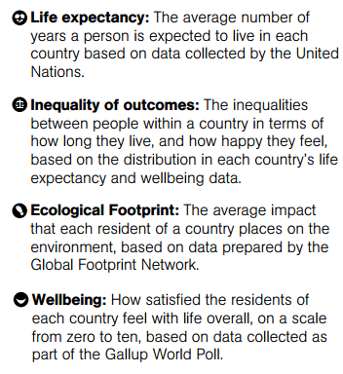
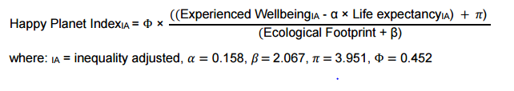
Confused?! We 2!

Slide 8


Our model features
Pupil-teacher ratio
Mobile Cellular
Subscriptions
=
Fertility Rate
Unemployment
Battle-related deaths
And much More…

Slide 9



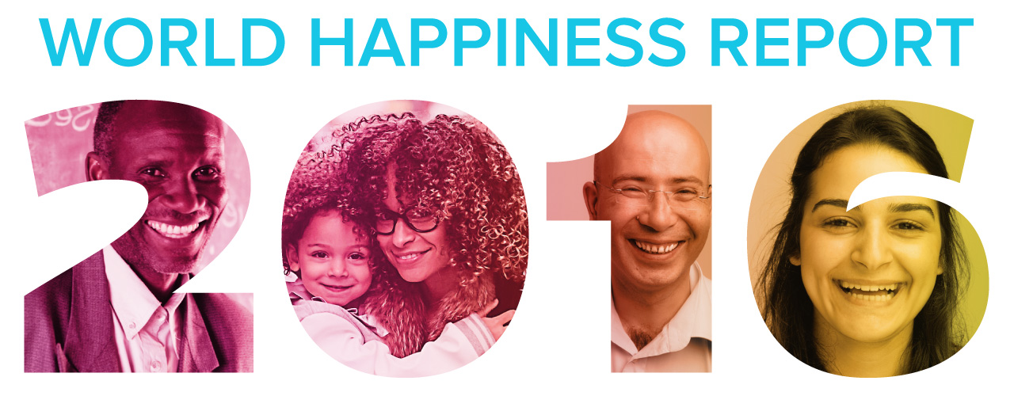
Want big impact?
Use big data.
Our DataSets:
OR
Jobs, Education & Financial

Slide 10
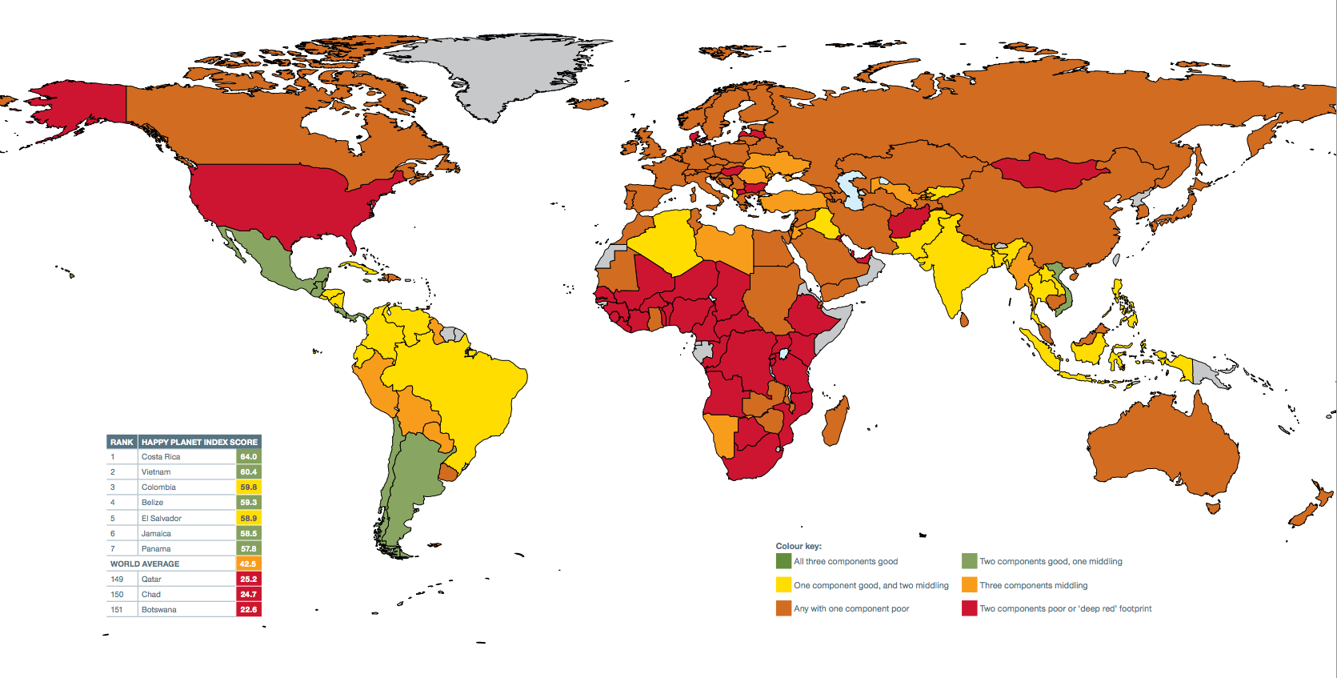
Maps

Slide 11
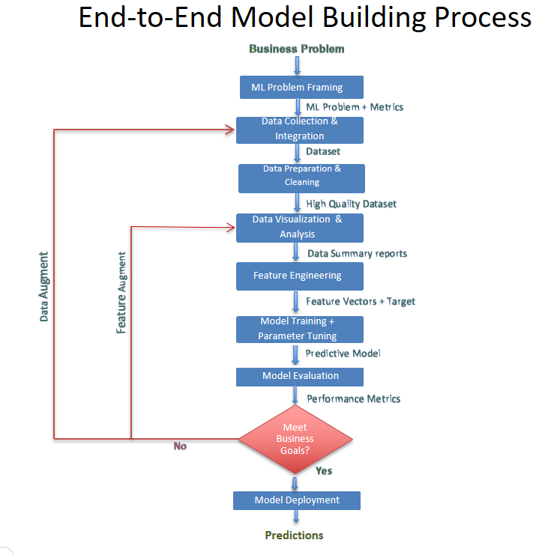
Our process is “easy”

Slide 12
Our Goal is to predicat…
Happiness Rate!
The scale of happiness rate will be chosen
After we choose the labels’ dataset.

Slide 13
Problems you have encountered so far…
Missing values –
Central tendency/feature removal
Noise & erroneous data – Select un-noisy years from the dataset
Labels dataset – Difficult to collect empirical outcomes

Slide 14


How do we work

Slide 15
Let’s review some concepts
Yellow
Is the color of gold, butter and ripe lemons. In the spectrum of visible light, yellow is found between green and orange.
Blue
Is the colour of the clear sky and the deep sea. It is located between violet and green on the optical spectrum.
Red
Is the color of blood, and because of this it has historically been associated with sacrifice, danger and courage.
Yellow
Is the color of gold, butter and ripe lemons. In the spectrum of visible light, yellow is found between green and orange.
Blue
Is the colour of the clear sky and the deep sea. It is located between violet and green on the optical spectrum.
Red
Is the color of blood, and because of this it has historically been associated with sacrifice, danger and courage.

Slide 16
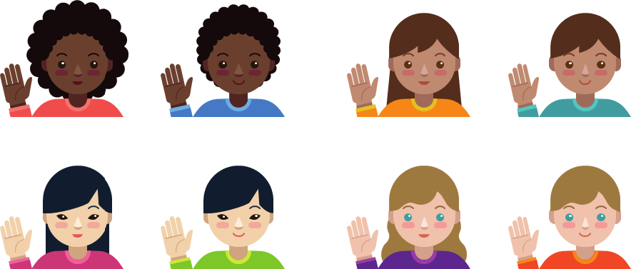
Thanks!
😉
Any questions?

