Slide 1
Happiness.
😉

Slide 2


Hello!
Team Members:
Noa Ecker
Yossi Tamarov
Avi Caciularu

Slide 3

“Happiness is when what you think, what you say, and what you do are in harmony.”
Mahatma Gandhi

Slide 4
Which one is the happiest ?
1. Spain
2. Vietnam
3. Thailand
4. Pakistan

Slide 5
Which one is the happiest?
1. Mexico
2. Netherlands
3. USA
4. Yemen

Slide 6
Which one is the happiest?
1. Egypt
2. Syria
3. Israel
4. Palestinian Authority
5. Lebanon
6. Jordan

Slide 7
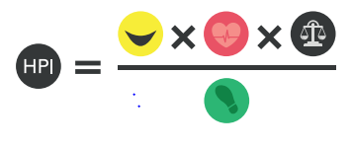
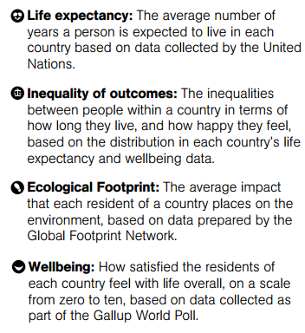
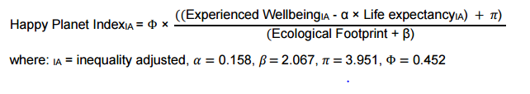
Confused?! We 2!

Slide 8


Our model features
New business density
Mobile Cellular
Subscriptions
=
Fertility Rate
School enrollment
Population ages distibution
And much More…

Slide 9



Want big impact?
Use big data.
Our DataSets:
For Labels
The Jobs Data-Base

Slide 10
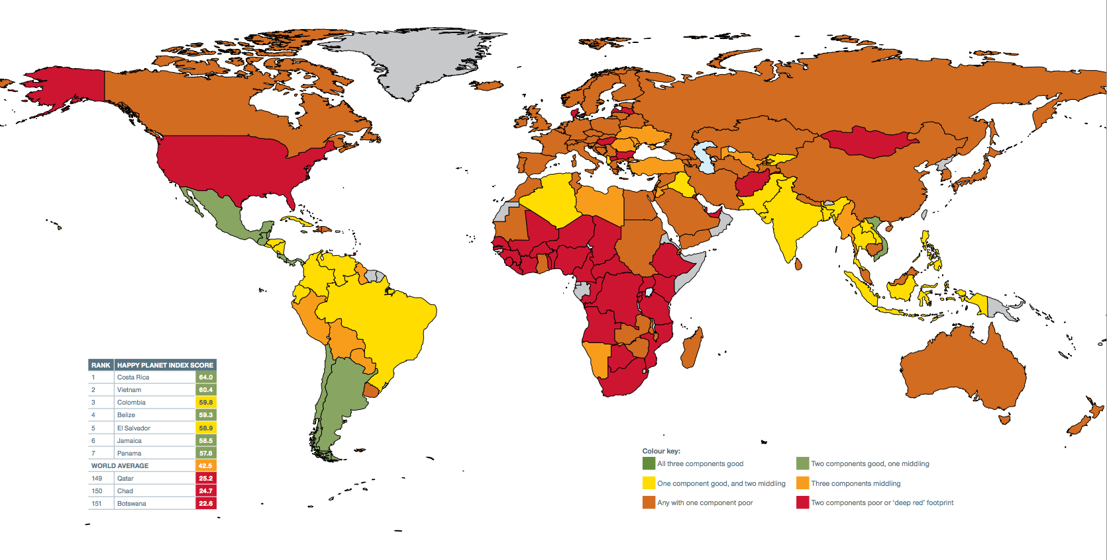
Maps

Slide 11
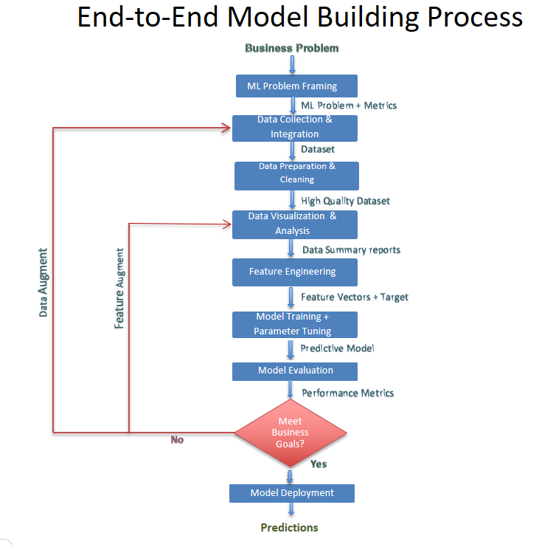
Our process is “easy”

Slide 12
Our Goal is to predicat…
Happiness Rate!
The scale of happiness rate will be chosen
After we choose the labels’ dataset.

Slide 13
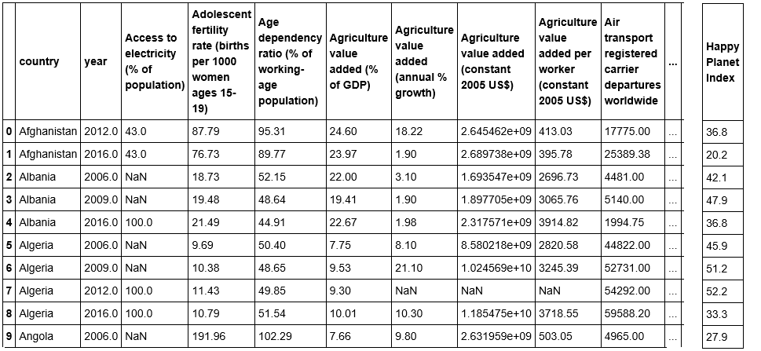

Slide 14
Problems we have encountered so far…
Missing values –
Central tendency/feature removal
Noise & erroneous data – Select un-noisy years from the dataset
Labels dataset – Difficult to collect empirical outcomes

Slide 15


How do we work

Slide 16

Thanks!
😉
Any questions?

