Slide 1


For great data understanding and analyzing we need great tools…
&

Slide 2
For great data understanding and analyzing we need great tools…
Basemap - The matplotlib basemap toolkit is a library for plotting 2D data on maps in Python.
Geonames - A Python library that provides functions to retrieve names and codes of continents, countries and US states as Python dictionaries.

Slide 3

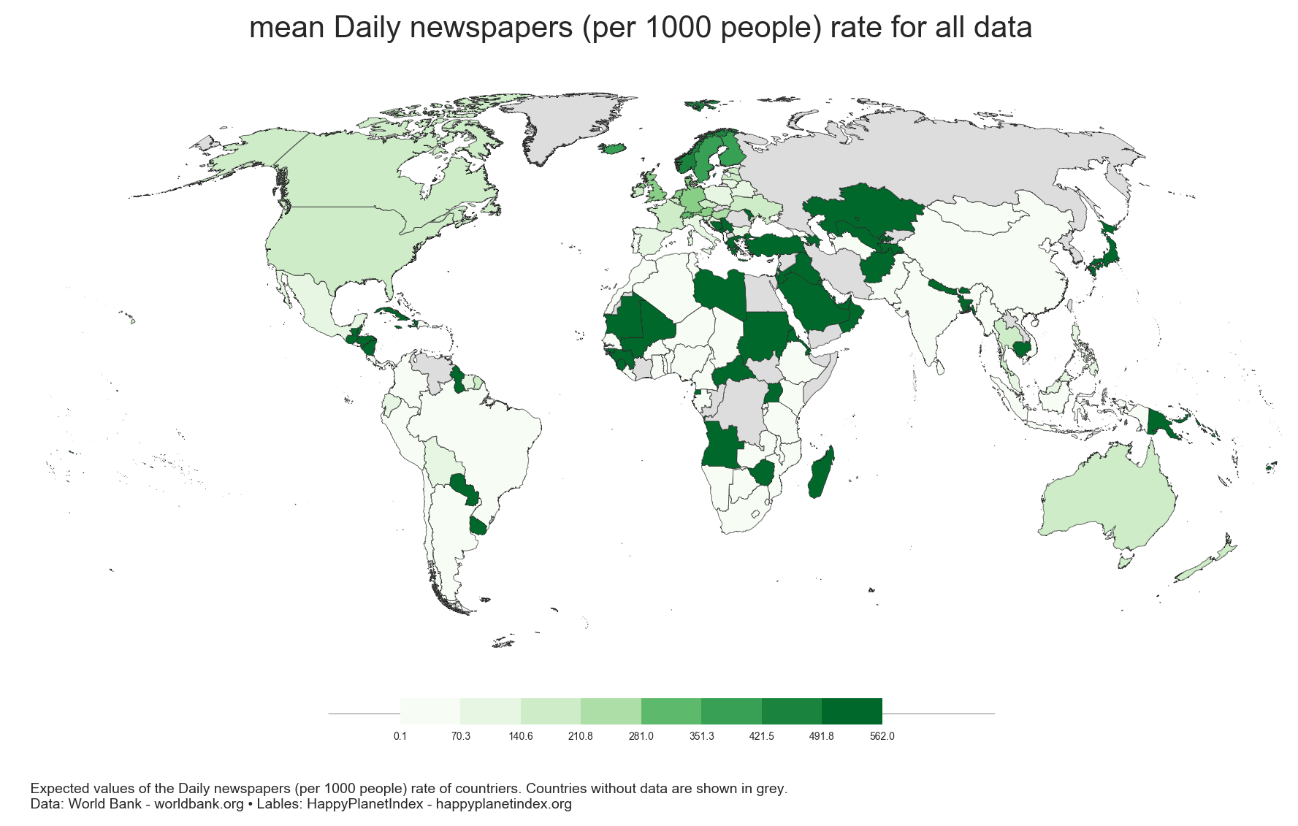
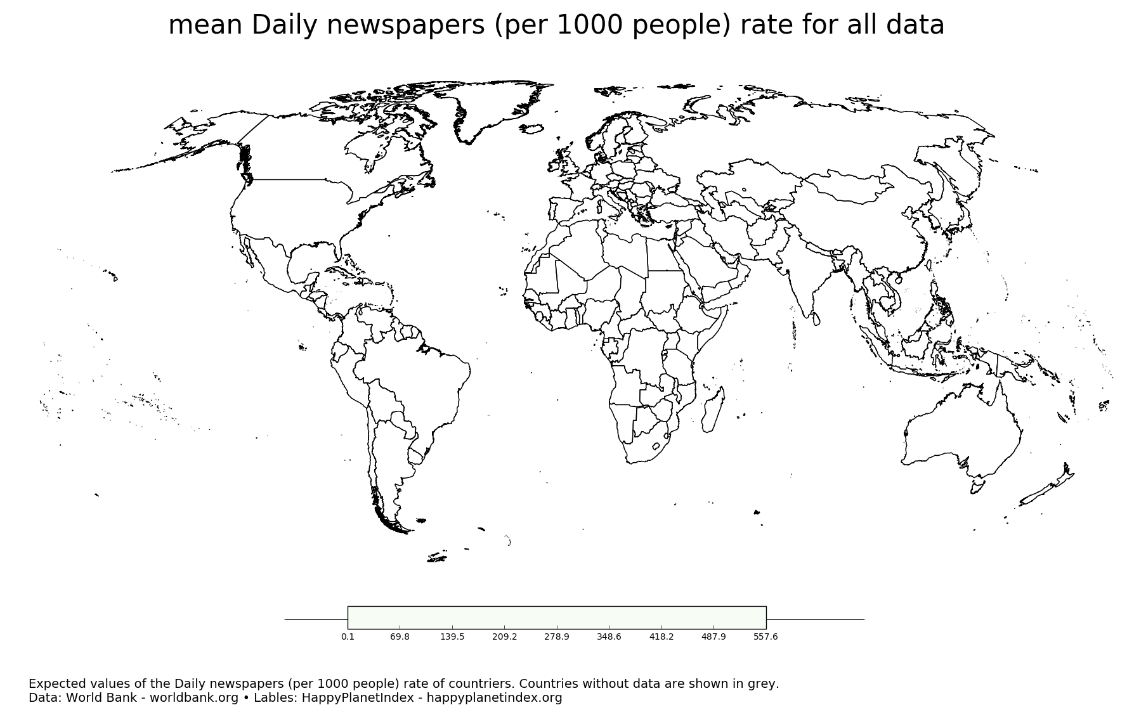
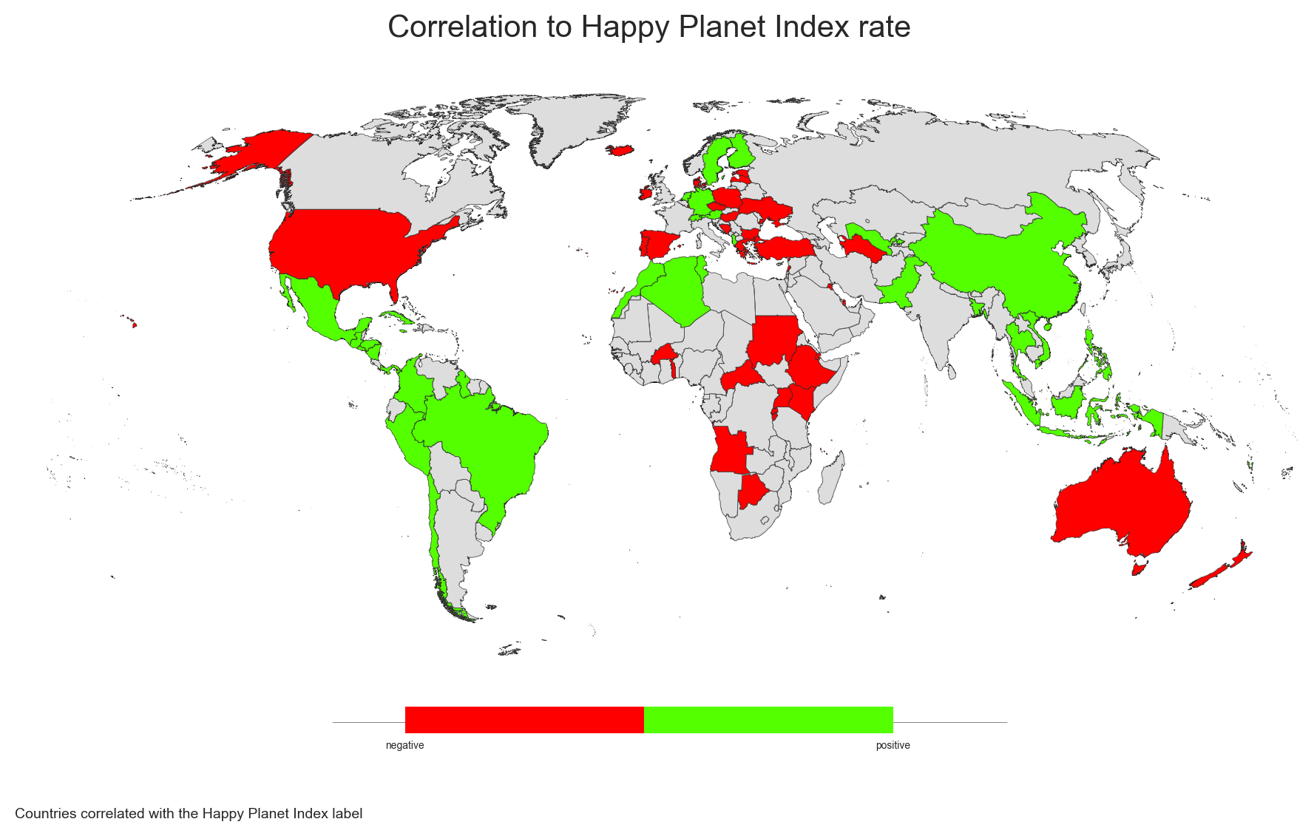
Want big impact?
Use big data.

Slide 4
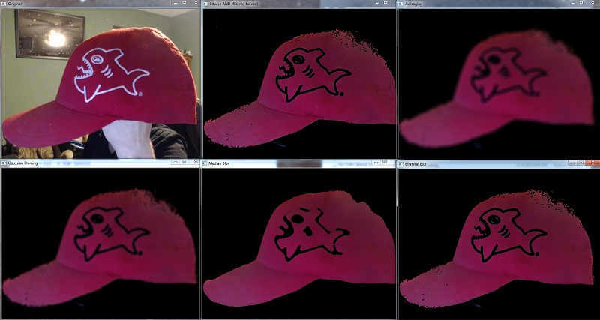

A little image processing with…

Slide 5
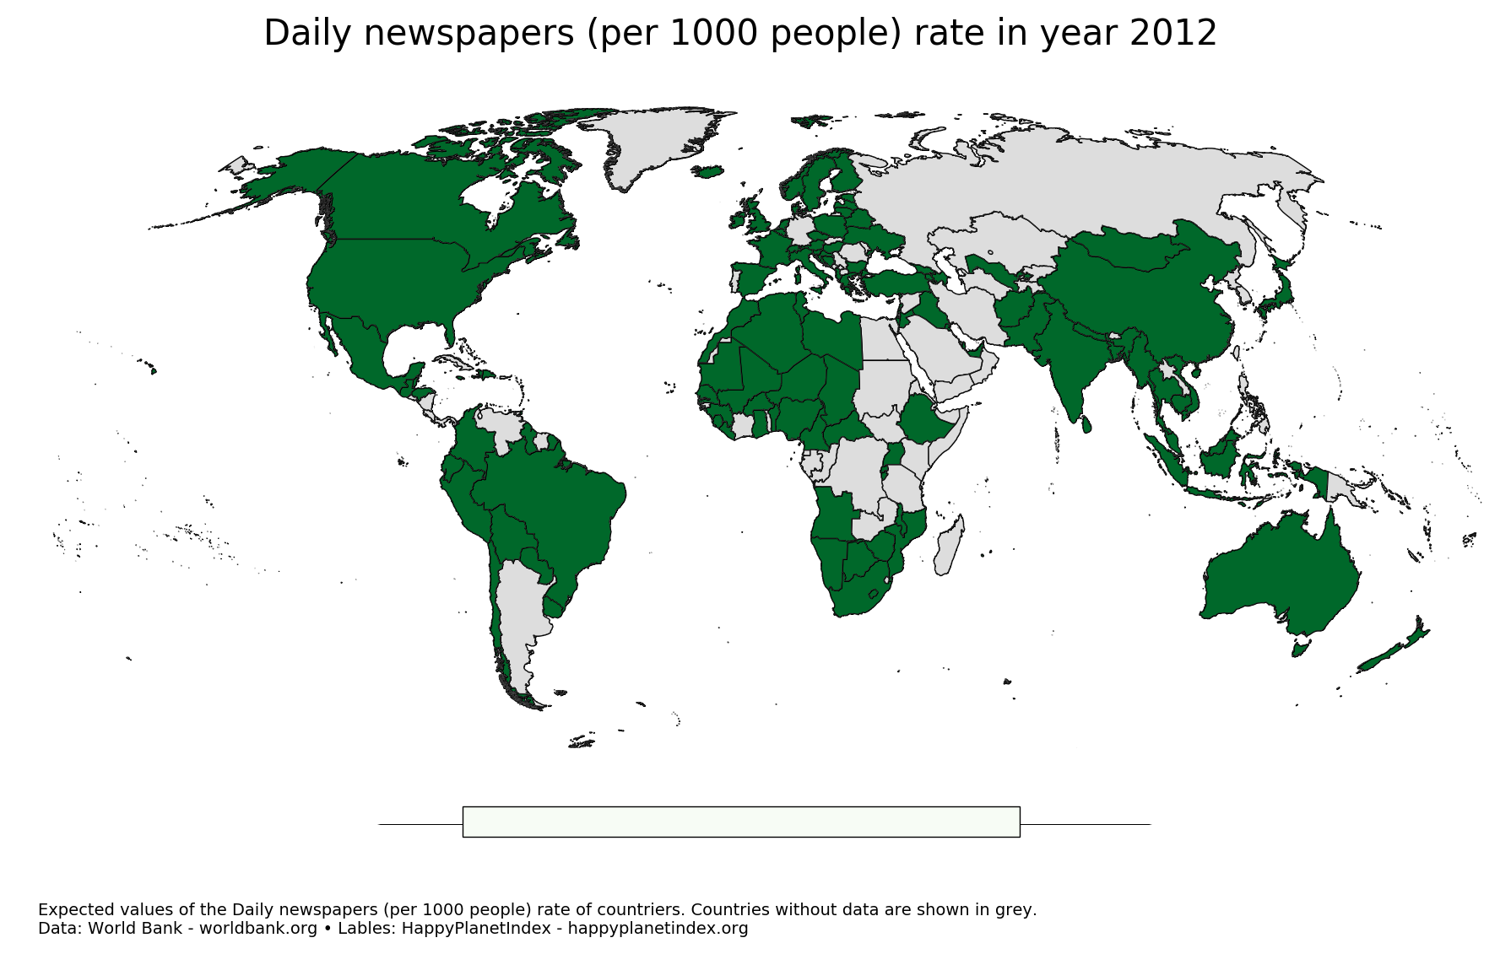
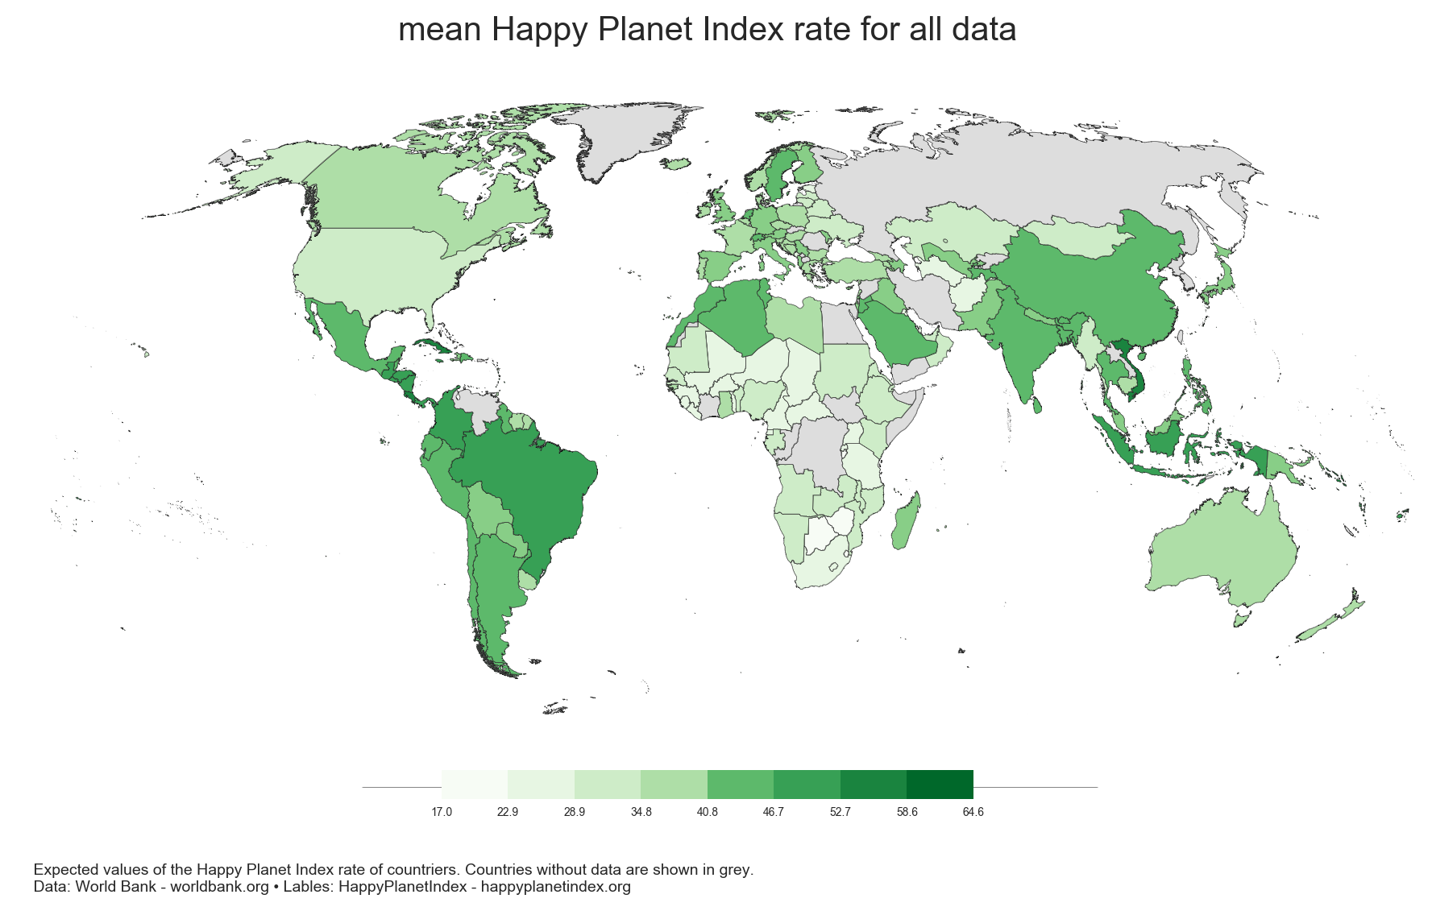
pixel subtraction!
-

Slide 6
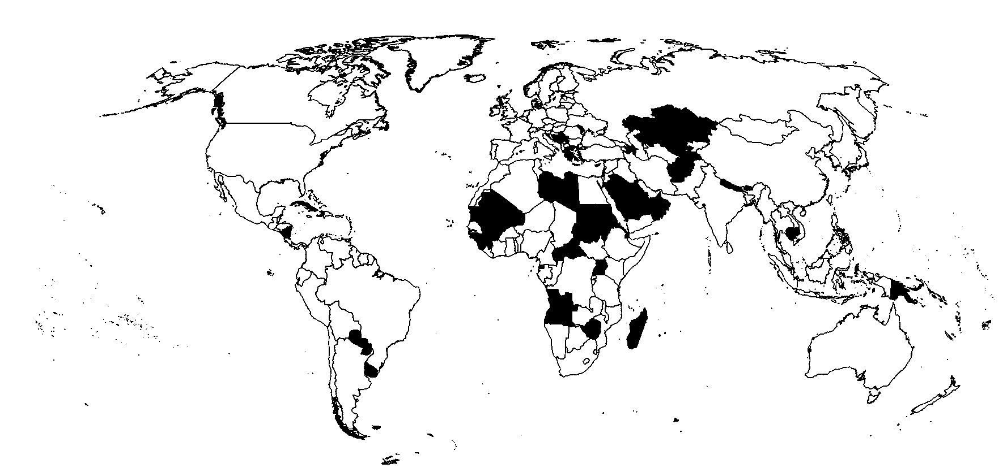
pixel subtraction!

