Slide 1
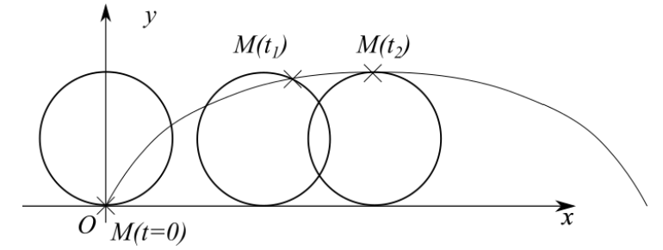





$$r$$
$$α$$
$$B$$
$$r$$
$$A$$

