Slide 1


Neuromorph Movement control
Solving the issue of Direct Kinematics in Biology and Robotics

Slide 2
Realtion between modeling and experiment
Mathematical model
Experimental protocol
Planning of the experiment (what? who? how? with?)
Computer simulation (MATLAB, Python)
Measured data
Importance of specification (space, time, sampling rate)
Movement analisys
Model adjustment
Comparision

Slide 3
Sensation – Execution Receptors sensitive to angular changes – Actuators to move
Direct and Inverse problems
Kinematics (describes the motion of bodies (objects) and systems (groups of objects) without consideration of the forces that cause the motion)
Joint angle Limb position
Dynamics (the time evolution of physical processes)
Angular acceleration (torques) Endpoint forces.

Slide 4
The motion of a human body segment respect to an adjacent segment is a combination of rotation and translation.
In most human movements (e.g. walking or reaching and object with an arm) the translation between the adjacent segments is very small comparing the whole movement.
In human direct kinematics, we consider joint motions as pure rotational movements, while the result of the rotations in a multijoint system’s joints may be a displacement of the body (e.g. during walking)

Slide 5
Definition of limb from biological point of view
Limb: can be regarded as an object containing
different segments linked to each other in joints
Segments are capable of rotating around joints and around their own longitudinal axis (supination, pronation)
Movements of the lower extremity (human leg)
Walking
Cycling
OthersEye movements („ one joint system”)
Head-Neck movements
1
2
1. Intersegmental joint angles: the angle between adjacent segments. Smaller than 180º )
2. Outer segmental joint angles: 180º – Intersegmental joint angles

Slide 6
Limb (e.g. a human lower or upper extremity) is regarded as a kinematic chain
One end of the chain is fixed. If the other end is not fixed than we speak about open kinematic chain and the other end is called endpoint of the limb or working point of the limb.
If the working point’s position is fixed, then the kinematic chain is a closed kinematic chain.
The size of the workspace is depending on:
Degrees of freedom (DoF) of joints
The number of DoF of the limb:
the sum of the DoF of individual joints
Segment lengths

Slide 7
Direct Kinematics (forward kinematics)
Compute the position of the endpoint of the limb if the first joint is fixed and the joint angles and segment lengths are given.
Compute the velocity of the endpoint of the limb if the first joint is fixed and the joint angles, angular velocities and segment lengths are given.
Joint angles and angular velocities are given in a reference frame defined by independent axes of rotations.
The number of independent axes of rotations depend on the degrees of freedom of the given joint.

Slide 8












Computation of Joint coordinates
$$EP_{x,y}=\left[\begin{matrix}l_{1}∗cα_{1}+l_{2}∗c(α_{1}+α_{2})+l_{3}∗c(α_{1}+α_{2}+α_{3}) \\ l_{1}∗sα_{1}+l_{2}∗s(α_{1}+α_{2})+l_{3}∗s(α_{1}+α_{2}+α_{3})\end{matrix}\right]$$
S = sine
c = cosine
$$y$$
$$α_{3}$$
$$l_{3}$$
$$W_{x,y}=\left[\begin{matrix}l_{1}∗cα_{1}+l_{2}∗c(α_{1}+α_{2}) \\ l_{1}∗sα_{1}+l_{2}∗s(α_{1}+α_{2})\end{matrix}\right]$$
$$l_{2}$$
Y
$$α_{2}$$
e(x,y)
Cos(α)= x Sin(α) = y
$$l_{1}$$
α
$$α_{1}$$
$$S=[0,0]$$
$$E_{x,y}=\left[\begin{matrix}l_{1}∗cα_{1} \\ l_{1}∗sα_{1}\end{matrix}\right]$$
$$x$$
X

Slide 9
Distance: is the length of traveled path
Displacement: is the vectoril difference between two positions (e.g. between the starting and the final position of a moving point)
Velocity: is the time rate of change of position
Speed: is the magnitude of velocity (rate of change of distance covered by the moving point)
Note that ...
The sequence of translational displacements of a point is commutative (the order of consecutive translations do not effect the final displacement)
The sequence of rotational displacements of a point is commutative in 2D space but not commutative in the 3D space.

Slide 10



Computation of the velocity vector in the endpoint
$$\left[\begin{matrix}EP_V_{x} \\ EP_V_{y}\end{matrix}\right]=\left[\begin{matrix}−l_{1}s(α_{1})−l_{2}s(α_{1}+α_{2})−l_{3}s(α_{1}+α_{2}+α_{3}) & −l_{2}s(α_{1}+α_{2})−l_{3}s(α_{1}+α_{2}+α_{3}) & −l_{3}s(α_{1}+α_{2}+α_{3}) \\ l_{1}c(α_{1})+l_{2}c(α_{1}+α_{2})+l_{3}c(α_{1}+α_{2}+α_{3}) & l_{2}c(α_{1}+α_{2})+l_{3}c(α_{1}+α_{2}+α_{3}) & l_{3}c(α_{1}+α_{2}+α_{3})\end{matrix}\right]\left[\begin{matrix}ω_{1} \\ ω_{2} \\ ω_{3}\end{matrix}\right]$$
$$y$$
$$\left[\begin{matrix}EP_V_{x} \\ EP_V_{y}\end{matrix}\right]$$
$$α_{3}$$
$$l_{3}$$
s=sine c = cosine
$$l_{2}$$
Y
$$α_{2}$$
e(x,y)
Cos(α)= x Sin(α) = y
$$l_{1}$$
$$ω=α^{′}(t)$$
$$α_{1}$$
α
$$S=[0,0]$$
$$x$$
X
$$E_{x,y}=\left[\begin{matrix}1∗c(α_{1}) \\ 1∗s(α_{1})\end{matrix}\right]$$

Slide 11
Inverse Kinematic problem
a)
Given: position of the endpoint of a kinematic chain (limb)
and the lengths of the chain’s segments.
Question: intersegmental angles in the joints
b)
Given: position and the velocity of the endpoint of a
kinematic chain and the lengths of the chain’s segments.
Question: the angular velocities in the joints.
In other words:
Given: a limb and a desired trajectory or target position of its endpoint.
Compute: the time course of joint angles that would result the given endpoint trajectory.

Slide 12
Problems with the IK solution
Redundancy problem
At least 6 degrees of freedom (DOF) required a chain to reach a target in 3D space
A chain with many links each having 6 DOF has more DOF needed to reach the goal
Infinite number of solutions
Targets out of workspace (unreachable)
Targets could be farther the chain reaches

Slide 13
Limb: an object containing
different segments (links) linked to each other via joints
Segments are capable of rotating around joints
Joint₁
Joint₃
θ₃
Θ_{i} = joint angles
θ₁
Base
l₁
l₃
l_{i} = segments
e_{current}
Joint_{i} = joints
l₂
e_{current} = current position of the endpoint of the limb
θ₂
e_{goal} = goal end point to be reached with (tartget)
Joint₂
J=Jacobian matrix of the limb
s=sine c = cosine
e_{goal}
= trajectory to be followed

Slide 14
Set of rotation angles of the entire chain
The position of the endpoint of the chain
The IK solution
IK can be calculated iteratively
Where J is the Jacobian matrix: generated by the partial derivatives of the endpoint of the kinematic chain.
Number of rows = number of dimension
Number of columns=number of joints

Slide 15
Definition of Inverse kinemaic problem
The Jacobian matrix
An iterative solution of the invers kinematic problem
Generating the inverse of the Jacobian (J) matrix
Is it possible to invert J? Usually not.
Pseudo inverse methods (Moore-Penroose)
Problems with the inverse kinematic problem
15
Notes:
TÁMOP – 4.1.2-08/2/A/KMR-2009-0006
15

Slide 16
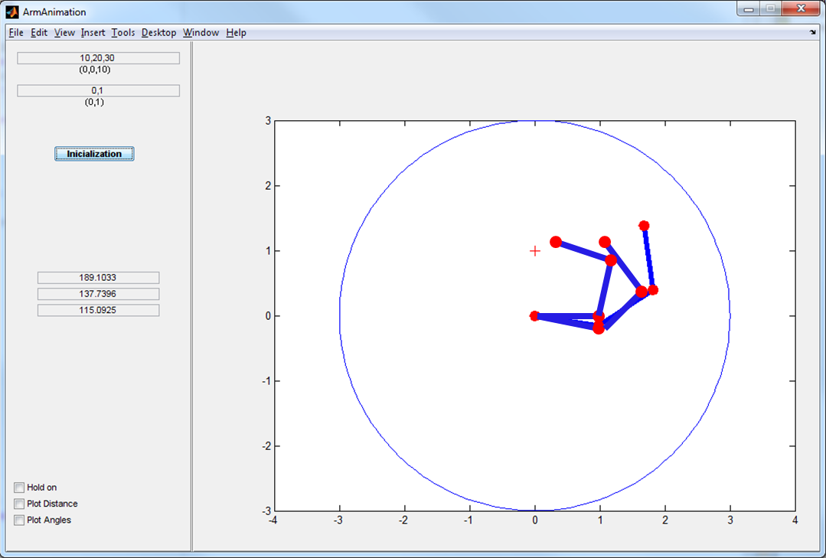
Initial values of external joint angles
2D coordinates of the goal
e_{current}
Worspace in 2D (circle)
e_{goal}
Displays the moving limb
Plots the distance between e_{current} and e_{goal}
Plots changes of θ

Slide 17
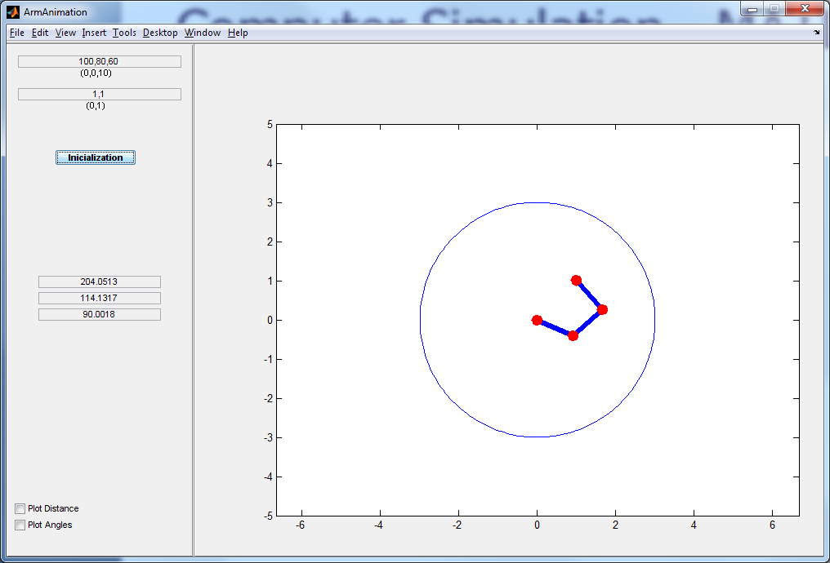
www.itk.ppke.hu
Unreachable area
Workspace

Slide 18
General algorithm to solve inverse kinematics (IK) problem
1. Compute J (jacobian matrix)
2. Compute (θ is a vector of joint angles)
3.
4. Update the joint angles and endpositions using 3.
Solved by Direct Kinematics
5. Repeat until e_{current} is within tolerance of e_{goal} or iteration count exhausted.

Slide 19
A simple example for J if n=m (dimensons=joints)
Consider: twe movement of a 2-joint system in which the lengths of two adjacent segments are equal (l₁=l₂)
In this case
Compute the determinant of J:
Singular configuration of this kinematic chain:
if sin(α2)=0 than det=(0)
In this case J is not invertable

