Slide 1
Controlling Human-Machine Interfaces
Controlling Human-Machine Interfaces
Control based on Principal Component Analysis

Slide 2
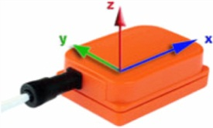
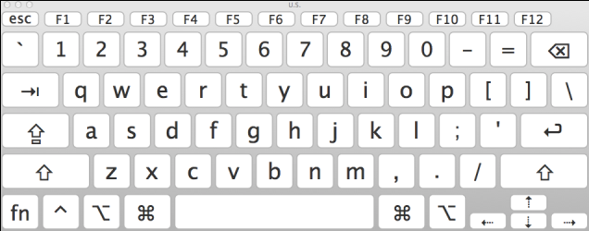
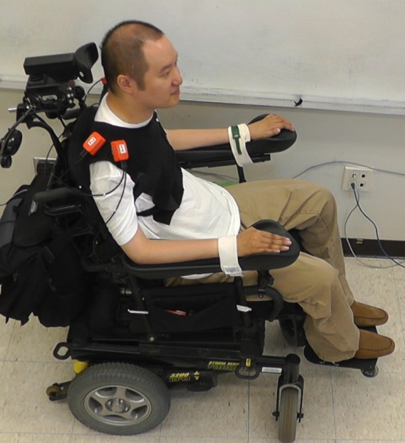
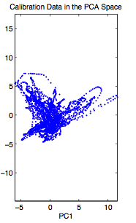
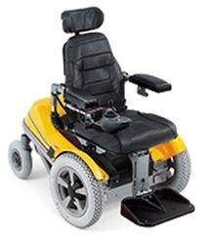
Test - Gép kapcsolat
Rehabilitation Institute of Chicago
A felsőtest mozgását transzformáljuk
mouse pointer mozgatássá
2021. 05. 20.
Notes:
SIMONYI-NAP 2017. október 16.

Slide 3
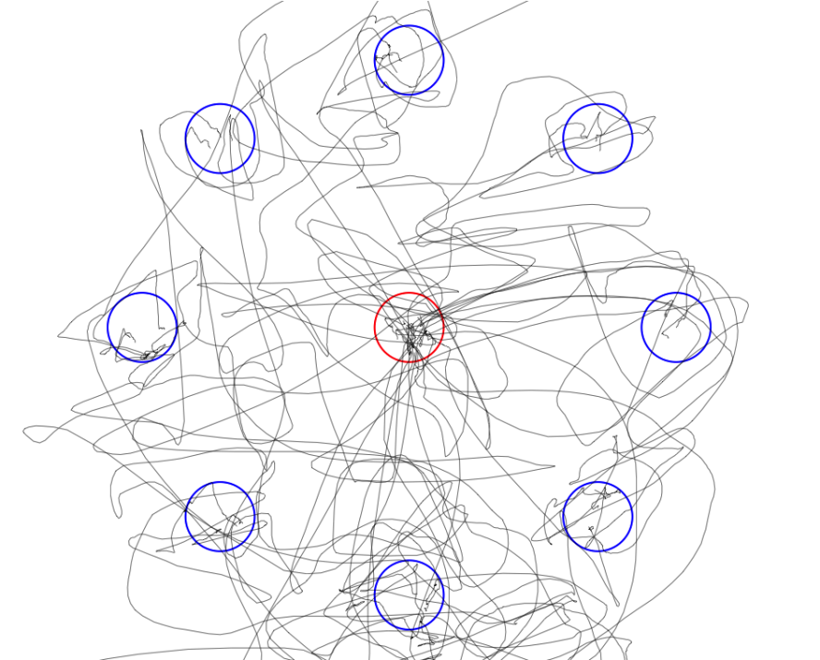
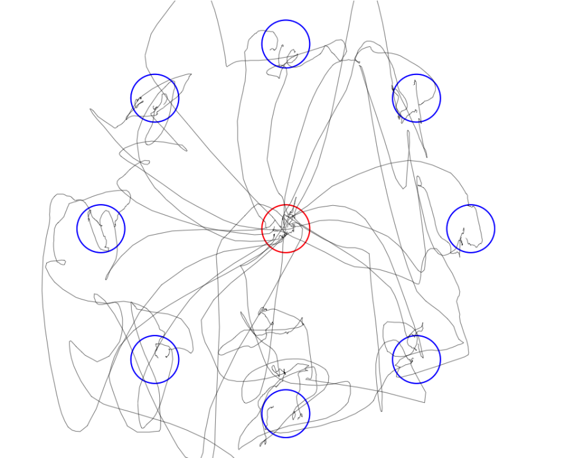
Reaching Trajectory
Before Training After Training

Slide 4
Controlling Human-Machine Interfaces
time | Ch₁ | Ch₂ | ... | Ch_{p}
1
2
3
Data are received in many channels
P is the number of channels.
In each channel, we receive a sequence of samples e.g. from a sensor.
N is the number of samples received in each channel.
M is a matrix of size N x P
N
Notes:
TÁMOP – 4.1.2-08/2/A/KMR-2009-0006

Slide 5
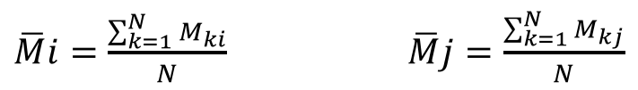
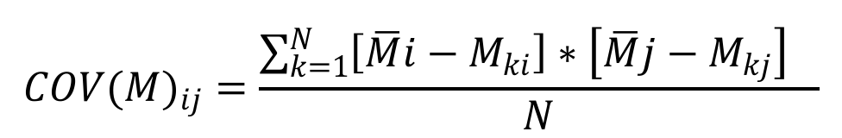
Controlling Human-Machine Interfaces
Computation of the Covariance Matrix of a set of time series
The time series are stored in the columns of a matrix M
Mi is the i^{th} column of Matrix M,
Mj is the j^{th} column of Matrix M.
Cov(M) is a p x p symmetric matrix,
Notes:
TÁMOP – 4.1.2-08/2/A/KMR-2009-0006

Slide 6
Controlling Human-Machine Interfaces
Compute the Covariance Matrix of M. It is denoted by Cov(M)
Compute the eigenvectors and eigenvalues of Cov(M).
Select the 2 eigenvectors that belong to the 2 largest eigenvalues.
From these 2 eigenvectors we construct a new matrix.
This matrix has p rows and 2 columns R ^{p x 2}
The first column will be one eigenvector of Cov(M),
The second column will be another eigenvector of Cov(M).
This matrix gives a transformation from the p dimensional “Sensory Space” to the 2 dimensional “Work Space”.
Let denote this matrix by PM
Notes:
TÁMOP – 4.1.2-08/2/A/KMR-2009-0006

Slide 7
Controlling Human-Machine Interfaces
P-dimensional vector of sensor signals S
Represented in a matrix of size 1 x p. (p dimensional vector).
During online control S is changing in time
S(t) is the sensor signal vector at time t
S is mapped onto the
2-dimensional command vector C
Represented by a matrix of 1 x 2. (2 dimensional vector)
by a linear transformation:
Real time control C(t) = S(t) * PM
Notes:
TÁMOP – 4.1.2-08/2/A/KMR-2009-0006

Slide 8
www.itk.ppke.hu
The presented method is related to Principal Component Analysis.
Dimension Reduction
Notes:
TÁMOP – 4.1.2-08/2/A/KMR-2009-0006

Slide 9
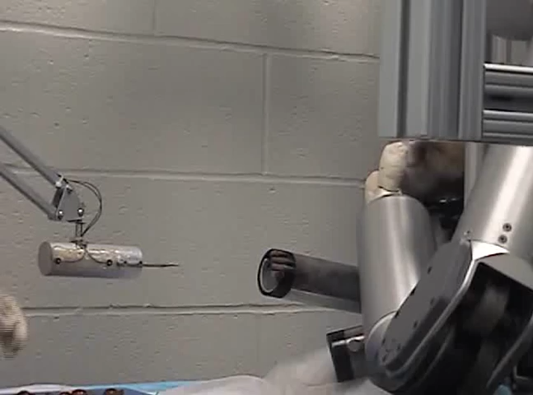
2021. 05. 20.

