Slide 1
Neuromorph Movement Control:
Material and special physical muscle properties
www.itk.ppke.hu
Main task of the muscle
    The series of impulses generated by the nervous system evoke action potential(AP)
    As a result of these APs (low voltage current) the muscle contracts (it shortens)
    During muscle contraction muscle force is generated
Notes:
TÁMOP – 4.1.2-08/2/A/KMR-2009-0006

Slide 2
Force generation capacity of muscles is determined by:
    Muscle geometry (fiber type, pennation angle)
    Material features of the muscle
    (elasticity, viscosity, stiffness, compliance)
    these properties may depend on temperature.
    The ability to respond to stimulus
    Conductivity – the ability to propagate stimuli
    Contractility – the ability to alter muscle length
    Resistance against stretch
    Adaptability – the ability to regenerate

Slide 3
Main task of the muscle
  To react or resist to perturbations of the external world
    Resulted by reflex processes
    Caused by external forces (e.g. gravity)
    Skeletal muscles may rotate body segments around each
    other and produce compensatory movements to stabilize
    posture (e.g. vestibulo-collic reflex, phasic stretch reflex)
    Maintenance of a vertical posture is an important task in
    human motor control.

Slide 4
www.itk.ppke.hu
Motor units and innervated muscle fibers
Motor unit (MU): a single α-motor neuron with its dendrites and the branches of its axon and all of the muscle fibers innervated by the motor neuron.
All muscle fibers in a motor unit are the same fiber type:
fast twitch or slow twitch
  If a MU is activated by the central nervous system (CNS), all of the innervated fibers generate contraction.
  Groups of MUs may be activated together to coordinate the contractions of a single muscle;
Notes:
TÁMOP – 4.1.2-08/2/A/KMR-2009-0006

Slide 5
MUs serving the same single muscle are called: motor unit pool
The number of muscle fibers contained by a MU is varying.
Innervation ratio of a muscle: the average number of muscle fibers innervated by a motor neuron
  Depends on the function the muscle.
  e.g. biceps brachii is connected to about 800 motor neurons and contains about 560.000 muscle fibers,
  thus its innervation ratio ≈ 700

Slide 6
Neuromorph Movement Control:
Material and special physical muscle properties
www.itk.ppke.hu
An extended table of the two fibre types (fast - Type II;slow - Type I) and features
Feature | Type I | Type II a | Type II b | Type II x
Size of motor neuron | Small | Medium | Very large | Large
Contraction time | Slow | Fast | Very fast | Fast
Fatigue resistance | High | High | Low | Medium
Type of activity | Aerobic | Long term anaerobic | Short term anaerobic | Short term anaerobic
Duration of use | hours | Less than 30 mins | Less than 1 min | Less than 5 mins
Force production | Low | Medium | Very high | High
Oxidative capacity | High | High | Low | Medium
Some important features representing the applicability of the major muscle fibre types
Notes:
TÁMOP – 4.1.2-08/2/A/KMR-2009-0006

Slide 7
Neuromorph Movement Control:
Material and special physical muscle properties
www.itk.ppke.hu
Classification as a function of:
  Muscle length changes
  Changes in force
concentric contraction: the muscle shortens during contraction
(the exerted force is enough to beat the resistance originating from material features or external load)
  Muscle is capable of contracting based on the sliding filament theory.
  Force is generated along tendons to decrease the inter-segmental angles in the joint.
  (e.g. biceps decreases elbow angle)
Notes:
TÁMOP – 4.1.2-08/2/A/KMR-2009-0006

Slide 8
eccentric contraction (lengthening contraction):
the force generated is not enough to beat the external load or
material features of the muscle
  Muscle lengthens as it contracts. (elongate while being under tension due to an opposing force)
  In eccentric contraction of the biceps: the elbow starts the movement while bent and then straightens as the hand moves away from the shoulder
  Control of eccentric contraction is different from control of concentric contraction. The information received from muscle fiber lengthening play an important role in eccentric contraction.

Slide 9
Neuromorph Movement Control:
Material and special physical muscle properties
www.itk.ppke.hu
Classification as a function of muscle length changes or changes of force levels
isometric contraction: the muscle remains at the same length.
  Holding an object without moving it (the exerted force precisely matches the load without moving it)
isotonic contraction:
The tension in the muscle remains constant despite the change of muscle length.
  It occurs if the maximal force of a muscle during contraction exceeds the total load acting on the muscle.
TÁMOP – 4.1.2-08/2/A/KMR-2009-0006
Notes:
TÁMOP – 4.1.2-08/2/A/KMR-2009-0006

Slide 10
Neuromorph Movement Control:
Material and special physical muscle properties
www.itk.ppke.hu
Important definitions determining material features of muscles
Stiffness: (material property) the resistance of an elastic material to deformation by a force.
Viscosity: describes a fluid's internal resistance to flow and may be regarded as the measure of fluid friction (resist shear flow and strain linearly with time)
  water is "thin” with lower viscosity,
  honey is "thick" with higher viscosity
Viscoelasticity: the property of materials that exhibit both viscous and elastic characteristics when undergoing deformation
Notes:
TÁMOP – 4.1.2-08/2/A/KMR-2009-0006

Slide 11
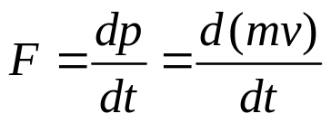
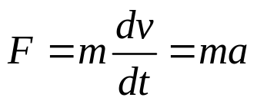
Neuromorph Movement Control:
Material and special physical muscle properties
www.itk.ppke.hu
Physical laws (Newton’s 2nd law)
Newton’s 2nd law of motion (how the velocity of an object changes when it is subjected to an external force): the net force on a particle is equal to the time rate of change of its linear momentum p in an inertial reference frame:
Where: F is the force, m is the mass of the body, and a is acceleration of the body and v is the velocity
Valid only for
constant mass
Notes:
TÁMOP – 4.1.2-08/2/A/KMR-2009-0006

Slide 12
Velocity: moving through a displacement (ds) during a time interval (dt)
v=ds/dt (1st time derivative of the displacement.)
Acceleration: the rate of change of the velocity
a=dv/dt (2nd time derivative of the displacement).
Physical laws (Moment of inertia of multisegment limb)
Moment of inertia (MoI) of a multisegment limb: is calculated by using the parallel axis theorem.
(θ_{cm} is the MoI about the center of mass; M is the mass of the segment; d is the distance between the axis through the center of mass and the parallel axis through the rotation center)

Slide 13
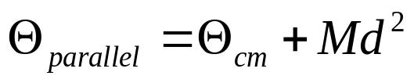
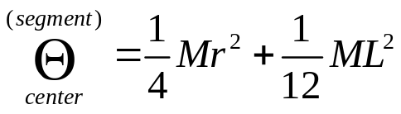
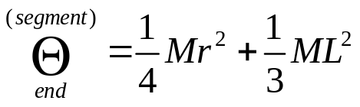
www.itk.ppke.hu
parallel axis theorem:
Arm segments can be regarded as uniform cylinders with different thickness.
  Moment of Inertia about the center of mass of a rotated segment:
  MoI around the end of a rotated segment:
Notes:
TÁMOP – 4.1.2-08/2/A/KMR-2009-0006

Slide 14
Adaptation of muscle force to the environment and to CNS commands based on material features of muscles
Stiffness (k) as a function muscle length changes
k=ΔF/Δl
The force required to a unit change of muscle length
Compliance as a function of muscle length changes
c=Δl/ΔF
Where F(t) is the force applied on the muscle (muscle fiber) and Δl is the displacement produced by F(t) (change of the muscle length).

Slide 15
www.itk.ppke.hu
Muscle force based on material features of muscles
Inertia (m): is the measure of resistance against change of muscle contraction velocity
Viscosity of a muscle (b): The ability of a muscle to generate force against muscle length velocity vector.
F(t)= m* l(t)’’ + b *l(t)’ + k*[l(t)-l_{o}(t)]
2nd law of motion
Inertia
Viscosity
Stiffness
Notes:
TÁMOP – 4.1.2-08/2/A/KMR-2009-0006

Slide 16
www.itk.ppke.hu
Force production capability (pennation angle)
From structural point of view: skeletal muscles are composed of high amount of muscle fibers.
Muscles are discerned based on the arrangements of muscle fibers.
2 major classes are divided: (Figures on the next slides)
    Muscles with muscle fibers arranged in parallel to the action line of the muscle (pennation angle 0)
    Muscles with muscle fibers having pennated arrangement
    (pennation is angle is not zero). In this case the fiber force that acts in the direction of the muscle’s action line, depends on the cosine of the angle of pennation
Notes:
TÁMOP – 4.1.2-08/2/A/KMR-2009-0006

Slide 17
Force production capability (pennation angle)
Muscles with pennated arrangement: A pennated muscle is a muscle with fibres that are attached to the tendons in a slanting way.
  These types of muscles are capable of producing higher peak force than parallel ones
  but
  With less range of motion.
  Most muscles have nonzero angle of pennation. More fibers
  can be arranged in the same volume in this manner.

Slide 18
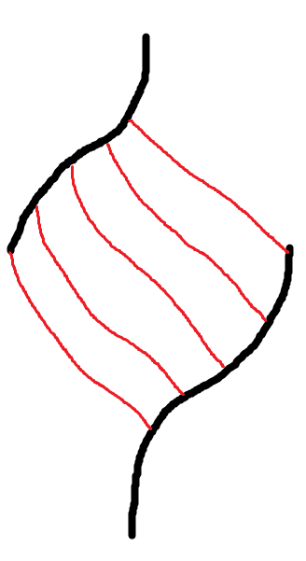
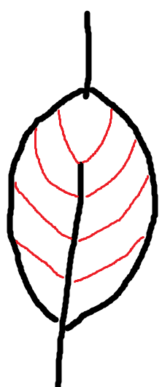
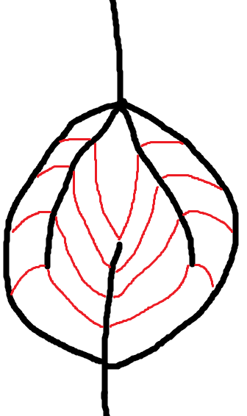
www.itk.ppke.hu
Force production capability (pennation angle) – Schematic figures
A) B) C)
A) unipennate: all muscle fibres are on the same side of the tendon (hand muscles)
B) bipennate: muscle fibres are on both sides of the central tendon (rectus femoris in the lower limb)
C) multipennate: the central tendon branches within a muscle (deltoid anterior-posterior in the shoulder)
Green lines: anatomical cross section area
TÁMOP – 4.1.2-08/2/A/KMR-2009-0006
Notes:
TÁMOP – 4.1.2-08/2/A/KMR-2009-0006

Slide 19


Neuromorph Movement Control:
Material and special physical muscle properties
www.itk.ppke.hu
Physiological cross sectional area (PCSA) and muscle force production
PCSA: is the total area (that can be found in pennated muscles) where the cross sections are perpendicular to the muscle fibres. (blue lines in the previous slide)
The importance of pennation angle in muscles: more muscle fibers are placed in parallel. (muscle is capable of exerting more force)
  However: the maximum force in along the direction of the muscle action line is less than the maximum force in the fiber direction.
Thus: the muscle force (F_{M}) a muscle can exert is computable if the total force and the pennation angle (α) of the muscle is known:
        where Tension is the force exerted by the fibers per unit of PCSA
TÁMOP – 4.1.2-08/2/A/KMR-2009-0006
Notes:
TÁMOP – 4.1.2-08/2/A/KMR-2009-0006

Slide 20
Neuromorph Movement Control:
Material and special physical muscle properties
www.itk.ppke.hu
Muscle models (Sliding filament theory)
1) Myosin heads are attached to the actin (thin) filaments at the myosin (thick) binding sites.
2) Myosin rotates at the myosin-actin binding extending an extensible region in the neck of the myosin head.
3) If the extensible region pulls the filaments across each other: shortening is resulted. (Myosin remains attached to the actin)
4) The binding of ATP „helps” myosin to detach from actin filaments. During detachment recharging of the myosin head occurs. Then myosin can bind actin again if the binding site is available.
5) The collective bending of numerous myosin heads (all in the same direction), combine to move the actin filament relative to the myosin filament. This results in muscle contraction.
TÁMOP – 4.1.2-08/2/A/KMR-2009-0006
Notes:
TÁMOP – 4.1.2-08/2/A/KMR-2009-0006

Slide 21
Neuromorph Movement Control:
Material and special physical muscle properties
www.itk.ppke.hu
Muscle models (Hill’s muscle model) – The 3 element muscle model
CE – contractile element SE – series element PE – parallel element
The model contains a contractile element and 2 non-linear spring element.
It models: the force generated by the actin and myosin cross-bridge cycles at the sarcomere level. (CE which is basically the activity of the connective tissue itself)
PE: passive force-length characteristics; it is responsible for the muscle passive behavior when streched by an external force
SE: represents the tendon and the intrinsic elasticity of the fibres
CE
SE
F
F
PE
TÁMOP – 4.1.2-08/2/A/KMR-2009-0006
Notes:
TÁMOP – 4.1.2-08/2/A/KMR-2009-0006

Slide 22




Neuromorph Movement Control:
Material and special physical muscle properties
www.itk.ppke.hu
Muscle models (Hill’s muscle model) – The 3 element muscle model
and
The net force-length characteristics of a modeled muscle is the sum of both active and passive force-length characteristics.
Furthermore according to the model:
Thus: In isometric contractions (no changes in muscle length) SE generates tension. (stretched a finite amount)
  Because: muscle length is constant, the stretching of SE occurs if and only if there is an equal shortening of the CE.
TÁMOP – 4.1.2-08/2/A/KMR-2009-0006
Notes:
TÁMOP – 4.1.2-08/2/A/KMR-2009-0006

Slide 23
Neuromorph Movement Control:
Material and special physical muscle properties
www.itk.ppke.hu
Motor units and innervated muscle fibers
(fast twitch or slow twitch)
There are two different method to categorize muscle fibers:
  the type of myosin present
  the degree of oxidative phosphorylation (ATP production)
Humans have slow (Type I) and fast (Type II)
Fast twitch: (have large axons that are less excitable)
  Contraction time is about 30-80ms
  develop high forces
  at high contraction velocity (fatigue quickly)
  „Red” due to the presence of the oxygen binding proteins (myoglobin)
TÁMOP – 4.1.2-08/2/A/KMR-2009-0006
Notes:
TÁMOP – 4.1.2-08/2/A/KMR-2009-0006

Slide 24
Slow twitch: (have small excitable axons) and few muscle fibers
  develop low force
  at slow contraction velocity (they are very resistant to fatigue)
  „White” due to the absence of myoglobin
  Contraction time is about 80-120 ms
  Contraction time is the time to reach maximal foorce as a response to an electrical impulse
  Difference in contraction time and contraction velocity depends on biochemical processes
  However peak tetanic force is not related to contraction time.

Slide 25
Neuromorph Movement Control:
Material and special physical muscle properties
www.itk.ppke.hu
Main points of the lecture
Main functions and task of skeletal muscles
Motor units and muscle fibers innervated
  Types of muscle fibers
Classification of muscle contractions
  Concentric,eccentric,isometric,isotonic,isokinetic
Material considerations of muscles
  Physical laws applied to understand material features of muscles
    Elasticity,viscosity,viscoelasticity,stiffness
    Newton’s 2nd motion law; Moment of inertia
Forcce production capability
  Types of muscle geometry (parallel; pennate fibers)
Muscle models (Hill’s model; Sliding filament model,Cross-bridge theory)
TÁMOP – 4.1.2-08/2/A/KMR-2009-0006
Notes:
TÁMOP – 4.1.2-08/2/A/KMR-2009-0006

Slide 26
Classification as a function of muscle length changes or changes of force levels
isokinetic contraction: the muscle contraction velocity remains constant, while force is allowed to vary.
  Really rare in the human body (occurs artificially under experimental conditions)
  Important definitions determining material features of muscles
Elasticity: the physical property of a material that returns to its original shape after the external force that made it deform is removed
(strain instantaneously when stretched and just as quickly return to their original state after stress is ended)

