Slide 1
Neuromorph Movement Control
Neuromorf mozgás szabályozás
Optimization techniques in motor control
(Optimalzációs technikák a motoros vezérlésben)

Slide 2
Neuromorph Movement Control:
Optimization techniques in motor control
www.itk.ppke.hu
Optimazation of energy (kinematic energy, rotational energy)
The least square solution
Optimization of smoothness in workspace and in joint space.
Notes:
TÁMOP – 4.1.2-08/2/A/KMR-2009-0006

Slide 3
Neuromorph Movement Control:
Optimization techniques in motor control
www.itk.ppke.hu
Motor redundancy
Determined sets of equations have as many equations as
many unknowns they have. Set of equations derived from human
movement studies are rarely determined.
Underdetermined sets of equations have more unknown than
equations and they have many solutions.
Such equation systems can give a particular solution only if additional
criteria, restrictions are added.
Optimization criteria helps us to find particular solutions.
The question is what kind of optimization criteria are satisfied by
natural solutions of equation systems based on human motor tasks?
Notes:
TÁMOP – 4.1.2-08/2/A/KMR-2009-0006

Slide 4
Neuromorph Movement Control:
Optimization techniques in motor control
www.itk.ppke.hu
Multi-joint musculoskeletal structures have more components than absolutely necessary to execute a motor task. The elements of the systems must work together to find a “good” solution.
„What is stabilized by the central nervous system (CNS)?”
What are the variables used by the CNS to control voluntary movements?
Parameters that may be controlled:
  Endpoint position (trajectory)
  Joint rotations
Notes:
TÁMOP – 4.1.2-08/2/A/KMR-2009-0006

Slide 5
Neuromorph Movement Control:
Optimization techniques in motor control
www.itk.ppke.hu
Minimizing the jerk (minimum jerk model)
Jerk is the rate of change of acceleration.
( derivative of acceleration )
The jerk of the endpoint of the limb or the jerk of the angular changes in the joints are of interest.
Thus jerk is the third time derivative of position (or angle),
The minimum jerk model considers only the kinematics.
The minimum torque change model accounts movement dynamics
Notes:
TÁMOP – 4.1.2-08/2/A/KMR-2009-0006

Slide 6
Neuromorph Movement Control:
Neuromorph Control of Human Movements : introduction
www.itk.ppke.hu
Differential kinematics
Position (of a point)
velocity
acceleration
jerk
Time derivative
Time derivative
Time derivative
Trigonometrics (3D mathematics)
Joint angle
Angular velocity
Angular acceleration
Angular jerk
Linear algebra – coordinate transformation
Calculating variances – optimal movement execution
TÁMOP – 4.1.2-08/2/A/KMR-2009-0006
Notes:
TÁMOP – 4.1.2-08/2/A/KMR-2009-0006

Slide 7
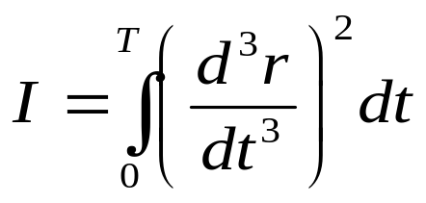
Neuromorph Movement Control:
Optimization techniques in motor control
www.itk.ppke.hu
The minimum jerk model
The redundancy problem and multi-joint limb movements
Redundancy: the number of participating joints are higher than necessary to execute an intended movement and there are many combinations of muscle activities and joint rotations to execute the given motor task.
One of the most commonly used method to solve the redundancy problem is to find the minimum jerk trajectory by minimizing:
where r is the endpoint position as function of time.
Notes:
TÁMOP – 4.1.2-08/2/A/KMR-2009-0006

Slide 8
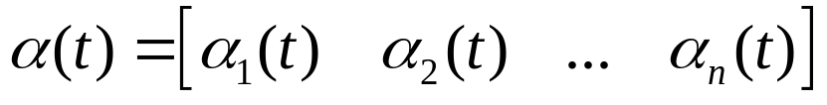

Neuromorph Movement Control:
Optimization techniques in motor control
www.itk.ppke.hu
The minimum jerk model
Due to the minimum jerk model:
The trajectory of the movement should be as smooth as possible
Given the following joint configuration vector:
(n-dimensional vector of joint angles where n is the number of joints)
It was shown: the Jacobian represents the relation between the change of joint configuration and change of endpoint position.
The velocity of the endpoint is calculated:
Notes:
TÁMOP – 4.1.2-08/2/A/KMR-2009-0006

Slide 9
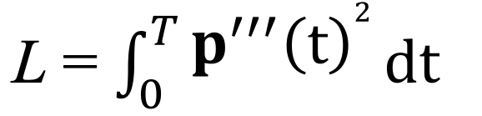

Smoothness of hand movements
endpoint position: p(t) = [p_{x}(t), p_{y}(t)]
Integral of squared jerk (total endpoint jerk) characterizes the smoothness
How does the total endpoint jerk depend on joint angular velocities, accelerations and jerks and on arm configuration?

Slide 10
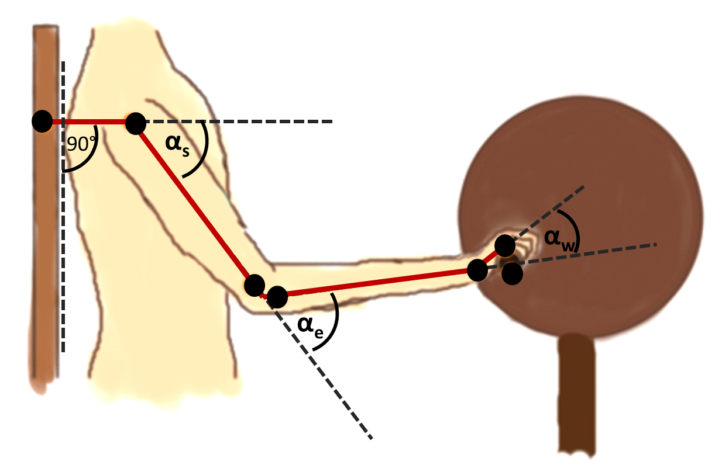
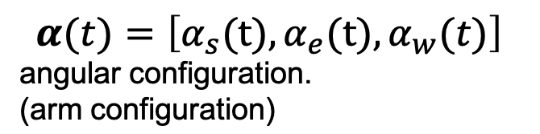

Relation of endpoint velocity and joint angular velocity
p(t) = [p_{x}(t), p_{y}(t)]
hand position
[p_{x,} p_{y}]
J
s=sin; c=cos

Slide 11
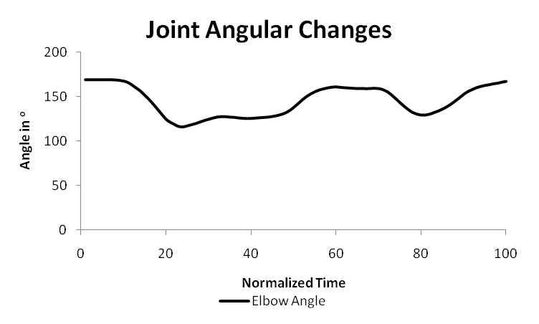
Neuromorph Movement Control:
Optimization techniques in motor control
www.itk.ppke.hu
The minimum jerk model – Data processing
(handling of time derivatives)
Joint angular changes
TÁMOP – 4.1.2-08/2/A/KMR-2009-0006
Notes:
TÁMOP – 4.1.2-08/2/A/KMR-2009-0006

Slide 12
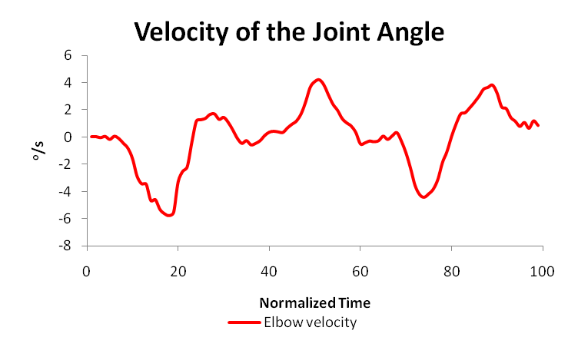
Neuromorph Movement Control:
Optimization techniques in motor control
www.itk.ppke.hu
The minimum jerk model – Data processing
(handling of time derivatives)
1st time derivative of joint angle
Noise ( ) is increasing with time derivatives
Methods reducing noise: RMS, moving avarage
Notes:
TÁMOP – 4.1.2-08/2/A/KMR-2009-0006

Slide 13
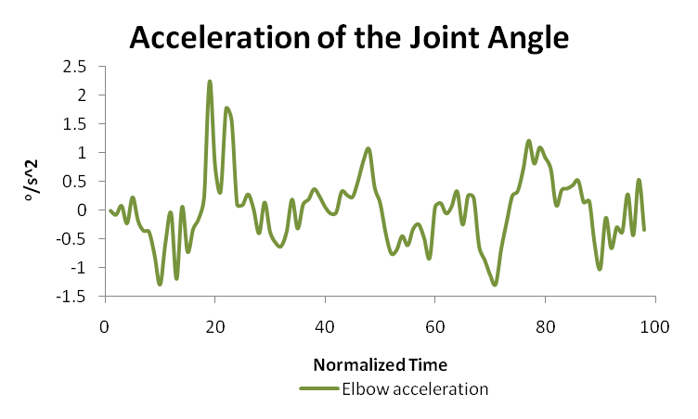
Neuromorph Movement Control:
Optimization techniques in motor control
www.itk.ppke.hu
The minimum jerk model – Data processing (handling of time derivatives)
2nd time drivatives of the joint angle presented in the previous slide (increasing noise)
Methods reducing noise: RMS, moving avarage
TÁMOP – 4.1.2-08/2/A/KMR-2009-0006
Notes:
TÁMOP – 4.1.2-08/2/A/KMR-2009-0006

Slide 14
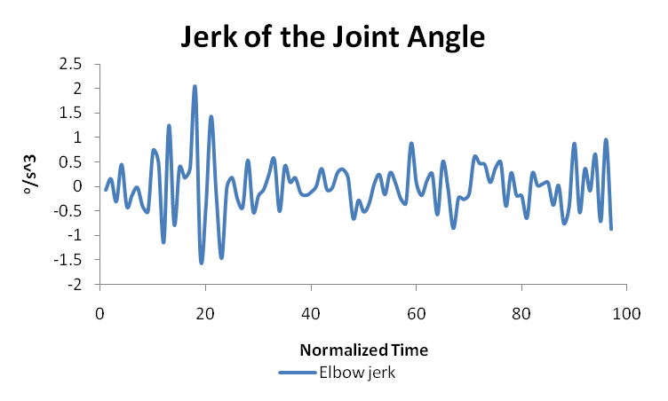
Neuromorph Movement Control:
Optimization techniques in motor control
www.itk.ppke.hu
The minimum jerk model – Data processing (handling of time derivatives)
3rd time drivatives of the joint angle presented in the previous slide (increasing noise)
Methods reducing noise: RMS, moving avarage
TÁMOP – 4.1.2-08/2/A/KMR-2009-0006
Notes:
TÁMOP – 4.1.2-08/2/A/KMR-2009-0006

Slide 15

Neuromorph Movement Control:
Optimization techniques in motor control
www.itk.ppke.hu
The minimum jerk model
Within all possible trajectories we have to choose the smoothest one by minimizing:
After minimizing this integral: (jerk computation and summation) the minimum jerk trajectory will be a straight line and the velocity and accelartion profiles will depend on the initial and final velocity and accelaration of the enpoint of the limb (boundary conditions).
An example is given on the following slide for zero initial and final velocity and acceleration.
Notes:
TÁMOP – 4.1.2-08/2/A/KMR-2009-0006

Slide 16

Neuromorph Movement Control:
Optimization techniques in motor control
www.itk.ppke.hu
This is a problem of variational calculus.
We assume that the following boundary criterias are given:
P’(0) =0, P’(T)=0
P’’(0)=0, P’’(T)=0
(T is total movement time, P(t)=(x(t),y(t),z(t)) ),
Than the following (x(t),y(t),z(t)) function minimizes the C
functional given on the previous slide
Notes:
TÁMOP – 4.1.2-08/2/A/KMR-2009-0006

Slide 17
Neuromorph Movement Control:
Optimization techniques in motor control
The least square solution
If a displacement of the endpoint of an n-joint system is represented in the n-dimensional joint space than the least square solution gives that displacement that is the shortest one in joint space.
Here distance is based on a Euclidean norm of the joint space.
The least square solution gives that displacement for which the sum of the squares of the angular changes in the joints is minimal. (The length of the displacement in the joint space is minimal)
Physically this relates to minimizing rotational energy:
If the weighted sum of the squares of the angular changes is minimized assuming that the weights are the moment of inertias of the rotated body parts than the total rotational energy is minimized.
Notes:
TÁMOP – 4.1.2-08/2/A/KMR-2009-0006

Slide 18
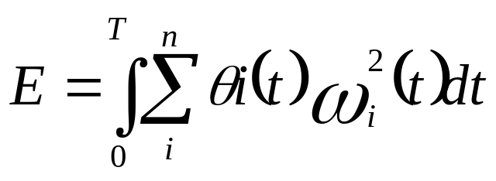
Neuromorph Movement Control:
Optimization techniques in motor control
www.itk.ppke.hu
Minimizing rotational energy for multi-joint movements.
The following cost function should be minimized:
ω_{i} is the angular velocity in the i^{th} joint,
θi is the moment of inertia of the body part rotated around the i^{th} joint,
T is movement time, n is the number of joints
Note that to find the angular velocities that satisfy this criteria, the movement time must be known in advance by the controller.
Notes:
TÁMOP – 4.1.2-08/2/A/KMR-2009-0006

Slide 19
Neuromorph Movement Control:
Optimization techniques in motor control
www.itk.ppke.hu
Minimizing other performance indices
Minimizing impulses
I = mv (impulse is the product of mass and velocity)
According to Newton’s second law F= dI/dt,
Thus impulse is the integral of force over time.
The minimal impulse solution relates to the minimal peak velocity, assuming that the mass is constant during the movement. This is the case for human movements. If the peak velocity is minimzed than the acceleration during movement excution is minimzed wich means that muscle forces and ultimately underlying neural activity is minimized
Notes:
TÁMOP – 4.1.2-08/2/A/KMR-2009-0006

Slide 20
Neuromorph Movement Control:
Optimization techniques in motor control
www.itk.ppke.hu
Equlibrium point hyphothesis
For a given neural command the muscle length changes until the muscle force and an external perturbation or load are balanced.
If the load chages than the treshold of the strech reflex (λ) is changed by the central neural command to reach a new equilibrium.
The treshold defined by the central command to the muscle relates to the muscle length at which α motoneurons are activated in response to muscle length change.
λ is considered as a measure of depolarozation of the α motoneuron membrane for the motoneuron pool sending signals to the muscle (Feldman 1986)
TÁMOP – 4.1.2-08/2/A/KMR-2009-0006
Notes:
TÁMOP – 4.1.2-08/2/A/KMR-2009-0006

Slide 21
Neuromorph Movement Control:
Optimization techniques in motor control
www.itk.ppke.hu
A change in λ can imply a muscle length change even if the muscle force is constant or a muscle force change while muscle length is constant (Latash 1998)
Equilibrium trajectory hyphothesis
Extension of the equlibrium point hyphothesis from single muscles to multijoint systems.
The CNS performs a passive simulation of a virtual trajectory of a passive movement of the endpoint of the system from one point to another one. This trajectory is defined by minimizing potential energy.
TÁMOP – 4.1.2-08/2/A/KMR-2009-0006
Notes:
TÁMOP – 4.1.2-08/2/A/KMR-2009-0006

Slide 22
Neuromorph Movement Control:
Optimization techniques in motor control
www.itk.ppke.hu
Then neural signals may adjust elastic muscle properties on that way that the movement will be performed as it was simulated inside CNS.
This can be applied for point to point (reaching) movements.
During target tracking (e.g. drawing) movement when a desired trajectory or is given by external (e.g. visual) stimuli.
According to the equilibrium trajectory hypothesis the central command is able to shift an internal image of the working point along a desired trajectory expressed in external coordinate systems
TÁMOP – 4.1.2-08/2/A/KMR-2009-0006
Notes:
TÁMOP – 4.1.2-08/2/A/KMR-2009-0006

Slide 23
Neuromorph Movement Control:
Optimization techniques in motor control
www.itk.ppke.hu
Equilibrium point hyphothesis
Muscle force
EP2
EP3
λ1
λ2
λ3
λ4
Muscle length
The central command may change muscle force
without changing muscle length by changing λ
TÁMOP – 4.1.2-08/2/A/KMR-2009-0006
Notes:
TÁMOP – 4.1.2-08/2/A/KMR-2009-0006

Slide 24
Neuromorph Movement Control:
Optimization techniques in motor control
www.itk.ppke.hu
The central command may change the threshold (λ) of the tonic stretch reflex,
As a consequence the whole force-length characteristic is shifted.
The curve of the force-length relation is invariant, it can not be changed by the central command, only the threshold of the tonic stretch reflex can be changed to control movements
The threshold of tonic stretch reflex:
The muscle length at which autogenic recruitment of α motoneurons starts firing during a muscle stretch.
L is the point of deviation of the active and passive force-length characteristic of the muscle (Latash 1993)
Notes:
TÁMOP – 4.1.2-08/2/A/KMR-2009-0006

Slide 25
Neuromorph Movement Control:
Optimization techniques in motor control
www.itk.ppke.hu
Motricity
The ability for biologically inspired active movements
(Llinas 2005).
Prediction and motricity are basic properties required for the
development of the central nervous system. Motricity takes place at
the periphery (muscular system) and spinal level as well.
Feedforward command for active movements:
to apply feedforward control the CNS must know the current state of
the musculoskeltal system and predict the desired state. The central
pattern generator produces the required active movement to reach
the desired state.
Notes:
TÁMOP – 4.1.2-08/2/A/KMR-2009-0006

Slide 26
Neuromorph Movement Control:
Optimization techniques in motor control
www.itk.ppke.hu
Motricity
Feedback control means that the controller uses the signals
received form the sensory system during movement
execution. This feedback signal modifies the central pattern.
The CNS rather generates a predicted image of an event to react
optimally if required or needed.
The joints, muscles and their abilities are inscribed in the
geometry of the neuro-musculo-skelatal system when we were born
and then we can adopt to the environment in which we grow up.
Notes:
TÁMOP – 4.1.2-08/2/A/KMR-2009-0006

Slide 27
Neuromorph Movement Control:
Optimization techniques in motor control
Summary
An intended motor task can be executed at an infinity of different ways by a multijoint system as a human limb.
It was investigated how an optimal solution can be defined and employed by neural control.
The minimal jerk optimization criteria has been presented.
The least square solution relates to optimization of rotational energy.
The equilibrium point hypothesis for muscles and its generalization the equilibrium trajectory hypothesis for multijoint movements were discussed. The latter one relates to minimization of potential energy.
Notes:
TÁMOP – 4.1.2-08/2/A/KMR-2009-0006

Slide 28
Neuromorph Movement Control:
Optimization techniques in motor control
Suggested literature
Latash ML (1993). Control of Human Movements. Chicago IL: Human Kinetics
Enoka R. Neuromechanical basis of kinesiology. Champaign IL. Human Kinetics. 1988.
Bizzi E, Mussa-Ivaldi FA, Giszter S. Computations underlying the execution of movement: a biological perspective. Science 1991;253:287-91.
Feldman AG: Once more on the equlibrium point hyphothesis (λ model) for motor control. Journal of Motor Behavior 18. pp. 17-54
Notes:
TÁMOP – 4.1.2-08/2/A/KMR-2009-0006

Slide 29
Neuromorph Movement Control:
Optimization techniques in motor control
Suggested literature
Laczko J, Jaric S, Tihanyi J, VM. Zatsiorsky & Mark L. Latash (2000) “Components of the End-Effector Jerk during Voluntary Arm Movements” Journal of Applied Biomechanics V.16. pp 14-26
Enoka R. Neuromechanics of Human movement (2002), Champaign IL. Human Kinetics, ISBN: 0-7360-0251-0
Laczkó J., Jaric S., Latash ML., Zatsiorsky VM. (1997): The relation between individual joint kinematics and the minimal jerk principle as applied to the hand during planar movements. Soc. Neurosci. Abstr. Vol 23, Part 2. p. 2089.
Notes:
TÁMOP – 4.1.2-08/2/A/KMR-2009-0006

Slide 30
Neuromorph Movement Control:
Optimization techniques in motor control
Suggested literature
Hogan N, Flash T (1987) Moving gracefully: quantitative theories of motr coordination Trends in Neurosciences, Volume 10, Issue 4, pp,170-174
Uno, Y., Kawato, M. and Suzuki, R., Formation and control of optimal trajectory in human multijoint arm movement. Minimum torque-change model, Biol Cybern, 61 (1989) 89-101.
Wada Y., Kaneko Y., Nakano E., Kawato M.,(2001),Quantitative examinations for multi joint arm trajectory planning – using a robust calculation algorithm of the minimum commanded torque change trajectory Neural Networks, Volume 14, Issues 4-5, Pp: 381-393
Notes:
TÁMOP – 4.1.2-08/2/A/KMR-2009-0006

