Slide 1







Scientific Python
Introduction
Marcell Miski 2023

Slide 2
Recommended literature
Bernd Klein: Python course
http://www.python-course.eu/
Guido van Rossum: An Introduction to Python
Guido van Rossum: Python for Unix/C Programmers
Mark Lutz: Learning Python (5th edition)
Mark Lutz: Programming Python (4th edition)
Zed A. Shaw: Learn Python - The hard way (Third edition)
https://learnpythonthehardway.org
Martin Fowler: UML distilled (3rd edition) https://dewacoding.files.wordpress.com/2017/01/uml-distilled-3rd-ed.pdf
We are going to use figures, examples from these sites and books along the entire slideshow.

Slide 3


Software environment
For Linux
For Windows
Python version 3 will be covered
For text editor you can use gedit or vim
For interactive interpreter we’ll be using iPython
https://github.com/
https://learngitbranching.js.org/
https://www.jetbrains.com/pycharm/
The group should create a GitHub project to share with me(misma2). All three people must have their own branch in addition to the main one.

Slide 4
The Zen of Python - Clearcoding
Beautiful is better than ugly.
Simple extension syntax
Consistent syntax and behaviour
Explicit is better than implicit.
No “hidden” loop variables
Use “self” to refer to object inside a method
Simple is better than complex.
Rely on garbage collection
Test statements with the interactive interpreter

Slide 5
The Zen of Python - Modules
Complex is better than complicated.
Use the right packages to solve a problem, without making your code complicated
Flat is better than nested.
Use modules from the standard library
Namespaces are flat
No need to use long module names
Sparse is better than dense.
Standard lib’s are kept small, use pip to install the rest.

Slide 6
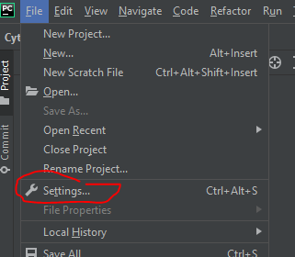

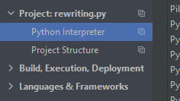


Install Modules
Use the pip program, if you don't already have it – install:
sudo apt install pip
then you can install the package
pip install <package_name>

Slide 7
The Zen of Python - Readability
Readability counts.
Whitespace for block structures
Minimal punctuation
Special cases aren't special enough to break the rules.
Everything is an object
Methods and functions differ by scope
Keep most features in external modules

Slide 8
The Zen of Python
Although practicality beats purity.
Multiple programming models (OOP, Procedural, Functional)
Errors should never pass silently.
Exception based error handling
Tracebacks aid debugging
Unless explicitly silenced.
Catch exceptions with try:except
Process / Convert / Ignore

Slide 9
The Zen of Python
In the face of ambiguity, refuse the temptation to guess.
Coarse types only when not surprising
Can not add a String to a number, but you can multiply a string
There should be one-- and preferably only one --obvious way to do it.
Eliminate redundancy
Easier to learn and remember

Slide 10
The Zen of Python
Although that way may not be obvious at first unless you're Dutch.
No comment...
Now is better than never.
Python2 vs Python3
Although never is often better than *right* now.
Language moratorium
Not everything goes into stdlib anymore

Slide 11
The Zen of Python
If the implementation is hard to explain, it's a bad idea.
If the implementation is easy to explain, it may be a good idea.
Namespaces are one honking great idea -- let's do more of those!
http://www.slideshare.net/doughellmann/an-introduction-to-the-zen-of-python

Slide 12
Why do people use Python?
Technical strengths
Roughly 1 million Python users worldwide
Main benefits
Software quality
Developer productivity
Program portability
Support libraries
Component integration
Object-Oriented and Functional
Free
Portable
Powerful
Mixable
Relatively Easy to Use
Relatively Easy to Learn

Slide 13
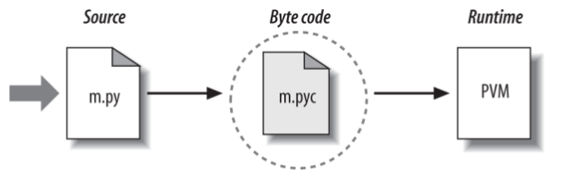
The Python Virtual Machine (PVM)
Start iPython and type: print(‘Hello World!’)

Slide 14
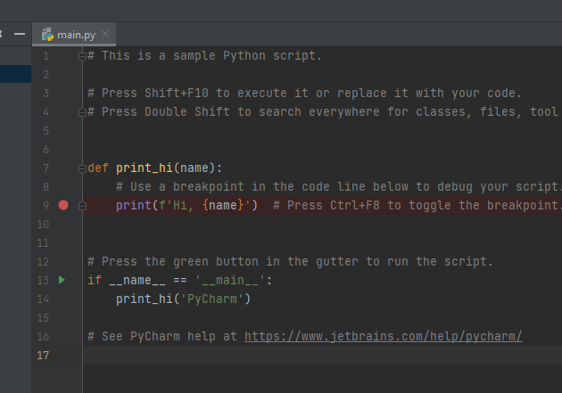
Hello World
Start create the file “hello.py” with the following content: #!/usr/bin/python print(“Hello World!”)
return 0
Give execute permission and run: $ chmod +x hello.py $ ./hello.py
File -> New Project…

Slide 15
The Python Conceptual Hierarchy
Programs are composed of modules.
Modules contain statements.
Statements contain expressions.
Expressions create and process objects.

Slide 16
Built-in objects
… make programs easy to write
… are components of extensions
… are often more efficient than custom data structures
… are a standard part of the language

Slide 17
Core Data Types
Types and examples
Numbers 123, 3.14, 3+4j, Decimal()
Strings ‘spam’, “Hello World!”
Lists [1, [2, 'three'], 4.5]
Dictionaries {'food': 'spam', 'taste': 'yum'}
Tuples (1, 'spam', 4, 'U')
Files open('eggs.txt')
Sets set('abc') , {'a', 'b', 'c'}
Other core types Booleans, types, None
Program unit types Functions, modules, classes
Implementation- Compiled code, stack tracebacks related types

Slide 18
Core Data Types: Numbers
Basics
>>> 123 + 222
345
>>> 1.5 * 4
6.0
>>> 2 ** 100
1267650600228229401496703205376
>>> import math
>>> math.pi
3.141592653589793
>>> math.sqrt(85)
9.219544457292887

Slide 19
Core Data Types: Strings
Sequence operations
>>> S = 'Spam'
>>> len(S)
4
>>> S[0] # index from the first item
'S'
>>> S[1]
'p'
>>> S[-1] # index backward
'm'
>>> S[-2]
'a'
>>> S[1:3] # range
'pa'

Slide 20
Core Data Types: Strings
>>> S[1:]
'pam'
>>> S
'Spam'
>>> S[0:3]
'Spa'
>>> S[:3]
>>> S + 'xyz' # Concatenation
'Spamxyz'
>>> S # S is unchanged
'Spam'
>>> S * 8 # Repetition
'SpamSpamSpamSpamSpamSpamSpamSpam'

Slide 21
Core Data Types: Strings
Immutability
>>> S
'Spam'
# Immutable objects cannot be changed
>>> S[0] = 'z'
(...)
TypeError: 'str' object does not support item assignment
# But we can run expressions to make new objects
>>> S = 'z' + S[1:]
>>> S
'zpam'
# A workaround?

Slide 22
Core Data Types: Strings
String manipulator methods
>>> S.find('pa')
1
>>> S.replace('pa', 'XYZ')
'SXYZm'
>>> S
'Spam'
>>> line = 'aaa,bbb,ccccc,dd'
>>> line.split(',')
['aaa', 'bbb', 'ccccc', 'dd']

Slide 23
Core Data Types: Strings
String manipulator methods
>>> S = 'spam8'
>>> S.upper()
'SPAM8'
>>> S.isalpha() >>> S.isalnum()
False True
>>> line = 'aaa,bbb,ccccc,dd\n'
# Remove whitespace characters on the right side
>>> line.rstrip()
'aaa,bbb,ccccc,dd'
# Combine two operations
>>> line.rstrip().split(',')
['aaa', 'bbb', 'ccccc', 'dd']

Slide 24
Core Data Types: Strings
String manipulator methods
>>> '%s, eggs, and %s' % ('spam', 'SPAM!')
'spam, eggs, and SPAM!' # Formatting expression (all)
>>> '{0}, eggs, and {1}'.format('spam', 'SPAM!')
'spam, eggs, and SPAM!' # Formatting method (2.6+, 3.0+)
>>> '{}, eggs, and {}'.format('spam', 'SPAM!')
'spam, eggs, and SPAM!'
>>> '{:,.2f}'.format(296999.2567)
'296,999.26'
>>> '%.2f | %+05d' % (3.14159, −42)
'3.14 | −0042'

Slide 25
Core Data Types: Strings
Regular expressions
>>> import re
>>> match = re.match('Hello[ \t]*(.*)world', 'Hello Python world')
>>> match.group(1)
'Python '
>>> match = re.match('[/:](.*)[/:](.*)[/:](.*)', '/usr/home:lumberjack')
>>> match.groups()
('usr', 'home', 'lumberjack')
>>> re.split('[/:]', '/usr/home/lumberjack')
['', 'usr', 'home', 'lumberjack']

Slide 26
Core Data Types: Lists
Sequence Operations
>>> L = [123, 'spam', 1.23]
>>> len(L)
3
>>> L[0] # Indexing by position
123
>>> L[:-1] # Slicing a list returns a new list
[123, 'spam']
>>> L + [4, 5, 6] # Concat/repeat make new lists too
[123, 'spam', 1.23, 4, 5, 6]
>>> L * 2
[123, 'spam', 1.23, 123, 'spam', 1.23]
>>> L
[123, 'spam', 1.23]

Slide 27
Core Data Types: Lists
Type-Specific Operations
>>> L.append('NI')
>>> L
[123, 'spam', 1.23, 'NI']
>>> L.pop(2)
1.23
>>> L
[123, 'spam', 'NI']
>>> M = ['bb', 'aa', 'cc']
>>> M.sort()
>>> M
['aa', 'bb', 'cc']
>>> M.reverse()
>>> M
['cc', 'bb', 'aa']

Slide 28
Core Data Types: Lists
Nesting
>>> M = [[1, 2, 3],
[4, 5, 6],
[7, 8, 9]]
>>> M
[[1, 2, 3], [4, 5, 6], [7, 8, 9]]
>>> M[1]
[4, 5, 6]
>>> M[1][2]
6

Slide 29
Core Data Types: Lists
Comprehensions
A powerful way to process structures.
>>> M
[[1, 2, 3], [4, 5, 6], [7, 8, 9]]
>>> col2 = [row[1] for row in M]
>>> col2
[2, 5, 8]
# Add 1 to each item in column 2
>>> [row[1] + 1 for row in M]
[3, 6, 9]

Slide 30
Core Data Types: Lists
Comprehensions
# Filter out odd items
>>> [row[1] for row in M if row[1] % 2 == 0]
[2, 8]
# Collect a diagonal from matrix
>>> diag = [M[i][i] for i in [0, 1, 2]]
>>> diag
[1, 5, 9]
# Repeat characters in a string
>>> doubles = [c * 2 for c in 'spam']
>>> doubles
['ss', 'pp', 'aa', 'mm']

Slide 31
Core Data Types: Lists
Comprehensions
# 0..3 (list() required in 3.X)
>>> list(range(4))
[0, 1, 2, 3]
# −6 to +6 by 2 (need list() in 3.X)
>>> list(range(−6, 7, 2))
[−6, −4, −2, 0, 2, 4, 6]
# Multiple values
>>> [[x ** 2, x ** 3] for x in range(4)]
[[0, 0], [1, 1], [4, 8], [9, 27]]

Slide 32
Core Data Types: Dictionaries
“And now for something completely different...”
Not sequences, instead mappings
Key - value pairs
Relative position doesn’t matter
Mutable (may be changed in place)
Can grow and shrink on demand

Slide 33
Core Data Types: Dictionaries
Mapping Operations
>>> D = {'food': 'Spam', 'quantity': 4}
>>> D['food']
'Spam'
>>> D['quantity'] += 1
>>> D
{'food': 'Spam', 'quantity': 5}
>>> D = {}
>>> D['name'] = 'Bob'
>>> D['job'] = 'dev'

Slide 34
Core Data Types: Dictionaries
Nesting
>>> rec = {'name': {'first': 'Bob', 'last': 'Smith'},
'jobs': ['dev', 'mgr'],
'age': 40.5}
>>> rec['name']
{'last': 'Smith', 'first': 'Bob'}
>>> rec['name']['last']
'Smith'

Slide 35
Core Data Types: Tuples
A list, that can not be changed.
Pronounced “toople” or “tuhple,”
Sequences, like lists, but they are immutable, like strings
Used to represent fixed collections of items
Have type-specific callable methods, but not as many as lists have
Support mixed types and nesting, but they don’t grow and shrink because they are immutable

Slide 36
Core Data Types: Tuples
A list, that can not be changed.
>>> T = (1, 2, 3, 4)
>>> len(T)
4
>>> T[0]
1
>>> T.index(4)
3
# Tuples are immutable
>>> T[0] = 2
TypeError: 'tuple' object does not support item assignment

Slide 37
Core Data Types: Files
# Make a new file in output mode ('w' is write)
>>> f = open('data.txt', 'w')
# Write strings of characters to it
>>> f.write('Hello\n')
6
# Return number of items written in Python 3.X
>>> f.write('world\n')
6
# Close to flush output buffers to disk
>>> f.close()

Slide 38
Core Data Types: Files
# 'r' (read) is the default processing mode
>>> f = open('data.txt')
# Read entire file into a string
>>> text = f.read()
>>> text
'Hello\nworld\n'
# print interprets control characters
>>> print(text)
Hello
world
# File content is always a string
>>> text.split()
['Hello', 'world']

Slide 39
Core Data Types: Files JSON
import json
# 'r' (read) JSON file into a Dictionary
with open(file) as f: data = json.load(f) f.close()
with open('filename.json', 'w') as outfile: outfile.write(json.dumps(newdata1, indent=4, sort_keys=True)) outfile.close()

Slide 40
Dynamic Typing
Variables, Objects, and References
Variable creation
when your code first assigns it a value
initial assignments make variables
Variable name
has no type information or constraints associated with it
they always simply refer to a particular object at a particular point in time
Variable use
When a variable appears in an expression, it is immediately replaced with the object that it currently refers to, whatever that may be
referencing unassigned variables results in errors

Slide 41
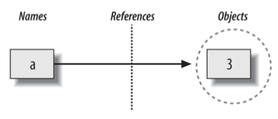
Dynamic Typing
>>> a = 3 # Assign a name to an object
Python will perform three distinct steps to carry out the request. These steps reflect the operation of all assignments in the Python language:
1. Create an object to represent the value 3 .
2. Create the variable a , if it does not yet exist.
3. Link the variable a to the new object 3.

Slide 42
Dynamic Typing
Python automatically follows the variable-to-object links:
Variables are entries in a system table, with spaces for links to objects.
Objects are pieces of allocated memory, with enough space to represent the values for which they stand.
References are automatically followed pointers from variables to objects.

Slide 43
Dynamic Typing
>>> a = 3 # It's an integer
>>> a = 'spam' # Now it's a string
>>> a = 1.23 # Now it's a floating point
Names have no types, types live with objects, not names
We haven’t actually changed the type of the variable “a”
We’ve simply made the variable reference a different type of object
Objects, know what type they are

Slide 44
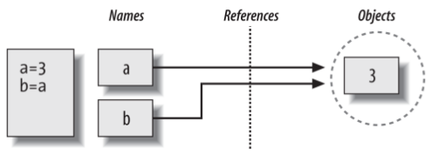
Dynamic Typing
Objects Are Garbage-Collected
Whenever a name is assigned to a new object, the space held by the prior object is reclaimed if it is not referenced by any other name or object
Shared references
>>> a = 3
>>> b = a

Slide 45
Dynamic Typing
>>> A = 8
>>> B = A
>>> B = 6
>>> A
8
Initially, variables A and B shares the same object (holding the 8), but
two names are never linked together in Python
When 6 gets assigned to variable B a new object is created, and linked to variable B
Thus, setting B to a different object has no effect on A

