Slide 1







Scientific Python
Scopes,Memoization, Exception handling
Marcell Miski 2023

Slide 2
Recommended literature
Bernd Klein: Python course
http://www.python-course.eu/
Guido van Rossum: An Introduction to Python
Guido van Rossum: Python for Unix/C Programmers
Mark Lutz: Learning Python (5th edition)
Mark Lutz: Programming Python (4th edition)
Zed A. Shaw: Learn Python - The hard way (Third edition)
https://learnpythonthehardway.org
Martin Fowler: UML distilled (3rd edition) https://dewacoding.files.wordpress.com/2017/01/uml-distilled-3rd-ed.pdf
We are going to use figures, examples from these sites and books along the entire slideshow.

Slide 3
Jumping forward
The omitted topics
Statements basics
Assignments, Expressions, Prints
if Statements
while and for Loops
Iterations and Comprehensions
Python Documentation
Function basics
(see recommended literature)

Slide 4
Why to use Scopes?
Scopes help prevent name clashes across your program’s code: names defined in one program unit don’t interfere with names in another
When you use a name in a program, Python creates, changes, or looks up the name in what is known as a namespace
The location of a name’s assignment in your source code determines the scope of the name’s visibility to your code

Slide 5
Functions as an extra namespace layer
The place where you assign a name in your source code determines the namespace it will live in, and hence its scope of visibility
Functions add an extra namespace layer to your programs to minimize the potential for collisions among variables of the same name
Names assigned inside a def can only be seen by the code within that def
Names assigned inside a def do not clash with variables outside the def

Slide 6
Types of Scopes
1. The enclosing module is a global scope
Global variables become attributes of a module object to the outside world after imports
Can also be used as simple variables within the module file itself.
The global scope spans a single file only
Names at the top level of a file are global to code within that single file only
You must always import a module explicitly
Assigned names are local unless declared global or nonlocal
local: function scope
nonlocal: enclosing function scope
global: module scope
Each call to a function creates a new local scope
each def statement (and lambda expression) defines a new local scope, but the local scope actually corresponds to a function call
Recursive function: each active call receives its own copy of the function’s local variables

Slide 7
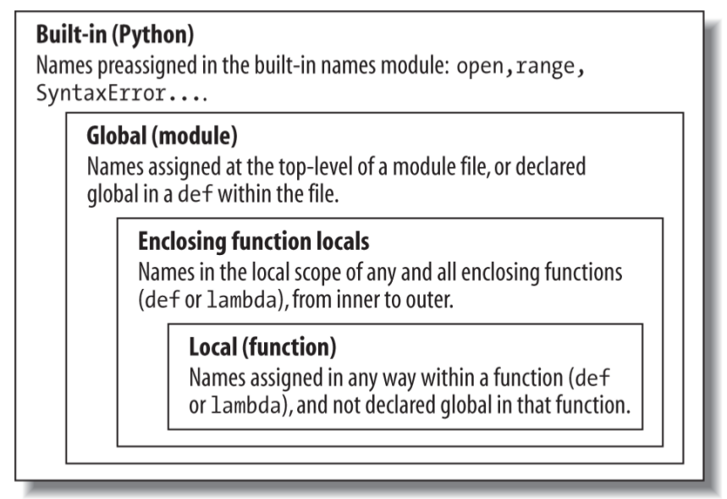
Lexical Scoping
Lexical scoping: variable scopes are determined by the loaction, not by function calls
If a variable is assigned inside a def, it is local to that function.
If a variable is assigned in an enclosing def, it is nonlocal to nested functions.
If a variable is assigned outside all def’s, it is global to the entire file.
Overuse of globals is a generally bad thing

Slide 8
Example:
#!/usr/bin/python3 #For Linux only x = 0
def outer(): x = 1
def inner(): nonlocal x x = 2
def innermost(): global x x = 3
innermost()
inner() print('outer\t', x) outer() print('global\t', x)
An example
Crerate a file named i.e. scopes.py
And run:
./scopes.py
outer 2
global 3

Slide 9
Memoization
Based on the Latin word memorandum, meaning "to be remembered"
A technique used in computing to speed up programs: memorizing the calculation results of processed input such as the results of function calls
If the same input or a function call with the same parameters is used, the previously stored results can be used again and unnecessary calculation are avoided

Slide 10
Memoization with Decorators
Memoization can be explicitly coded by the programmer, i.e. using a simple array for storing the results, but Python provides mechanisms to automatically memoize functions
We will use decorators to implement memoization
We can use a decorator for the same purpose
@memoize
def fib(n):
if n == 0:
(...)

Slide 11
Memoization example – fibonacci- explicitly
#!/usr/bin/python3 def memoize(f): memo = {} def helper(x): if x not in memo: memo[x] = f(x) return memo[x] return helper
def fib(n): if n == 0: return 0 elif n == 1: return 1 else: return fib(n-1) + fib(n-2) fib = memoize(fib) print(fib(30))
There is no other way anymore to call the original fib directly: the code of the original fib function can from now on only be reached via the "f" function of the helper function
After having executed fib = memoize(fib) fib points to the body of the helper function, which had been returned by memoize

Slide 12
Exception handling
Exceptions can modify the flow of control though a program
In Python, exceptions are triggered automatically on errors, and they can be triggered and intercepted by your code

Slide 13
Exception handling- keywords
try / except
Catch and recover from exceptions raised by Python, or by you.
try / finally
Perform cleanup actions, whether exceptions occur or not.
raise
Trigger an exception manually in your code.
assert
Conditionally trigger an exception in your code.
with / as
Implement context managers

Slide 14
Example 1: Index Error
>>> def fetcher(obj, index):
return obj[index]
>>> x = 'spam'
>>> try:
fetcher(x, 4)
except IndexError:
print('got exception')
got exception

Slide 15
Example 2: continuing
>>> def catcher():
try:
fetcher(x, 4)
except IndexError:
print('got exception')
print('continuing')
>>> catcher()
got exception
continuing
>>>

Slide 16
Example 3: Raising exceptions
>>> try:
... raise IndexError
... except IndexError:
... print('got exception')
...
got exception
>>>

Slide 17
Example 4: User defined exceptions
>>> class AlreadyGotOne(Exception): pass
>>> def grail():
raise AlreadyGotOne()
>>> try:
... grail()
... except AlreadyGotOne:
... print('got exception')
...
got exception

Slide 18
Example 5: Termination actions
>>> try:
... fetcher(x, 3)
... finally:
... print('after fetch')
...
'm'
after fetch
>>>

Slide 19
Example 5: Termination actions
>>> def after():
try:
fetcher(x, 3)
finally:
print('after fetch')
print('after try?')
>>> after()
after fetch
after try?
>>>

Slide 20
try Statement Clauses
except:
Catch all (or all other) exception types.
except name:
Catch a specific exception only.
except name as value:
Catch the listed exception and assign its instance.
except (name1, name2):
Catch any of the listed exceptions.
except (name1, name2) as value:
Catch any listed exception and assign its instance.
try … else:
Run if no exceptions are raised in the try block.
try … finally:
Always perform this block on exit.

Slide 21
Example 6: except … as … raise
>>> try:
... 1 / 0
... except Exception as E:
... raise TypeError('A bad thing happend') from E
Direct cause: ZeroDivisionError: division by zero
Resulted exception: TypeError: A bad thing happend

Slide 22
Exception handling - assertion
The assert Statement
Can be thought of as a conditional raise statement
assert test, data # data is optional
Works like the following code:
if __debug__:
if not test:
raise AssertionError(data)
If the test evaluates to False, Python raises an exception
Like all exceptions, AssertionError exception will kill your program, if it’s not caught

Slide 23
Example: Assertion
asserter.py
def f(x):
assert x < 0, 'x must be negative'
return x ** 2
>>> import asserter
>>> asserter.f(1)
(...)
AssertionError: x must be negative

Slide 24
With/as
An alternative to a common try / finally usage idiom
Intended for specifying termination-time or
“cleanup” activities
Handles entry actions, can reduce code size, and allows code contexts to be managed with full OOP
Built-in tools with context managers:
Files that automatically close themselves
Thread locks that automatically lock and unlock
Programmers can code context managers of their own
with/as Context Managers: Basic usage
with expression [as variable]:
with-block
The expression here is assumed to return an object that supports the context management protocol
The object may also return a value that will be assigned to the name variable if the optional as clause is present
The object returned by the expression may run startup code before the with-block is started, as well as termination code after the block is done, regardless of whether the block raised an exception or not.

Slide 25
with/as Context Managers: Built-in example
with open(r'C:\misc\data') as myfile:
for line in myfile:
print(line)
myfile = open(r'C:\misc\data')
try:
for line in myfile:
print(line)
finally:
myfile.close()
These snippets are identical

Slide 26
with/as Context Managers: How it works?
The expression is evaluated, resulting in an object known as a context manager that must have __enter__ and __exit__ methods.
The context manager’s __enter__ method is called. The value it returns is assigned to the variable in the as clause if present, or simply discarded otherwise.
The code in the nested with block is executed.

Slide 27
with/as Context Managers: How it works?
4. If the with block raises an exception, the __exit__(type, value, traceback) method is called with the exception details. If this method returns a false value, the exception is reraised; otherwise, the exception is terminated. The exception should normally be reraised so that it is propagated outside the with statement.
5. If the with block does not raise an exception, the __exit__ method is still called, but its type , value , and traceback arguments are all passed in as None.

Slide 28
Example with/as – the class
class TraceBlock: def message(self, arg): print('running ' + arg) def __enter__(self): print('starting with block') return self def __exit__(self, exc_type, exc_value, exc_tb): if exc_type is None: print('exited normally\n') else: print('raise an exception! ' + str(exc_type)) return False # Propagate

Slide 29
Example: with/as - the main
if __name__ == '__main__': with TraceBlock() as action: action.message('test 1') print('reached') with TraceBlock() as action: action.message('test 2') raise TypeError print('not reached')

