Slide 1
COMPUTER NETWORKS MINI-PROJECT
Distributed Backup System Using TCP Socket Programming and SDN
Reliable file backup over a Mininet network controlled by a Ryu OpenFlow controller
Anubhav · Arush · Aryan
PES University · Computer Networks
github.com/acrticsludge/CN-Mini
Notes:
Introduce the team and the project in one sentence: a TCP-based backup application running over an SDN where a Ryu controller computes paths with Dijkstra and reroutes on link failure. Rubric: sets up A (problem/architecture).

Slide 2
Overall System Architecture
Ryu controller (OpenFlow 1.3)
Communication flow
Client (h1/h2) opens TCP to server h3, then h4 on failover
DATA frames go to the server; ACK frames come back
Ryu discovers topology (LLDP), installs flows, reacts to port-status events
Flask dashboard (:5000) shows topology and transfers via REST + WebSocket
h1
client
s1
s2
h3
server
h2
client
s3
s4
h4
server
data plane (TCP :9000)
control plane (all 4 switches)
Source: docs/architecture.md (host-to-switch attachment read from its diagram) · Evidence: documented
Notes:
Rubric A and D. Solid cyan lines are the data plane carrying TCP. Dashed violet lines are the OpenFlow control plane. Point out the controller never touches file data. The Flask dashboard is a monitoring layer, not part of the transfer path.

Slide 3
Main Problems to overcome
WHAT GOES WRONG
WHAT WE BUILT
Data corruption
CRC32 per 8 KB chunk
Bits flip in transit or on disk
Server verifies and ACKs each chunk
Interrupted transfers
RESUME from last ACKed chunk
Connection drops mid-file; restart wastes work
Client + server track progress
Network link failure
Dijkstra rerouting in Ryu
Path disappears; traffic black-holes
Port-down event triggers new flow rules
Notes:
Rubric A. Walk left to right: each problem maps to one mechanism. Stress that the system tolerates three failure types: corruption, interrupted transfer, and network link failure, each handled at a different layer.

Slide 4
TCP Socket Programming
Client (h1)
Server (h3:9000)
Socket flow (confirm in source)
Server: socket, bind :9000, listen, accept; one thread per client
Client: socket, connect, send/recv
connect() / accept(): 3-way handshake
HELLO (filename, size)
ACK (ready)
DATA chunk i + CRC32
ACK (i)
TCP ACK is not an app ACK
TCP ACK: kernel received the bytes
App ACK (0x02): chunk passed CRC32 and was stored
Only the app ACK drives RESUME
connection drops
RESUME (last_ack)
ACK (resume from i+1)
close(): FIN exchange
Notes:
Rubric B. Walk the sequence top to bottom. Key viva point: a TCP ACK only means bytes reached the peer's kernel buffer. Our application ACK means the chunk passed CRC32 and was stored. We did not retrieve the source files, so open client.py and server.py and show the actual socket calls live.

Slide 5
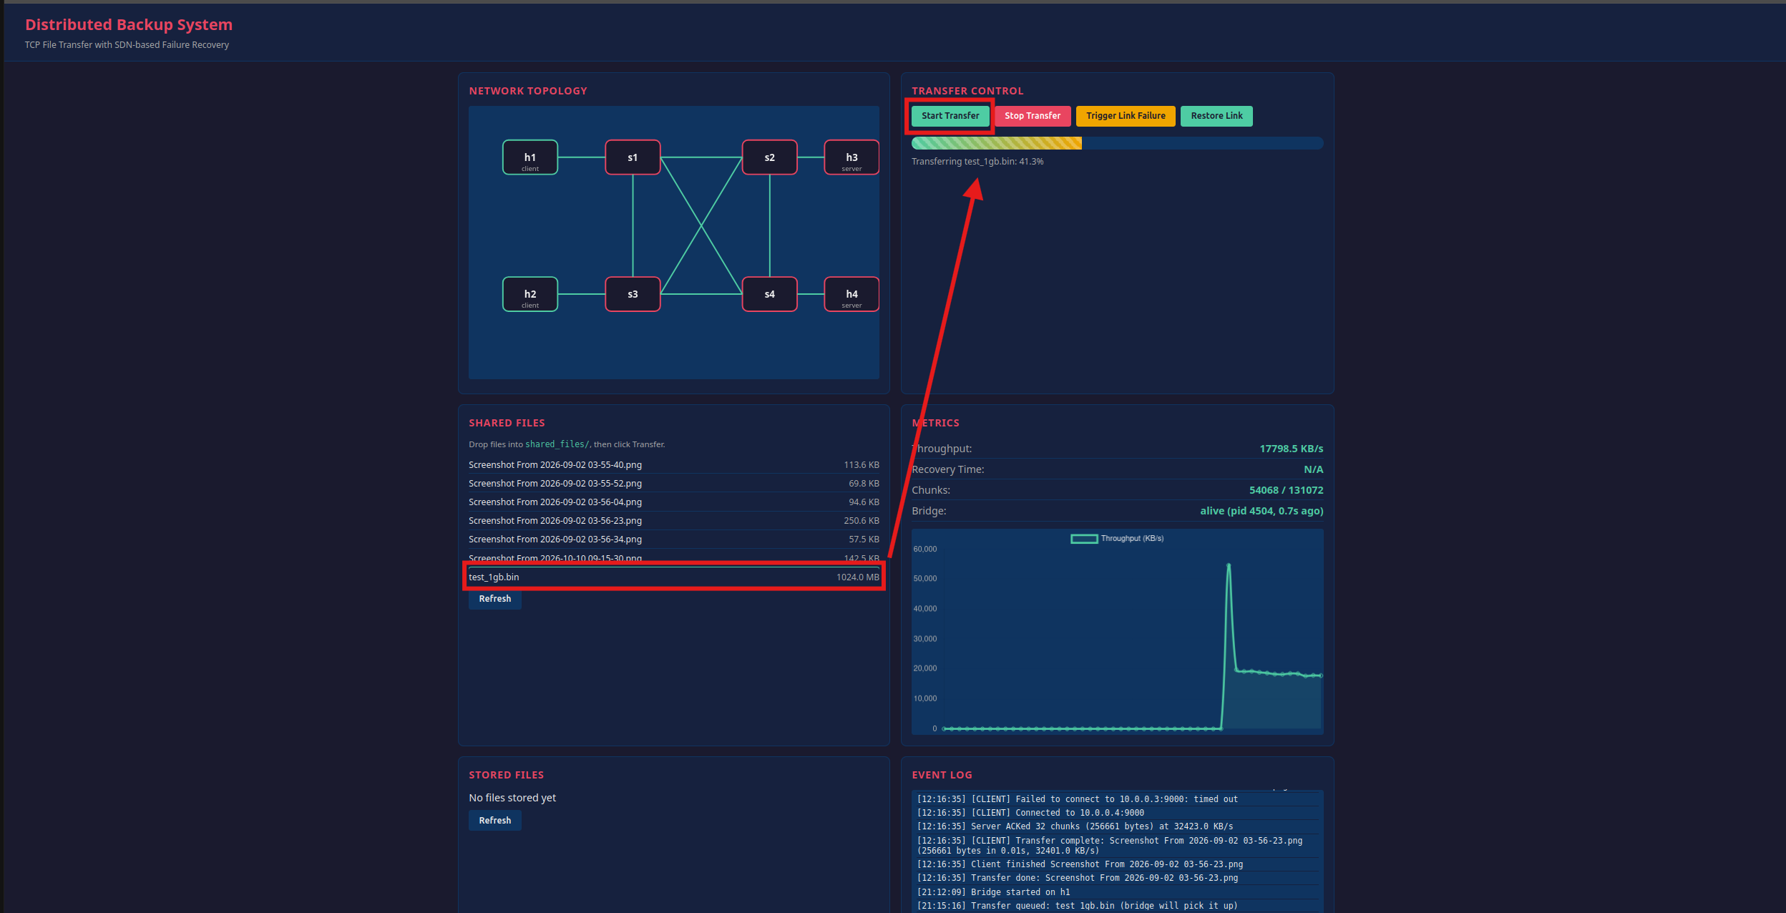
Notes:
Rubric B. Walk the sequence top to bottom. Key viva point: a TCP ACK only means bytes reached the peer's kernel buffer. Our application ACK means the chunk passed CRC32 and was stored. We did not retrieve the source files, so open client.py and server.py and show the actual socket calls live.

Slide 6
File Backup Protocol and Integrity
magic
4 B
type
1 B
index
4 B
total_chunks
4 B
CRC32
4 B
data_len
4 B
payload
up to 8 KB
1024 MB file
1,31,072 × 8 KB chunks
CRC32 per chunk
(zlib.crc32)
DATA frame
over TCP
Server recomputes
CRC32
Write to disk,
send ACK(i)
Message types
CRC32: limits
Persistence + resume
0x01 DATA
0x02 ACK
0x03 RESUME
0x04 HELLO
Detects accidental corruption
Not authentication; cannot stop deliberate tampering
Server tracks last ACKed chunk
/tmp/backup bind-mounted to stored_files/h3, h4
Notes:
Rubric B and F. Explain the 21-byte header, then the pipeline. State clearly that CRC32 catches accidental errors only. Persistence works because server hosts bind-mount /tmp/backup to stored_files on the host disk.

Slide 7
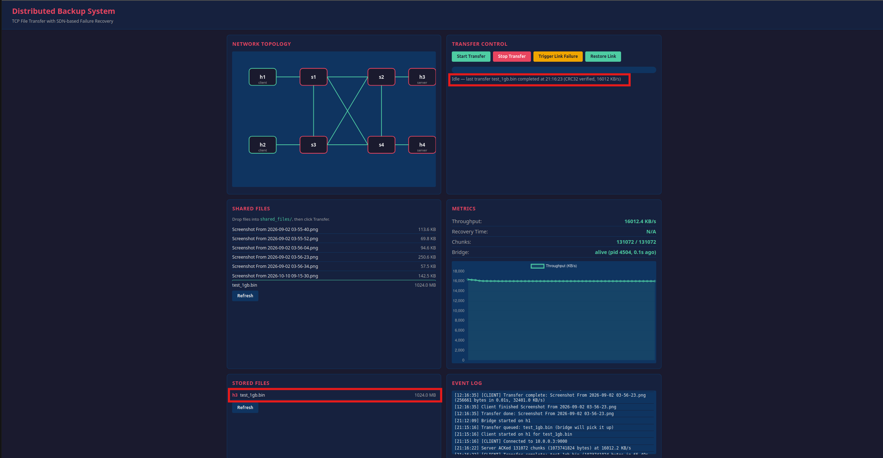
Notes:
Rubric B and F. Explain the 21-byte header, then the pipeline. State clearly that CRC32 catches accidental errors only. Persistence works because server hosts bind-mount /tmp/backup to stored_files on the host disk.

Slide 8
Mininet Topology and SDN Controller
Mininet (mininet/topology.py)
Ryu (controller/sdn_controller.py)
4 OVS switches, full mesh: 6 inter-switch links
h1, h2 = clients; h3, h4 = servers
Remote controller, OpenFlow 1.3
Backup dirs bind-mounted for persistence
Topology discovery via LLDP
Dijkstra shortest path
Flow rules installed on switches
Port-status handling; flow stats every 5 s
sudo python mininet/topology.py # T1: network
ryu-manager controller/sdn_controller.py # T2: controller
mininet> pingall # connectivity
mininet> sh ovs-ofctl -O OpenFlow13 dump-flows s1
Notes:
Rubric C. The topology is the one from the repo: four OVS switches in a full mesh, so six switch-to-switch links, and four hosts. Verify connectivity with pingall, and show flows with ovs-ofctl dump-flows.

Slide 9
Dynamic Routing and Failure Recovery
BEFORE: all links up
AFTER: s1–s2 down
✕
h1
s1
s2
h3
h1
s1
s2
h3
s3
s4
s3
s4
Port goes down
OFPPortStatus to Ryu
Edge removed from graph
Dijkstra recompute
New flow rules to switches
Illustrative: assumes hop-count weights; the alternate may run via s3 or s4. Confirm in controller log. Limitation: a static flow table would not recompute.
Notes:
Rubric G, the highest-weighted. Explain Dijkstra briefly, then the event chain. Be honest: unit tests prove the graph logic, and the live behaviour must be shown with controller logs and dump-flows. Which equal-cost alternate path is chosen depends on the code, so check the log.

Slide 10
Socket–SDN Integration and End-to-End Workflow
APPLICATION LAYER (client h1 to server h3)
1 Client chunks file,
computes CRC32
2 TCP connect
to server :9000
3 Server verifies,
stores, ACKs
4 On error: RESUME
or failover to h4
NETWORK LAYER (Ryu + Open vSwitch)
Ryu installs Dijkstra
path (FlowMods)
OVS forwards frames
by flow table
Link-down raises
PortStatus event
Ryu recomputes and
reinstalls flows
No direct controller–app link
Three recovery layers
Controller never sees chunks or RESUME
Interaction happens only via the network
Network: Ryu reroutes (flow rules)
Transport: TCP retransmission
Application: RESUME / failover
Notes:
Rubric D. Key message: the controller and the application never talk to each other. They interact only through the network: the controller keeps the path alive, TCP and the app protocol deal with whatever the transfer experiences. Do not claim the controller resumes transfers.

Slide 11
Challenging Scenario: Link Failure During Backup
BEFORE
DURING
AFTER
1024 MB file, 1,31,072 × 8 KB chunks
h1 to h3 over s1–s2
Flows from Dijkstra
Link s1–s2 down mid-transfer
Mininet link down or dashboard button
PortStatus, recompute, new flows
Reported: traffic flowing.
Throughput ~14000 vs ~12500 KB/s
All chunks received
Network connectivity restored
TCP connection preserved
App-level RESUME used
File integrity verified
REPORTED: 1.3 s
UNVERIFIED: docs credit TCP retransmission
UNVERIFIED: check client log
REPORTED 128/128; run sha256sum
These four outcomes are separate achievements; do not treat them as one.
Notes:
Rubric H. Use before/during/after, then be precise on the four outcomes. The docs credit TCP retransmission for survival of the connection, but the README also says the transfer resumes. Check the client log to see whether RESUME actually fired. They are different achievements.

Slide 12
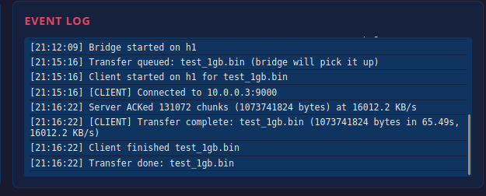
Notes:
Rubric H. Use before/during/after, then be precise on the four outcomes. The docs credit TCP retransmission for survival of the connection, but the README also says the transfer resumes. Check the client log to see whether RESUME actually fired. They are different achievements.

Slide 13
Performance Evaluation and Baseline Comparison
Recovery stage | Time
Link down to detected | 0.3 s
Detected to flows recomputed | 0.2 s
Recomputed to traffic flowing | 0.8 s
Total | 1.3 s
Dynamic vs static | Dynamic | Static
Normal (KB/s) | 842.7 | 850.3
After link failure | 1.3 s recovery | Fails (reported)
Chunk loss | 0% | 100% after failure
Setup: 4-switch mesh, Ryu + Dijkstra, 128 × 8 KB chunks. Not yet measured: larger files, packet-loss %, a throughput run for the static baseline. Static outcome is binary, so a fair rate comparison is not possible.
Notes:
Rubric I. All numbers come from docs/results.md; none are ours to invent. Failure case is about 28 percent slower than normal (612.5 vs 850.3). The static baseline is reported only as fails-after-link-down, so there is no throughput for it. Missing: larger files, packet-loss percentage, a measured static run. State this openly.

Slide 14
Testing, Results and Demonstration
Test case | Initial condition | Expected | Status
Frame pack/unpack, CRC32 (test_transfer) | Unit level | Round-trip OK; bad magic or short frame rejected | PENDING: run
16 KB and 40 KB transfer | Server listening | Received file equals original | PENDING: run
Corrupted chunk (bad CRC32) | Forged chunk | Server drops chunk | PENDING: run
Resume after 3 chunks | Partial file | Completes from chunk 3 | PENDING: run
3 concurrent clients | Threaded server | All transfers succeed | PENDING: run
Dijkstra recompute (graph only) | Edge removed, restored | Alternate path, then optimal restored | PENDING: run
pingall + dump-flows | Topology and Ryu up | All hosts reachable; flows present | NOT DOCUMENTED
Live s1–s2 down mid-transfer | 1 MB transfer | Reroute, 128/128, hash match | REPORTED: re-verify
Notes:
Rubric E and F. Run pytest on the VM before the demo and replace PENDING with the real result. Capture screenshots: pytest output, pingall, dump-flows before and after link-down, the dashboard, and sha256sum of source versus stored file. Note that the SDN unit tests check graph logic, not a live network.

Slide 15
Conclusion, Limitations and Future Scope
Demonstrates
Limitations
Future scope
TCP sockets with a custom framed protocol
CRC32 integrity, chunk ACKs, resume
Mininet + OpenFlow 1.3 + Ryu
Dijkstra rerouting on link failure
Strongest result: 1.3 s recovery, 128/128 chunks (reported)
Controller and app are decoupled
SDN unit tests are graph-level
1 MB file, 5 runs only
CRC32 only; no TLS or auth
Static baseline not measured for throughput
Redundancy is failover; replication unconfirmed
Larger files, loss % and recovery sweeps
SHA-256 + TLS
Controller REST hook for app-aware routing
Bandwidth-aware weights from flow stats
Replicate chunks to both servers
Notes:
Rubric J. Keep it evidence-based. Strongest result: reported 1.3 s recovery with 128/128 chunks after a link failure. Be upfront that several claims need the source or logs to confirm.

