Slide 1
WELCOME
IPL Power Ranking
Ranking 15 franchises with rank, projection and eigenvectors: eleven linear algebra steps from raw matches to a final table
1,243 matches | 19 seasons | 15 franchises
Anubhav Rai
Arnab Sen
Anish Alladi
Anish De
PES1UG25CS078
PES1UG25CS093
PES1UG25CS070
PES1UG25CS071
PES University | Linear Algebra project
Notes:
ANUBHAV (about 25 s)
Good morning, ma'am. We are Anubhav, Arnab, Anish Alladi and Anish De. Our project ranks IPL franchises using only linear algebra: matrices, rank, projection and eigenvectors. We will walk through eleven steps, from raw match data to a final ranking, in about ten minutes. I will start with the data and the matrix.

Slide 2
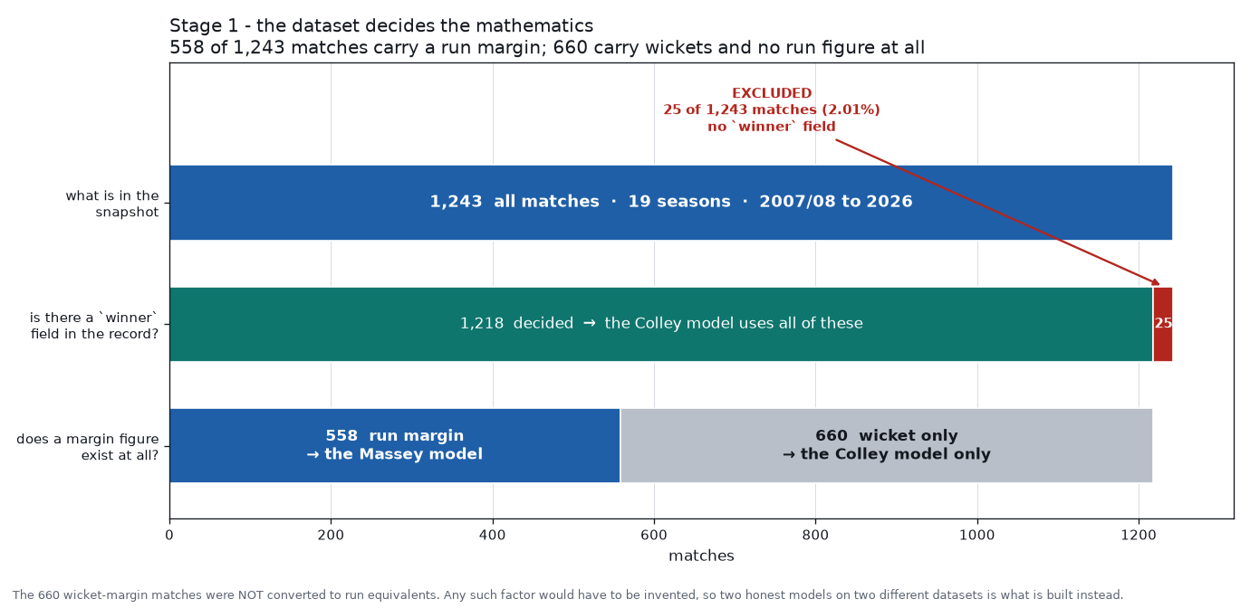
The data decides the maths
STAGE 1 | REAL-WORLD DATA
Anubhav
1,218
decided matches, used by the Colley model
558
run-margin matches, used by the Massey model
25
excluded: no winner (2.01%)
660 wicket-only matches are not converted to runs: that factor would have to be invented, so we build two honest models.
Notes:
ANUBHAV (about 40 s)
The dataset has 1,243 matches over 19 seasons. 25 have no winner, so we drop them, which leaves 1,218. Only 558 of those record a run margin. The other 660 were won by wickets and carry no run figure. We did not convert wickets into runs, because that would be invented data. So we build two models: Massey on the 558 run-margin matches, and Colley on all 1,218.

Slide 3
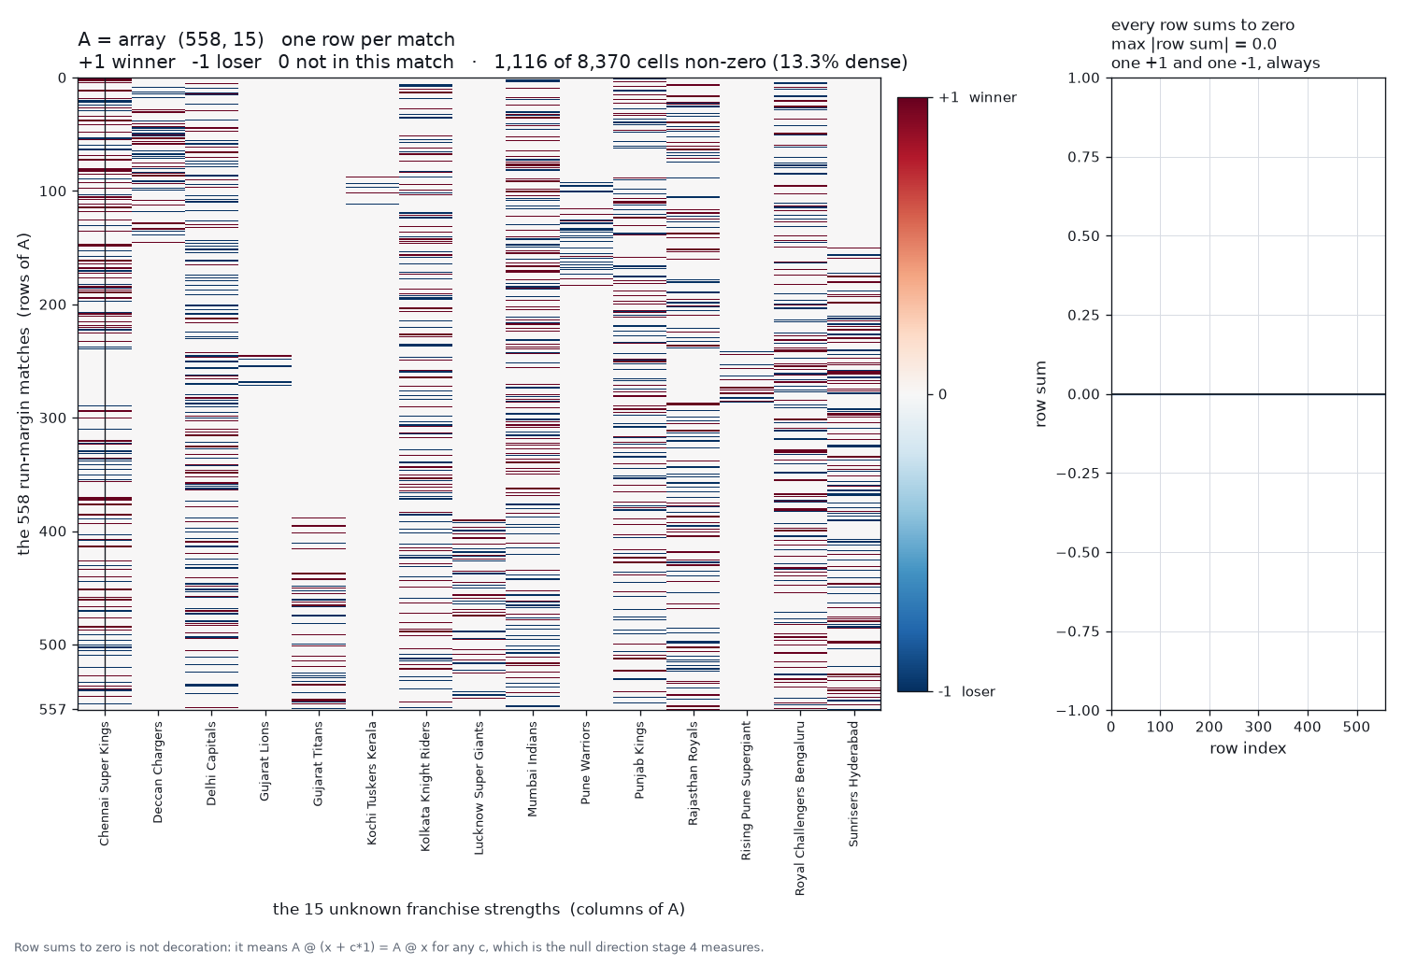
One match, one equation
STAGE 2 | MATRIX REPRESENTATION
Anubhav
558 x 15
matrix A: a row per match, a column per franchise
row sum = 0
so A times the all-ones vector is 0
Each row: +1 for the winner, -1 for the loser, 0 for the other 13 teams. We solve A x = b, where b holds the run margins and x the team strengths.
Notes:
ANUBHAV (about 40 s)
Each run-margin match becomes one equation. A has 558 rows and 15 columns, one per franchise: plus one for the winner, minus one for the loser, zero otherwise. The right-hand side b holds the run margin. We solve A x equals b for the team strengths x. Notice that every row sums to zero. That will matter in the next two steps.

Slide 4
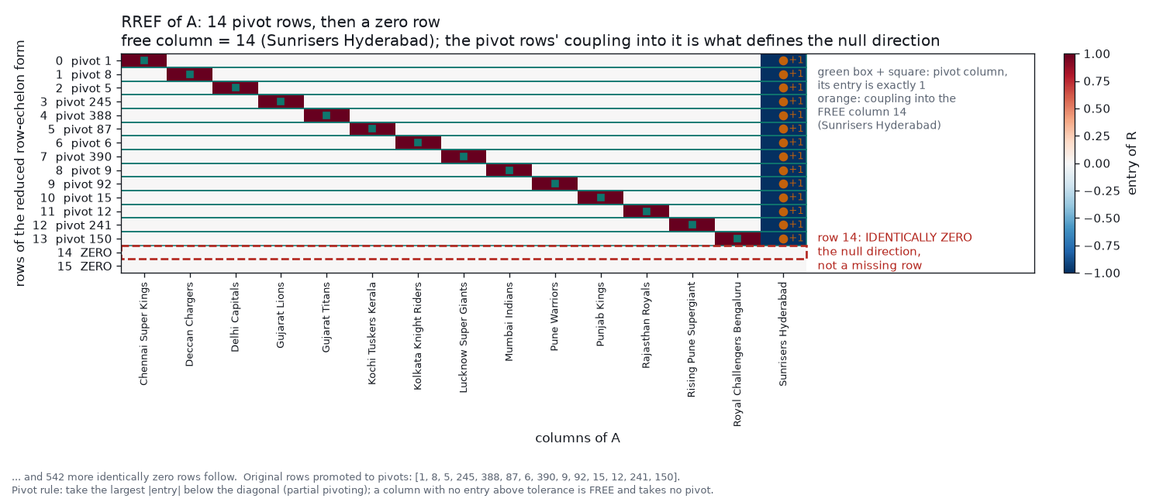
Row reduction: the pivots
STAGE 3 | MATRIX SIMPLIFICATION
Anubhav
14
pivot rows after Gauss-Jordan elimination
1
free column: Sunrisers Hyderabad, no pivot
544
rows reduce to zero
Hand-written elimination with partial pivoting. The zero row is the null direction, not a missing row.
Notes:
ANUBHAV (about 35 s)
We simplify A with Gauss-Jordan elimination, written by hand with partial pivoting. We get 14 pivot rows, and every other row reduces to zero, 544 of them. One column, Sunrisers Hyderabad, never gets a pivot. That is the free column. So A is not full rank. Arnab will take it from here.

Slide 5
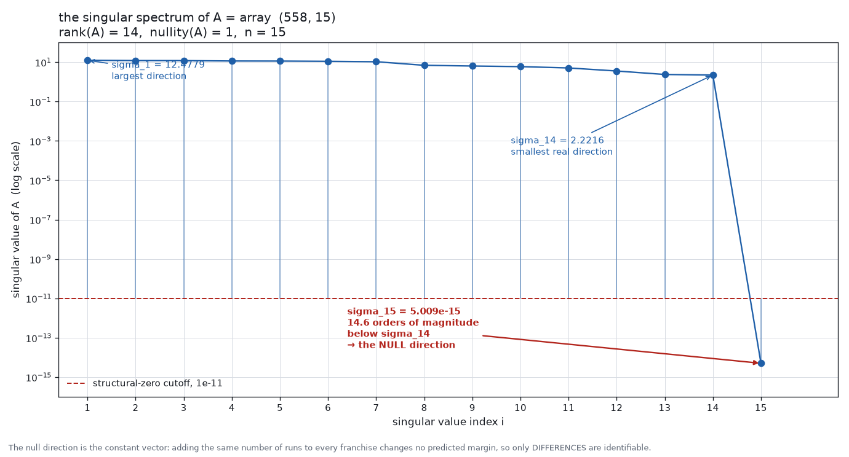
Rank 14 of 15, nullity 1
STAGE 4 | STRUCTURE OF THE SPACE
Arnab
rank 14
of n = 15 columns
nullity 1
the null vector is the all-ones vector
5.0e-15
sigma 15, 14.6 orders below sigma 14 = 2.22
Adding the same runs to every team changes no prediction, so only differences between teams are identifiable.
Notes:
ARNAB (about 40 s)
That gives rank 14 and nullity 1, out of 15 columns. The singular values confirm it: the smallest real one is 2.2, and the fifteenth is about 5 times 10 to the minus 15, fourteen orders of magnitude lower, so it is zero. The null direction is the all-ones vector, because rows sum to zero. Adding the same runs to every team changes nothing, so only differences between teams can be measured.

Slide 6
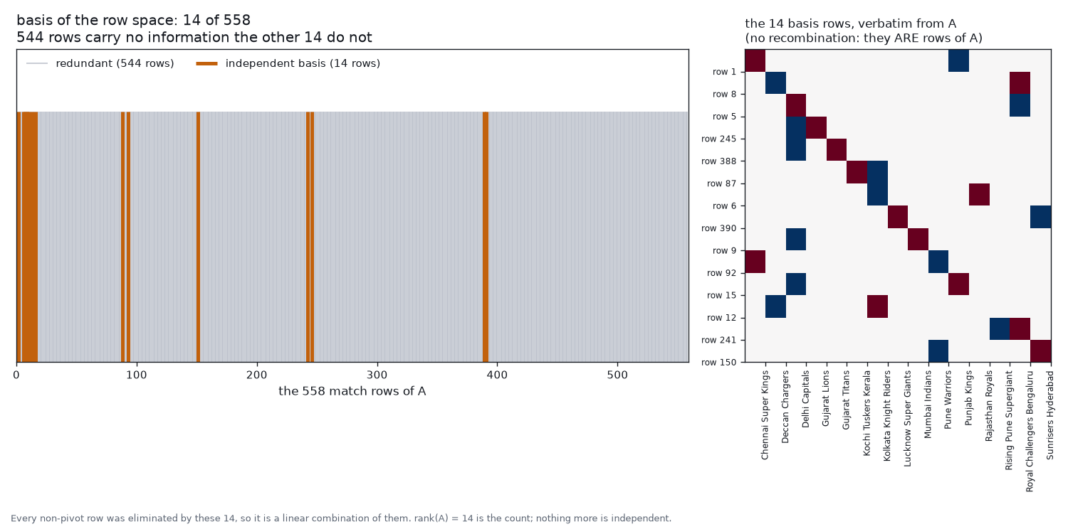
Only 14 rows matter
STAGE 5 | REMOVE REDUNDANCY
Arnab
14
linearly independent rows: the row-space basis
544
redundant rows, combinations of those 14
2.5%
of the 558 equations carry all the information
The 14 basis rows are taken verbatim from A, with no recombination.
Notes:
ARNAB (about 30 s)
Next, we remove redundancy. Of the 558 equations, only 14 are linearly independent. The other 544 are combinations of those 14 and add no new information. We keep the 14 pivot rows, taken as they are from A. That is a basis for the row space.

Slide 7
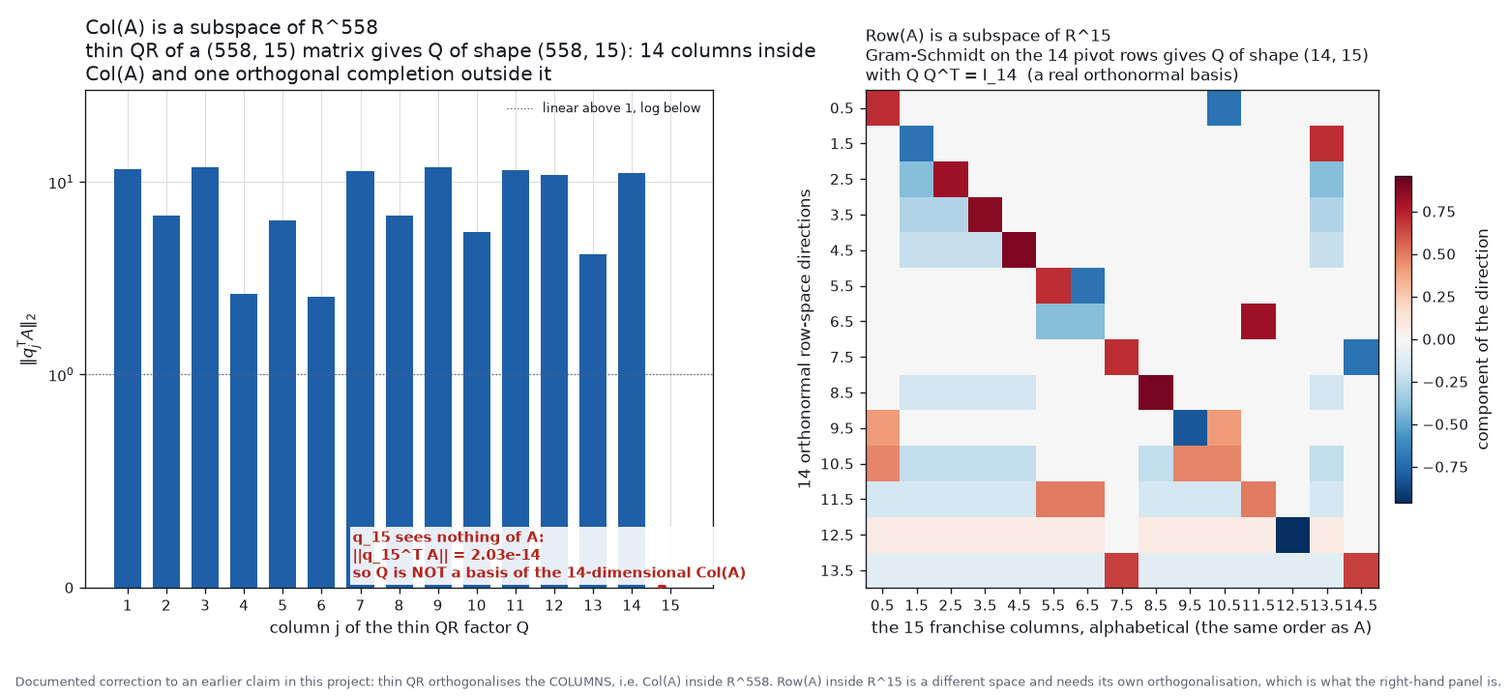
Orthonormal bases
STAGE 6 | ORTHOGONALIZATION
Arnab
14 + 1
QR columns: 14 span Col(A), 1 lies outside it
Q Q^T = I
Gram-Schmidt basis of Row(A), 14 x 15
2e-14
q15 sees nothing of A
Two different spaces: QR orthogonalises Col(A) in R^558, Gram-Schmidt orthogonalises Row(A) in R^15.
Notes:
ARNAB (about 40 s)
Now we orthogonalise, in two different spaces. The column space sits inside R to the 558. QR factorisation gives 14 orthonormal columns that span it, and a fifteenth that lies outside it. The row space sits inside R to the 15. Gram-Schmidt on the 14 pivot rows gives an orthonormal basis there, with Q times Q transpose equal to identity. We also corrected an earlier mistake of treating QR as the row-space basis.

Slide 8
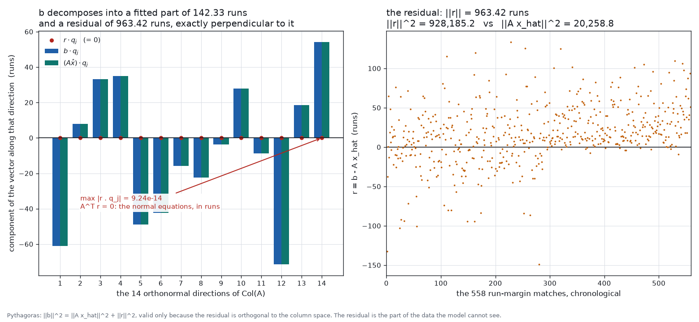
Projecting b onto Col(A)
STAGE 7 | PROJECTION
Arnab
142.33
runs: length of the fitted part, A x-hat
963.42
runs: length of the residual r
9e-14
max |r . q_j|: A^T r = 0, the normal equations
b = A x-hat + r with r perpendicular to Col(A). Pythagoras holds: 928,185 + 20,259 = ||b||^2.
Notes:
ARNAB (about 40 s)
Now we project b onto the column space. b splits into a fitted part, A x-hat, of length 142 runs, and a residual of length 963 runs. The residual is exactly perpendicular: its dot product with each of the 14 directions is zero to about 10 to the minus 13. That is the normal equations, A transpose r equals zero. And Pythagoras holds: the squared lengths 20,259 and 928,185 add up to the squared length of b. Anish Alladi will continue.

Slide 9
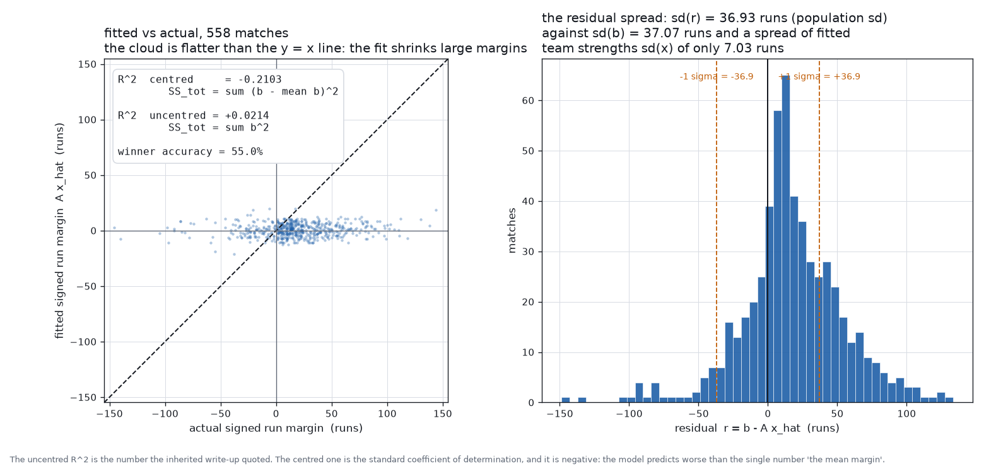
Least squares: a weak fit
STAGE 8 | PREDICTION / LEAST SQUARES
Anish A.
-0.21
centred R^2: worse than predicting the mean margin
55.0%
winner accuracy
7.0 vs 36.9
runs: spread of fitted strengths vs residual
The residual spread (36.9) is almost the whole spread of the data (37.1): the fit shrinks large margins.
Notes:
ANISH ALLADI (about 40 s)
The projection gives the least-squares solution, and three different routes agree to about 5 times 10 to the minus 14. But the fit is weak. Centred R-squared is minus 0.21, and winner accuracy is 55 percent. The residual spread, 36.9 runs, is almost the whole spread of the data, 37.1, while the fitted team strengths vary by only 7 runs. So in this model, run margins carry little team signal.

Slide 10
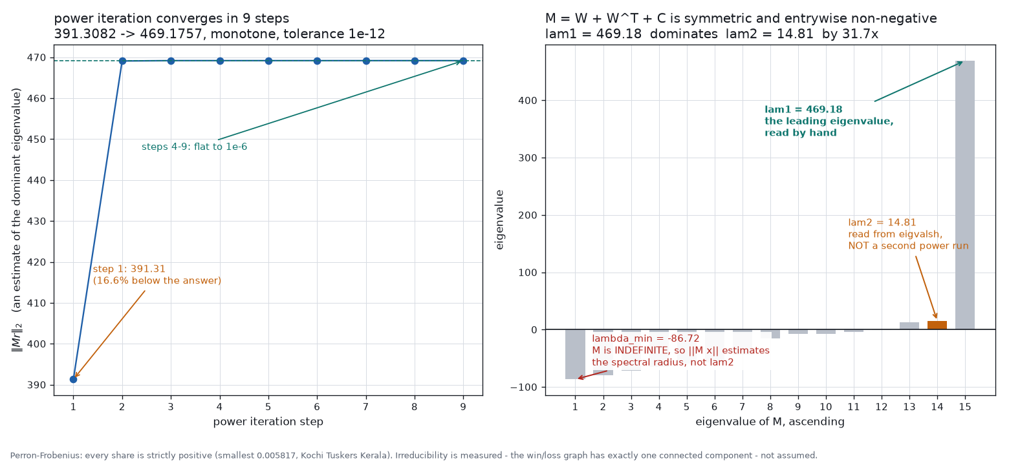
Colley: the leading eigenvector
STAGE 9 | PATTERN DISCOVERY
Anish A.
469.18
lambda 1, found by power iteration in 9 steps
31.7x
lambda 1 over lambda 2 = 14.81
> 0
every share strictly positive (Perron-Frobenius)
M = W + W^T + C is symmetric and non-negative, built from all 1,218 decided matches.
Notes:
ANISH ALLADI (about 45 s)
Second model: Colley, on all 1,218 decided matches. We form M equals W plus W transpose plus C, where W counts wins and C counts games played. M is symmetric and non-negative, so Perron-Frobenius guarantees a positive leading eigenvector. Power iteration finds it in 9 steps: lambda 1 is 469.18, which dominates lambda 2 of 14.81 by 31.7 times. Every team's share comes out strictly positive.

Slide 11
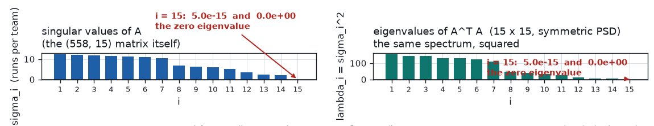
Diagonalising A-transpose A
STAGE 10 | SYSTEM SIMPLIFICATION
Anish A.
15 x 15
lambda = sigma^2
1 zero
A^T A is symmetric PSD and replaces the 558 x 15 matrix
eigenvalues of A^T A equal the squared singular values
eigenvalue 5.0e-15: the rank-14 deficiency again
Diagonalisation is applied to A^T A: a 15 x 15 problem instead of 558 x 15.
Notes:
ANISH ALLADI (about 35 s)
Diagonalisation simplifies the problem. A transpose A is a 15 by 15 symmetric positive semi-definite matrix, replacing the 558 by 15 one. Its eigenvalues are exactly the squared singular values of A. And the single zero eigenvalue is the same rank-14 deficiency we saw in stage 4. What we found by elimination shows up again here. Anish De will finish.

Slide 12
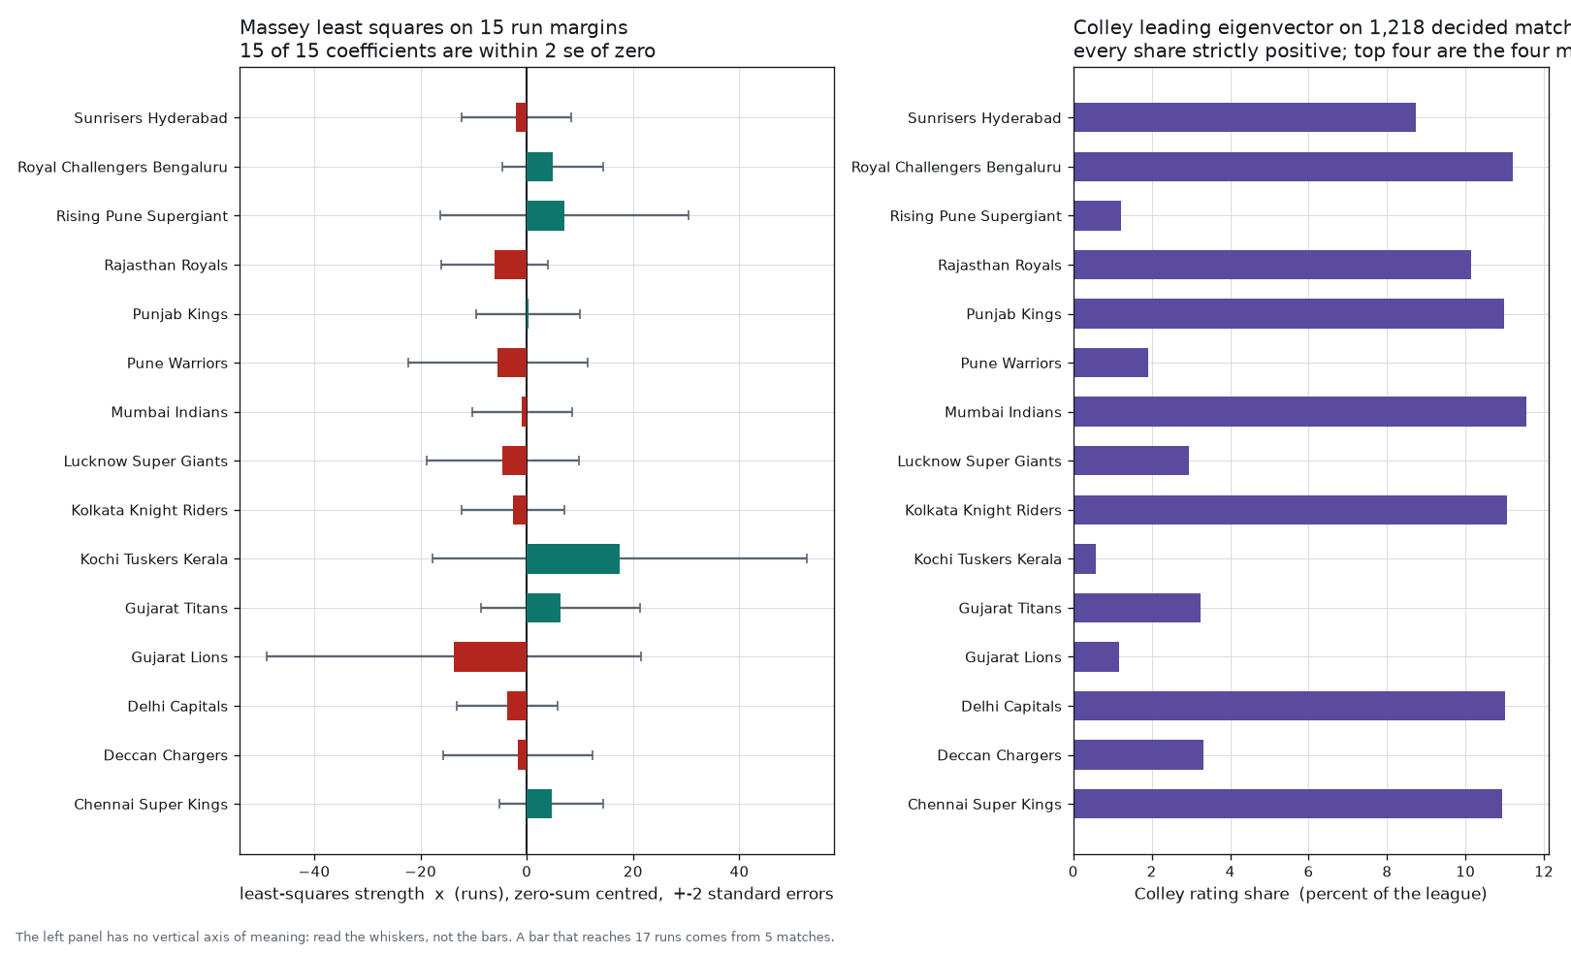
Ranking with both models
STAGE 11 | FINAL APPLICATION OUTPUT
Anish D.
0 of 15
Massey coefficients beyond 2 s.e. (max |t| = 1.20)
5 matches
behind the two most extreme: Kochi, Gujarat Lions
Fewer games, wilder value: corr(games played, |x|) = -0.66. Colley shares are all positive; its top four are Mumbai, Bangalore, Kolkata, Delhi.
Notes:
ANISH DE (about 45 s)
Now the final output. On the left, Massey: every one of the 15 coefficients lies within two standard errors of zero, the largest t-value is only 1.2. The most extreme ones, Kochi and Gujarat Lions, come from just 5 matches each. On the right, Colley gives all-positive shares, with Mumbai, Bangalore, Kolkata and Delhi on top.

Slide 13
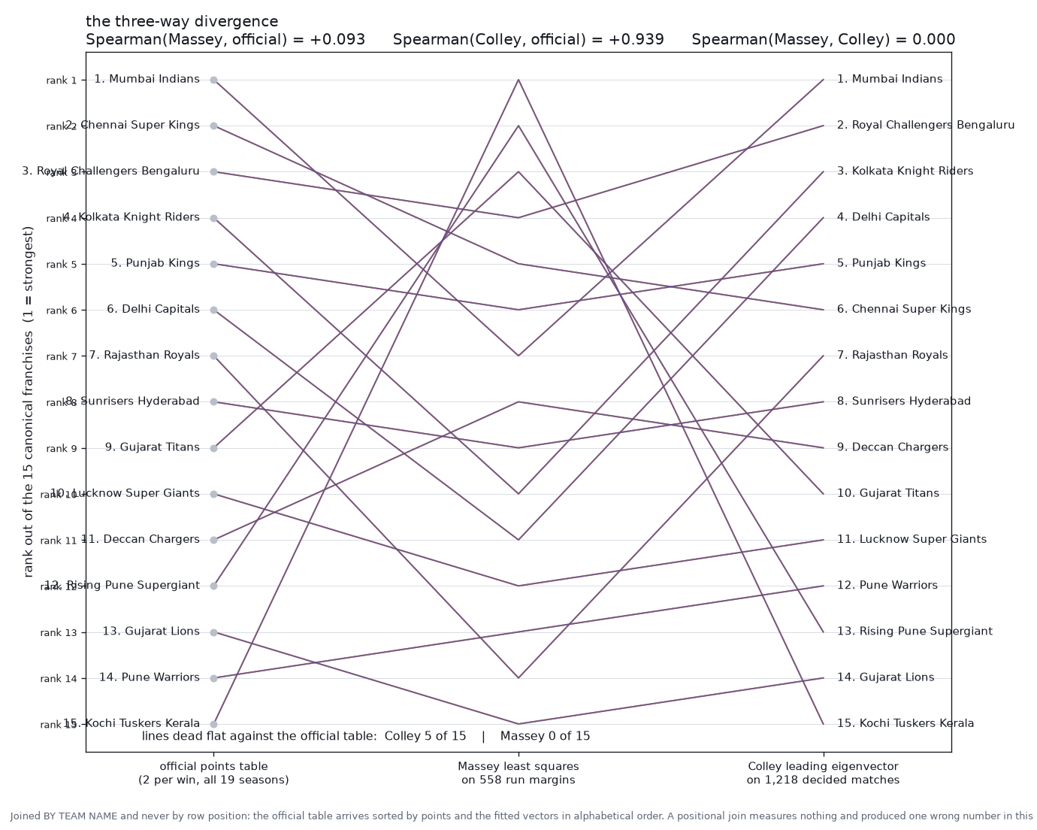
Checking the official table
STAGE 11 | FINAL APPLICATION OUTPUT
Anish D.
0.94
Spearman: Colley vs official
0.09
Spearman: Massey vs official
0.00
Spearman: Massey vs Colley
Joined by team name, never by row position.
Notes:
ANISH DE (about 35 s)
We compare both rankings with the official points table, joined by team name. Colley agrees strongly, Spearman 0.94. Massey barely agrees, 0.09, and it has no agreement with Colley at all. So win-and-loss information ranks the teams sensibly, while our run-margin least squares does not.

Slide 14
Conclusions and limits
SUMMARY
Anish D.
OK
What the mathematics showed
!
Known limitation from our audit
Rank 14, nullity 1: strengths exist only up to a constant
Projection: r is perpendicular to Col(A), checked to 1e-13
Colley eigenvector tracks the official table: 0.94
Design-matrix sign is inconsistent in 123 of 558 rows
With consistent signs: Massey vs official 0.09 to 0.60
Massey numbers are provisional; rank and null space stand
Notes:
ANISH DE (about 40 s)
To conclude: rank, null space, projection and eigenvectors all behaved as the theory predicts. One limitation we found in our own audit: in the design matrix, 123 of the 558 rows have an inconsistent sign. Re-fitting with consistent signs lifts the Massey versus official Spearman from 0.09 to 0.60. So the Massey figures are provisional, while the structural results, rank and null space, stand.

Slide 15
Thank you
Questions?
Data to matrix
Rank 14, null space
Projection
Leading eigenvector
Anubhav Rai (PES1UG25CS078) | Arnab Sen (PES1UG25CS093)
Anish Alladi (PES1UG25CS070) | Anish De (PES1UG25CS071)
Notes:
ANISH DE (about 20 s)
That is our work. To recap: the data became a matrix, elimination found rank 14, projection gave least squares, and the eigenvector gave a robust ranking. Thank you, ma'am. We are happy to take questions.

