Slide 1
Joe's coin shop
Austin Crumrine
Notes:
Today we will be diving into the current situation in Joe's Coin Shop, a local business trying to survive in the 21st century.

Slide 2
Introduction
Joe's Coin Shop in business for 15 years
Struggles with profitability
Uncertain future
Auctions off inventory, selling to highest bidder
Specializes in rare coins
Notes:
The business in question is Joe's Coin Shop; an auctioning business that has been in business for about 15 years now. Unfortunately, Joe's Coin Shop has continuously struggled with profitability. Because of this the future of the company is uncertain, and this is a concern. The business specializes on the auctioning of rare coins, which are eventually sold to the highest bidder.

Slide 3
Case background
Business peaked in 2005
Peak income at around 1 million USD net
In 2006 business decreased about 80%
Business became profitable again
Still paying off debt from the years of recession
Notes:
The business had its peak in 2005 when it raked in about 1 million USD in net income, but the subsequent years would see a decrease in business due to an economic recession. During the recession, the business began to lose $200,000 yearly from 2007-2009. In 2010 however, the store lost a whopping $754,000 despite there being decreases in operating expenses. The business has since recovered but is still in debt.

Slide 4
Approach
K-means clustering
Linear optimization
Data charts
Notes:
The approach for this case will involve a multitude of analysis and visualizations being conducted on the data provided by the company in order to learn new things about the company and its merchandise, as well as the evaluation of possible ways to make the business successful now, and for the years to come.

Slide 5
Analysis Method
K-means clustering
Data charts
The use of:
IBM SPSS Modeler
R/R Studio
Tableau
Notes:
To analyze the data, three things will be used: Tableau, R/R Studio and IBM SPSS Modeler. These will enable us to create the necessary visualizations, conduct K-means clustering of the data, find the most important variables in relation to an auctioned item, and give overall deeper insight into the data and of course the state of the company and what needs to be done to improve its current situation.

Slide 6
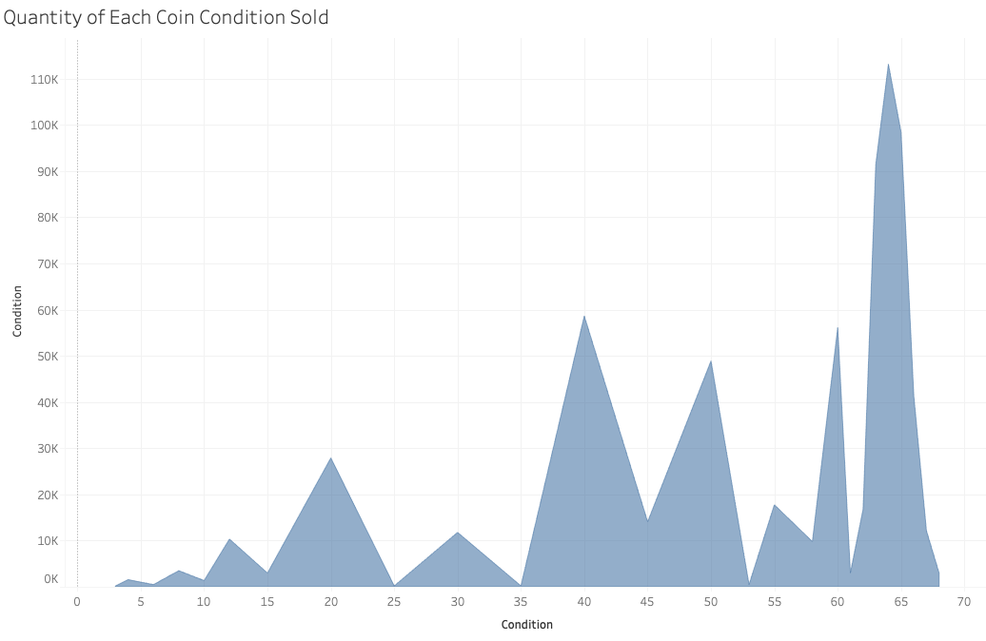
Tableau Analysis pt. 1
Notes:
This visual shows us how many coins were sold based on their 'condition' status. According to the visual, the top selling condition seems to be 65 which may be an indicator of coins in very good condition since that is usually what coin collectors are interested in.

Slide 7
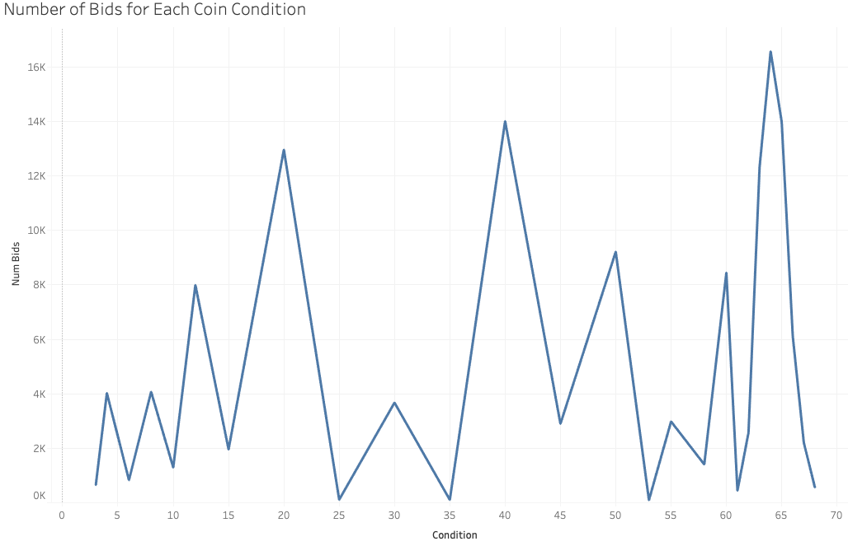
Tableau analysis pt. 2
Notes:
While somewhat similar to the previous visual, this one represents the quantity of bids placed by customers depending on what the condition of the coins were. There are more bids for coins in condition 65 which could mean those coins are more popular based on how well they have been preserved. Condition 40 and 20 coins are also high up there, and this could allude to there having to be a variety in coin conditions to better cater to the customers financial needs and interests.

Slide 8
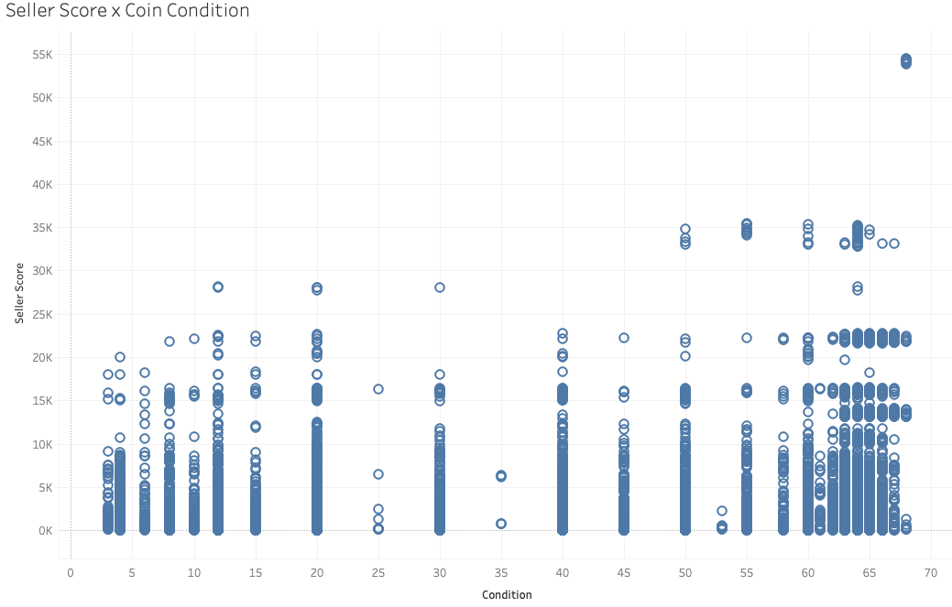
Tableau analysis pt. 3
Notes:
This shows the score of a seller that auctions coins through Joe's Coin Shop, and it seems that for a lot of coins listed, the seller score is lower which could mean a lot of new sellers use the company to sell their products. This also shows that a lot of higher condition coins are being sold by lower score sellers.

Slide 9
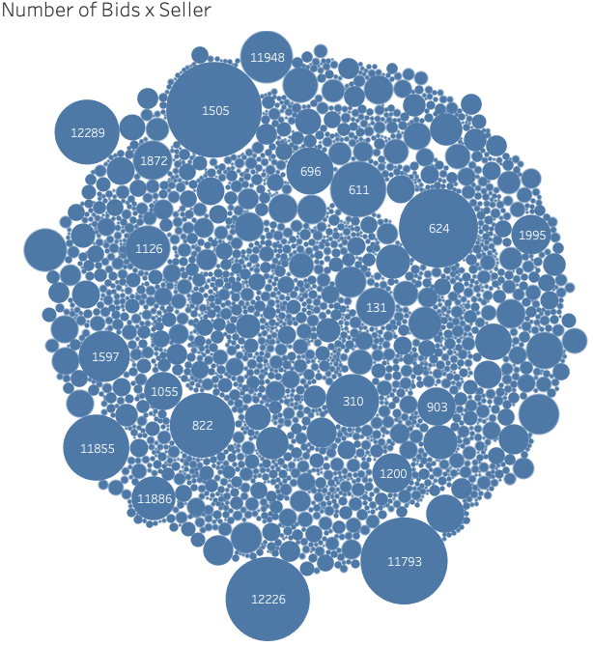
Tableau analysis pt. 4
Notes:
This one represents the number of bids for a coin based on who the seller is. Based off this chart, it can be deduced that the top sellers are those with the seller ID's 1505, 12226, 11793, and 624. These sellers are essential for the business because they are more likely to turn a higher profit for the company considering there's more bids for their coins, and that they have good merchandise that contributes good to the business. It is more likely that these sellers will return to do more business with the company.

Slide 10
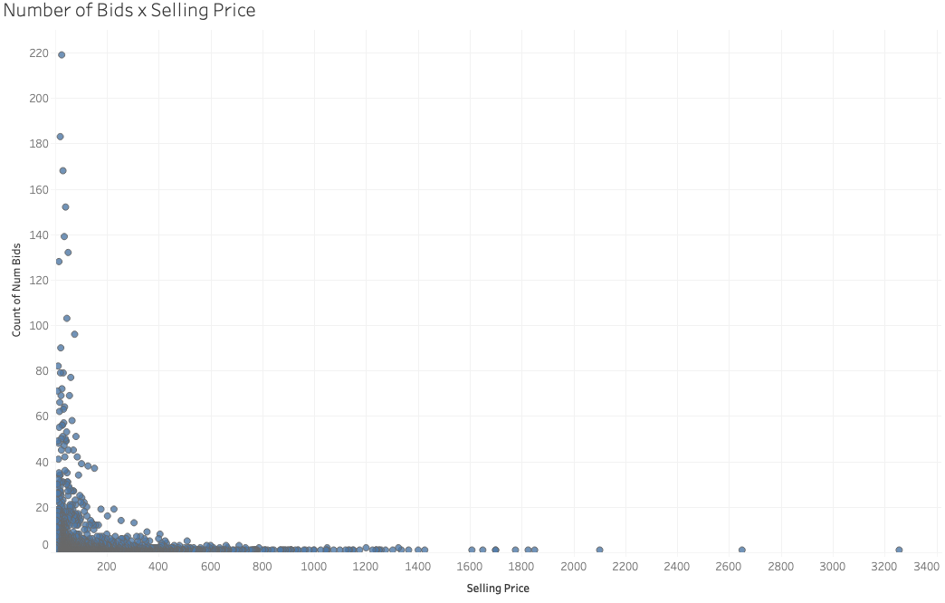
Tableau analysis pt 5
Notes:
The number of bids going off of what the selling price for a coin is. This shows that the ceiling total amount of bids is higher for coins that are being sold for a cheaper price. As the price increases, there are fewer bids. As the price decreases, the number of bids is generally higher. According to this, the higher cost merchandise could be sold instead of auctioned since they are already out of many people's price range, and it would be unwise to auction it when there is such a small pool of potentially buying customers.

Slide 11

R analysis pt. 1
Notes:
The lowest condition rating for an item having sold in the coin auctions is 3 and the highest is 68. The middle value of condition rating is 55 which is a lot closer to 68. The calculated average condition of items listed is 45.9.

Slide 12
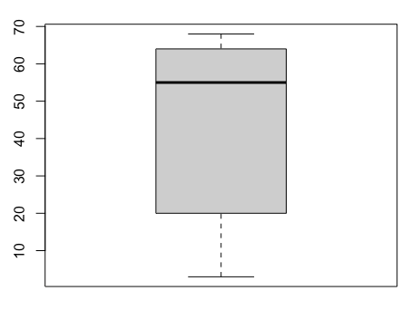
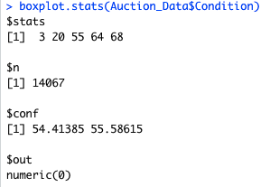
R analysis pt. 2
Notes:
According to the plot on the left, there are no outliers in the data set and this is backed by the statistics on the right where it says $out and the answer is numeric(0). There are no coin condition values that are making the statistical analysis innacurate by skewing the results. There is a total of 14,067 collected data values containing the condition of a coin in the Auction's data set.

Slide 13
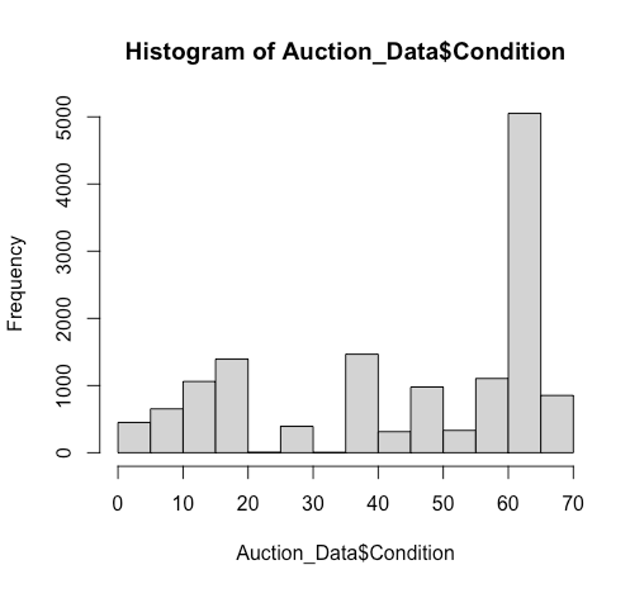
R Analysis pt. 3
Notes:
This shows that there is a whole lot more coins sold in a condition rating between 60 and 70, than in other condition categories. Because all of those coins have been auctioned off, it seems that selling even more coins with such a condition rating could be beneficial for the business since there is a proven demand for it.

Slide 14
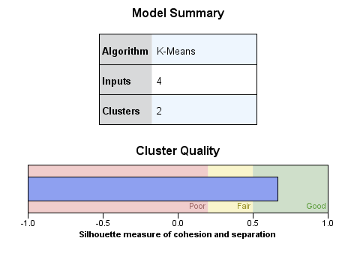
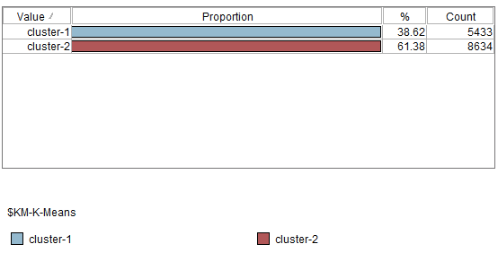
Spss results pt. 1
Notes:
For the k-means clustering conducted in SPSS Modeler by IBM, it is apparent that 2 clusters is the best option since the quality of the clusters is higher than when using 3, 4 or 5 clusters with the data set. The cluster quality is not extremely close to 1 so it is an accurate but not the most accurate analysis. Most of the data from the Auction table falls into cluster 2.

Slide 15
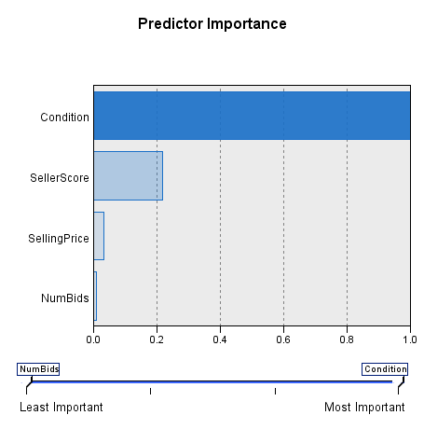
Spss results pt. 2
Notes:
The most important predictor out of the selected variables Seller Score, Selling Price, Number of Bids and Condition would be the Condition. The coins condition has the most to do with how the auction goes, and the overall outcome of it.

Slide 16
Marketing insights pt. 1
Coin condition is a telltale factor of:
How many coins are sold
How high the bid goes for the item
Whether or not a coin is auctioned off
Marketing to people who have collectible coins
In good condition
Who want to turn a profit
Notes:
If Joe's Coin Shop were to spread the word and encourage more people to partner with them and auction off collectible coins, that could be just what the business needs to increase profits and the amount of sellers who go with them. This would eventually create a sense of trust for the partner and the business, and they would be likely to be return business partners. Telling people to check if they have any collectible or unique coins in good condition, to check out Joe's so they can make money off of it since good condition coins are most likely to sale guaranteed.

Slide 17
Marketing insights (cont.)
Higher sales volume may increase profit
Foot traffic may prove ineffective, hence establishing online store
Regularly engaging on social media with customers
Notes:
Increasing the volume of overall sales through whatever means possible can result in more sales for the company which should increase profit assuming there is no losses on an auction. There has to be a profit on each item auctioned through Joe's, and a minimum bid amount for a sale. Interacting with potential clients on social media can help raise overall awareness of the business' existence, and increase website traffic which will eventually lead to more sales.

Slide 18
Recommended course of action
Joes Coin Shop Should:
Establish a social media presence
Attract more sellers
Auction more coins in high condition rating
Establish an online store
Create a cheap marketing campaign online
Notes:
The recommended course of action for Joe's Coin Shop is for them to establish their online presence on social media, attract more sellers through social media and other means such as word of mouth (incentivize it for referrals), seek more coins that have high condition values as to increase overall sales volume, eventually establish an online store where specific merchandise is being sold and the rest are in-store and finally using social media to create a targeted marketing campaign that focuses on people interested in coin collecting and selling.

Slide 19
Possible obstacles w/ latter
The website not being made
The website being improperly designed
Improperly targeted online marketing
Failing to attract more sellers and customers
Notes:
While the plan is nice, there are potential obstacles that can come with it. An obstacle would be improperly branding the company on social media, not establishing the online store or even going the cheap route which results in an online store that is not as credible and may deter people from doing business with the company. It is also possible that the marketing efforts fail, resulting in money lost for a marketing effort that was fruitless.

Slide 20
Additional marketing approaches
Utilize demographic marketing
Utilize geographic marketing
Notes:
They could run a local marketing campaign based on geographical location or demographics based on the age and other info collected on past buyers and sellers. This will not be extremely targeted but can attract more foot traffic into the brick and mortar location of the store, or even encourage more people to check out the website. The publicity will be good and people would tell their relatives or parents to sell a coin if they have one.

Slide 21
closing
Expanding presence from pysical to both online and the latter
Reaching more potential partners and customers through:
Social Media
Word of Mouth
Targeted Online Advertisements
Placing emphasis on coins that have higher condition ratings
Increasing overall sales volume
Notes:
Joe's Coin Shop is a business that in the past has struggled with profitability during the recent economic recession, but has sprung back thanks to the help of a consultant. The business would be able to eventually pay off its debts if it were to make some adjustments in the way they do business, and if they were to expand from solely a brick and mortar presence, into an online one as well. By having both presences, they could make sales through auctions and also reach more potential customers. Keeping the brick and mortar location helps back the credibility of the business, and with that being said the website must be professionally done and have a way for people to list their coins and sell them as a third party partner. Finally, by increasing sales volume by having marketing materials and an online social media presence it will be possible for them to eventually increase sales volume and build credibility as a trusted partner for potential sellers/vendors.

