Slide 1






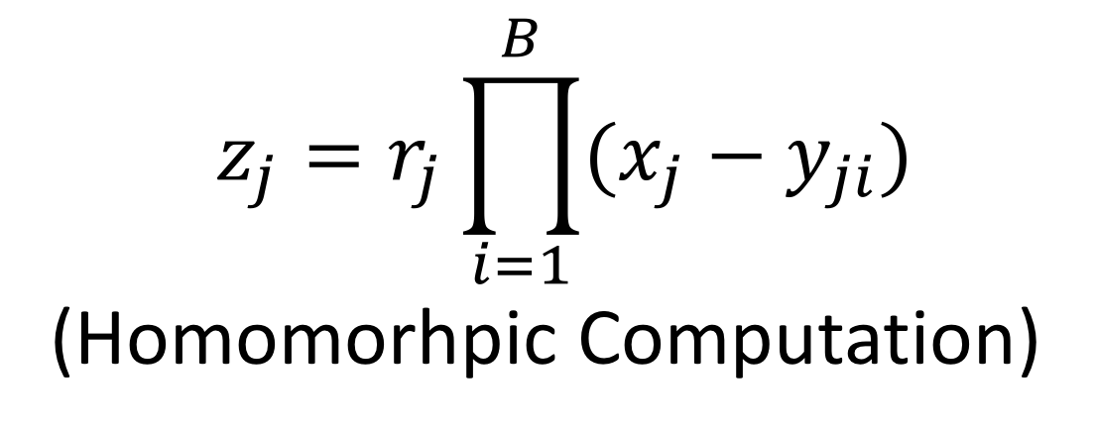
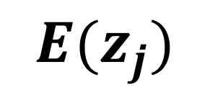


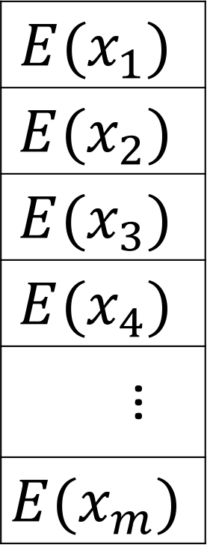






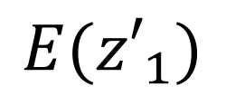
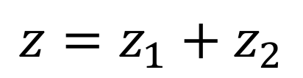
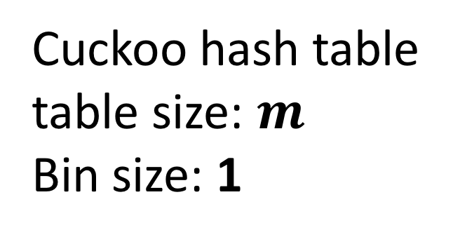
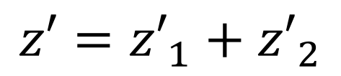



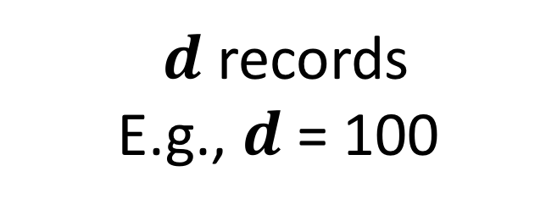
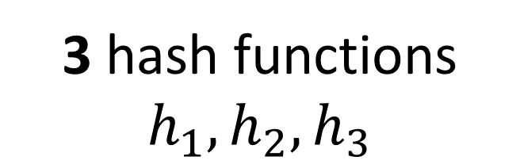
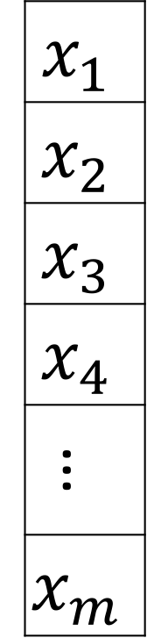
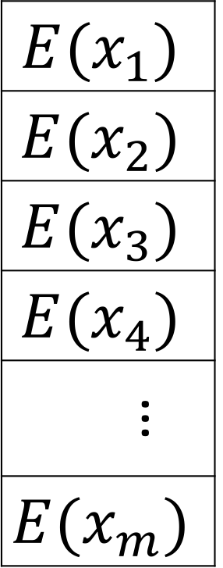

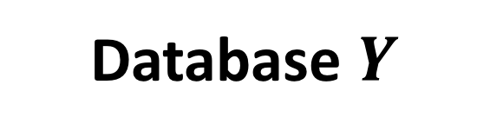

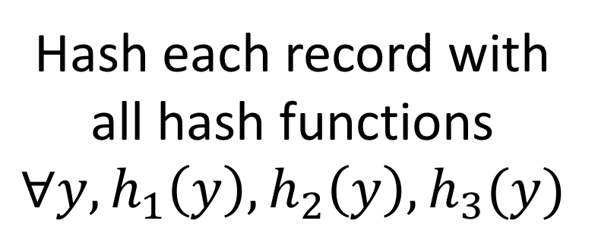



Medical Record De-duplication with APSI
Hao Chen¹, Kyoohyung Han², Zhicong Huang³, Amir Jalali⁴, Kim Laine¹, Kristin Lauter¹
¹Microsoft Research, ²Seoul National University, ³École Polytechnique Fédérale de Lausanne, ⁴Florida Atlantic University
Medical Record De-duplication
Step 1: Asymmetric Private Set Intersection [1]
Step 2: Secret-Sharing Set Union
In this batch of records, which of them exist in other hospitals?
Server (S1)
Sharing
$$x_{1}$$
$$x_{2}$$
$$x_{3}$$
$$x_{4}$$
…
$$x_{m}$$
SEAL homomorphic encryption
$${E(x}_{1})$$
$${E(x}_{2})$$
$${E(x}_{3})$$
$$E(x_{4})$$
…
$${E(x}_{m})$$
$$E({z′}_{1})$$
$${z′}_{2}$$
$$E(z′)$$
S3
Batch $X$
Cuckoo hashing
S1
$$z′={z′}_{1}+{z′}_{2}$$
S3
$d$ records
E.g., $d$ = 100
3 hash functions
$$h_{1}, h_{2}, h_{3}$$
Cuckoo hash table
table size: $m$
Bin size: 1
$$E(z_{1})$$
$$z_{2}$$
$$E(z)$$
101, Hash(Alice, F, 1976-2-23)
102, Hash(Bob, M, 1992-10-12)
103, Hash(Charlie, M, 1983-1-15)
104, Hash(David, M, 2005-4-30)
...
S2
S1
S2
$$z=z_{1}+z_{2}$$
Server (S2 and S3)
$$y_{11}$$ | $$y_{12}$$ | $$y_{13}$$ | $$…$$ | $$y_{1B}$$
$$y_{21}$$ | $$y_{22}$$ | $$y_{23}$$ | $$…$$ | $$y_{2B}$$
$$y_{31}$$ | $$y_{32}$$ | $$y_{33}$$ | $$…$$ | $$y_{3B}$$
$$y_{41}$$ | $$y_{42}$$ | $$y_{43}$$ | $$…$$ | $$y_{4B}$$
$$…$$ | $$…$$ | $$…$$ | $$…$$ | $$…$$
$$y_{m1}$$ | $$y_{m2}$$ | $$y_{m3}$$ | $$…$$ | $$y_{mB}$$
Combining
Simple hashing
S1
Two-Party Multiplication Protocol with Multiplication Triplet [2]
S2
Database $Y$
Hash each record with all hash functions
$$∀y, h_{1}\left(y\right), h_{2}\left(y\right), h_{3}(y)$$
$$R_{1}$$
$$R_{2}$$
$D$ records
$$D≫d$$
E.g., $D$=1 million
$$R_{1}+R_{2}=\left(z_{1}+z_{2}\right)⋅({z′}_{1}+{z′}_{2})$$
$$z_{1}, {z′}_{1}$$
$$z_{2}, {z′}_{2}$$
Simple hash table
table size: $m$ ; Bin size: B
Extending to arbitrary number of servers: GMW protocol
Setting
1000 hospitals
Each hospital has 10, 000 records
3~5 servers
Hospitals send records in batches of 100 to a server
Sequential and synchronized
Semi-honest model
Honest majority among servers
Hospitals don’t collude with servers
Server (S1)
Server (S2 and S3)
$${E(x}_{1})$$
$${E(x}_{2})$$
$${E(x}_{3})$$
$$E(x_{4})$$
…
$${E(x}_{m})$$
$$y_{11}$$ | $$y_{12}$$ | $$y_{13}$$ | $$…$$ | $$y_{1B}$$
$$y_{21}$$ | $$y_{22}$$ | $$y_{23}$$ | $$…$$ | $$y_{2B}$$
$$y_{31}$$ | $$y_{32}$$ | $$y_{33}$$ | $$…$$ | $$y_{3B}$$
$$y_{41}$$ | $$y_{42}$$ | $$y_{43}$$ | $$…$$ | $$y_{4B}$$
$$…$$ | $$…$$ | $$…$$ | $$…$$ | $$…$$
$$y_{m1}$$ | $$y_{m2}$$ | $$y_{m3}$$ | $$…$$ | $$y_{mB}$$
$$z_{j}=r_{j}\prod_{i=1}^{B}{(x_{j}−y_{ji})}$$
(Homomorhpic Computation)
Results
$$E($$
$$)$$
$${E(z}_{j})$$
Optimization:
Symmetric polynomial; Splits; Generalized batching; Multithreading
[1] H. Chen, K. Laine, and P. Rindal, “Fast Private Set Intersection from Homomorphic Encryption”, CCS, 2017.
[2] D. Demmler, T. Schneider, and M. Zohner, “ABY-A Framework for Efficient Mixed-Protocol Secure Two-Party Computation”, NDSS, 2015.

