Slide 1
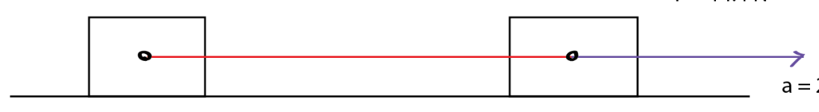
Problem
There are two blocks on a horizontal frictionless surface with a mass of 2 kg and 3 kg. They are linked to each other by a string. We pull them with a force of 10 N.
Find the acceleration of the system.
Find the tension force on the string.

Slide 2
Problem 2.
F=150 N
m₁=15 kg
m₂=25 kg
m₃=10 kg
Calculate:
Acceleration
Tension forces
m₃
m₂
m₁
F=150 N

Slide 3
Problem 3.
There are two blocks on a horizontal frictionless surface with a mass of 2 kg and 3 kg. They are linked to each other by a string. We pull them with a force of 10 N.
Find the acceleration of the system.
Find the tension force on the string.

Slide 4
Friction

Slide 5
https://www.youtube.com/watch?v=x_24FBNa788
https://www.youtube.com/watch?v=VUfqjSeeZng

Slide 6
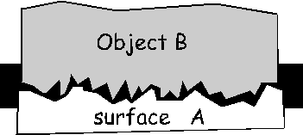
Cause of friction
Surfaces are not smooth
Under high magnification they are rough with irregularities (hills and dales)
These irregularities tend to interlock with each other
This interlocking of irregularities opposes the motion
This opposing force is called friction
The magnitude of friction depends on the degree of irregularities.

Slide 7

Friction
A force that opposes the motion between two surfaces in contact.
Friction exists between two things.
A rocket traveling through the atmosphere
There is friction
A rocket traveling in the vacuum of space
There is no friction

Slide 8
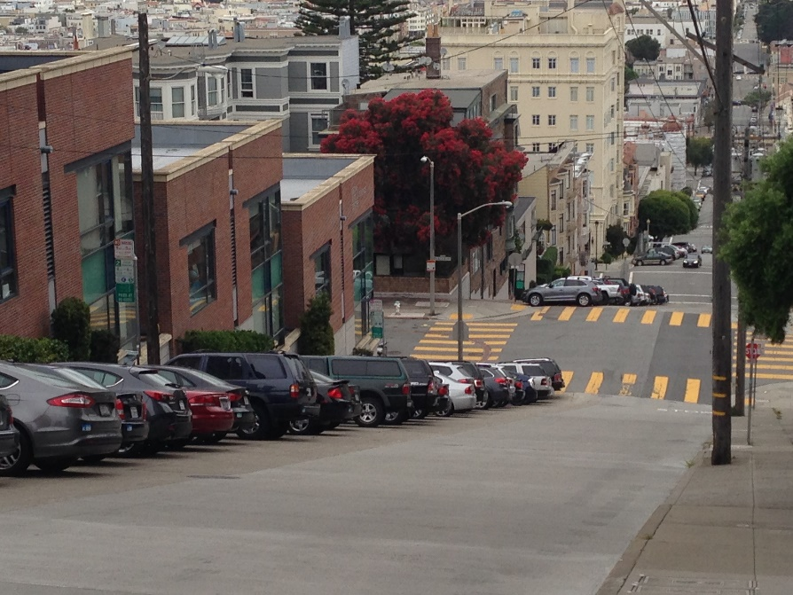
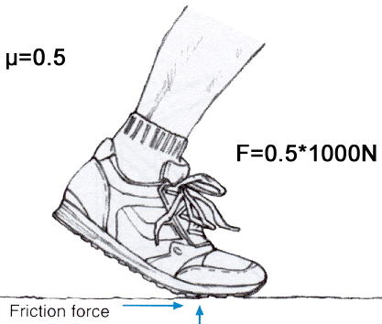
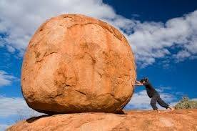
Static friction
Is a force that keeps object at rest
Prevents the surfaces from sliding
It must be overcome to start moving the object

Slide 9
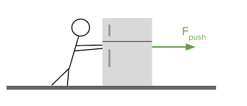
Static friction
If a small amount of force is applied to an object the static friction has an equal magnitude in the opposite direction.
If the force is increased at some point the value of the maximum static friction will be reached and the object will move.

Slide 10
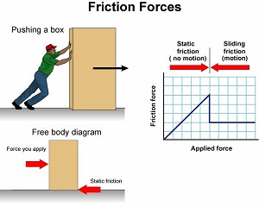
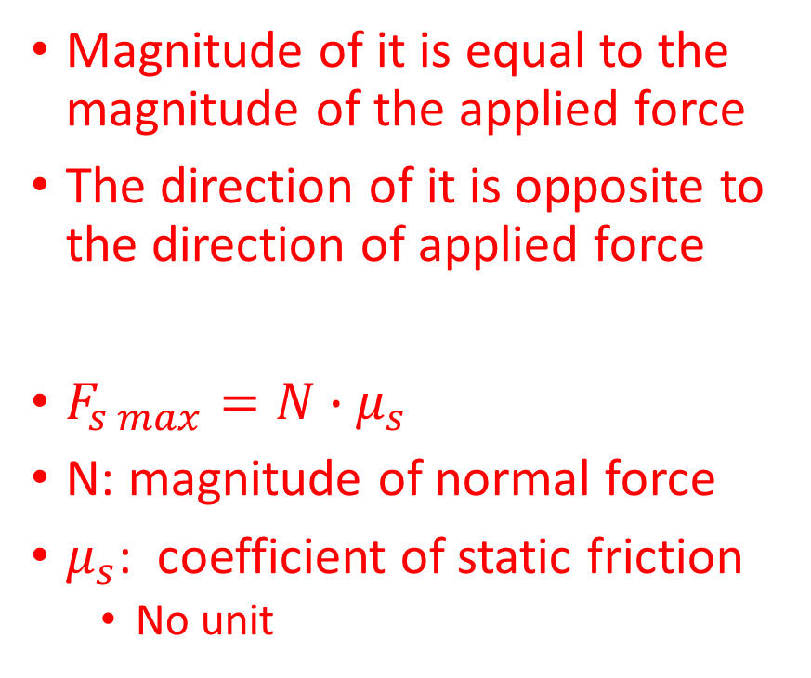
Static friction
Magnitude of it is equal to the magnitude of the applied force
The direction of it is opposite to the direction of applied force
$F_{s max}=N∙μ_{s}$
N: magnitude of normal force
$μ_{s}$: coefficient of static friction
No unit

Slide 11
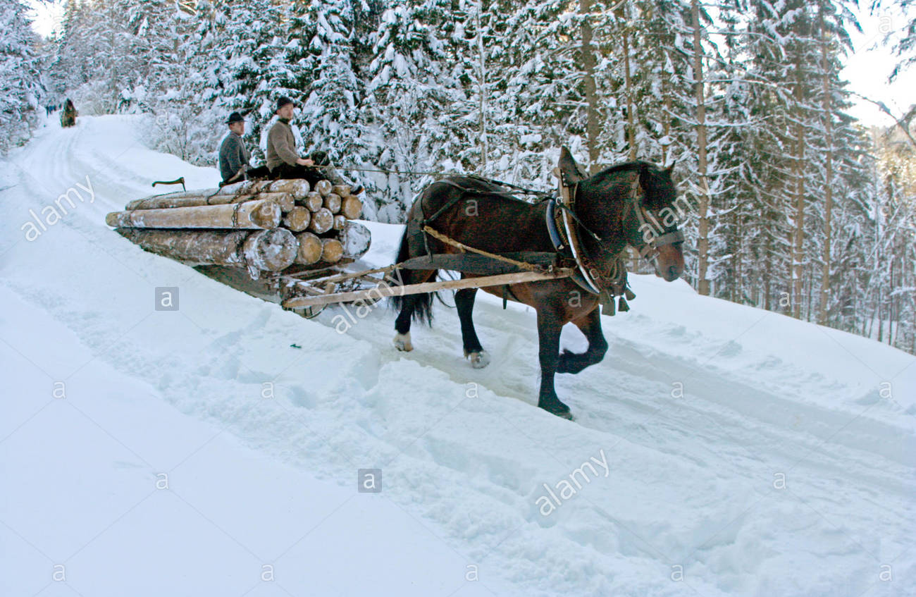
Problem 1.
There is a sled full of firewood in a snow-covered forest. The skis of the sled have a coefficient of static friction μ_{s} = 0.75 with the snow. If the fully-loaded sled has a mass of 700 kg, what is the maximum force of static friction, and is the force applied enough to overcome it?
What happens if a 5500 N force is applied to this sled?

Slide 12
Problem 2.
A person building a brick-making machine wants to measure the coefficient of static friction between brick and wood. To do this, she places a 2.00 kg brick on a flat piece of wood, and gradually applies more and more force until the brick moves. She finds that the brick moves when exactly 11.8 N of force is applied. What is the coefficient of static friction?

Slide 13
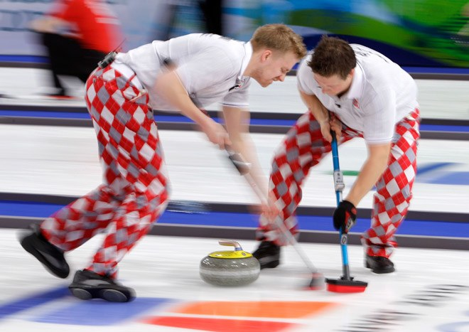
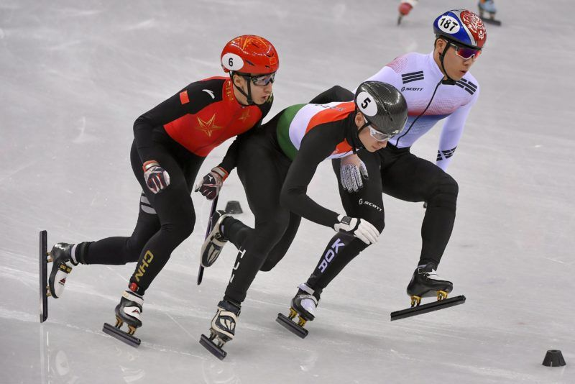
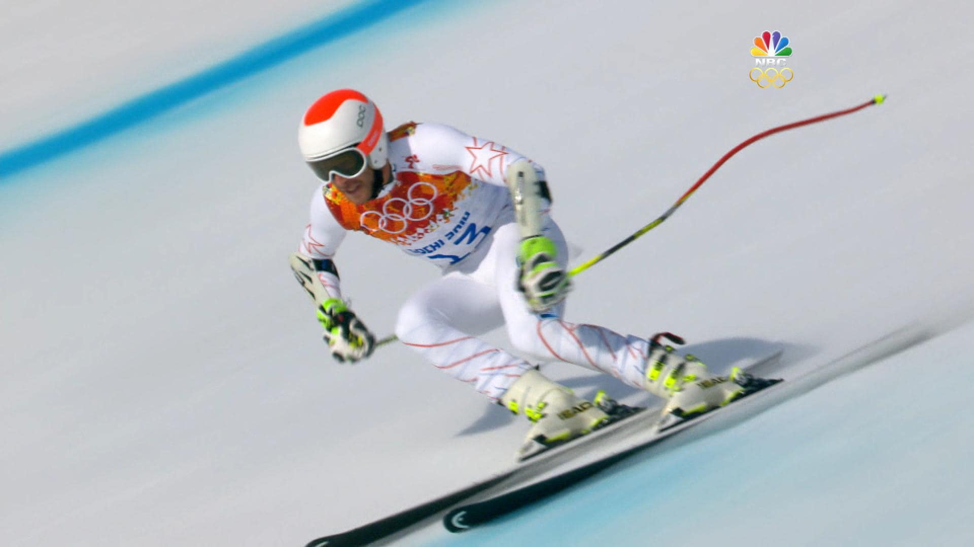
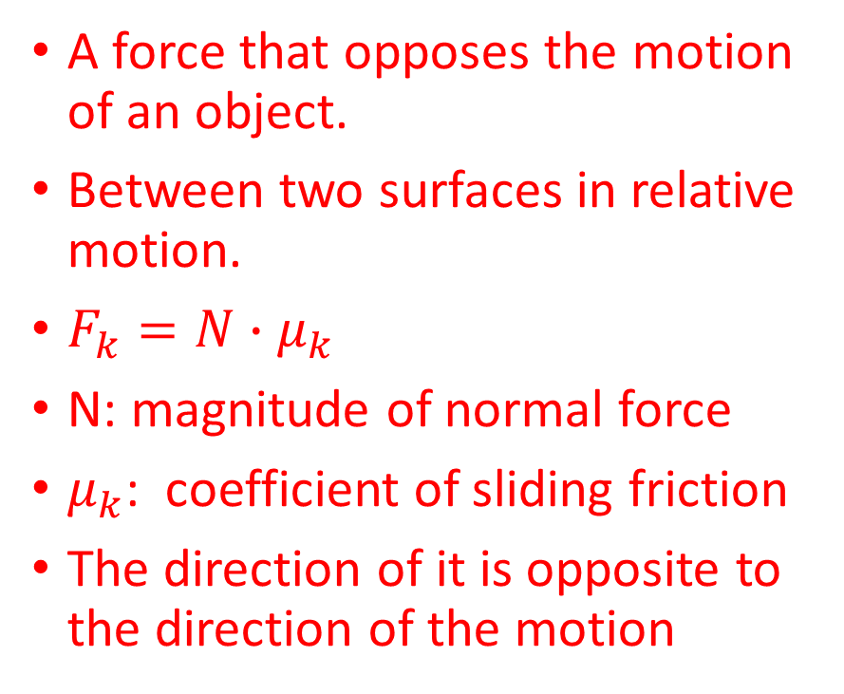
Sliding friction-Kinetic friction
A force that opposes the motion of an object.
Between two surfaces in relative motion.
$F_{k}=N∙μ_{k}$
N: magnitude of normal force
$μ_{k}$: coefficient of sliding friction
The direction of it is opposite to the direction of the motion

Slide 14
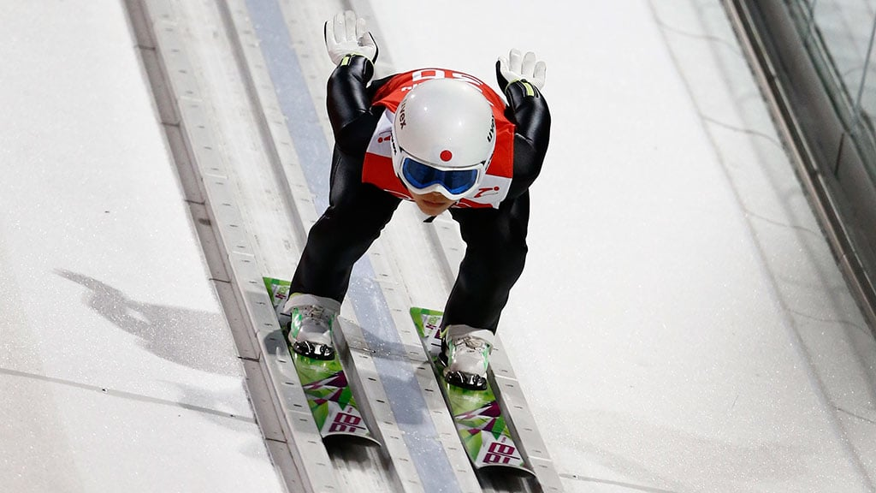
Sliding friction
Depends on
Normal force
Surfaces in contact
Independent of the contact area between the two surfaces

Slide 15
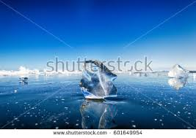
Problem 1.
A large block of ice is being pulled across a frozen lake. The block of ice has a mass of 250 kg. The coefficient of friction between two ice surfaces is small: μ_{k} = 0.05. What is the force of friction that is acting on the block of ice?

Slide 16
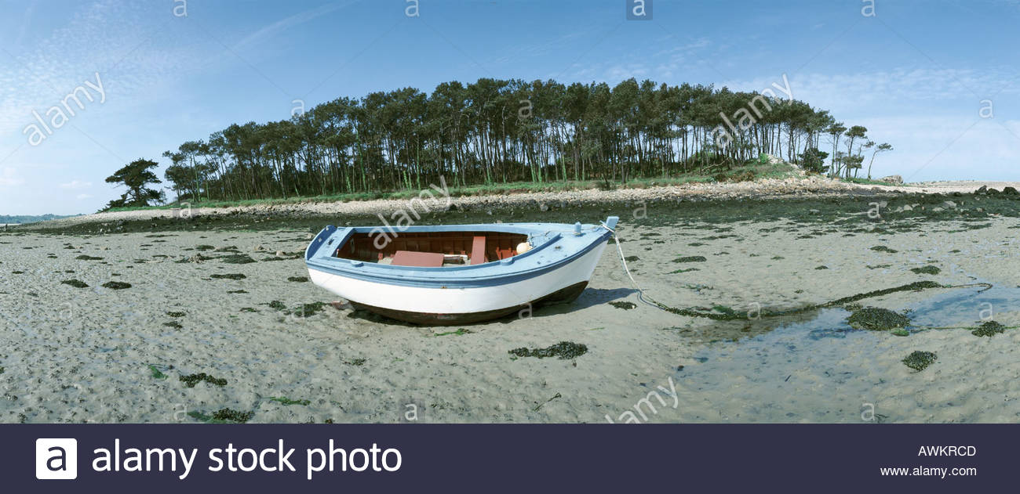
Problem 2.
A man's boat was stuck on shore when the tide went out. He begins pushing his boat across the mud to get to the water. The coefficient of friction between his wooden boat and the mud is μ = 0.400. If the boat has a mass of 50.0 kg, what is the magnitude of the force of friction acting on the boat?

Slide 17
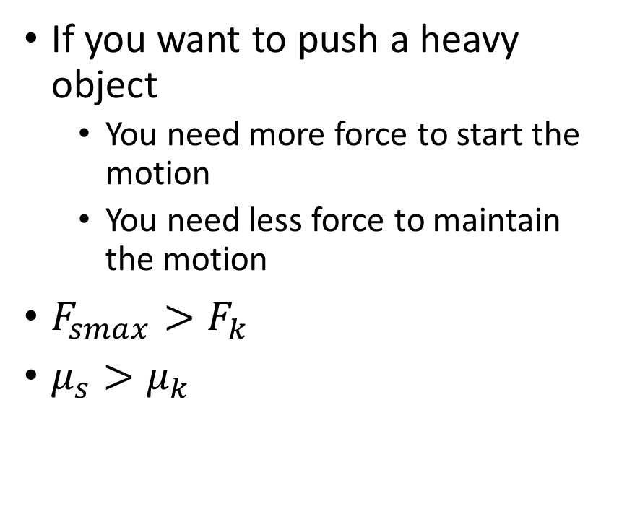

$$μ_{s}−μ_{k}$$
If you want to push a heavy object
You need more force to start the motion
You need less force to maintain the motion
$F_{smax}>F_{k}$
$μ_{s}>μ_{k}$

Slide 18
Problem 3
There are two blocks on a horizontal surface with a mass of 2 kg and 3 kg. They are linked to each other by a string. We pull them with a force of 10 N. The coefficient of kinetic friction is 0.1.
Find the acceleration of the system.
Find the tension force on the string.

Slide 19
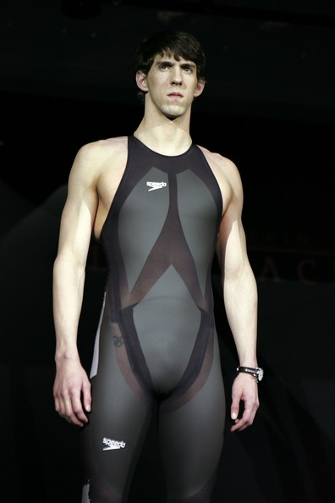
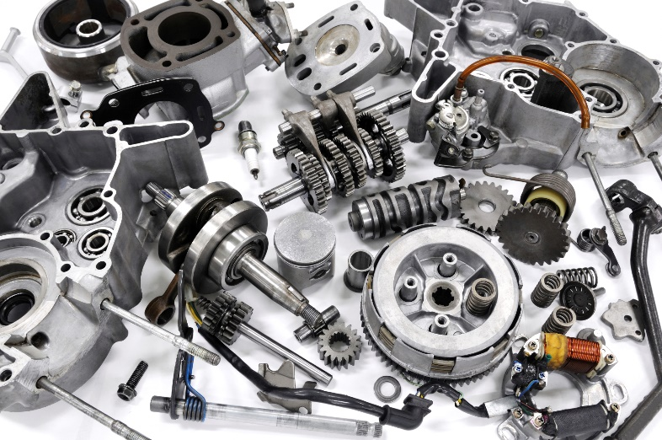
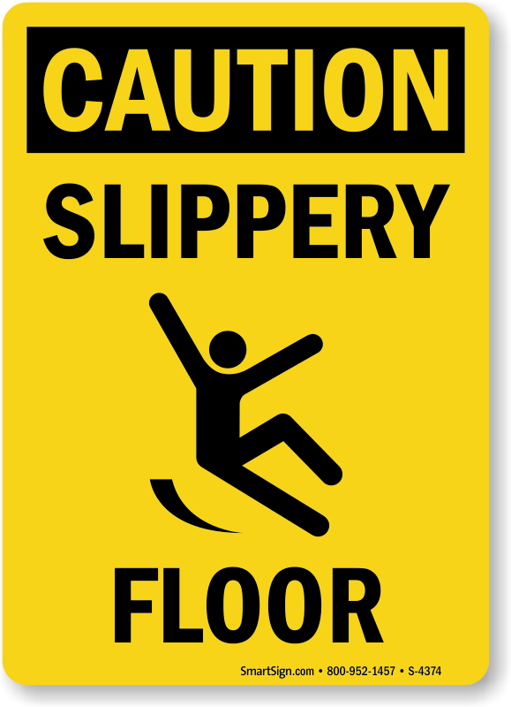
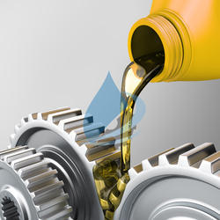
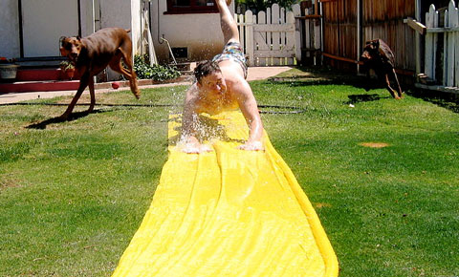
How to reduce friction?
Make the surfaces smoother
Irregularities will be smaller
Lubrication
Irregularities will be filled by the liquid- they will be smaller

Slide 20
Homework
https://www.youtube.com/watch?v=qy-EJRDyt-A

Slide 21

Problem 4
We start a 3 kg brick with an initial speed of $5\frac{m}{s}$. $μ_{k}$=0.333. Describe the motion of the brick. Calculate the distance covered until the brick stops.

Slide 22

Problem 5.
The mass of a car is 1100 kg. The engine accelerates it to the speed of $54\frac{km}{h}$ in 30 s. Calculate the applied force if the $μ_{k}=0.05.$

Slide 23

Problem 6.
Find the applied force if an 1000 kg object accelerates with $0.2\frac{m}{s^{2}}$ and $μ_{k}=0.05$.

Slide 24
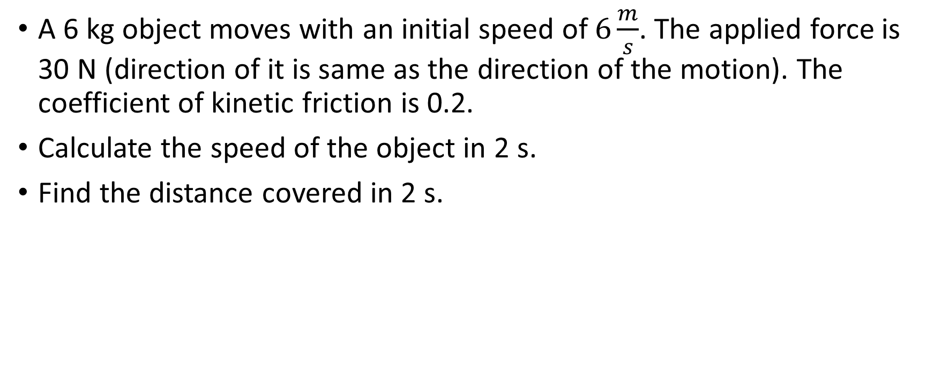
Problem 7.
A 6 kg object moves with an initial speed of $6\frac{m}{s}$. The applied force is 30 N (direction of it is same as the direction of the motion). The coefficient of kinetic friction is 0.2.
Calculate the speed of the object in 2 s.
Find the distance covered in 2 s.

Slide 25
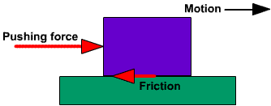
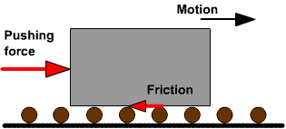
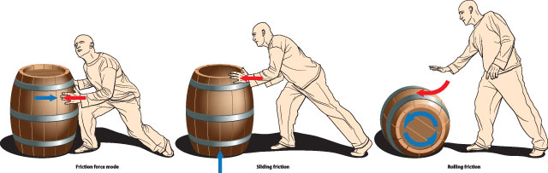

Rolling friction
$F_{r}=N∙μ_{R}$
N: normal force
$μ_{R}$: coefficient of rolling friction
$μ_{R}<μ_{k}$

Slide 26
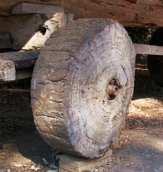
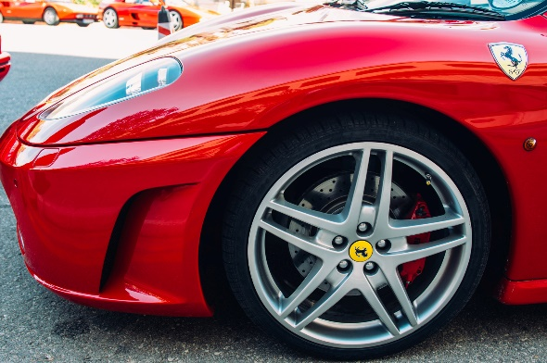
The wheel
is often described as the most important invention of all time
it had a fundamental impact on transport and later on agriculture and industry.

