Slide 1
Weight

Slide 2
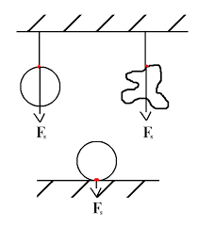

English
Magyar
Weight = force of gravity
Apparent weight: the force that an object exerts on its support
Súlyerő $≠$ gravitációs erő
Súlyerő = Az az erő, amellyel a test nyomja az alátámasztást vagy húzza a felfüggesztést.

Slide 3
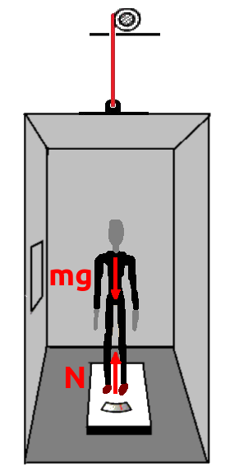
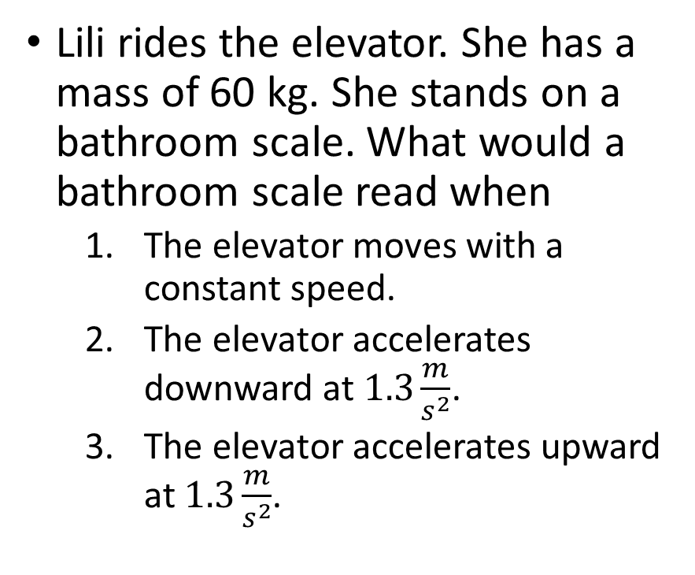
Problem 1.
Lili rides the elevator. She has a mass of 60 kg. She stands on a bathroom scale. What would a bathroom scale read when
The elevator moves with a constant speed.
The elevator accelerates downward at $1.3\frac{m}{s^{2}}$.
The elevator accelerates upward at $1.3\frac{m}{s^{2}}$.

Slide 4
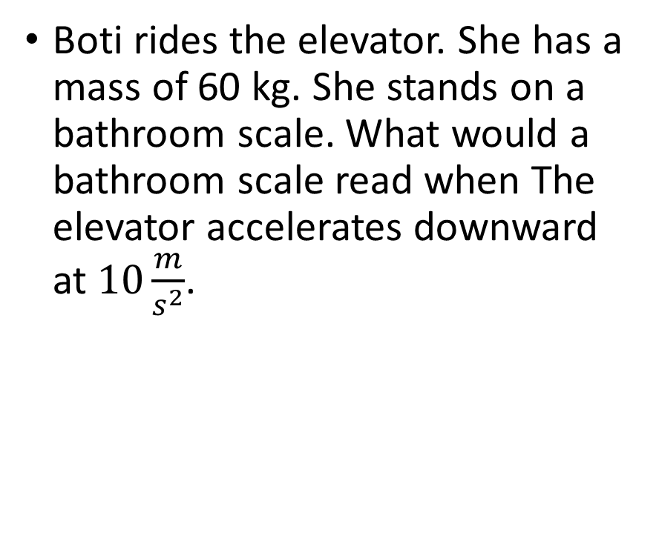
Problem 2.
Boti rides the elevator. She has a mass of 60 kg. She stands on a bathroom scale. What would a bathroom scale read when The elevator accelerates downward at $10\frac{m}{s^{2}}$.

Slide 5
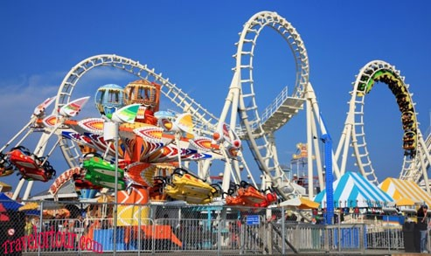
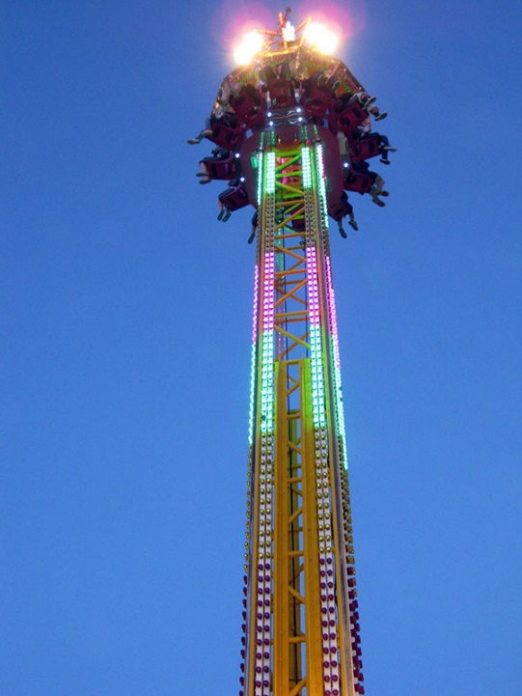
Weightlessness
Apparent weight = 0
The object doesn’t exert any force on its support- there is no external contact force pushing or pulling upon the object
Free fall
Súlyerő =0
A test nem nyomja az alátámasztást és nem húzza a felfüggesztést.

Slide 6
Weightlessness in Orbit in the space
Astronauts on the orbiting space station are weightless because...
there is no gravity in space and they do not weigh anything.
b. space is a vacuum and there is no gravity in a vacuum.
c. space is a vacuum and there is no air resistance in a vacuum.
d. the astronauts are far from Earth's surface at a location where gravitation has a minimal effect.

Slide 7
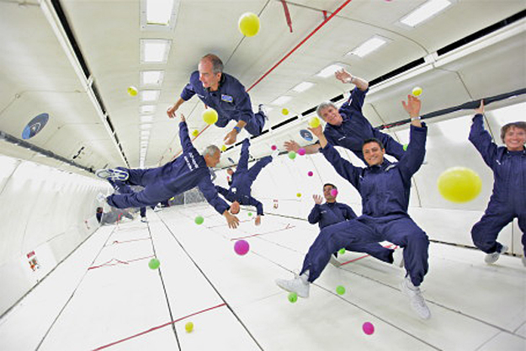
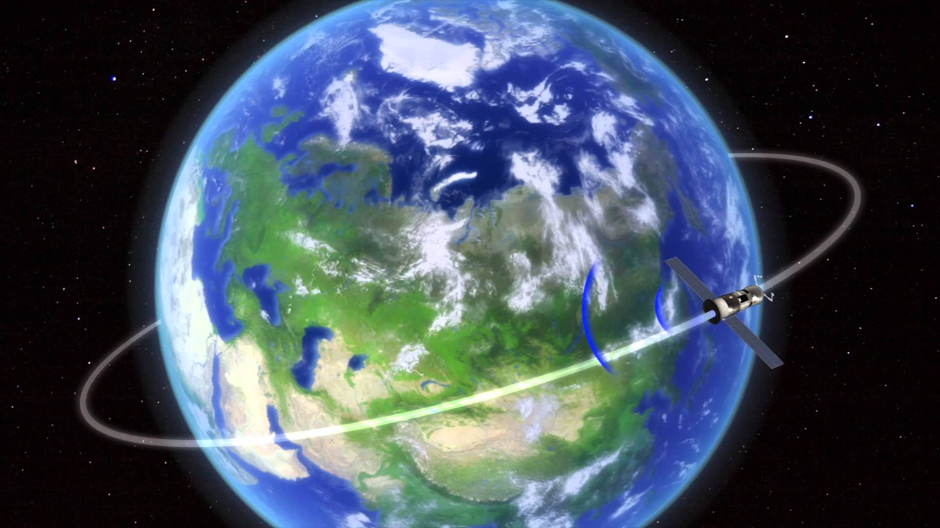
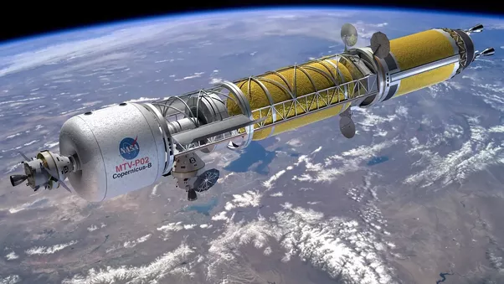
Weightlessness in Orbit in the space
Is there any gravity in the space?
The only force acting upon the object is the gravity.
The astronauts are falling toward the Earth without colliding into it.
The tangential velocity allows them to remain in orbital motion.

