Slide 1
Work
In Physics

Slide 2

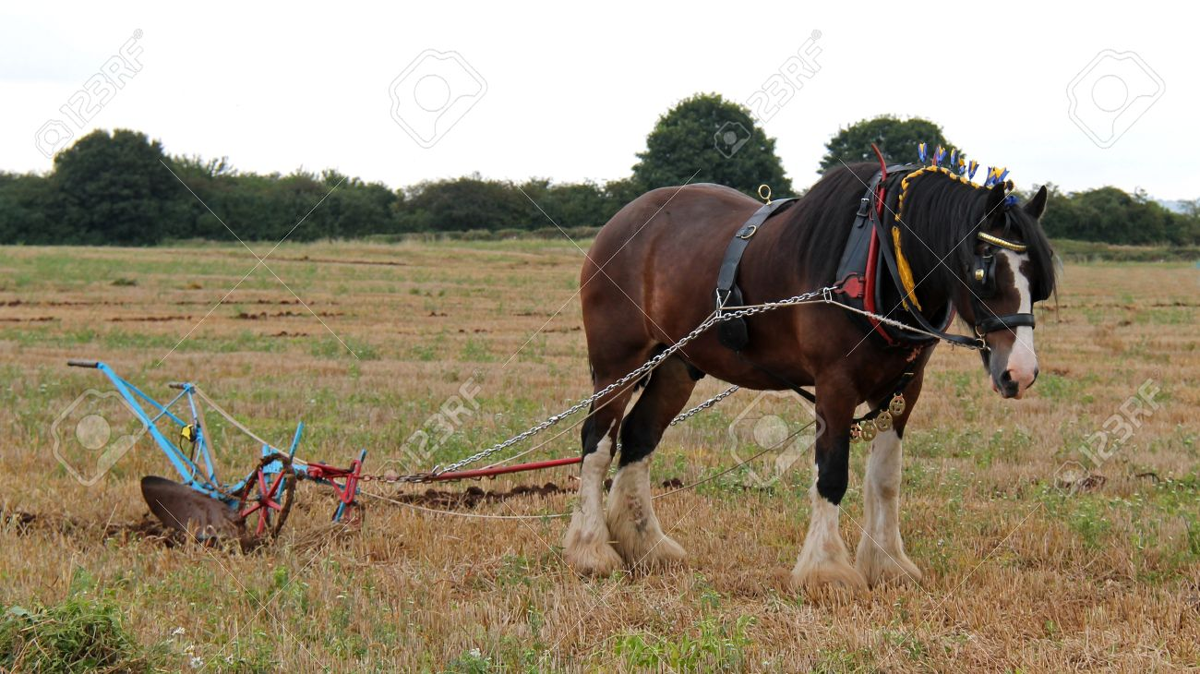
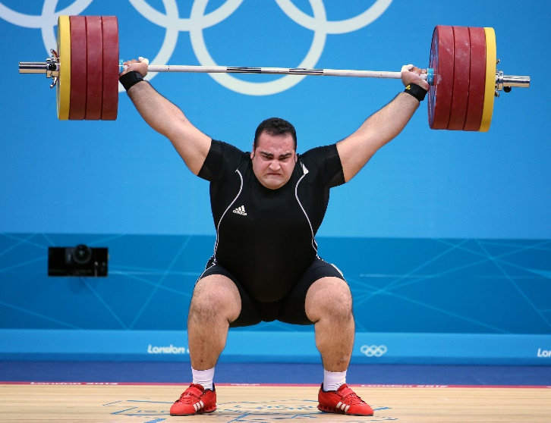
Work
When a force acts upon an object to cause a displacement of the object, it is said that work was done upon the object

Slide 3
True or false: whether or not the statements represent examples of work
Anna applies a force to a wall and becomes exhausted.
A book falls off a table and free falls to the ground.
A rocket accelerates through space.
Aunt Mary stands on the street with a heavy grocery bag in her hand and talks to her friend for an hour

Slide 4
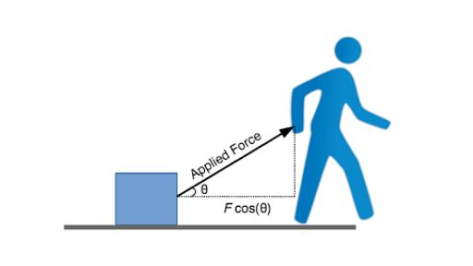
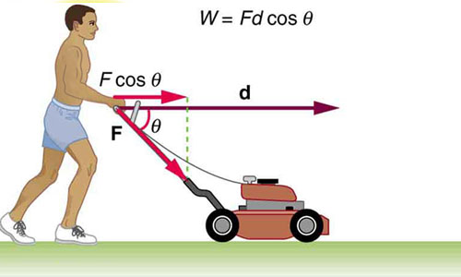
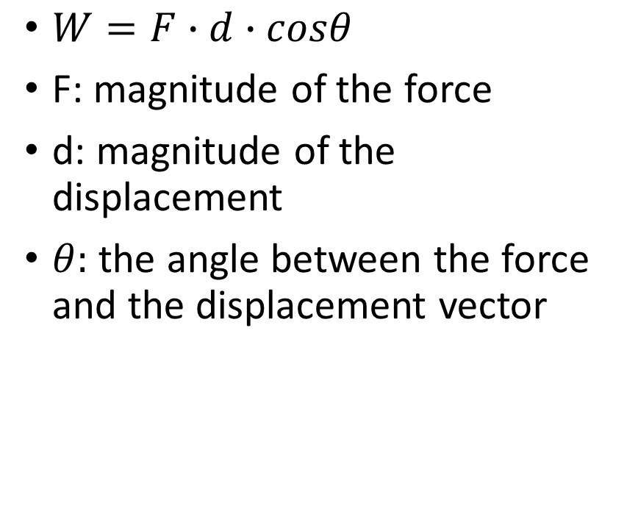
Work - mathematically
$W=F∙d∙cosθ$
F: magnitude of the force
d: magnitude of the displacement
$θ:$ the angle between the force and the displacement vector

Slide 5
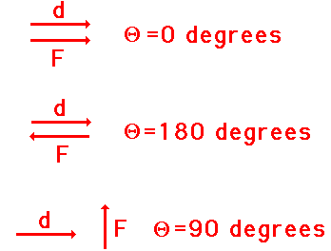


$$W=F∙d∙cosθ$$
The direction of the force and the displacement are the same:
$W=F∙d∙\cos{0°=F∙d∙1}$
$$W=F∙d$$

Slide 6

$$W=F∙d∙cosθ$$
The direction of the force and the displacement are perpendicular:
$W=F∙d∙\cos{90°=F∙d∙0}$
$$W=0$$

Slide 7
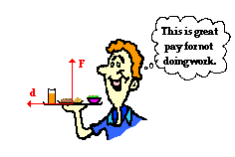
A waiter carries a tray full of meals above his head by one arm straight across the room at constant speed.
Is there any work?

Slide 8

Work
Symbol: W
Unit: $1N∙1m=1Nm=1 J$
1 Joule
Scalar quantity

Slide 9
Problem 1.
How many joules of work are done against a cart when a force of 50 N pushes it 1 kilometer away?

Slide 10
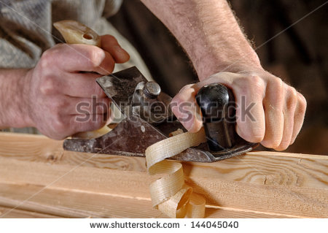
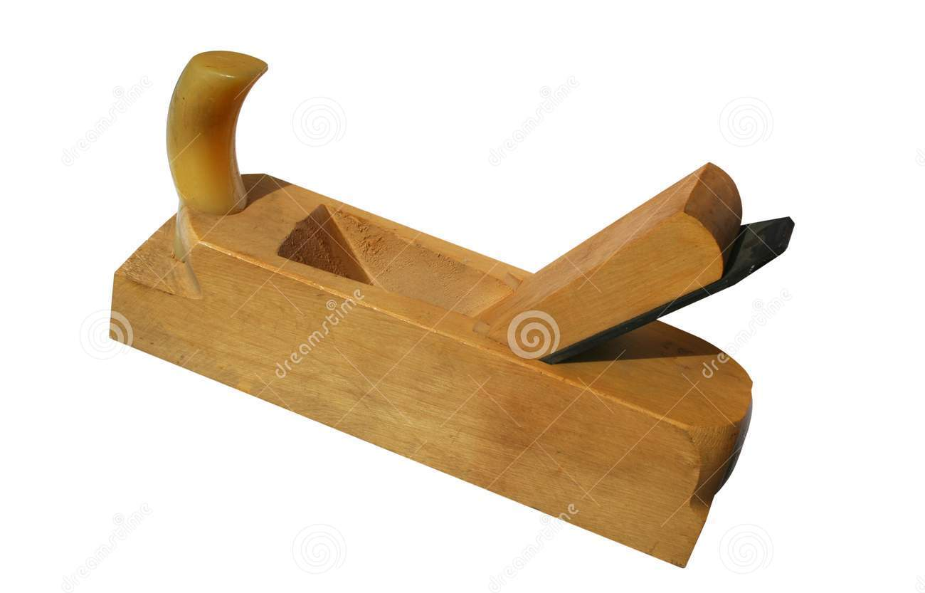
Problem 2.
A carpenter pushes the plane 50 cm. His work is 30 J. Find his force.

Slide 11
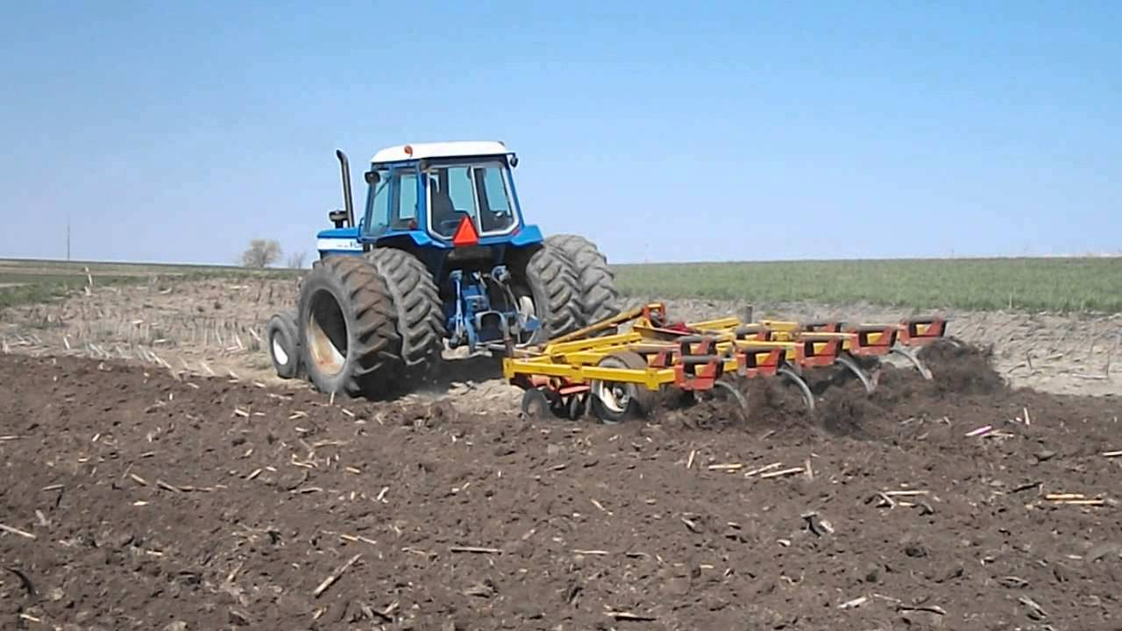
Problem 3.
A tractor pulls the plow with a force of 2500 N. Its work is 500 kJ. Find the distance.

Slide 12
Problem 4.
A weight lifter raises his 150 kg barbell to a height of 2.2 m above the ground. Find his work.

Slide 13
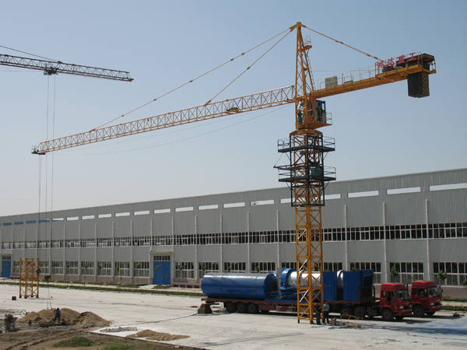
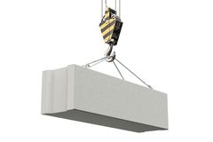
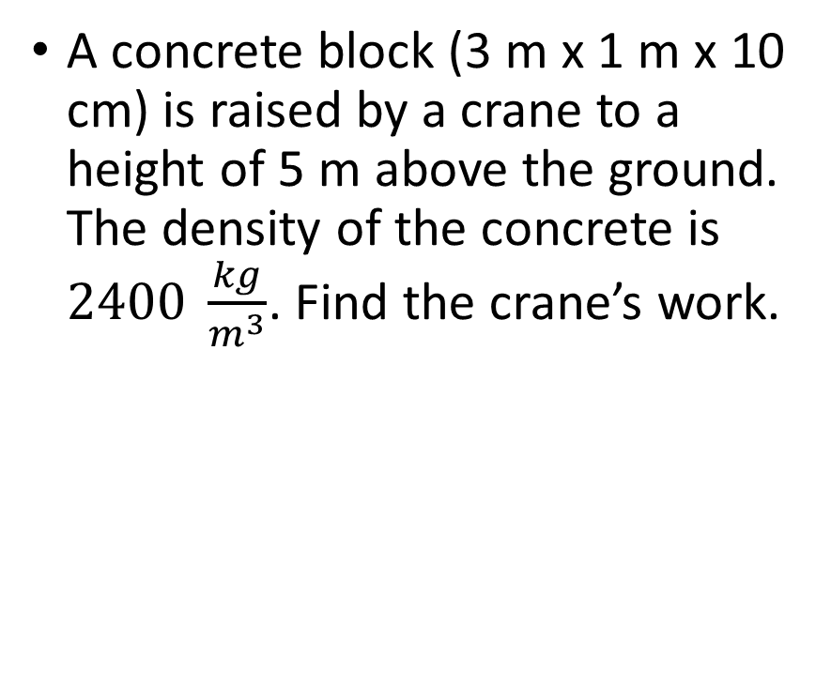
Problem 5.
A concrete block (3 m x 1 m x 10 cm) is raised by a crane to a height of 5 m above the ground. The density of the concrete is $2400 \frac{kg}{m^{3}}$. Find the crane’s work.

