Slide 1
Functions
Domain and Range

Slide 2

Functions vs. Relations
A "relation" is just a relationship between sets of information.
A “function” is a well-behaved relation, that is, given a starting point we know exactly where to go.

Slide 3
Example
People and their heights, i.e. the pairing of names and heights.
We can think of this relation as ordered pair:
(height, name)
Or
(name, height)

Slide 4
Example (continued)
Name | Height
Joe=1 | 6’=6
Mike=2 | 5’9”=5.75
Rose=3 | 5’=5
Kiki=4 | 5’=5
Jim=5 | 6’6”=6.5

Slide 5
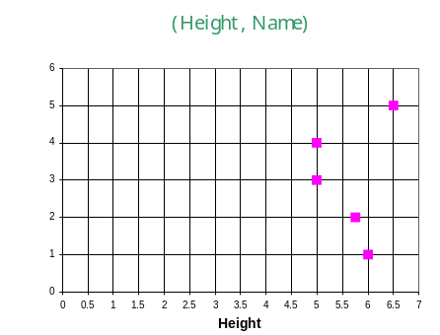
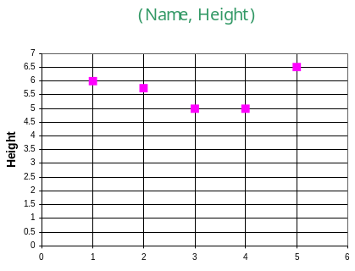
Jim
Kiki
Rose
Mike
Joe
Joe
Mike
Rose
Kiki
Jim
Both graphs are relations
(height, name) is not well-behaved .
Given a height there might be several names corresponding to that height.
How do you know then where to go?
For a relation to be a function, there must be exactly one y value that corresponds to a given x value.

Slide 6
Conclusion and Definition
Not every relation is a function.
Every function is a relation.
Definition:
Let X and Y be two nonempty sets.
A function from X into Y is a relation that associates with each element of X exactly one element of Y.

Slide 7
Recall, the graph of (height, name):
What happens at the height = 5?

Slide 8
Vertical-Line Test
A set of points in the xy-plane is the graph of a function if and only if every vertical line intersects the graph in at most one point.

Slide 9
Representations of Functions
Verbally
Numerically, i.e. by a table
Visually, i.e. by a graph
Algebraically, i.e. by an explicit formula

Slide 10
Ones we have decided on the representation of a function, we ask the following question:
What are the possible x-values (names of people from our example) and y-values (their corresponding heights) for our function we can have?

Slide 11
Recall, our example: the pairing of names and heights.
x=name and y=height
We can have many names for our x-value, but what about heights?
For our y-values we should not have 0 feet or 11 feet, since both are impossible.
Thus, our collection of heights will be greater than 0 and less that 11.

Slide 12
We should give a name to the collection of possible x-values (names in our example)
And
To the collection of their corresponding y-values (heights).
Everything must have a name ☺

Slide 13
Variable x is called independent variable
Variable y is called dependent variable
For convenience, we use f(x) instead of y.
The ordered pair in new notation becomes:
(x, y) = (x, f(x))
Y=f(x)
(x, f(x))
x

Slide 14
Domain and Range
Suppose, we are given a function from X into Y.
Recall, for each element x in X there is exactly one corresponding element y=f(x) in Y.
This element y=f(x) in Y we call the image of x.
The domain of a function is the set X. That is a collection of all possible x-values.
The range of a function is the set of all images as x varies throughout the domain.

Slide 15
Our Example
Domain = {Joe, Mike, Rose, Kiki, Jim}
Range = {6, 5.75, 5, 6.5}

Slide 16

More Examples
Consider the following relation:
Is this a function?
What is domain and range?

Slide 17
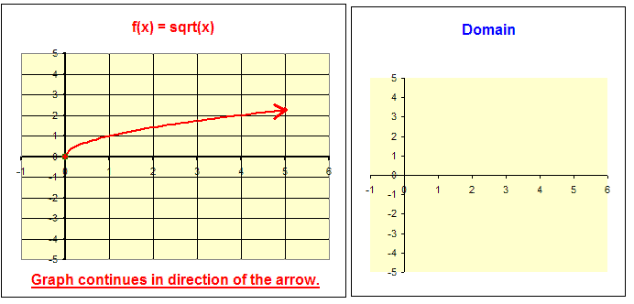
Visualizing domain of

Slide 18
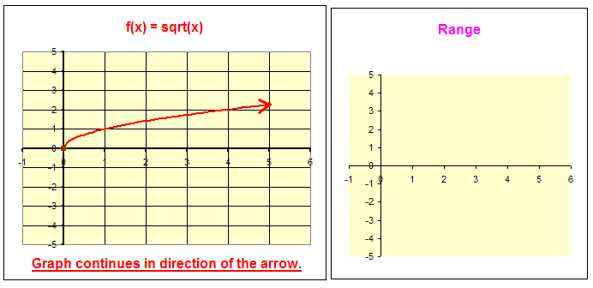
Visualizing range of

Slide 19
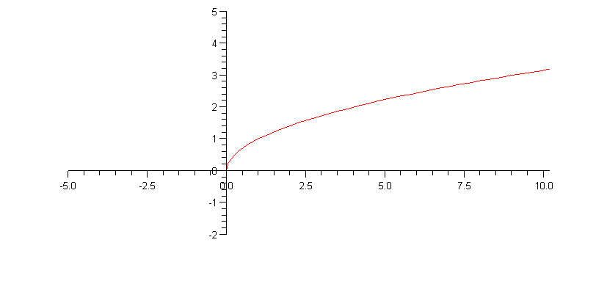
Domain = [0, ∞) Range = [0, ∞)

Slide 20
More Functions
Consider a familiar function.
Area of a circle:
A(r) = πr²
What kind of function is this?
Let’s see what happens if we graph A(r).

Slide 21
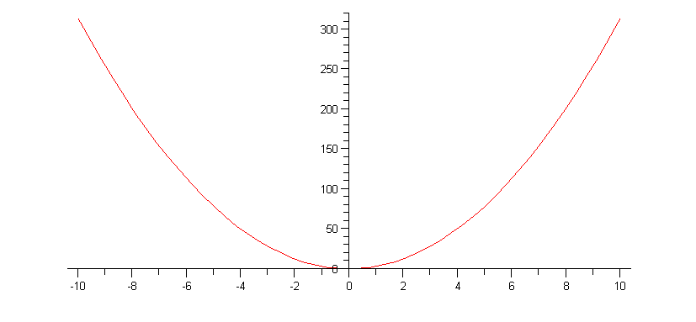
Graph of A(r) = πr²
A(r)
r
Is this a correct representation of the function for the area of a circle???????
Hint: Is domain of A(r) correct?

Slide 22
Closer look at A(r) = πr²
Can a circle have r ≤ 0 ?
NOOOOOOOOOOOOO
Can a circle have area equal to 0 ?
NOOOOOOOOOOOOO

Slide 23
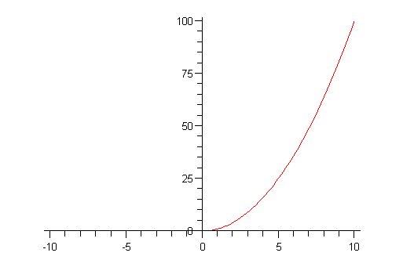
Domain and Range of A(r) = πr²
Domain = (0, ∞) Range = (0, ∞)

Slide 24
Just a thought…
Mathematical models that describe real-world phenomenon must be as accurate as possible.
We use models to understand the phenomenon and perhaps to make a predictions about future behavior.
A good model simplifies reality enough to permit mathematical calculations but is accurate enough to provide valuable conclusions.
Remember, models have limitations. In the end, Mother Nature has the final say.

