Slide 1
Projectiles
Hajítások

Slide 2
Projectiles
Vertically launched projectiles
Horizontally launched projectiles
Non-horizontally launched projectiles

Slide 3
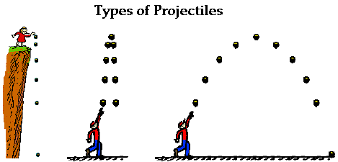
Vertically launched projectiles
Downward
Upward

Slide 4
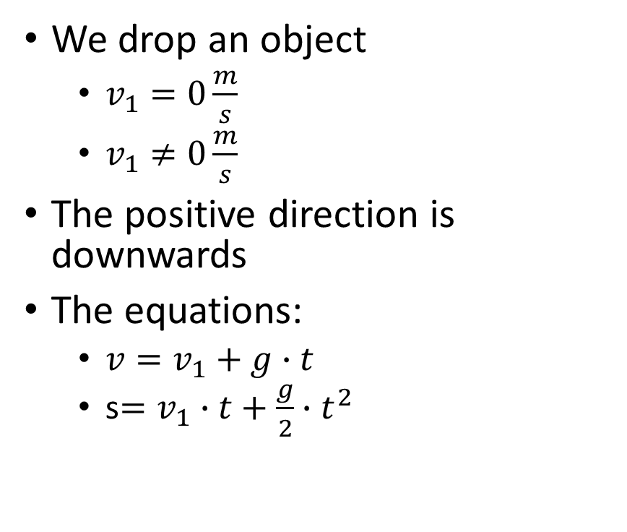
Vertically launched projectile - downwards
We drop an object
$v_{1}=0\frac{m}{s}$
$v_{1}≠0\frac{m}{s}$
The positive direction is downwards
The equations:
$v=v_{1}+g∙t$
s$=v_{1}∙t+\frac{g}{2}∙t^{2}$
+

Slide 5
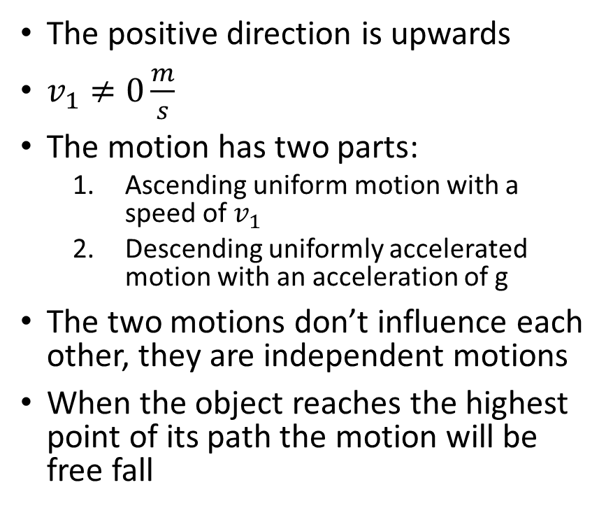
Vertically launched projectile - upwards
The positive direction is upwards
$v_{1}≠0\frac{m}{s}$
The motion has two parts:
Ascending uniform motion with a speed of $v_{1}$
Descending uniformly accelerated motion with an acceleration of g
The two motions don’t influence each other, they are independent motions
When the object reaches the highest point of its path the motion will be free fall
+

Slide 6
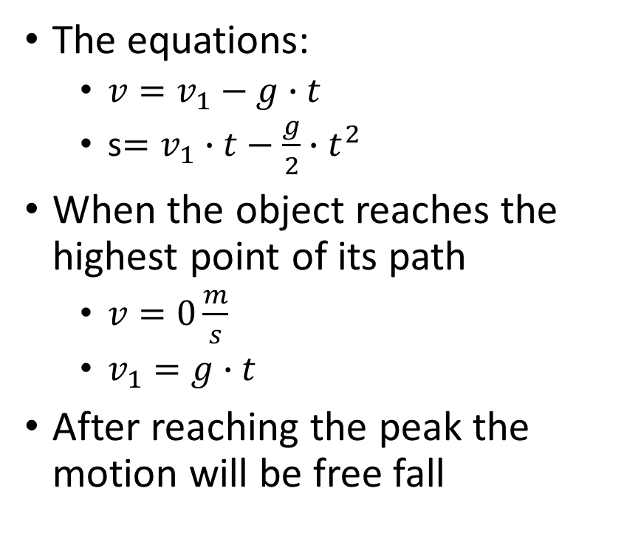
The equations:
$v=v_{1}−g∙t$
s$=v_{1}∙t−\frac{g}{2}∙t^{2}$
When the object reaches the highest point of its path
$v=0\frac{m}{s}$
$v_{1}=g∙t$
After reaching the peak the motion will be free fall

Slide 7
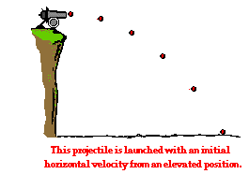
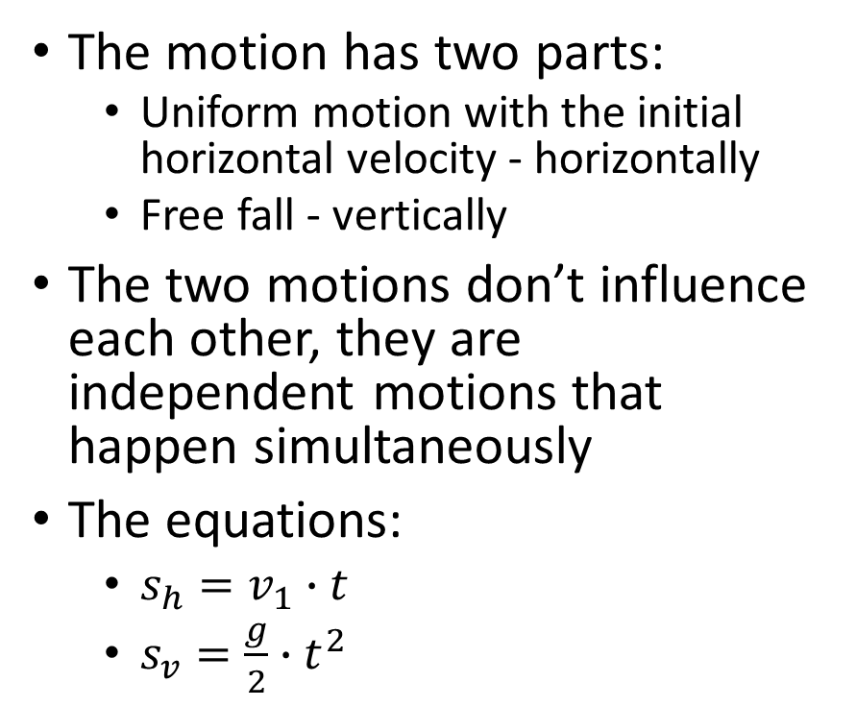
Horizontally launched projectile
The motion has two parts:
Uniform motion with the initial horizontal velocity - horizontally
Free fall - vertically
The two motions don’t influence each other, they are independent motions that happen simultaneously
The equations:
$s_{h}=v_{1}∙t$
$s_{v}=\frac{g}{2}∙t^{2}$

