Slide 1
Spring
is coming

Slide 2

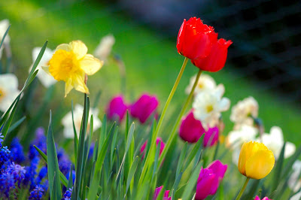
Spring
First Day of Spring
March 20.
The spring equinox-The vernal equinox
The length of day and night are approximately equal
The fall equinox: 2018. Sept. 23.
The summer solstice: 2018. June 21.
The winter solstice: 2018. Dec. 21.

Slide 3
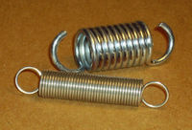
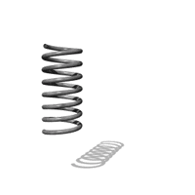
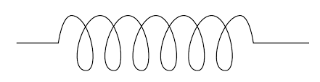
Spring in Physics

Slide 4
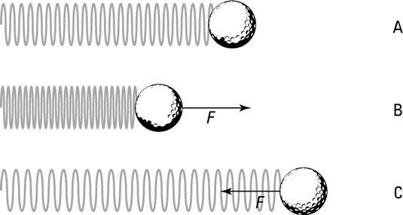
Spring force
When a spring is pushed together and when the pressure is taken away the spring force pops back to its normal self
When a spring is pulled out and the force is taken away the spring force pulls back to its normal self

Slide 5
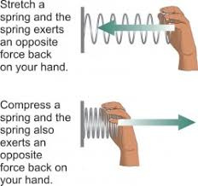
Spring force
if an object applies a force to a spring, then the spring applies an equal and opposite force to the object

Slide 6
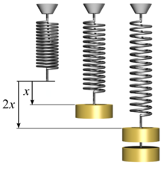
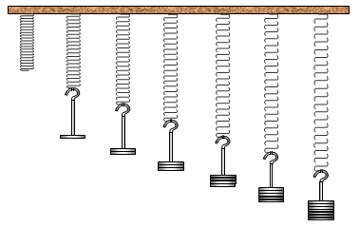
Spring force
The spring force is proportional to the deformation
It depends on the stiffness of the spring
Stiff spring-more force
Weak spring-less force

Slide 7
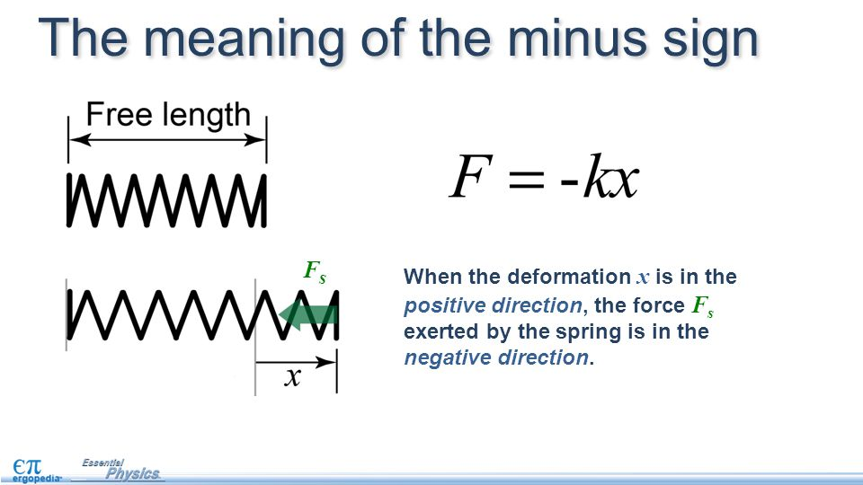
Hooke’s Law
gives the force a spring exerts on an object attached to it
F = –kx
x is the distance the spring is stretched or compressed away from its rest position – deformation
k is the spring constant
k is greater at stiff spring

Slide 8

Spring constant
k
Unit: $\frac{N}{m}$
5 $\frac{N}{m}$ : F=5 N $→x=1 m$

Slide 9
Problem 1.
What is the magnitude of the force required to stretch a 20 cm-long spring, with a spring constant of 100 N/m, to a length of 21 cm?

Slide 10
Problem 2.
What is the spring constant of a spring that needs a force of 3 N to be compressed from 40 cm to 35 cm?

Slide 11

Problem 3.
A 75 kg person stands on a compression spring with spring constant 5000 $\frac{N}{m}$ and rest length 0.25 m. What is the total length of the loaded spring?

Slide 12
Problem 4.
We pull a spring with a force of 10 N. Its extension is going to be 6 cm. Find the spring constant.

