Slide 1
Projectiles
Hajítások

Slide 2
Projectiles
Vertically launched projectiles
Horizontally launched projectiles
Non-horizontally launched projectiles

Slide 3
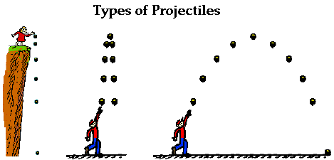
Vertically launched projectiles
Downward
Upward

Slide 4
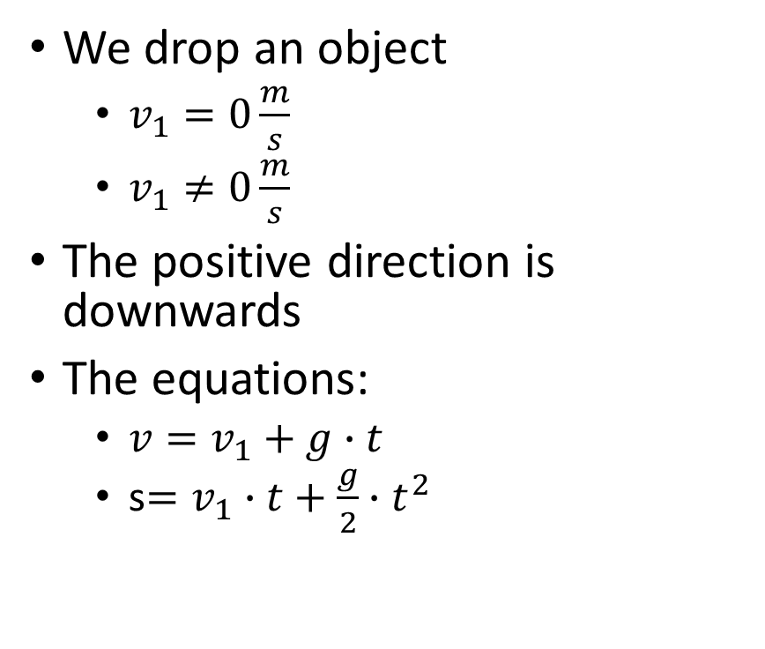
Vertically launched projectile - downwards
We drop an object
$v_{1}=0\frac{m}{s}$
$v_{1}≠0\frac{m}{s}$
The positive direction is downwards
The equations:
$v=v_{1}+g∙t$
s$=v_{1}∙t+\frac{g}{2}∙t^{2}$
+

Slide 5
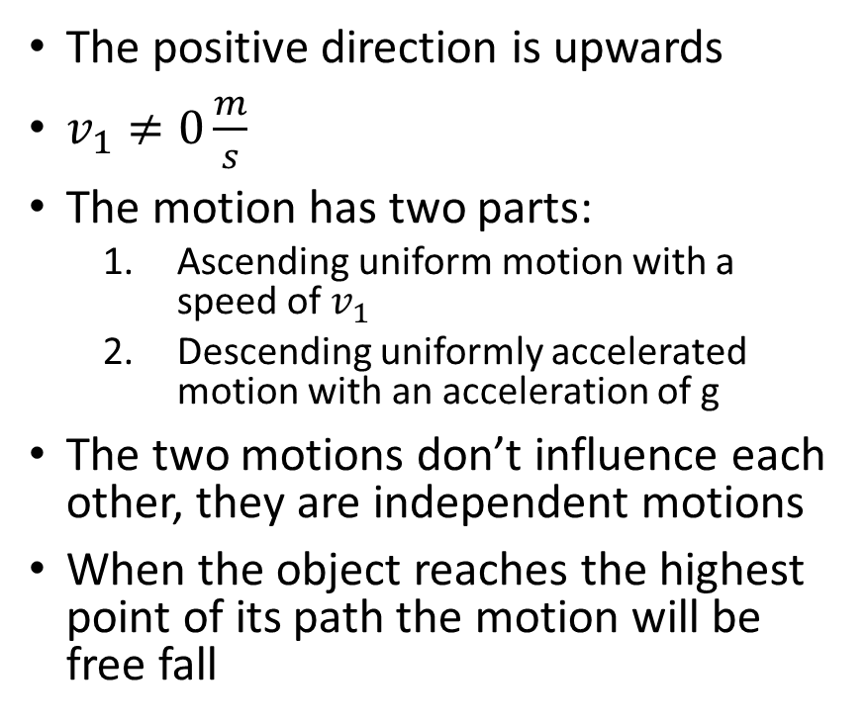
Vertically launched projectile - upwards
The positive direction is upwards
$v_{1}≠0\frac{m}{s}$
The motion has two parts:
Ascending uniform motion with a speed of $v_{1}$
Descending uniformly accelerated motion with an acceleration of g
The two motions don’t influence each other, they are independent motions
When the object reaches the highest point of its path the motion will be free fall
+

Slide 6
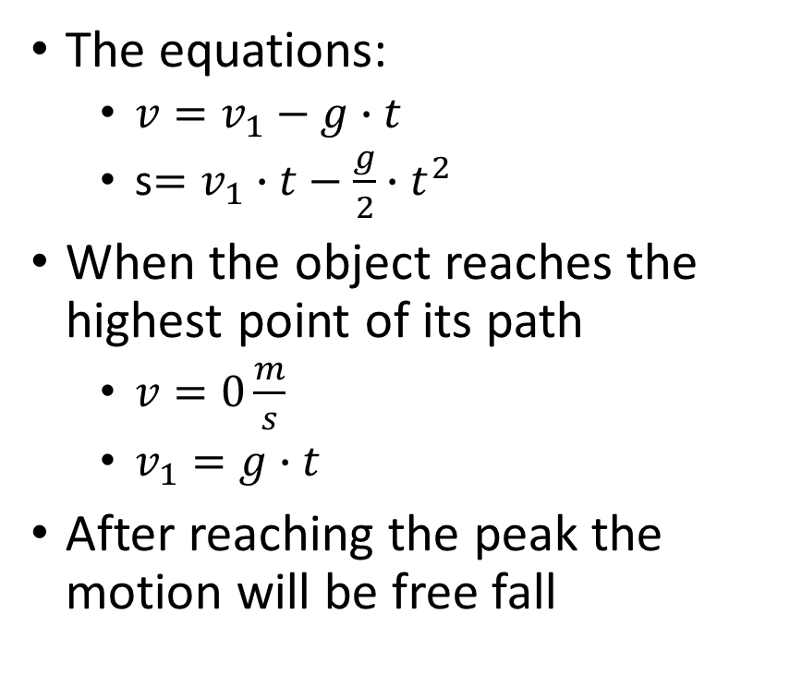
The equations:
$v=v_{1}−g∙t$
s$=v_{1}∙t−\frac{g}{2}∙t^{2}$
When the object reaches the highest point of its path
$v=0\frac{m}{s}$
$v_{1}=g∙t$
After reaching the peak the motion will be free fall

Slide 7
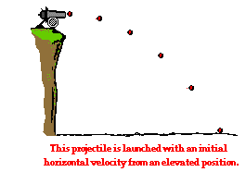
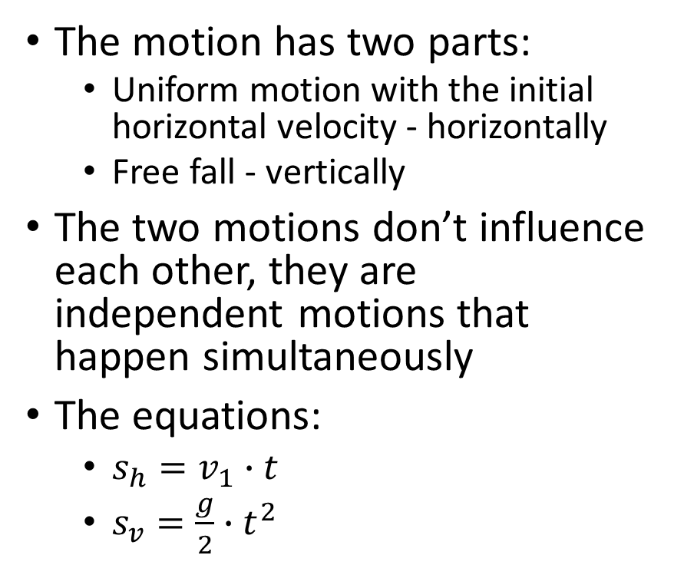
Horizontally launched projectile
The motion has two parts:
Uniform motion with the initial horizontal velocity - horizontally
Free fall - vertically
The two motions don’t influence each other, they are independent motions that happen simultaneously
The equations:
$s_{h}=v_{1}∙t$
$s_{v}=\frac{g}{2}∙t^{2}$

Slide 8
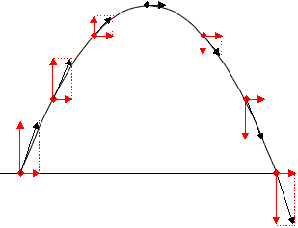
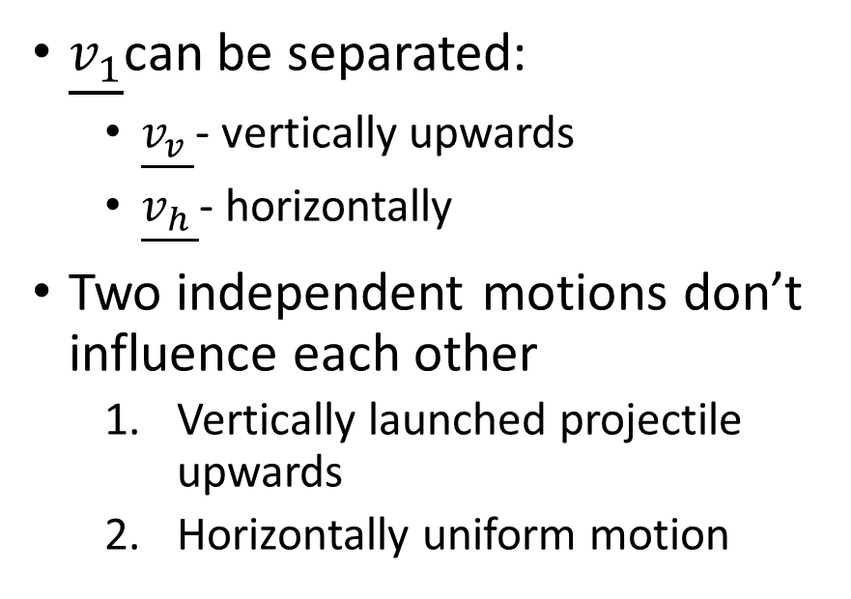
Non-horizontally launched projectile
$\underline{v_{1}}$can be separated:
$\underline{v_{v }}$- vertically upwards
$\underline{v_{h }}$- horizontally
Two independent motions don’t influence each other
Vertically launched projectile upwards
Horizontally uniform motion

Slide 9
Non-horizontally launched projectile
We can calculate:
Ascending and descending time from the vertically launched projectile
Maximum height of the projectile from the vertically launched projectile
Distance of the projectile from the horizontally uniform motion.

Slide 10
Problem solving
A football is kicked with an initial velocity of 25 m/s at an angle of 45-degrees with the horizontal. Determine the time of flight, the horizontal displacement, and the peak height of the football.

