Slide 1
Statics
Statika

Slide 2
Statics
Is the study of forces in equilibrium

Slide 3
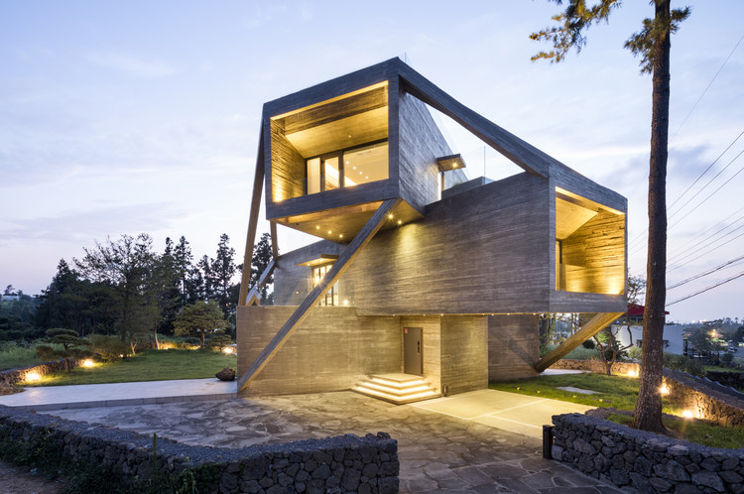
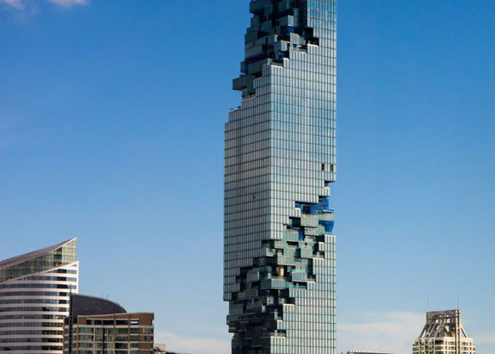
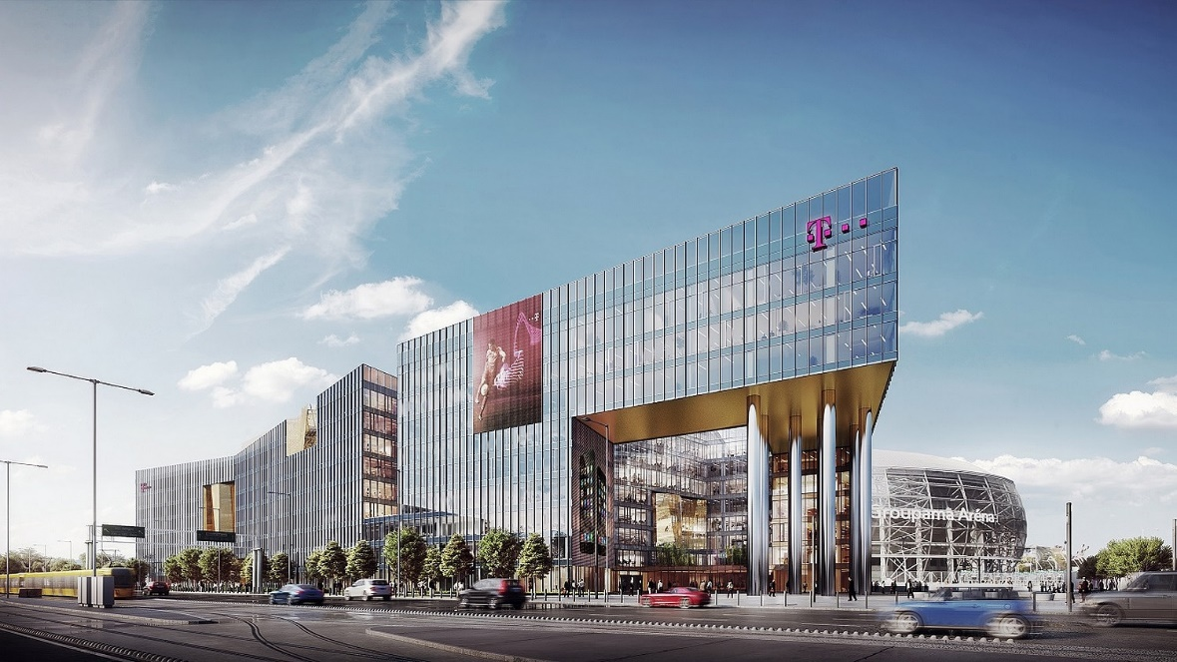


Slide 4
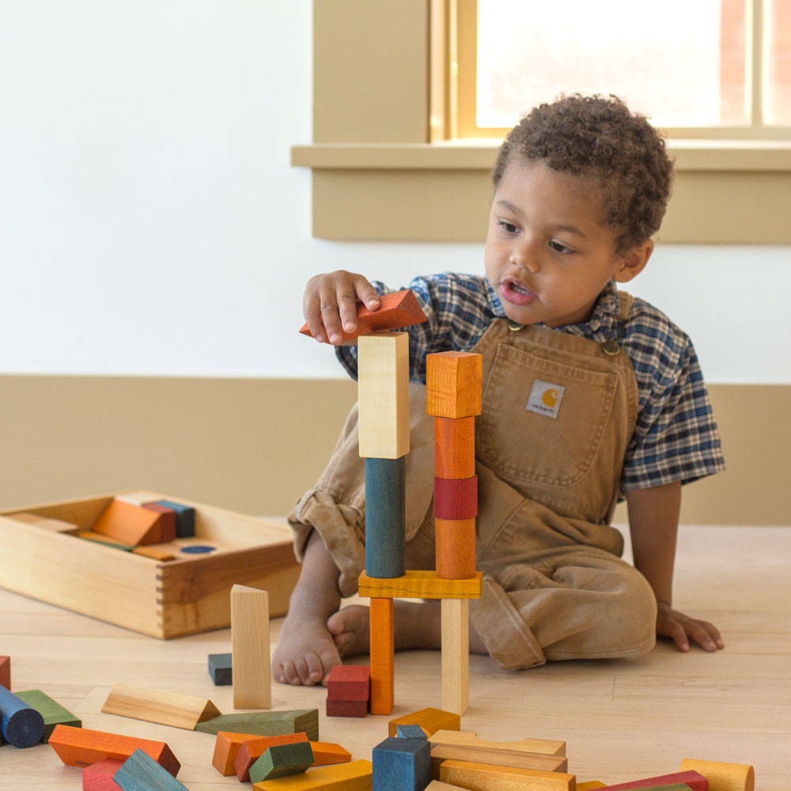

Slide 5
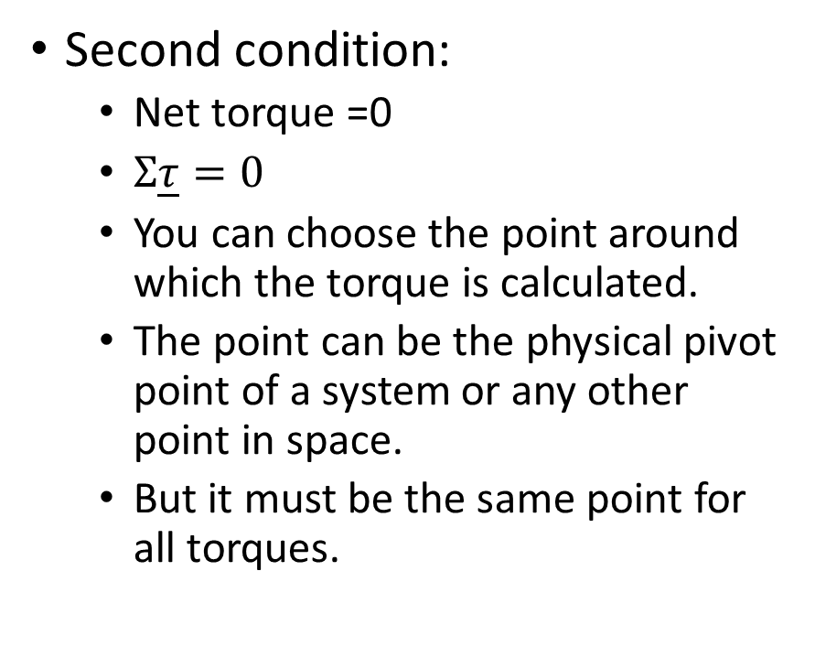

Conditions of equilibrium
First condition:
Net force = 0
$Σ\underline{F}=0$
Second condition:
Net torque =0
$Σ\underline{τ}=0$
You can choose the point around which the torque is calculated.
The point can be the physical pivot point of a system or any other point in space.
But it must be the same point for all torques.

Slide 6
Statics
Point of application - P
is the exact location at which a force is applied to a body
Támadáspont
Line of action – l
is a line that passes through the vector of the force
hatásvonal
F
P
l

Slide 7

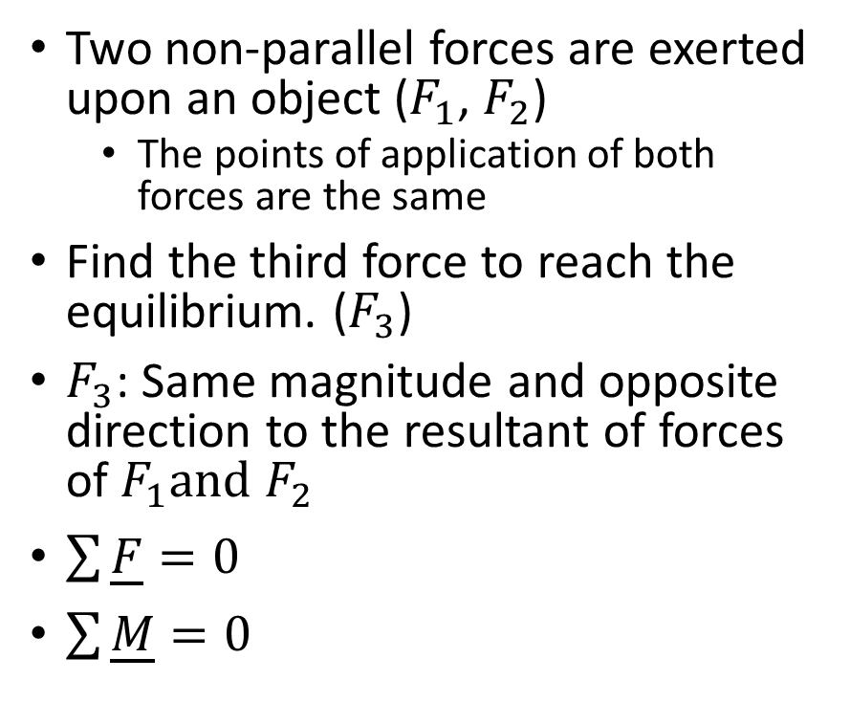



Equilibrium
Two non-parallel forces are exerted upon an object ($F_{1}$, $F_{2}$)
The points of application of both forces are the same
Find the third force to reach the equilibrium. ($F_{3}$)
$F_{3}$: Same magnitude and opposite direction to the resultant of forces of $F_{1}and$ $F_{2}$
$\sum{\underline{F}=0}$
$\sum{\underline{M}=0}$
$$\underline{F_{1}}$$
$$\underline{F_{3}}$$
$$\underline{F_{r12}}$$
$$\underline{F_{2}}$$

Slide 8
The vector of the force can be shifted along the line of action without changing the effect of it.
F
P
l

Slide 9

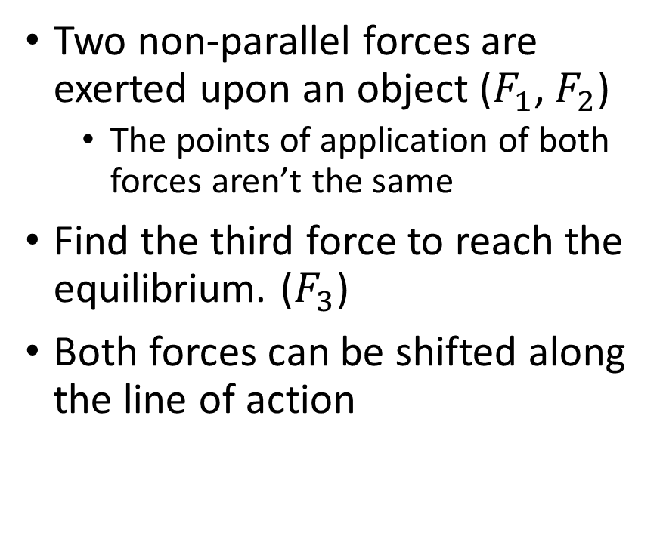

Equilibrium
Two non-parallel forces are exerted upon an object ($F_{1}$, $F_{2}$)
The points of application of both forces aren’t the same
Find the third force to reach the equilibrium. ($F_{3}$)
Both forces can be shifted along the line of action
$$\underline{F_{2}}$$
$$\underline{F_{1}}$$

Slide 10
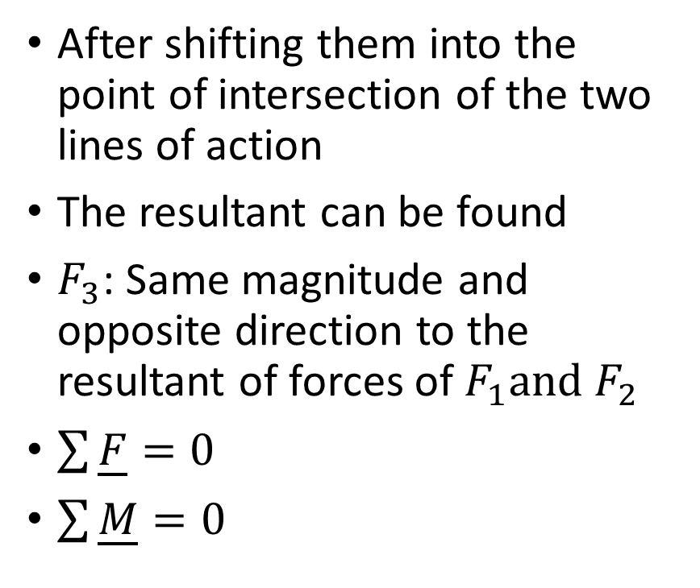


Equilibrium
After shifting them into the point of intersection of the two lines of action
The resultant can be found
$F_{3}$: Same magnitude and opposite direction to the resultant of forces of $F_{1}and$ $F_{2}$
$\sum{\underline{F}=0}$
$\sum{\underline{M}=0}$
$$\underline{F_{12}}$$
$$\underline{F_{2}}$$
$$\underline{F_{1}}$$
$$\underline{F_{3}}$$

Slide 11
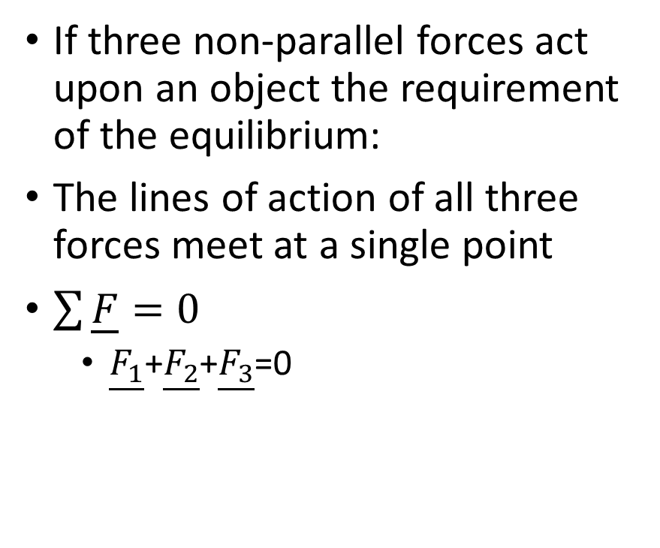
Equilibrium
If three non-parallel forces act upon an object the requirement of the equilibrium:
The lines of action of all three forces meet at a single point
$\sum{\underline{F}=0}$
$\underline{F_{1}}$+$\underline{F_{2}}$+$\underline{F_{3}}$=0

Slide 12
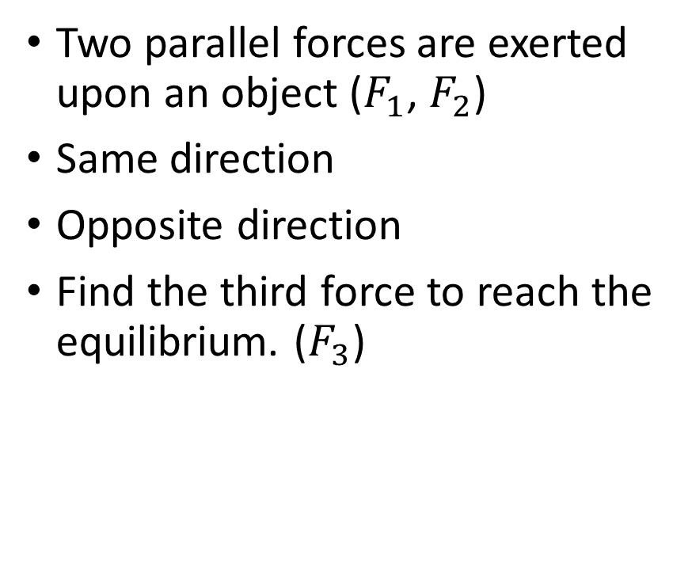
Parallel forces
Two parallel forces are exerted upon an object ($F_{1}$, $F_{2}$)
Same direction
Opposite direction
Find the third force to reach the equilibrium. ($F_{3}$)

Slide 13

Problem 1.
We exert two parallel forces on an object with the same direction. $F_{1}=80 N, F_{2}=20 N,$the distance between them is 100 cm. Find the magnitude of the third force that keeps the object in equilibrium. Find the position of the line of the action.

Slide 14
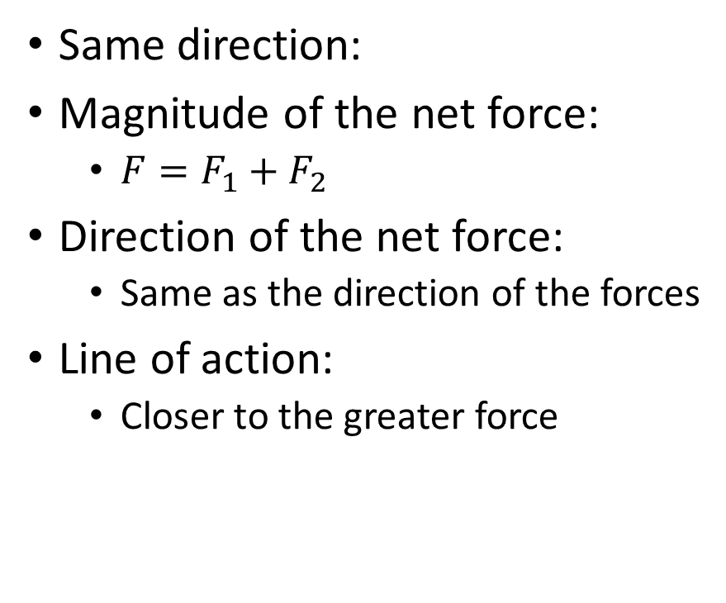

Net force of two parallel forces ${(F}_{1,}F_{2}$)
Same direction:
Magnitude of the net force:
${F=F}_{1}+F_{2}$
Direction of the net force:
Same as the direction of the forces
Line of action:
Closer to the greater force

Slide 15

Problem 2.
We exert two parallel forces on an object with opposite direction. $F_{1}=80 N, F_{2}=20 N.$Find the magnitude of the third force that keeps the object in equilibrium. Find the position of the line of the action.

Slide 16
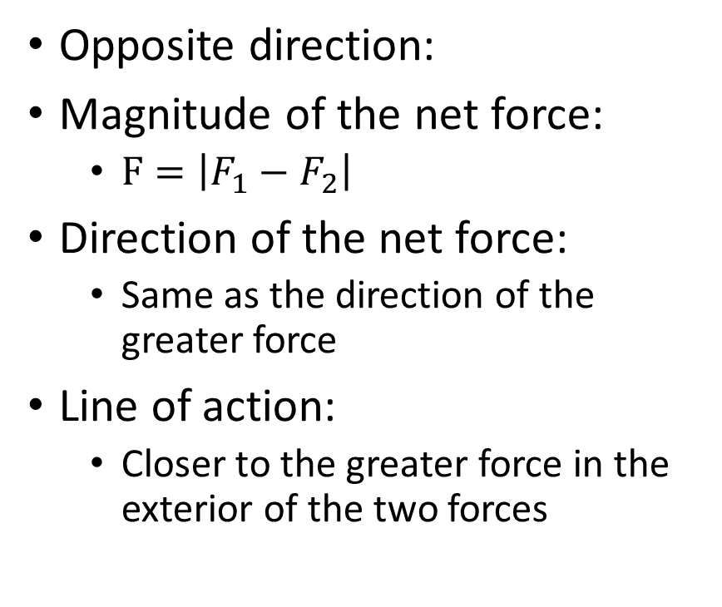
Net force of two parallel forces ${(F}_{1,}F_{2}$)
Opposite direction:
Magnitude of the net force:
$F=\left|F_{1}−F_{2}\right|$
Direction of the net force:
Same as the direction of the greater force
Line of action:
Closer to the greater force in the exterior of the two forces

Slide 17
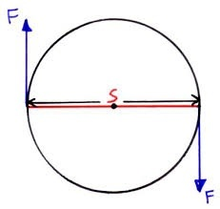
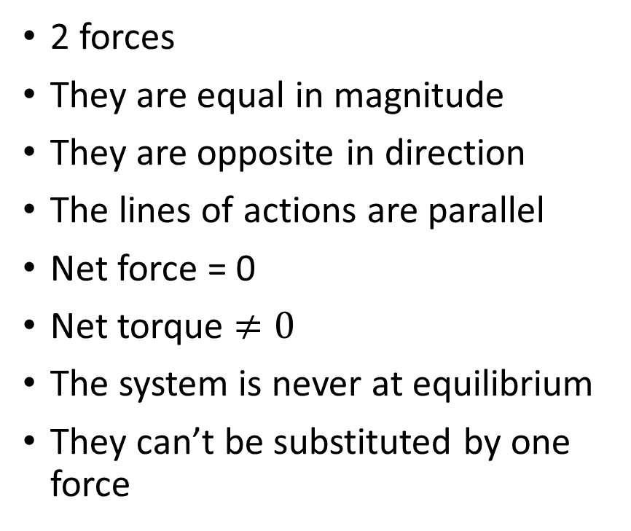
Couple - Erőpár
2 forces
They are equal in magnitude
They are opposite in direction
The lines of actions are parallel
Net force = 0
Net torque $≠0$
The system is never at equilibrium
They can’t be substituted by one force

