Slide 1
Dynamics-Dinamika

Slide 2
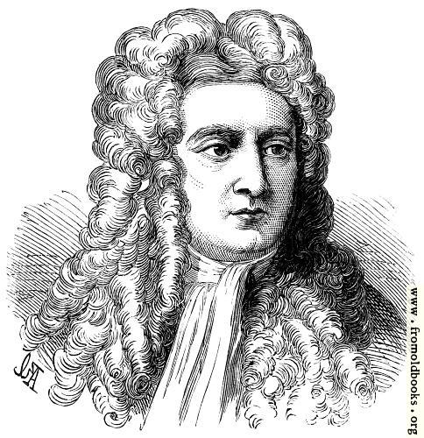
Dynamics
It explains why objects move or don’t move as they do.
Isaac Newton (1642-1727)
https://www.khanacademy.org/science/physics/forces-newtons-laws/newtons-laws-of-motion/v/newton-s-1st-law-of-motion

Slide 3
Newton First Law
Law of an Inertia
Tehetelenség törvénye

Slide 4
Newton First Law
An object
at rest stays at rest
and
an object in motion stays in motion with the same velocity
unless acted upon by an unbalanced force.
Minden test
nyugalomban van
vagy
egyenes vonalban egyenletesen mozog mindaddig,
míg környezete ennek megváltoztatására nem kényszeríti.

Slide 5
https://www.youtube.com/watch?v=LEHR8YQNm_Q

Slide 6
Experiments
Penny on a Card Experiment
a small plastic cup,
a playing card
a coin
a ruler
Procedure
Put a playing card on top of the plastic cup
Put a coin on top of the card
Goal: put the coin into the cup with one movement, you can’t touch the coin or the card only the the ruler
The coin has inertia, meaning it really wants to stay in one place.
If you move the card slowly, it isn’t fast enough to overcome that force.
If you flick it quickly, the coin stays in one place and then drops into the cup.
An object at rest will remain at rest.

Slide 7
Pendulum on a bus
In a bus a rope is attached to the ceiling
At the other end of the rope a heavy ball is hanging
What’s happening with this pendulum
When the bus is starting
When the bus is braking
When the bus is turning
Why?
When the bus is starting
The ball is moving backwards
When the bus is braking
The ball is moving forward
When the bus is turning
The ball is moving in the opposite direction
Newton’s First Law
The ball has inertia, meaning it really wants to stay in one place or keep moving

Slide 8
Why should you hold on to something if you stand on a bus?
Why do you shake a dust cloth?
If you shake an apple tree why do the apples fall off?
An astronaut steps out of the moving spacecraft. Why doesn’t he get left behind?
Why is it dangerous to jump off a moving train?
+1: What did Newton do with the apple that fell on his head?

Slide 9
Inertial frame of reference
Frame of reference in which Newton’s First Law is true

Slide 10
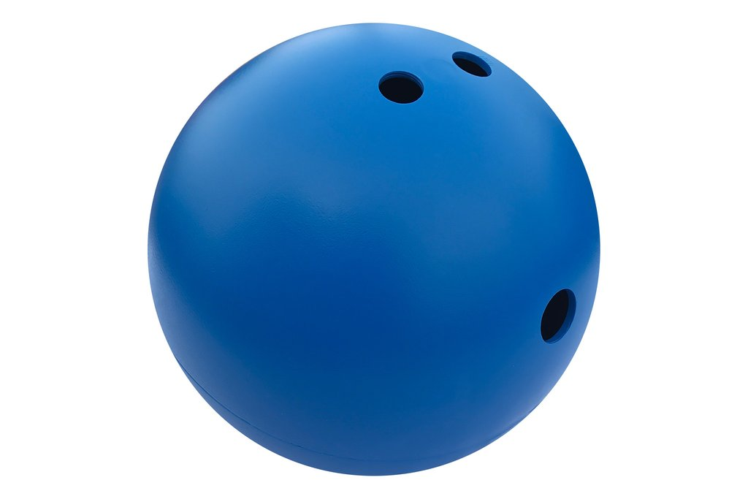
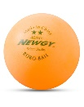
Mass
Every object has inertia
Inertia is a tendency of an object to resist a change in state of motion
Mass = a measure of inertia
https://www.youtube.com/watch?v=1kjgVcflx0Y

Slide 11

Density
Symbol: $ρ (ró)$
$ρ=\frac{m}{V}$
$ρ=\frac{mass}{Volume}$
Unit: $\frac{kg}{m^{3}}$
Other units:$\frac{kg}{{dm}^{3}}$, $\frac{g}{{cm}^{3}}$

Slide 12
Word problem

