Slide 1
Kinematics

Slide 2
Kinematics
Branch of Physics that studies the motion of objects without consideration of the cause of their motion
The word comes from Greek “κίνημα” (kinema) = movement, motion
A known word with same root:
cinema

Slide 3
Motion
Objects are in motion all around of us.

Slide 4
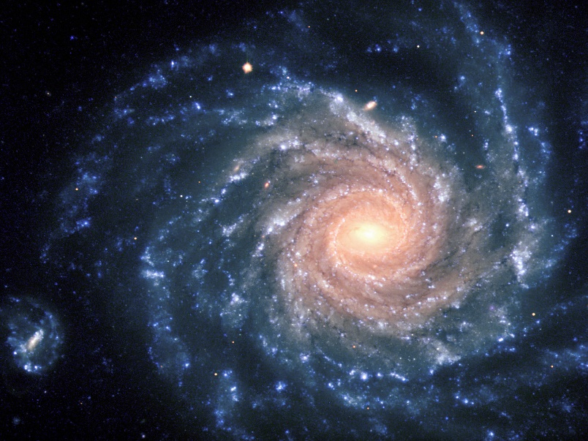

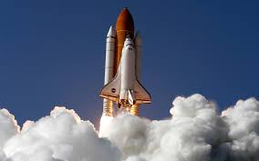
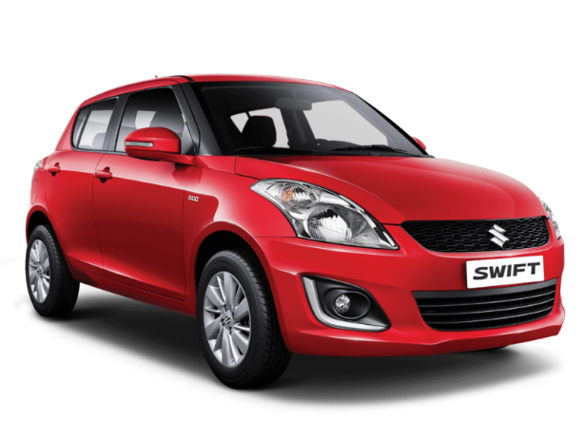
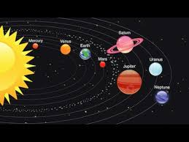
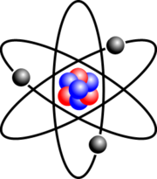
Motion

Slide 5
Questions can arise
How long will it take for a space probe to travel to Mars?
Where will a football land if thrown at a certain angle?
How long will it take for us to reach our destination by car?

Slide 6
Describing the motion of an object
Describing its position – where it is at any particular time
Object: up, down, in front of, behind, moves, stays at place etc. is relative
https://www.youtube.com/watch?v=pyBNImQkRuk
We must be able to check the object’s position and motion relative to something else

Slide 7
Frame of reference, Reference frame
An object or a system of objects to what we relate the motion.
Most convenient
Car-
earth’s surface
Sailor –
deck of the ship
Person in an airplane –
airplane
Planet –
the sun
Electron in an atom –
the atom’s nucleus
Key: the proper frame of reference
Motion of same objects from different frame of reference can be really different.

Slide 8
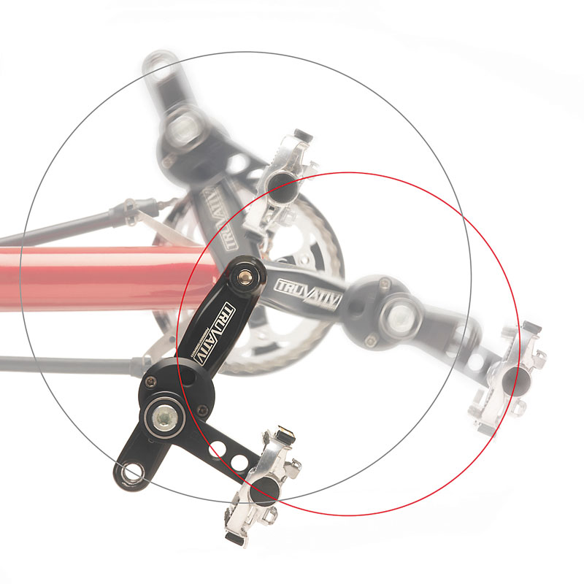
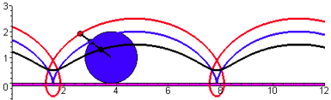
Motion of a point of the pedal of a bicycle
From the point of view of the cyclist:
From the point of view of someone standing on the road:

Slide 9
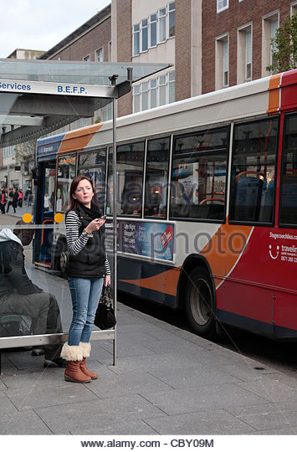

In a reference frame an object is moving
In another reference frame the same object stays at place

Slide 10
Reference frame
Earth
An object that stays at place on the surface of the Earth
A moving vehicle

Slide 11
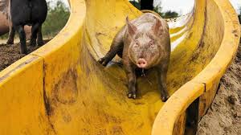
Pointlike object
Every portion of an object moves in the same direction and at the same rate
A pig slipping down a straight playground slide might be considered to be moving like a particle

Slide 12
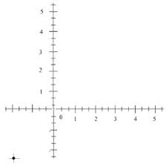
Coordinate system
We can describe the position of an object with numbers

Slide 13
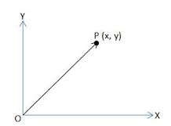
Position vector
It starts at the origin and ends at point P

Slide 14
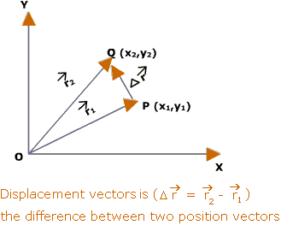
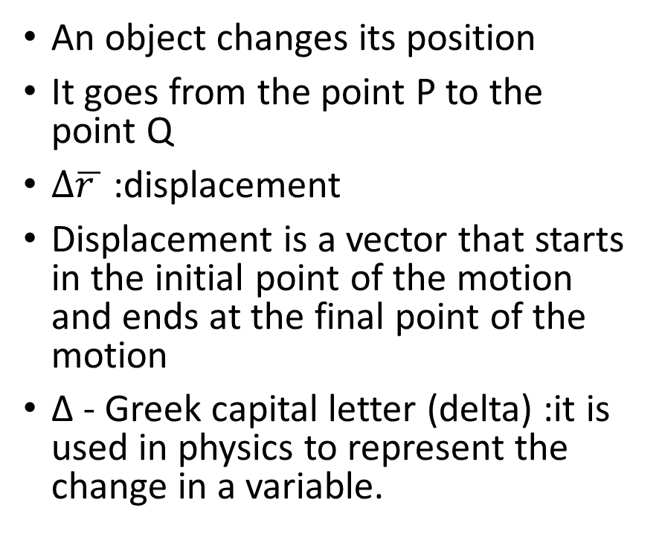
Motion
An object changes its position
It goes from the point P to the point Q
$∆\overline{r }$ :displacement
Displacement is a vector that starts in the initial point of the motion and ends at the final point of the motion
Δ - Greek capital letter (delta) :it is used in physics to represent the change in a variable.

Slide 15
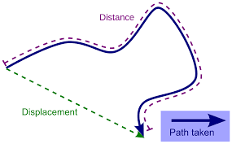
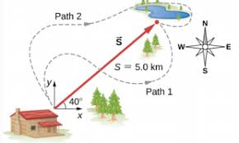
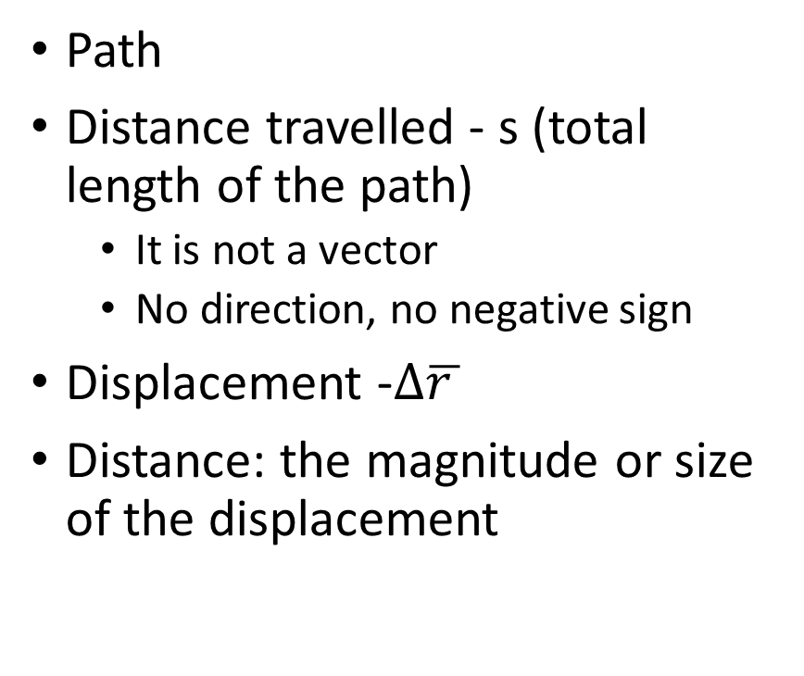
Terms
Path
Distance travelled - s (total length of the path)
It is not a vector
No direction, no negative sign
Displacement -$∆\overline{r }$
Distance: the magnitude or size of the displacement

Slide 16
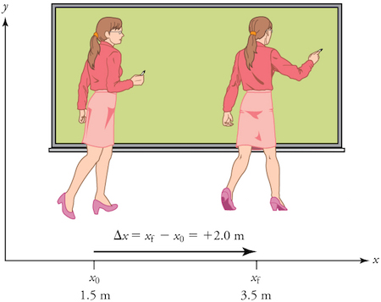
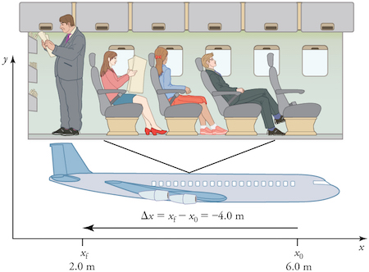

Slide 17
Displacement
It is a vector: it has a direction as well as a magnitude
It is represented an arrow that points from the initial position to the final position

Slide 18
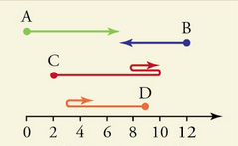
Example 1: Displacement of four moving objects
Four objects move according to the paths shown in the diagram below. Assume the units of the horizontal scale are given in meters.
A: Δx​_{A} = 7 m – 0m = 7m
Object A had an initial position of 0 m and a final position of 7m
B: Δx​_{B}​​=7 m−12 m=−5 m
C:Δx​_{C}​​=10 m−2 m=+8 m
D: Δx​_{D}​​=5 m−9 m=−4 m

Slide 19
Example 2: Distance traveled of four moving objects
Four objects move according to the paths shown in the diagram below. Assume the units of the horizontal scale are given in meters.
A: s = 7m
B: s = 5m
C: s = 8 + 2 + 2 = 12 m
D: s= 6 + 2 = 8 m
Total distance of 8m

Slide 20
Source: https://www.khanacademy.org/science/physics/one-dimensional-motion/displacement-velocity-time/a/what-is-displacement

