Slide 1
Galileo Galilei

Slide 2
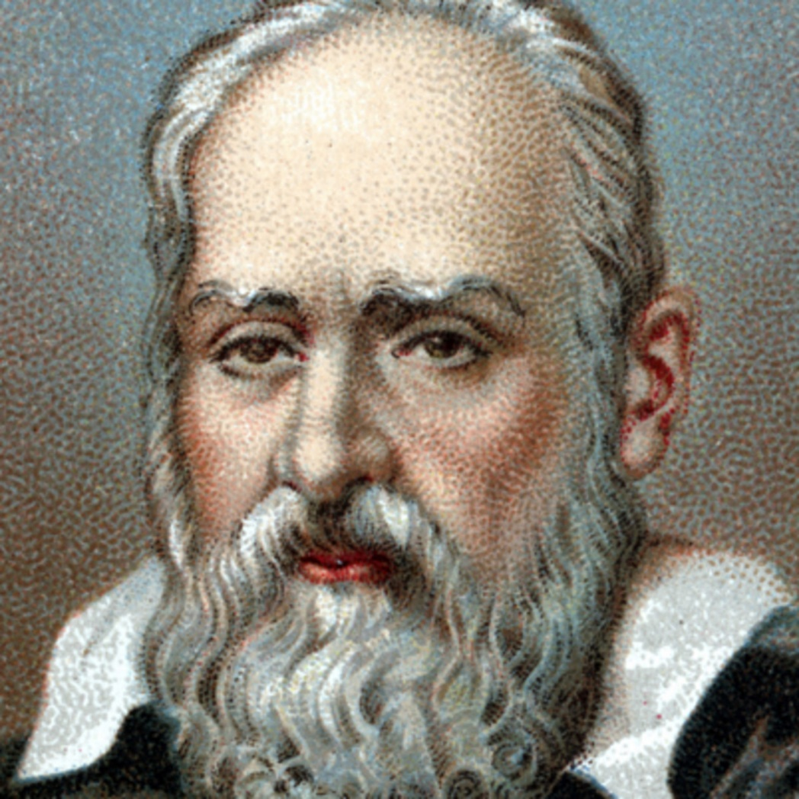
Galileo Galilei
1564-1642
Pisa, Italy

Slide 3
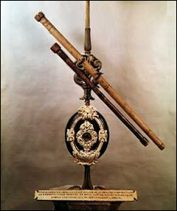
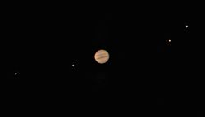
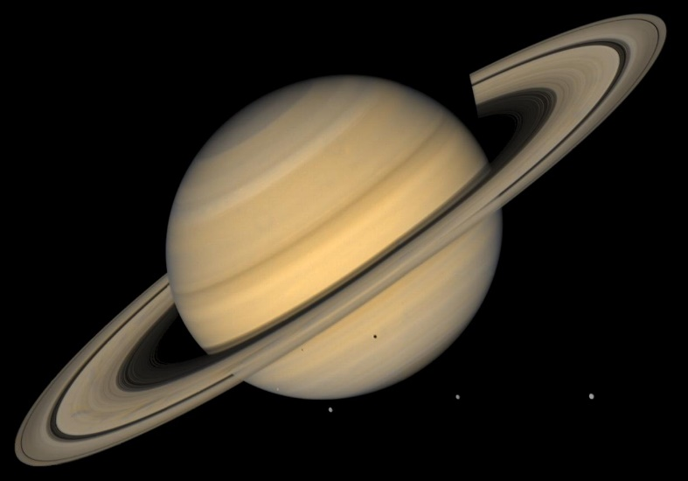
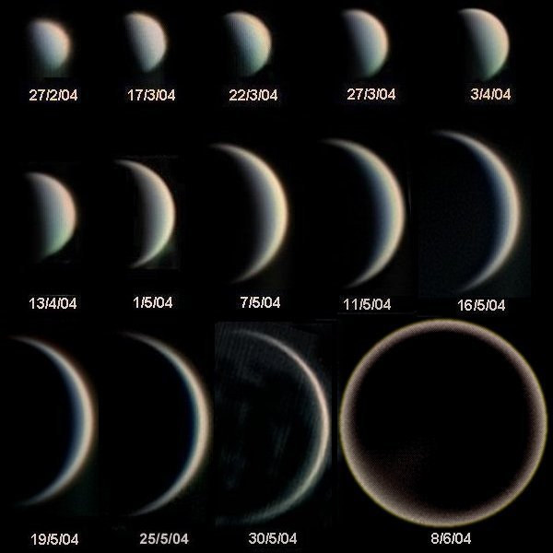
Discoveries
First telescope -1609
4 moons of Jupiter-Galilean satellites
Io, Europa, Ganymede, Callisto
Rings of Saturn
Phases of Venus

Slide 4
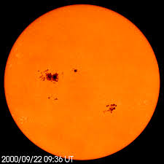
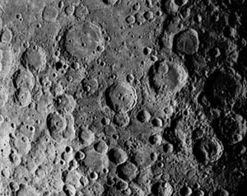
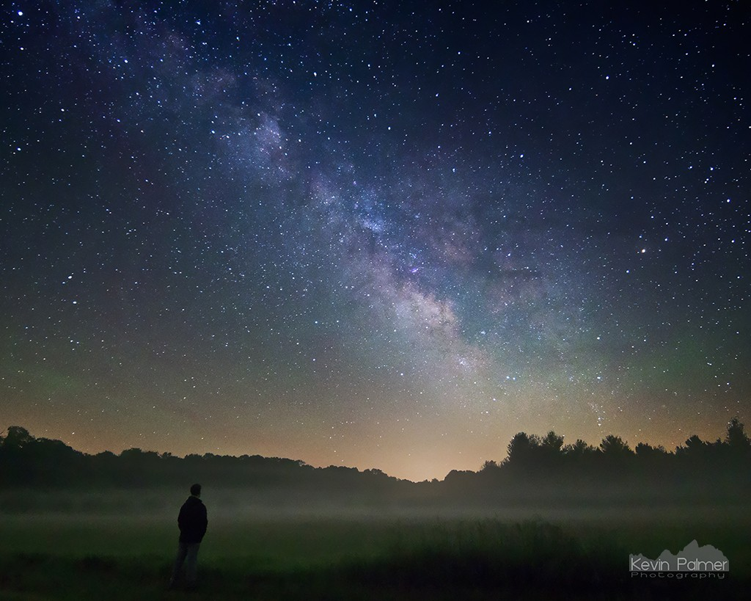
Discoveries
Sunspots
Mountains and craters on the Moon
Milky way
Previously-nebulous
Multitude of stars

Slide 5
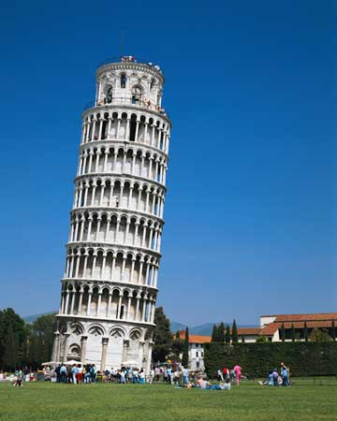
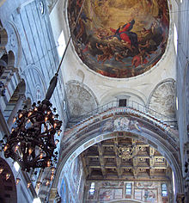
Discoveries
Experimental work on the motion of the bodies
Dropped balls of the same material but different masses from the Leaning Tower of Pisa
Previously: their time of descent was independent of their mass
Contrary to Aristotle: heavy objects fall faster than lighter ones
Pendulum-bronze chandelier of cathedral of Pisa

Slide 6
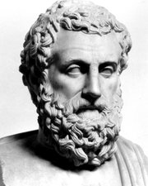
Scientific methods
Proved his theories with experiments and mathematical methods
Before (Until the XVI. Century)
Aristotle (384-322 BC)
“Ipse dixit!”
“He himself said it!”
Assertion without proof

Slide 7
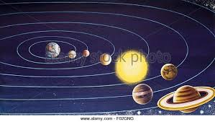
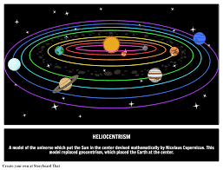
Heliocentrism
Jupiter’s moons changed their position
There circled Jupiter not Earth
The Earth circles the Sun
Aristotle-geocentrism
Conflict with the Church
Earth was the center of the Universe- heavenly bodies revolved around the Earth

Slide 8
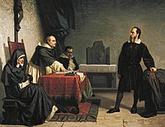
Inquisition
Reinterpet the Bible
1616 - Order: to abandon the opinion of heliocentrism
Not to hold, teach or defend it in any way
1633 –
house arrest
His book was banned
He recanted his theory
“And yet it moves”
He was rehabilitated in
1992!

Slide 9
Videos
Albert Einstein: Father of modern science
https://www.youtube.com/watch?v=E43-CfukEgs

