Slide 1
Momentum

Slide 2

Momentum
https://www.youtube.com/watch?v=DoxkySFRrxI
$\underline{p}=m∙v$
Unit: $kg∙\frac{m}{s}$
Vector quantity

Slide 3
Determine the momentum of …
a. … an electron (m= 9.1 x10⁻³¹ kg) moving at 2.18 x 10⁶ m/s (as if it were in a Bohr orbit in the H atom).
b. … a 0.45 Caliber bullet (m = 0.162 kg) leaving the muzzle of a gun at 860 m/s.
c. … a 110-kg professional fullback running across the line at 9.2 m/s.
d. … a 360,000-kg passenger plane taxiing down a runway at 1.5 m/s

Slide 4

Calculate your momentum when you walk with a speed of $0.5\frac{m}{s}$.
The mass of a car is 1000 kg, its speed is $72\frac{km}{h}$. Find the momentum.
An object’s mass is 2 kg and it falls free from the height of 4 m. Find the initial and the final momentum and the change of momentum.

Slide 5
A bicycle has a momentum of 24 kg•m/s. What momentum would the bicycle have if it had …
a. … twice the mass and was moving at the same speed?
b. … the same mass and was moving with twice the speed?
c. … one-half the mass and was moving with twice the speed?
d. … the same mass and was moving with one-half the speed?
e. … three times the mass and was moving with one-half the speed?
f. … three times the mass and was moving with twice the speed?

Slide 6
Conservation
The term conservation refers to something which doesn’t change
This means that a conserved quantity is constant over the time
It has same value both before and after an event
In mechanics there are three fundamental quantities which are conserved:
Momentum
Energy
Angular momentum

Slide 7
Isolated system
Conservation of momentum applies only to an isolated system of objects
Isolated system: It’s not acted upon by force external to the system

Slide 8
Momentum Conservation Principle
Conservation of momentum is mostly used for describing collision between objects
For a collision occurring between object 1 and object 2 in an isolated system
The total momentum of the two objects before the collision is
equal to the total momentum of the two objects after the collision.
The momentum lost by object 1 is equal to the momentum gained by object 2.
The total momentum of a collection of objects (a system) is conserved - that is, the total amount of momentum is a constant or unchanging value
It’s true only in case of isolated system
Conserved- constant, not changing
Law of momentum conservation

Slide 9
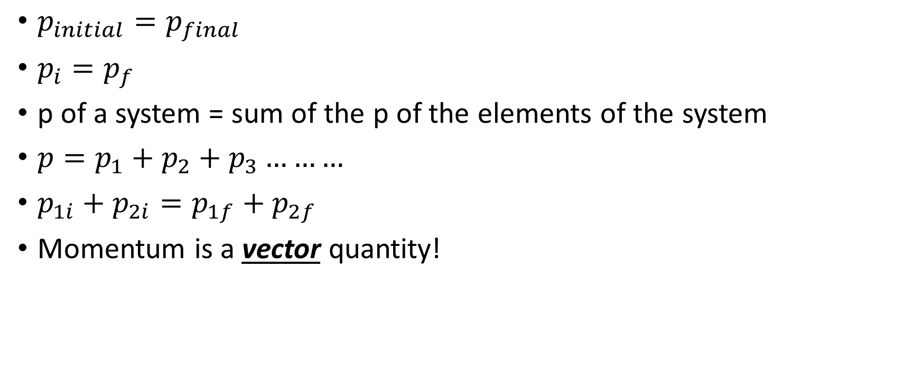
Momentum Conservation Principle
$p_{initial}=p_{final}$
$p_{i}=p_{f}$
p of a system = sum of the p of the elements of the system
$p=p_{1}+p_{2}+p_{3}………$
$p_{1i}+p_{2i}=p_{1f}+p_{2f}$
Momentum is a vector quantity!

Slide 10
Recoil of guns
https://www.youtube.com/watch?v=aMTSaeo85TE
Classic problem:
There is a wheeled, 500 kg cannon firing a 2 kg cannonball horizontally from a ship. The ball leaves the cannon traveling at 200 m/s. At what speed does the cannon recoil as a result?

Slide 11
Problem 2.
Suppose a 100 kg football player is at rest on an ice rink. A friend throws a 0.4 kg football towards him at a speed of 25 m/s. In a smooth motion he receives the ball and throws it back in the same direction at a speed of 20 m/s. What is the speed of the player after the throw?

Slide 12

Problem 3.
Two small cars with a mass of 250 g and 500 g connected with a spring. We push them apart by the spring and the lighter car’s velocity will be $1\frac{m}{s}$. Find the velocity of the other car.

Slide 13
Problem 4.
A car of 500 kg, traveling at 30 m/s rear ends another car of 600 kg, traveling at 20 m/s. in the same direction The collision is great enough that the two cars stick together after they collide. How fast will both cars be going after the collision?

Slide 14
Homework
There is a cart with a mass of 30 kg. A kid of 45 kg stands on the cart. He runs from the cart backwards with a velocity of 2 m/s. Find the velocity of the cart.
A gun fires a bullet of 30 g with a speed of 800 m/s. Find the speed of the gun after recoiling. The gun’s mass without the bullet is 6 kg.
There is a boat of 200 kg on a lake at rest. A kid of 50 kg jumps off the boat with a speed of 4 m/s. Find the boat’s velocity.
A ball of 86 g moves with a speed of 30 cm/s. It hits another ball. The second ball’s mass is 129 g, its speed is 0.2 m/s. After the collision they stick together. Find their final speed.

Slide 15
Rocket principle
https://www.youtube.com/watch?v=SpWCOVNWUyo

Slide 16
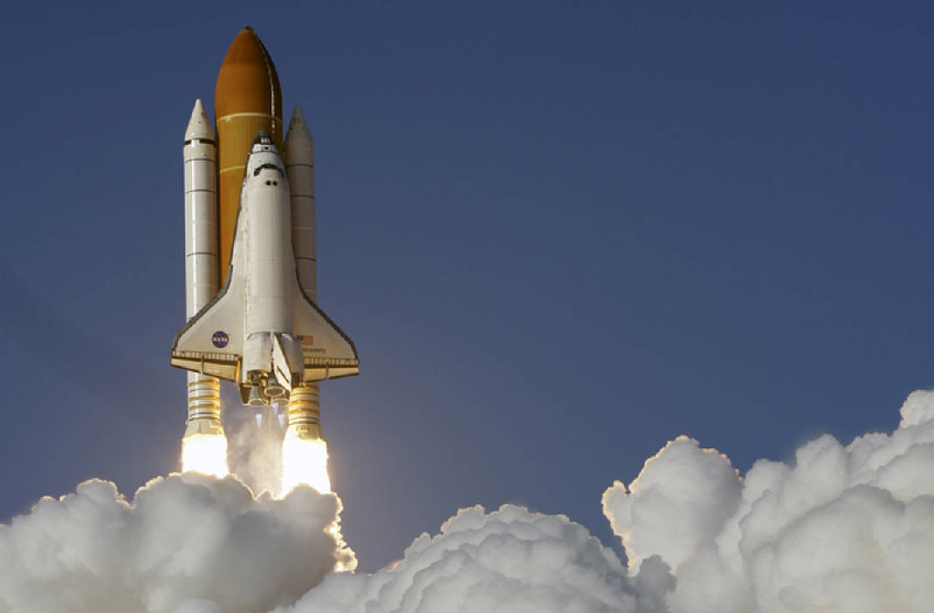
Rocket principle
A rocket launches itself by injecting some of its own mass downward.
Before the launch the momentum of the rocket was zero.
If some mass goes downward it is going to have some momentum.
Because of the conservation of the momentum the rocket has to have the same amount of momentum with opposite direction!
So the rocket is going to move upward!

