Slide 1
Force

Slide 2
Newton’s First Law- the velocity of an object remains constant
When another object acts upon it its velocity might change
A boy kicks a ball- the ball’s velocity is going to change
A girl catches a ball- the ball’s velocity is going to change
A force is any influence that can change the velocity of an object.
The influence can happen with
direct contact – you push a box
No direct contact- an apple falling toward the Earth

Slide 3

Force
Symbol: $\underline{F}$
Unit: 1 N (1 Newton)
Derived quantity: $1N=1kg∙\frac{m}{s^{2}}$
Vector quantity!

Slide 4
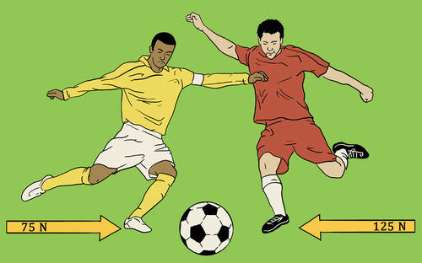
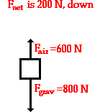
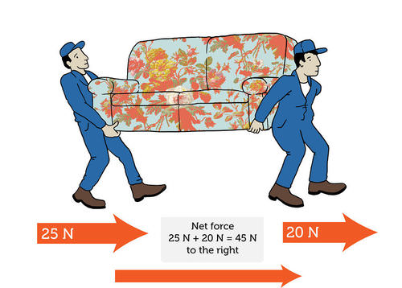
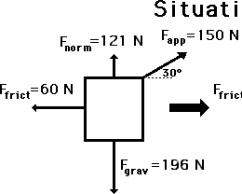

Net force
The Net force is the vector sum of all the forces that act upon an object.
Symbol:$\sum{\underline{F}}$

Slide 5
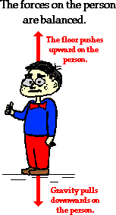
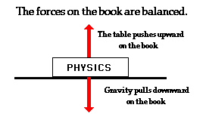
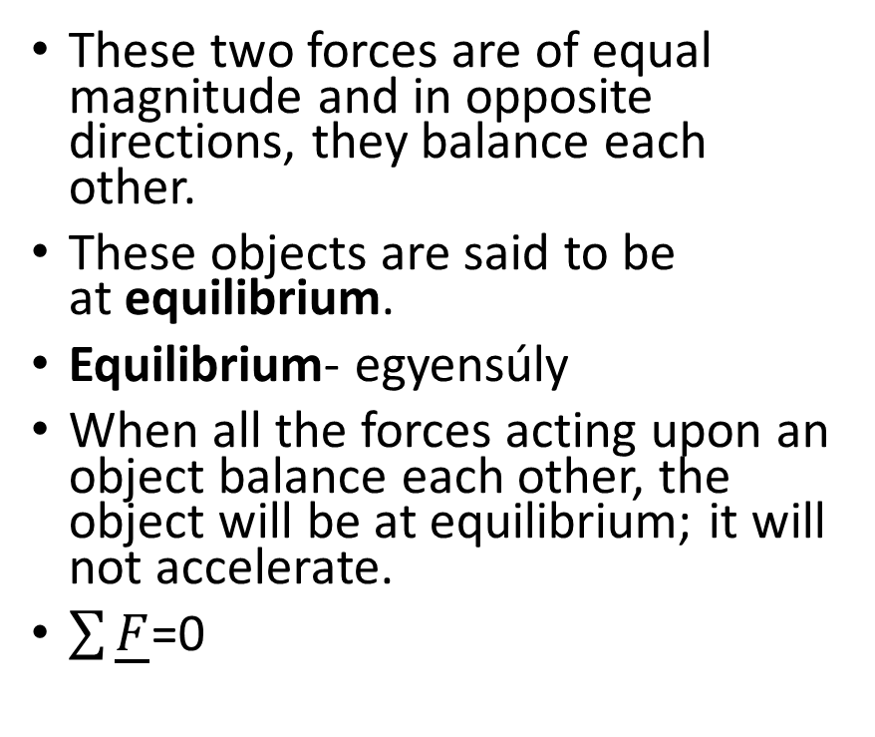
Balanced force
These two forces are of equal magnitude and in opposite directions, they balance each other.
These objects are said to be at equilibrium.
Equilibrium- egyensúly
When all the forces acting upon an object balance each other, the object will be at equilibrium; it will not accelerate.
$\sum{\underline{F}}$=0

Slide 6
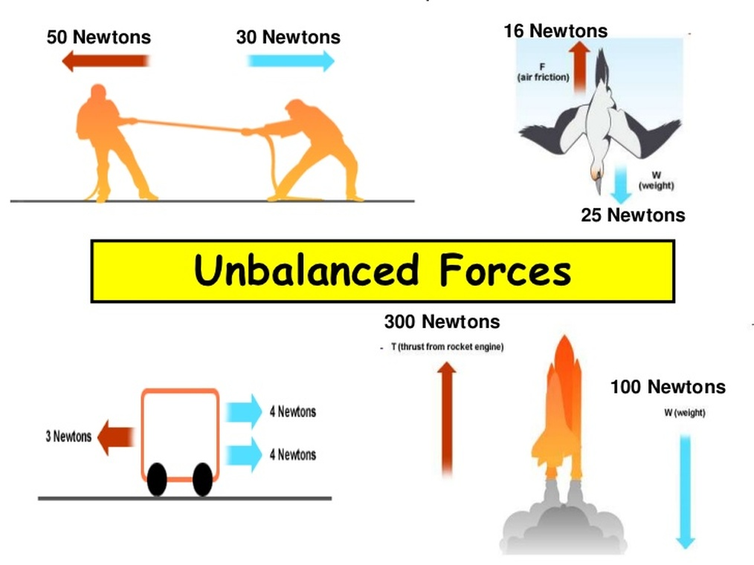
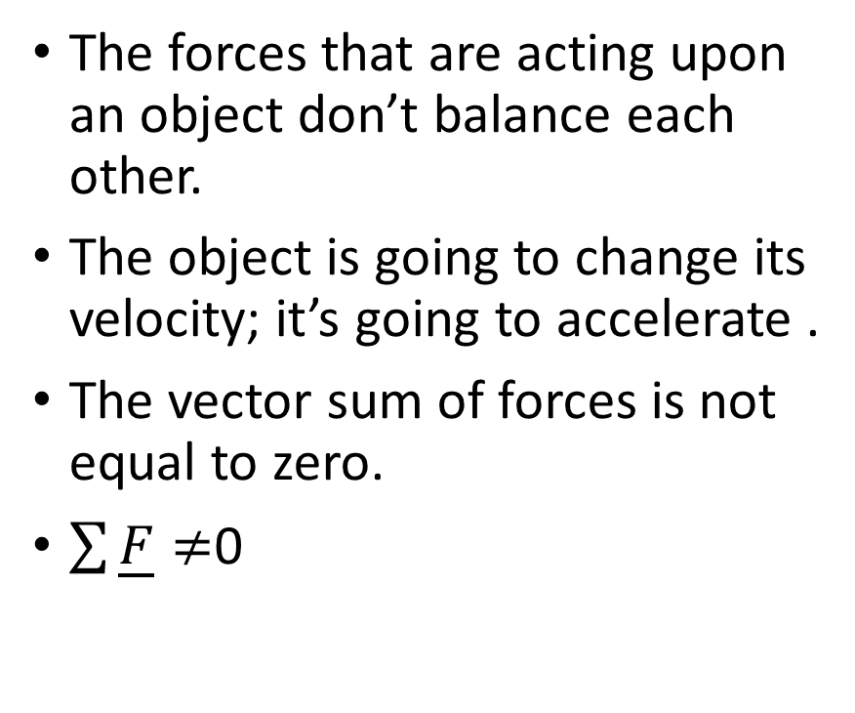
Unbalanced force
The forces that are acting upon an object don’t balance each other.
The object is going to change its velocity; it’s going to accelerate .
The vector sum of forces is not equal to zero.
$\sum{\underline{F}}≠$0

Slide 7
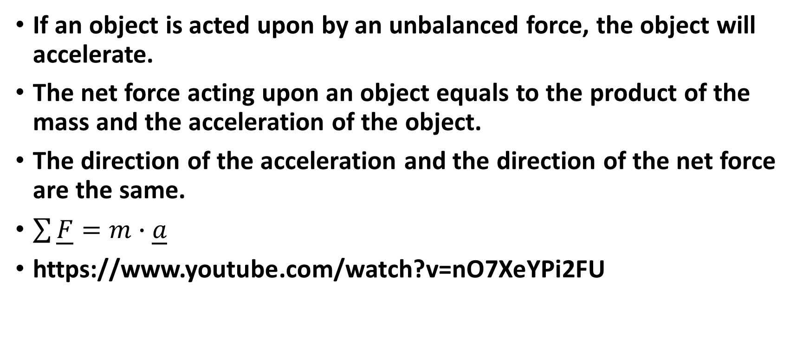
Newton’s Second Law of Motion
If an object is acted upon by an unbalanced force, the object will accelerate.
The net force acting upon an object equals to the product of the mass and the acceleration of the object.
The direction of the acceleration and the direction of the net force are the same.
$\sum{\underline{F}}=m∙\underline{a}$
https://www.youtube.com/watch?v=nO7XeYPi2FU

Slide 8

Word problem 1.
A force of 10 N accelerates an object of 20 kg. The objects starts from rest and attains the speed of $10\frac{m}{s}$. How long does the acceleration take?

Slide 9

Problem 2.
You kick a ball of 0.5 kg for 0.04 s and it attains a speed of $20 \frac{m}{s}$. How big is the average force of the kicking?

Slide 10
Problem 3.
A 800 kg car starts from rest. A force of 1000 N accelerates it for 10 s. How much will be the car’s speed and momentum? How much distance will be covered by the car?

Slide 11
Problem 4.
A 0.15 kg object moves with a speed of 6 m/s. It starts to brake and stops in 20 s. Find the force.

Slide 12
Problem 5.
A train of 450 t starts to brake. Its speed decreases from 72 km/h to 54 km/h in 25 s. a.) Calculate the distance covered. b.) Calculate the braking force.

