Slide 1
Power
Teljesítmény

Slide 2
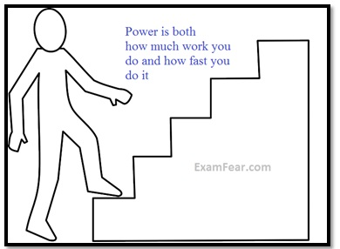
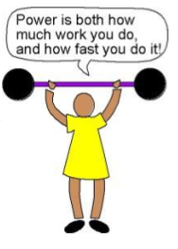
Power
If the work is done quickly – power is greater
If the work is done slowly-the power is less

Slide 3
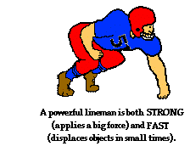

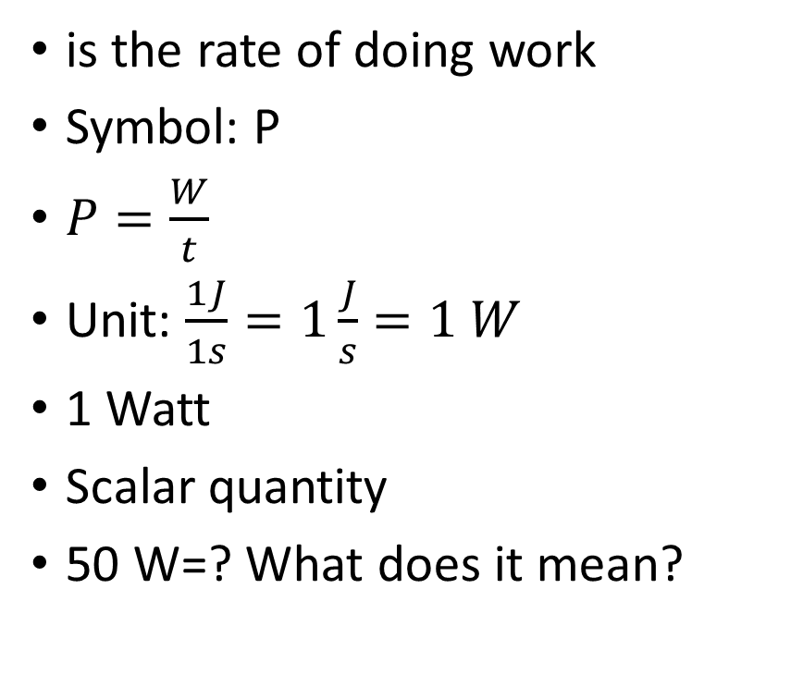
Power
is the rate of doing work
Symbol: P
$P=\frac{W}{t}$
Unit: $\frac{1J}{1s}=1\frac{J}{s}=1 W$
1 Watt
Scalar quantity
50 W=? What does it mean?

Slide 4

Units
$1 Watt$
1 Horsepower – Power of a horse-1hp
Lóerő-LE
$1 Horsepower≈735W$

Slide 5
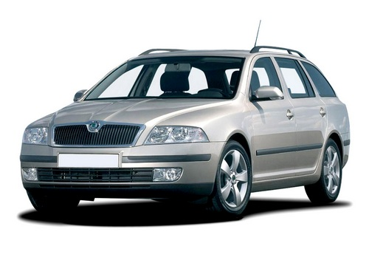
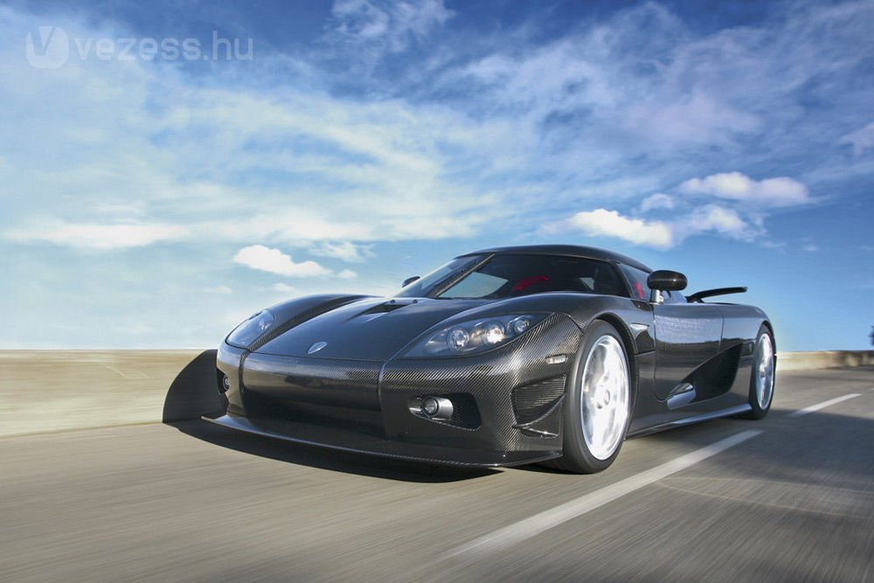
Power of machines
Machines are build to do work
They are described by a power rating
Car engine’s power relates to how rapidly the car can accelerate
Skoda: 90 kW = 122LE
Koenigsegg CCR-X: 750kW=1018 LE

Slide 6
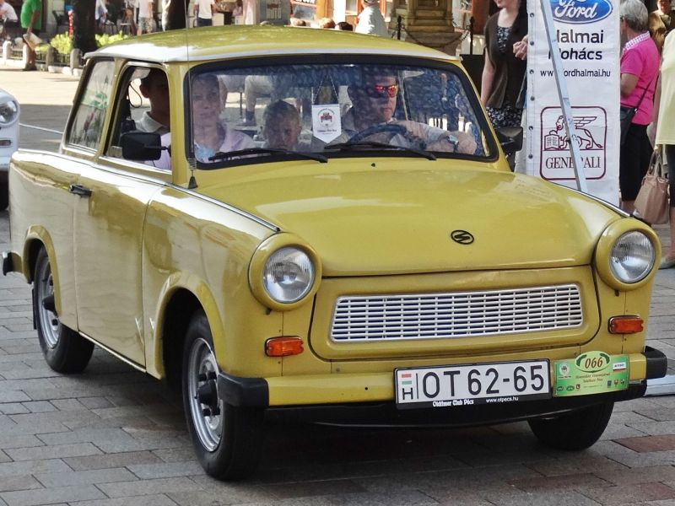
Problem 1.
The power of a car’s engine is 25kW. Find its work in 1 minute.

Slide 7
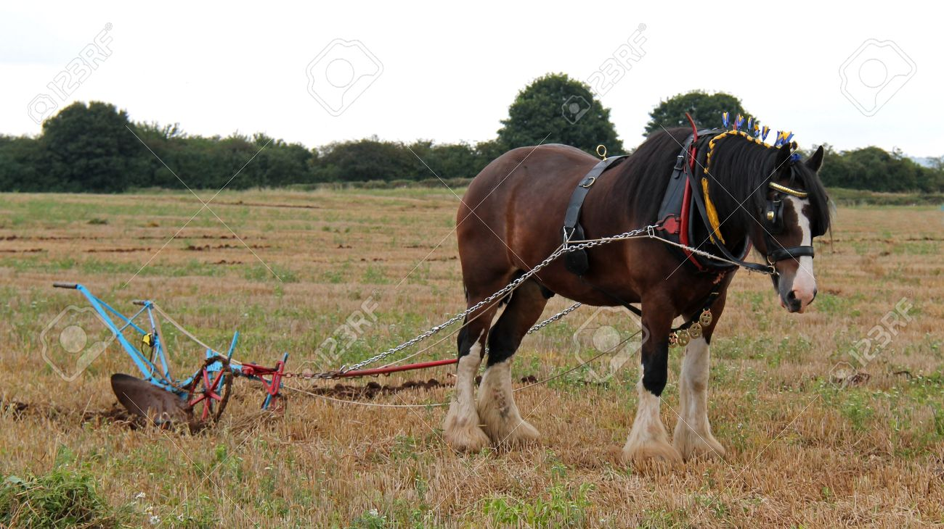
Problem 2.
A horse’s power is 300 W. He does the work of 6 kJ. Find the time of his work.

Slide 8
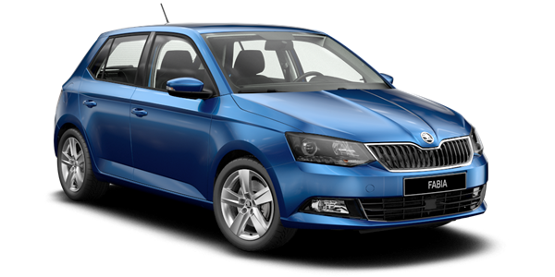

Problem 3.
A 1000 kg car is accelerated from rest to the speed of $100 \frac{km}{h}$ in 10 s. Find the power?

Slide 9
Problem 4.
How much water can be removed from 60 m under the ground in 15 minutes using a 4 hp pump?

Slide 10
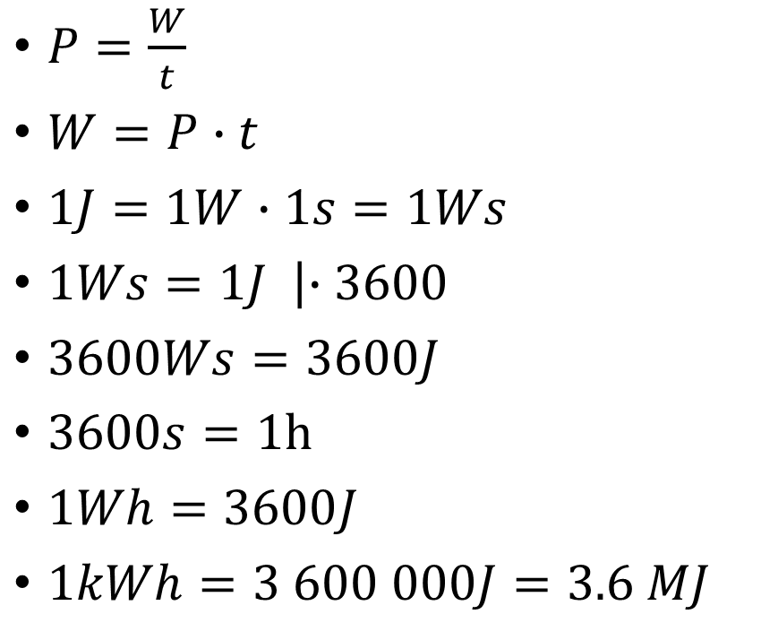
Another unit of work
$P=\frac{W}{t}$
$W=P∙t$
$1J=1W∙1s=1Ws$
$1Ws=1J \left|∙3600\right.$
$3600Ws=3600J$
$3600s=1h$
$1Wh=3600J$
$1kWh=3 600 000J=3.6 MJ$

Slide 11
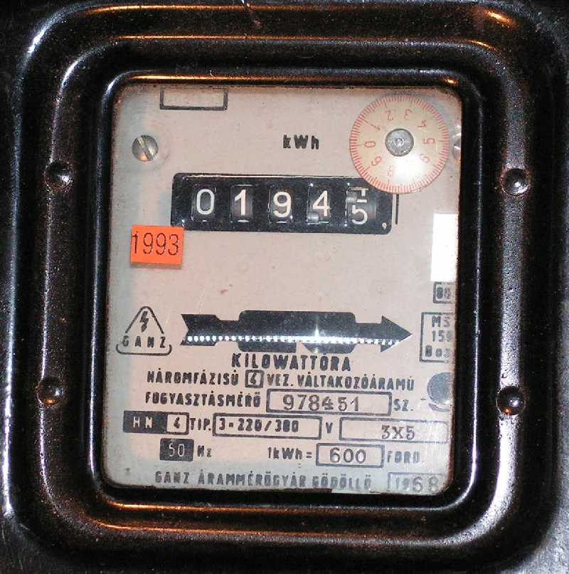
Electricity meter

Slide 12
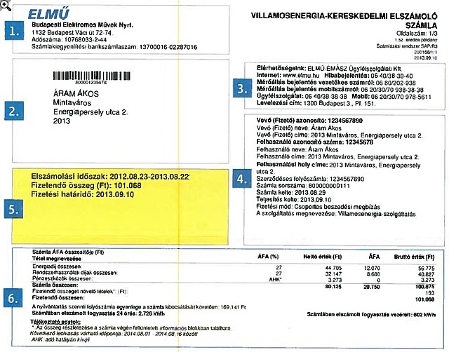
Electricity bill

Slide 13


Problem 4.
We pull a box at a constant speed. The force of the kinetic friction is 250 N. How far can we pull it if ${10}^{−3}kWh$work is done?

Slide 14
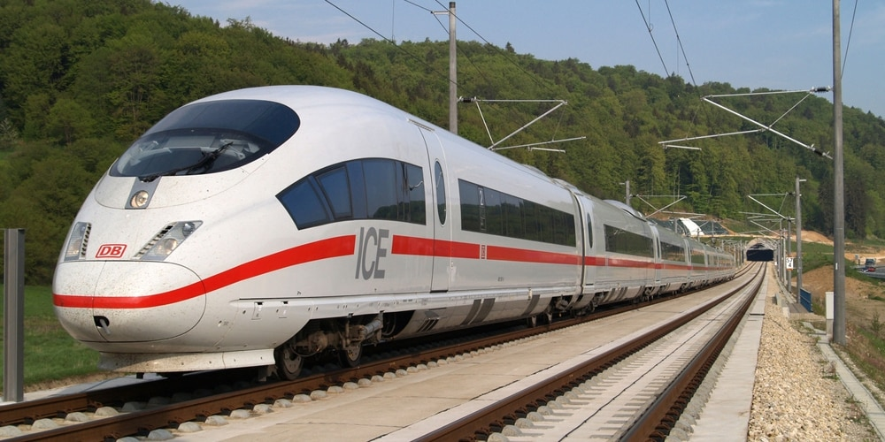
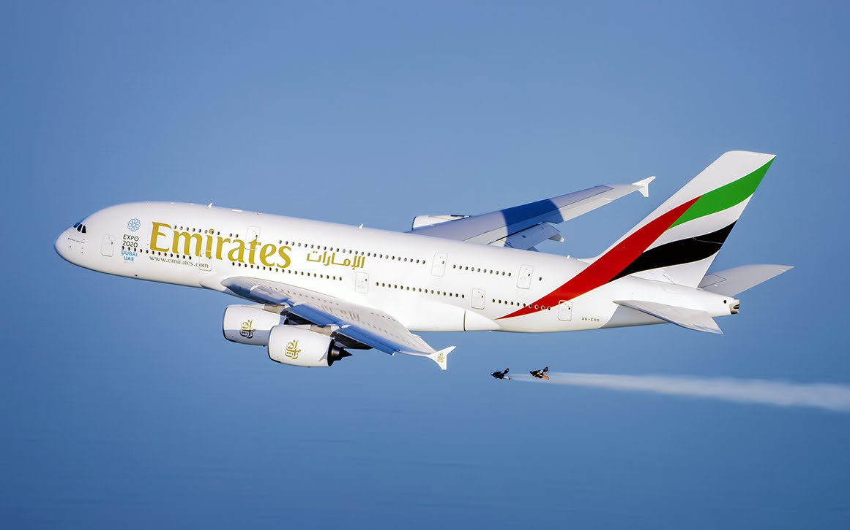
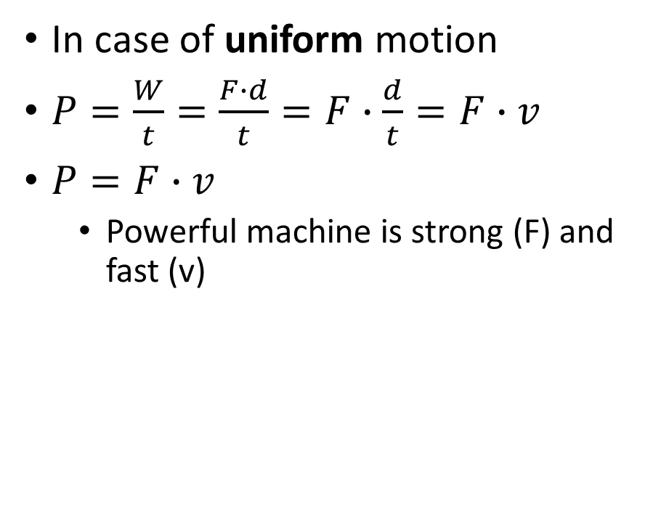
Power – another formula
In case of uniform motion
$P=\frac{W}{t}=\frac{F∙d}{t}=F∙\frac{d}{t}=F∙v$
$P=F∙v$
Powerful machine is strong (F) and fast (v)

Slide 15
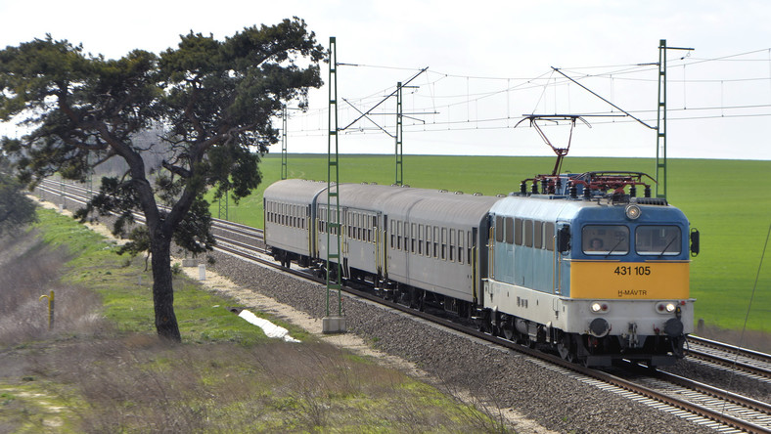

Problem 5.
An engine pulls a train with a force of $2∙{10}^{5}N$ at a constant speed of $54\frac{km}{h}$. Find its power.

Slide 16
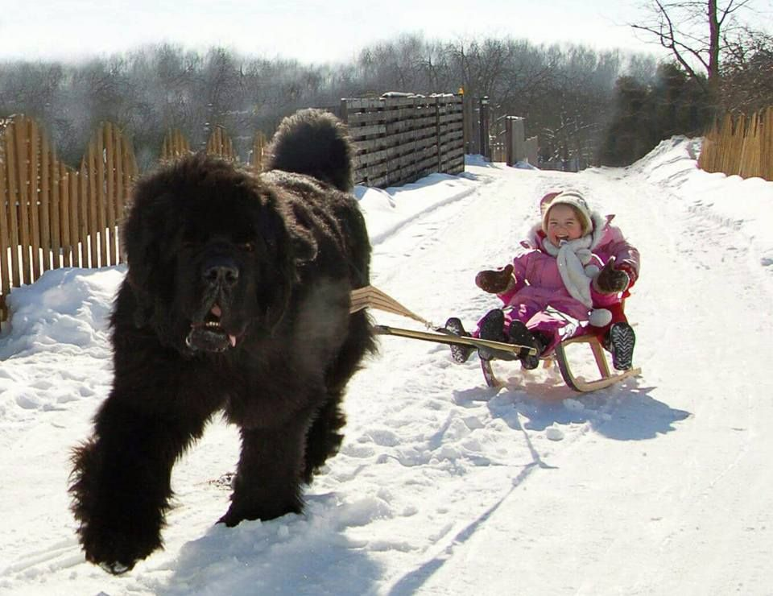
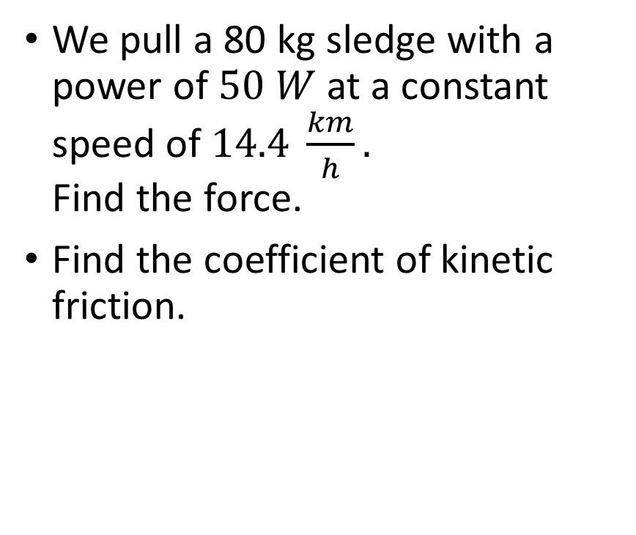
Problem 6.
We pull a 80 kg sledge with a power of $50 W$ at a constant speed of $14.4 \frac{km}{h}.$ Find the force.
Find the coefficient of kinetic friction.

