Slide 1
Word problems

Slide 2
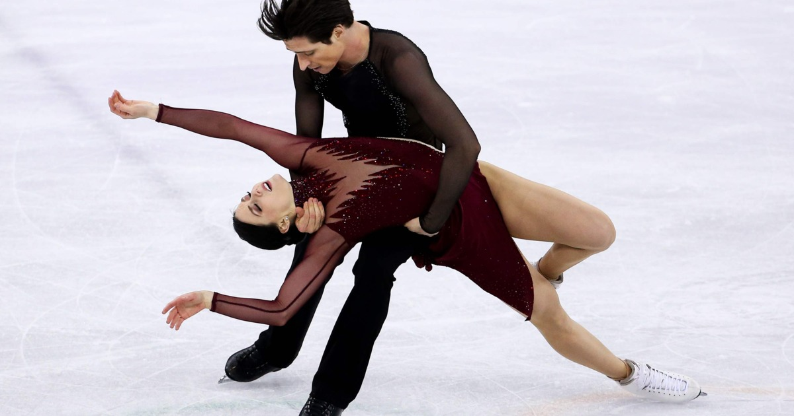
The Canadian ice dance pair Tessa Virtue and Scott Moir won gold medal at the 2018 Winter Olympics. Tessa’s mass is 50 kg, Scott’s mass is 75 kg. The coefficient of kinetic friction between their skates and the ice i s 0.04. The coefficient of static friction is 0.1.

Slide 3

Tessa and Scott push off each other on the ice. Scott starts to move with a $2 \frac{m}{s^{2}}$ acceleration. Find the acceleration of Tessa.
Tessa’s mass is 50 kg, Scott’s mass is 75 kg. The coefficient of kinetic friction between their skates and the ice i s 0.04. The coefficient of static friction is 0.1.

Slide 4
Scott starts to brake and he stops in 2 s and covers the distance of 5 m. Calculate the magnitude of the braking force.
Tessa’s mass is 50 kg, Scott’s mass is 75 kg. The coefficient of kinetic friction between their skates and the ice i s 0.04. The coefficient of static friction is 0.1.

Slide 5
Scott pulls Tessa with a horizontal force of 50 N. Find Tessa’s acceleration.
Tessa’s mass is 50 kg, Scott’s mass is 75 kg. The coefficient of kinetic friction between their skates and the ice i s 0.04. The coefficient of static friction is 0.1.

Slide 6
Scott moves with a speed of 5 m/s and Tessa moves with a speed of 2 m/s in the same direction. Scott bumps into Tessa and they move together in the original direction Find their speed.
Tessa’s mass is 50 kg, Scott’s mass is 75 kg. The coefficient of kinetic friction between their skates and the ice i s 0.04. The coefficient of static friction is 0.1.

Slide 7
Scott moves downward on an 30° inclined plane with a constant speed. Find the applied force (upwards parallel to the inclined plane) on Scott if the coefficient of kinetic friction is 0.04.
Tessa’s mass is 50 kg, Scott’s mass is 75 kg. The coefficient of kinetic friction between their skates and the ice i s 0.04. The coefficient of static friction is 0.1.

Slide 8
They stand on the ice linked by a rope and their trainer pulls Tessa with a force of 100 N. Calculate their acceleration and the tension force.
Tessa’s mass is 50 kg, Scott’s mass is 75 kg. The coefficient of kinetic friction between their skates and the ice i s 0.04. The coefficient of static friction is 0.1.

Slide 9
Find the gravitational force between them if the distance between their bodies’ center is 50 cm.
Tessa’s mass is 50 kg, Scott’s mass is 75 kg. The coefficient of kinetic friction between their skates and the ice i s 0.04. The coefficient of static friction is 0.1.

Slide 10

Tessa tries to pull Scott by a spring with a spring constant of $2000\frac{N}{m}$. Find the deformation of the spring before Scott starts to move.
Tessa’s mass is 50 kg, Scott’s mass is 75 kg. The coefficient of kinetic friction between their skates and the ice i s 0.04. The coefficient of static friction is 0.1.

Slide 11
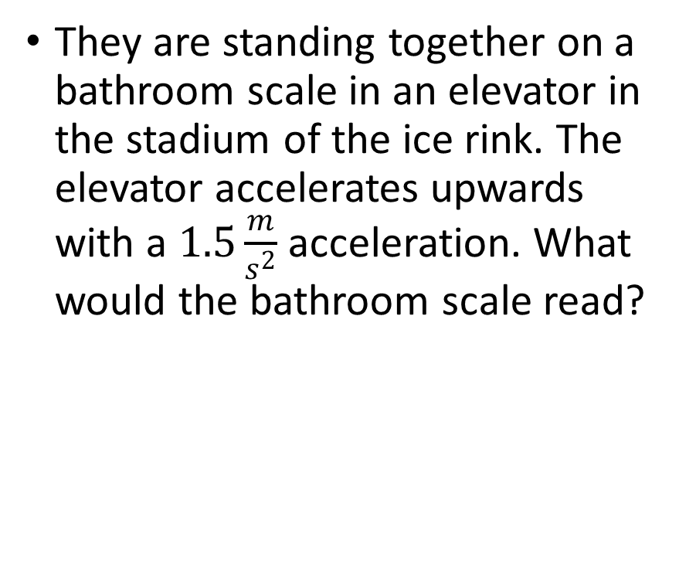
They are standing together on a bathroom scale in an elevator in the stadium of the ice rink. The elevator accelerates upwards with a $1.5\frac{m}{s^{2}}$ acceleration. What would the bathroom scale read?
Tessa’s mass is 50 kg, Scott’s mass is 75 kg. The coefficient of kinetic friction between their skates and the ice i s 0.04. The coefficient of static friction is 0.1.

Slide 12
Scott throws up Tessa. Calculate Tessa’s apparent weight while she floats in the air.
Tessa’s mass is 50 kg, Scott’s mass is 75 kg. The coefficient of kinetic friction between their skates and the ice i s 0.04. The coefficient of static friction is 0.1.

