Slide 1
Torque
Forgatónyomaték

Slide 2
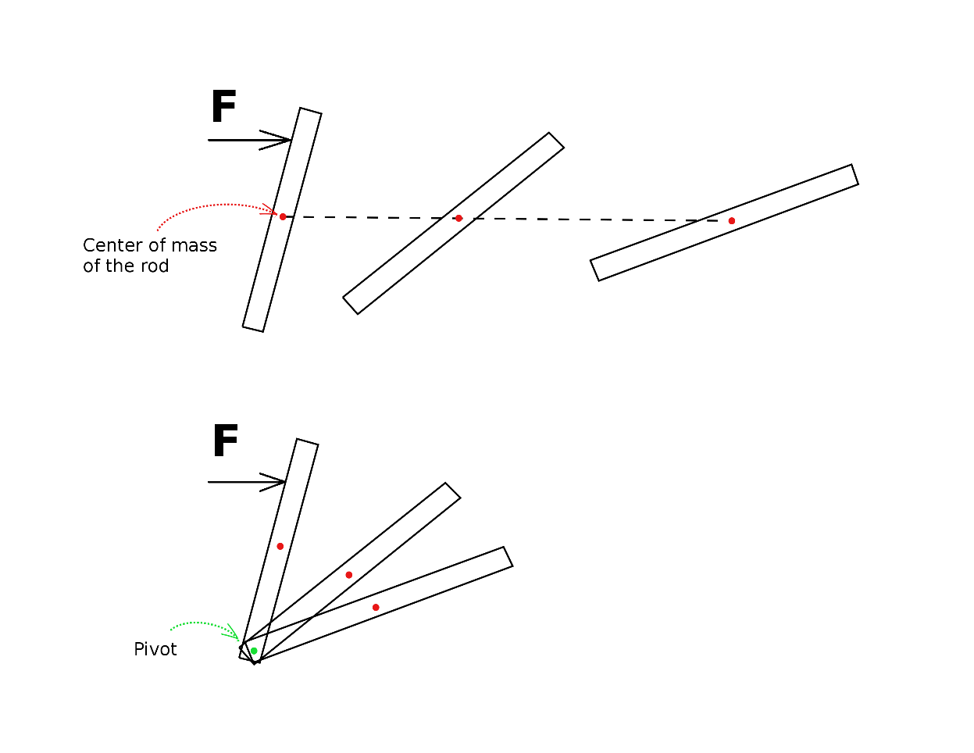
A rod fixed at a point
If you apply force upon it – it is going to rotate

Slide 3
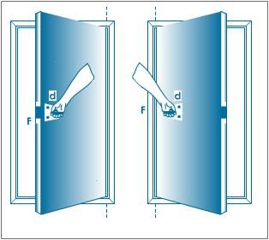
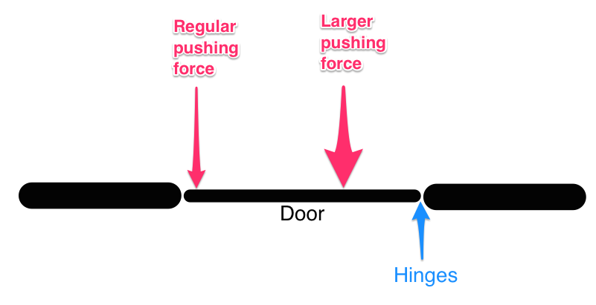
Opening a door
If you open a door
You push on the side of the door farthest from the hinges
If you push it on the side closest to he hinges requires more force.
If you want something to rotate the effect depends on not only the measure of the force but the distance of force from the pivot

Slide 4
Torque - Forgatónyomaték
is a twisting force that tends to cause rotation
is a measure of the force that can cause an object to rotate about an axis.

Slide 5
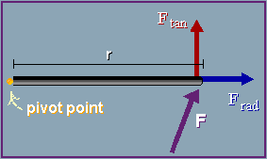
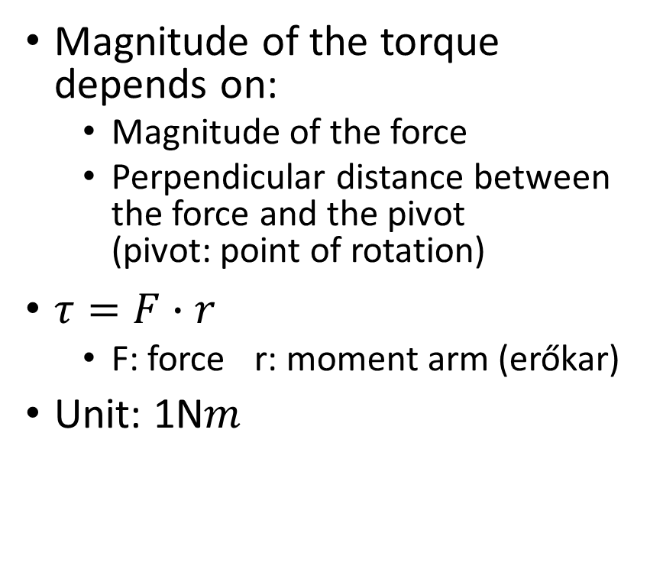
Torque
Magnitude of the torque depends on:
Magnitude of the force
Perpendicular distance between the force and the pivot (pivot: point of rotation)
$τ=F∙r$
F: force r: moment arm (erőkar)
Unit: 1N$m$

Slide 6
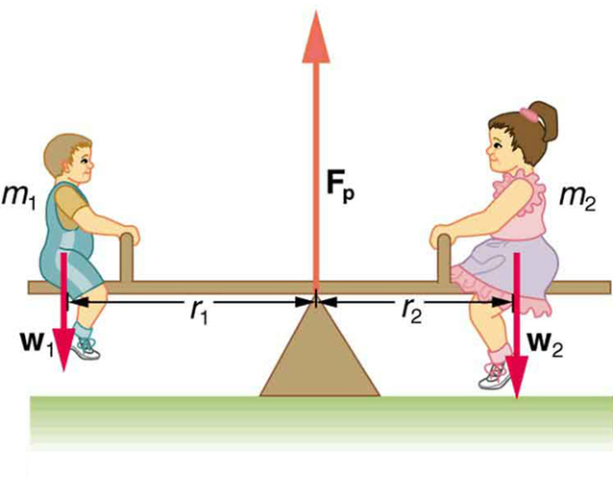
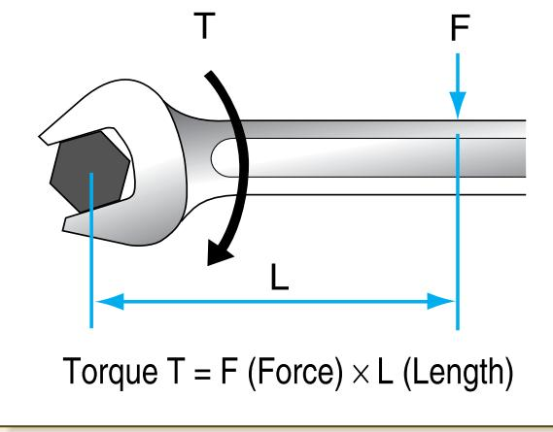
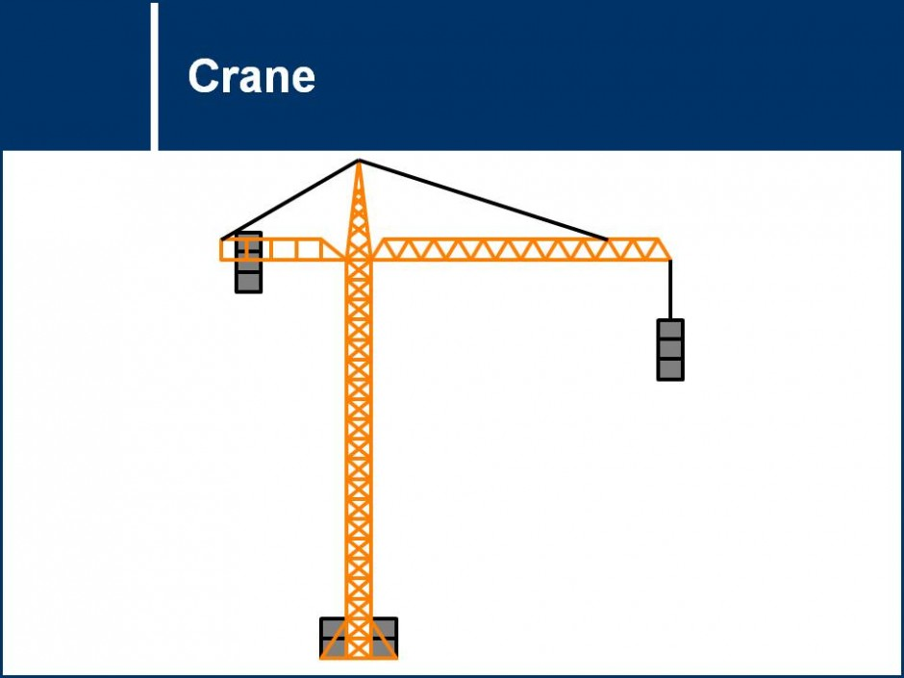
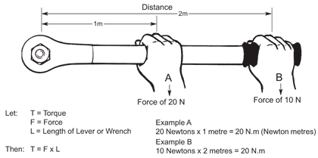

Slide 7
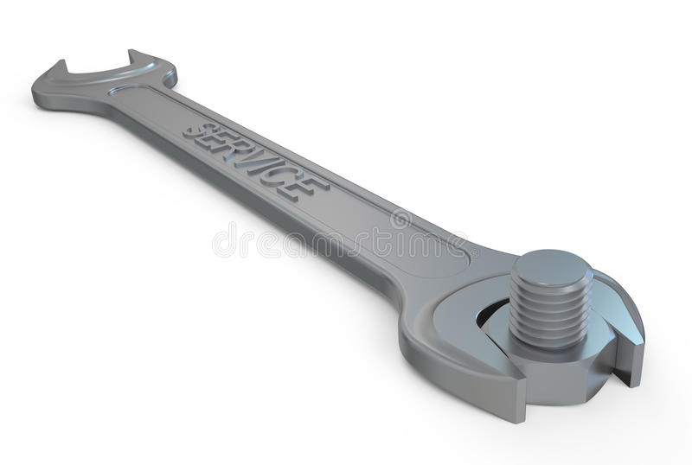
Problem 1.
Determine the torque on a bolt, if you are pulling with a force of 200 N directed perpendicular to a wrench of length 20 cm?

Slide 8
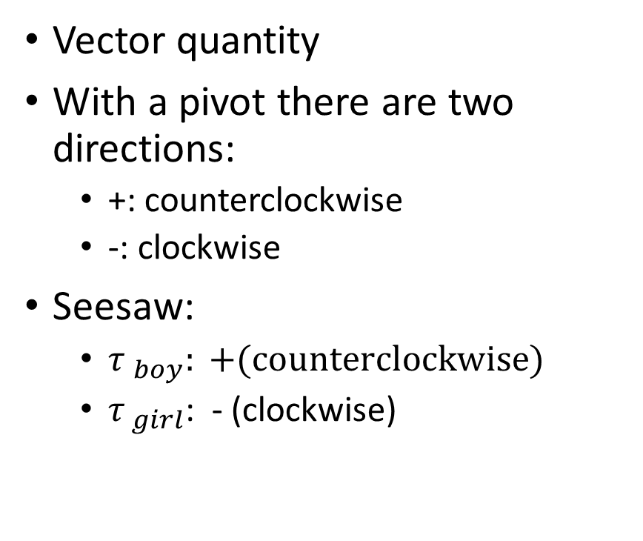
Torque
Vector quantity
With a pivot there are two directions:
+: counterclockwise
-: clockwise
Seesaw:
${τ }_{boy}: +(counterclockwise)$
${τ }_{girl}$: - (clockwise)

Slide 9
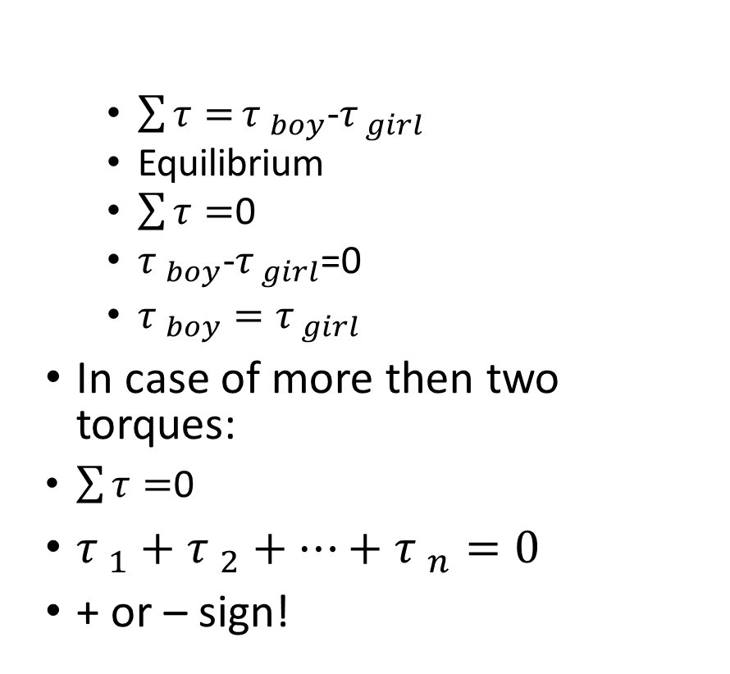
$\sum{τ=}{τ }_{boy}$-${τ }_{girl}$
Equilibrium
$\sum{τ=}$0
${τ }_{boy}$-${τ }_{girl}$=0
${τ }_{boy}={τ }_{girl}$
In case of more then two torques:
$\sum{τ=}$0
${τ }_{1}+{τ }_{2}+…+{τ }_{n}=0$
+ or – sign!

Slide 10
Problem 2.
If a 5000 kg elephant is on a plank 1.25 m to the left of the pivot how far to the right of the pivot would a 75 kg man have to stand to balance the elephant? Assume the plank would be balanced if nothing was on it.

Slide 11
Problem 3.
A 85 kg mass is hanging on a rod 5.7 m to the left of a pivot and a second mass is hanging 9.8 m to the right of the pivot. Assuming the pivot is in the middle of the rod, what is the mass of the second mass?

Slide 12
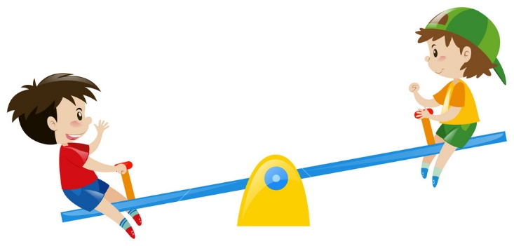
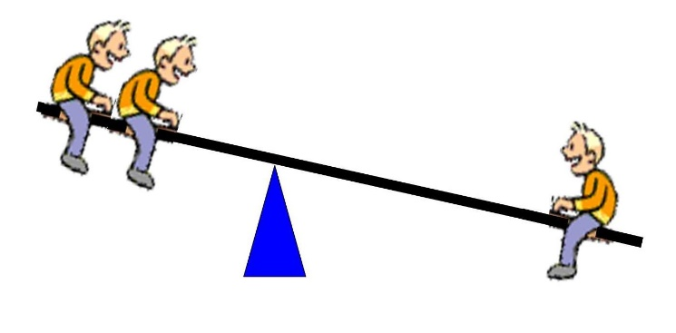
Problem 4.
Two 45 kg kids sit on the two sides of a seesaw. One of them is 3 m , two other one is 1.5 m away from the pivot. Where should a 65 kg third kid sit, if the seesaw is in equilibrium.

