Slide 1
Energy

Slide 2
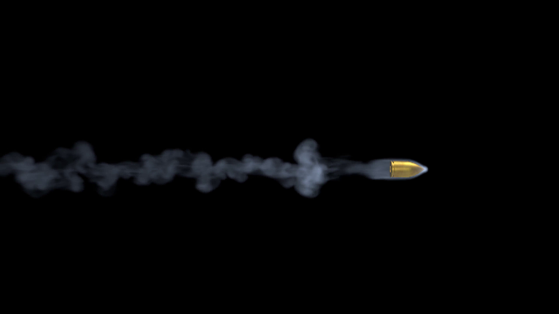
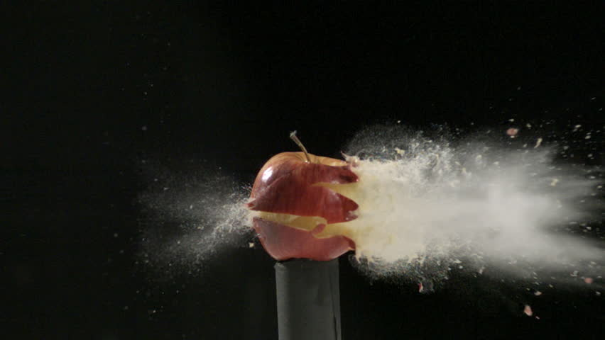
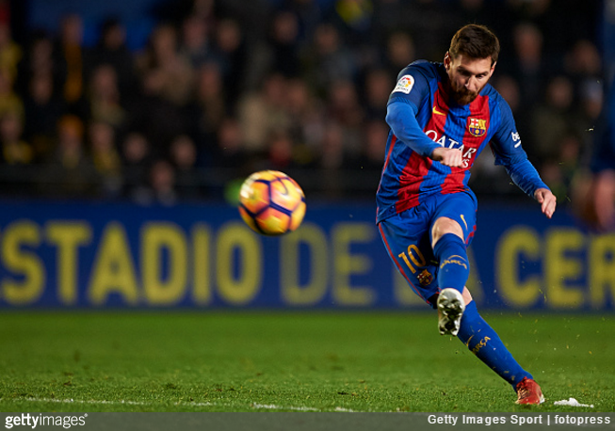
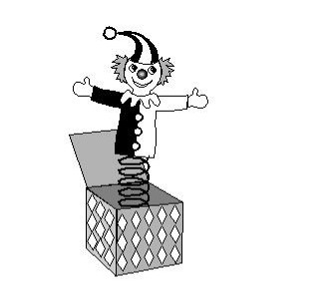
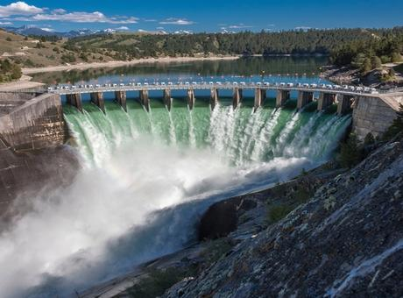
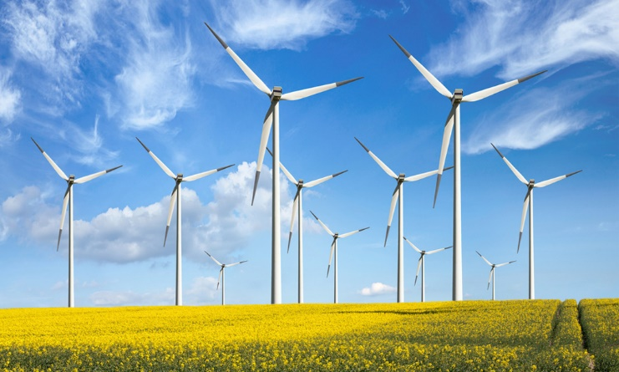
Energy
A system or an object has energy if it has ability to do work.
Munkavégző képesség
Flying bullet
Kicked soccer ball
Jack-in-the-box: compressed spring
Flowing water
Wind

Slide 3
Energy is …
a scalar quantity
abstract and cannot always be perceived
a central concept in science

Slide 4
Energy
Symbol: E
Unit: 1 J

Slide 5
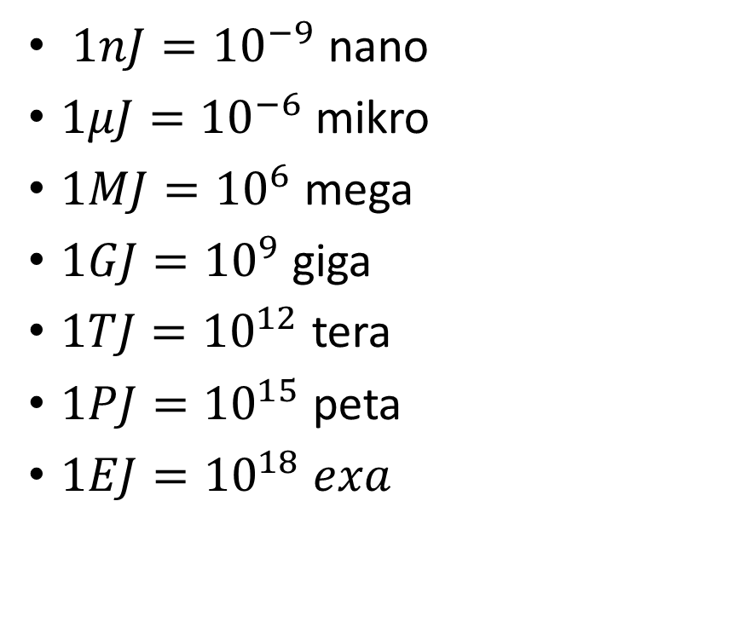
650 nJ | kinetic | falling snowflake
85 µJ | kinetic | falling raindrop
3–12 J | gravitational | an apple in a tree
60 kJ | heat | making a cup of coffee or tea
270 kJ | chemical | an apple in the digestive tract
390 kJ | kinetic | car driving at freeway speed
1.4 MJ | electrical | television running for four hours
2 MJ | chemical | stick of dynamite
3.8 MJ | chemical | food for one person for one year
4.184 GJ | chemical | ton of TNT, by definition
63 TJ | nuclear | Hiroshima atomic bomb
42 PJ | kinetic | Tunguska meteor impact (1908)
21 EJ | electrical | one year of operation of Google
37 EJ | electrical | one year of Bitcoin mining
$1nJ={10}^{−9}$ nano
$1μJ={10}^{−6}$ mikro
$1MJ={10}^{6}$ mega
$1GJ={10}^{9}$ giga
$1TJ={10}^{12}$ tera
$1PJ={10}^{15}$ peta
$1EJ={10}^{18} exa$

Slide 6
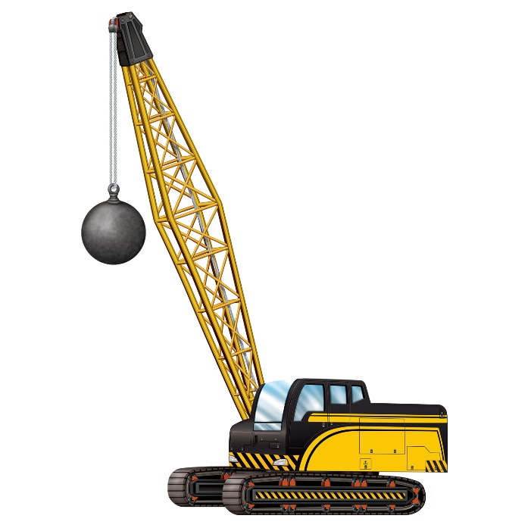
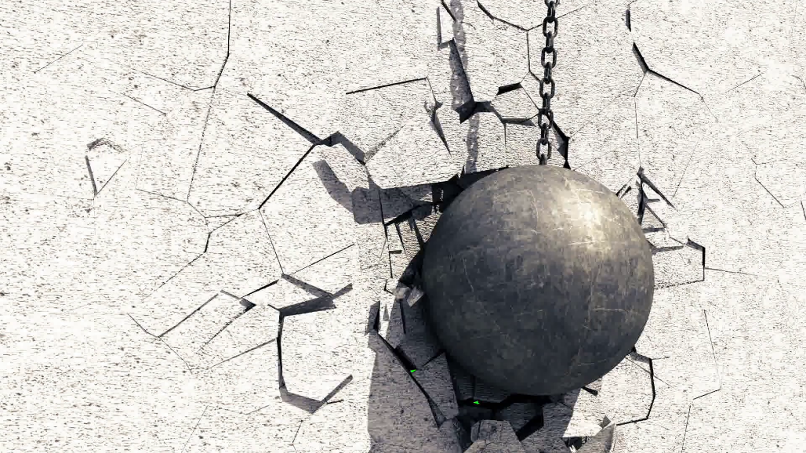
Kinetic energy
When an object in motion it has ability to do work
Wrecking ball (450kg-5400kg)
Slow-moving wrecking ball can do a lot of work (damage)
If it doesn’t move: doesn’t do any work
This energy is called kinetic energy
Mozgási energia

Slide 7
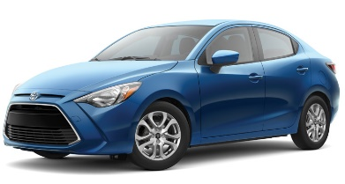
Potential energy
If a wrecking ball doesn’t move it doesn’t have kinetic energy
What would happen if it were lifted two stories up and suspended above a car?
It has ability to do work!
This type of energy is called gravitational potential energy
Helyzeti energia

Slide 8
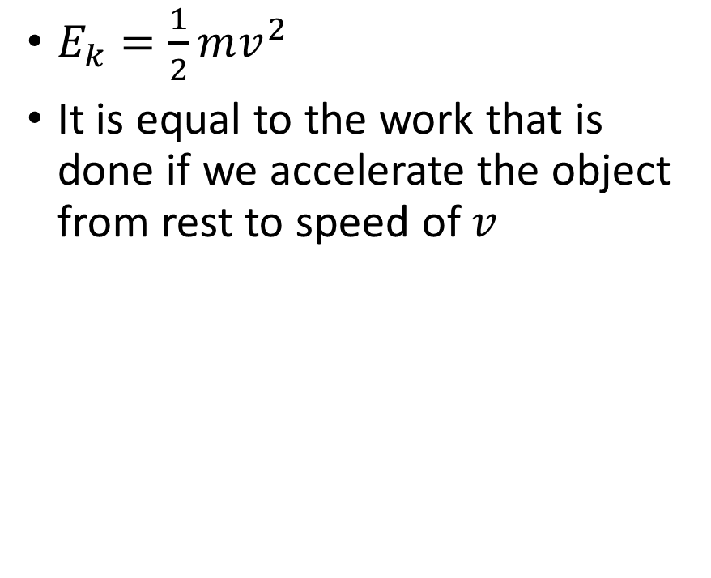
Kinetic energy
$E_{k}=\frac{1}{2}mv^{2}$
It is equal to the work that is done if we accelerate the object from rest to speed of $v$

Slide 9
Problem 1.
A 500 kg wrecking ball’s falls from the height of 10 m above the ground. Find its kinetic energy when it hits the ground.

Slide 10
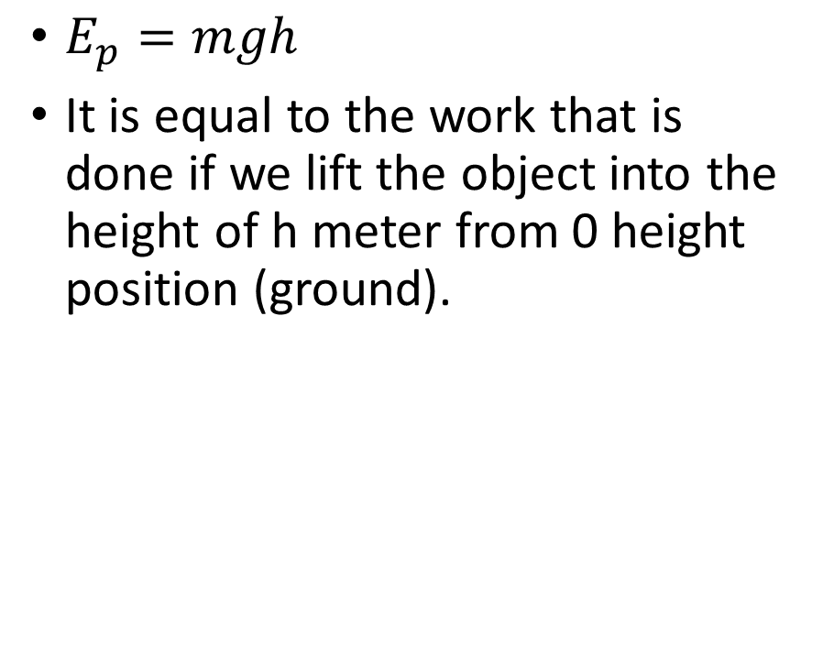
Gravitational potential energy
$E_{p}=mgh$
It is equal to the work that is done if we lift the object into the height of h meter from 0 height position (ground).

