Slide 1
Energy

Slide 2
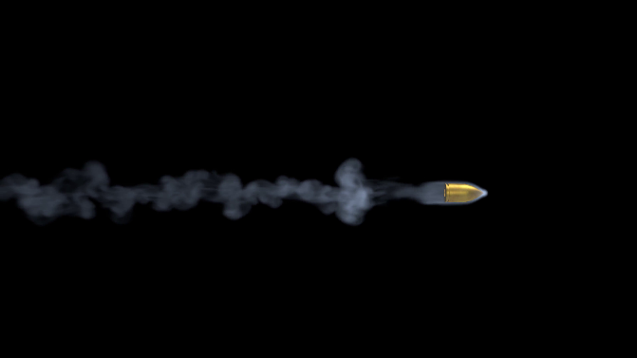
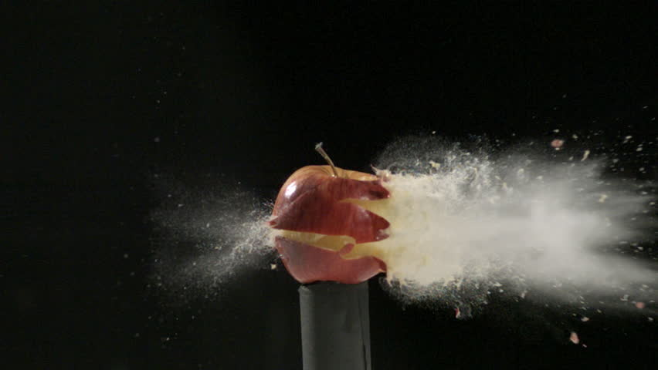
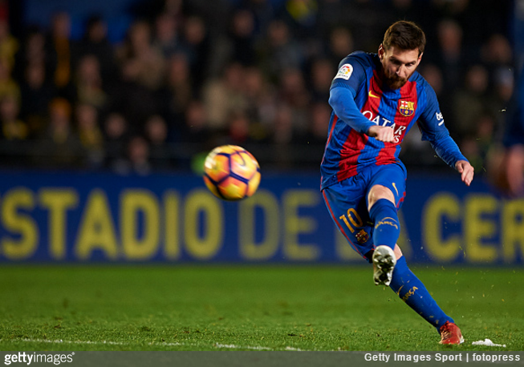
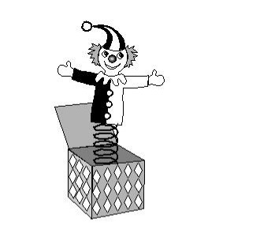
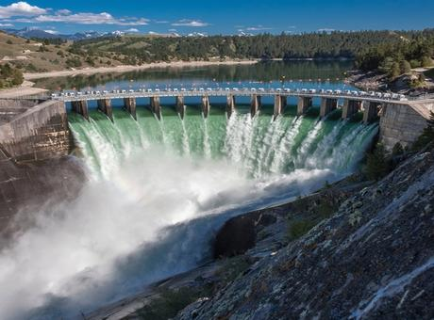
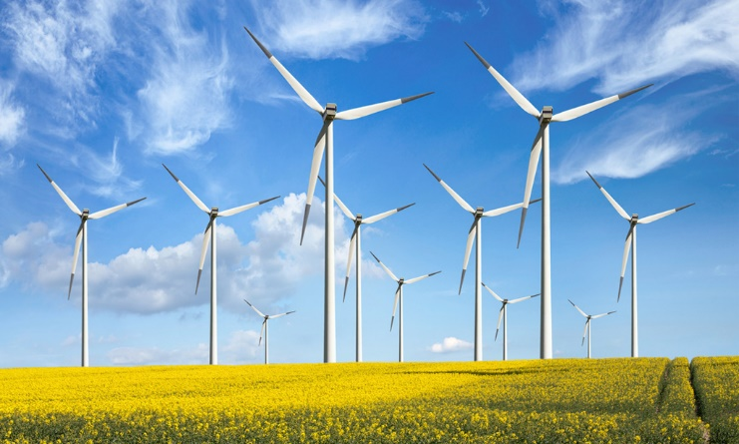
Energy
A system or an object has energy if it has ability to do work.
Munkavégző képesség
Flying bullet
Kicked soccer ball
Jack-in-the-box: compressed spring
Flowing water
Wind

Slide 3
Energy is …
a scalar quantity
abstract and cannot always be perceived
a central concept in science

Slide 4
Energy
Symbol: E
Unit: 1 J

Slide 5
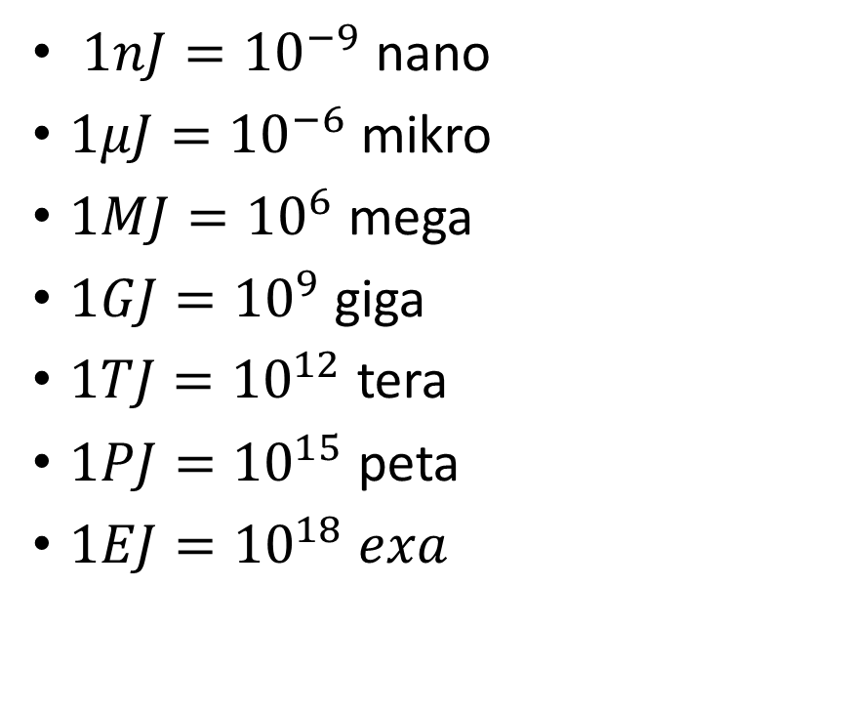
650 nJ | kinetic | falling snowflake
85 µJ | kinetic | falling raindrop
3–12 J | gravitational | an apple in a tree
60 kJ | heat | making a cup of coffee or tea
270 kJ | chemical | an apple in the digestive tract
390 kJ | kinetic | car driving at freeway speed
1.4 MJ | electrical | television running for four hours
2 MJ | chemical | stick of dynamite
3.8 MJ | chemical | food for one person for one year
4.184 GJ | chemical | ton of TNT, by definition
63 TJ | nuclear | Hiroshima atomic bomb
42 PJ | kinetic | Tunguska meteor impact (1908)
21 EJ | electrical | one year of operation of Google
37 EJ | electrical | one year of Bitcoin mining
$1nJ={10}^{−9}$ nano
$1μJ={10}^{−6}$ mikro
$1MJ={10}^{6}$ mega
$1GJ={10}^{9}$ giga
$1TJ={10}^{12}$ tera
$1PJ={10}^{15}$ peta
$1EJ={10}^{18} exa$

Slide 6
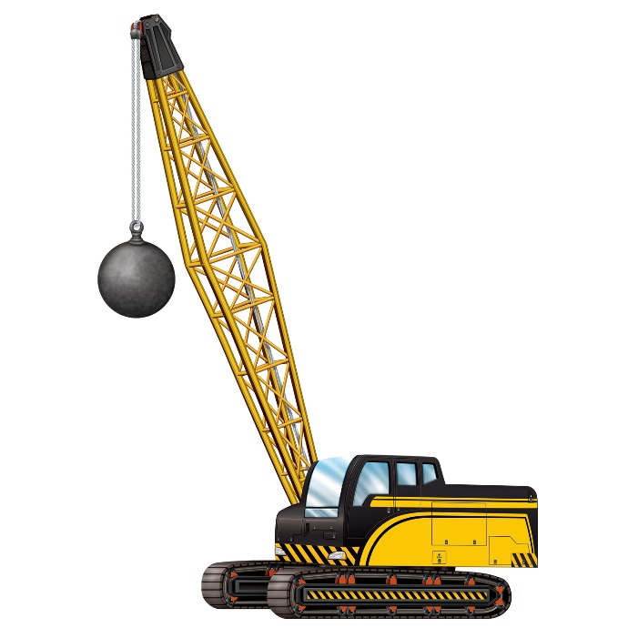
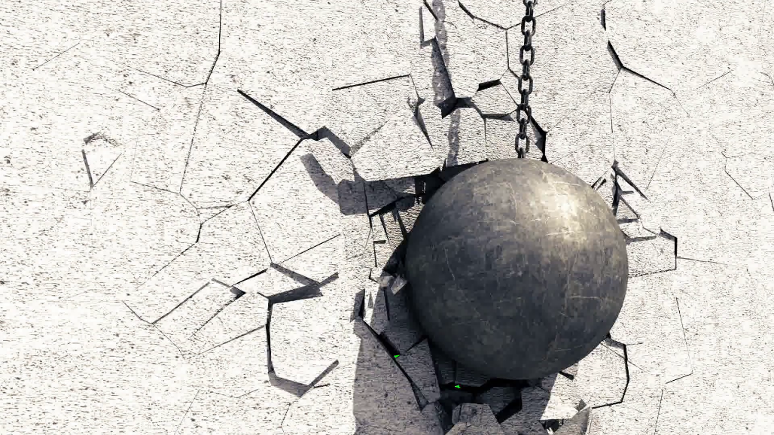
Kinetic energy
When an object in motion it has ability to do work
Wrecking ball (450kg-5400kg)
Slow-moving wrecking ball can do a lot of work (damage)
If it doesn’t move: doesn’t do any work
This energy is called kinetic energy
Mozgási energia

Slide 7
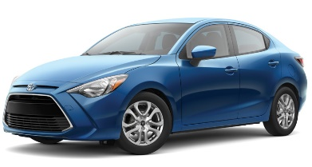
Potential energy
If a wrecking ball doesn’t move it doesn’t have kinetic energy
What would happen if it were lifted two stories up and suspended above a car?
It has ability to do work!
This type of energy is called gravitational potential energy
Helyzeti energia

Slide 8
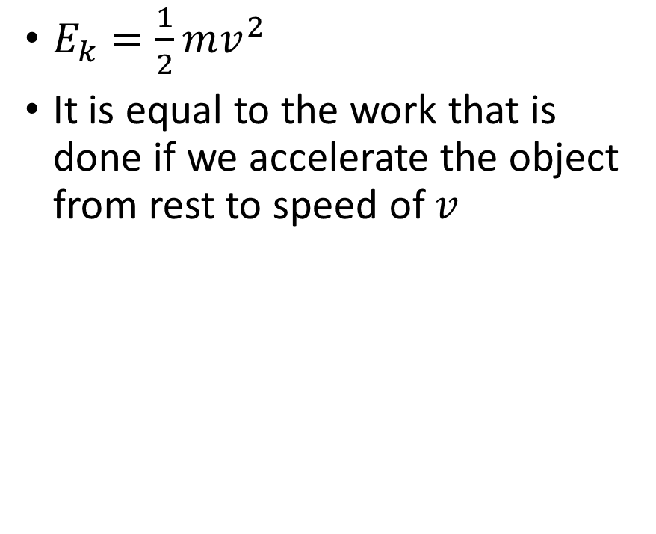
Kinetic energy
$E_{k}=\frac{1}{2}mv^{2}$
It is equal to the work that is done if we accelerate the object from rest to speed of $v$

Slide 9
Problem 1.
A 500 kg wrecking ball’s falls from the height of 10 m above the ground. Find its kinetic energy when it hits the ground.

Slide 10
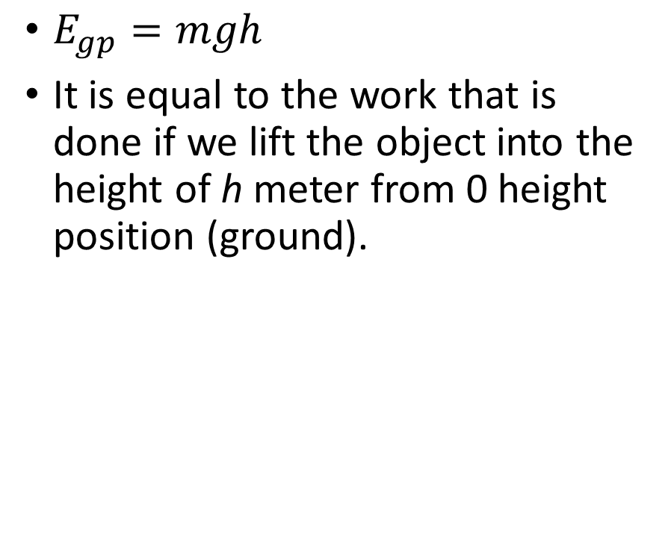
Gravitational potential energy
$E_{gp}=mgh$
It is equal to the work that is done if we lift the object into the height of h meter from 0 height position (ground).

Slide 11
Problem 2.
A 5 kg object is 45 m above the ground.
Find its gravitational potential energy.
It starts to fall free. Find its gravitational potential energy in 1 s.
Find its kinetic energy at this moment.

Slide 12
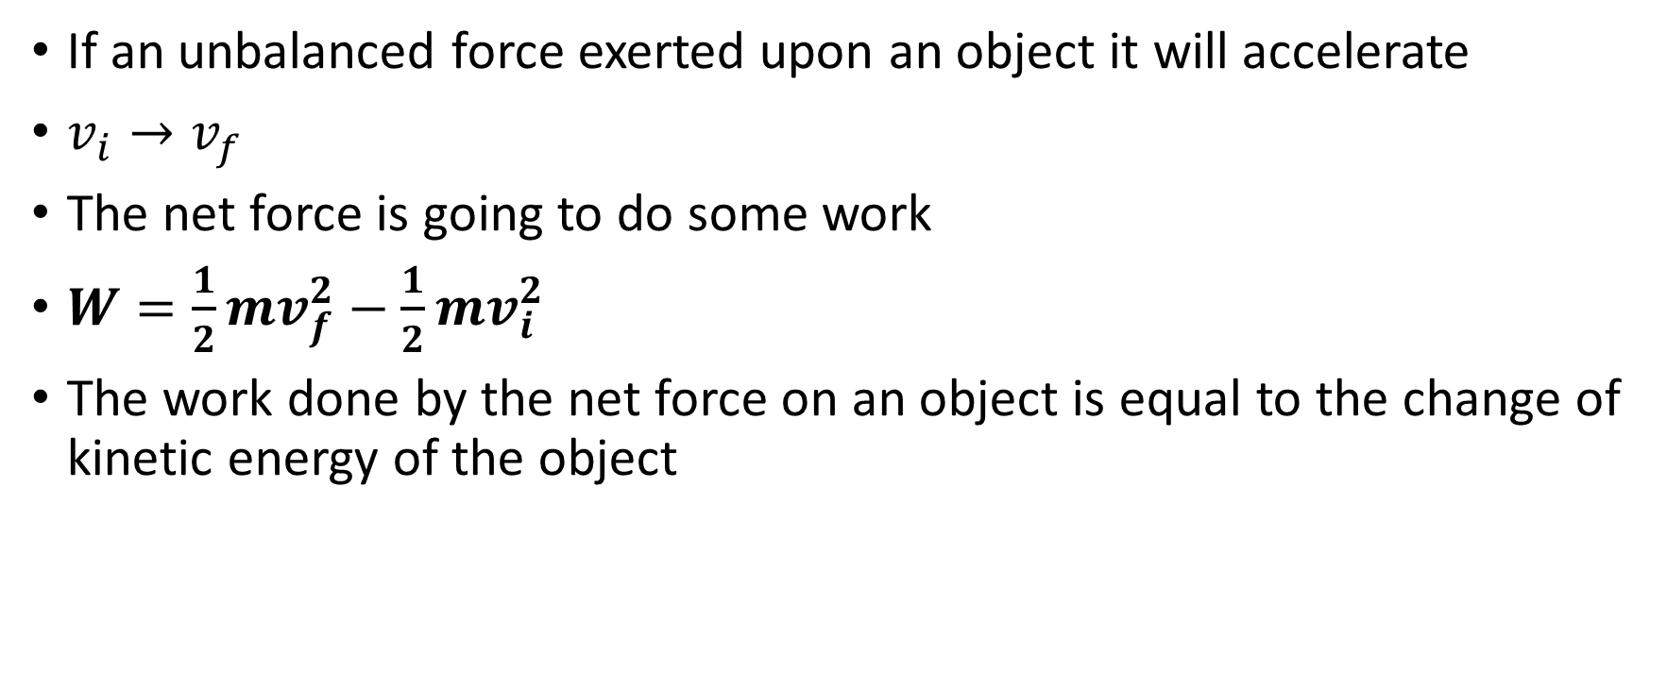
Work Energy Principle
If an unbalanced force exerted upon an object it will accelerate
$v_{i}→v_{f}$
The net force is going to do some work
$W=\frac{1}{2}mv_{f}^{2}−\frac{1}{2}mv_{i}^{2}$
The work done by the net force on an object is equal to the change of kinetic energy of the object

Slide 13

Problem 3.
A race car with a mass of 600 kg accelerates from rest to $the speed of 180\frac{km}{h}$ and covers 400 m of distance. Calculate the applied force.

Slide 14
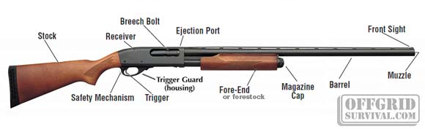
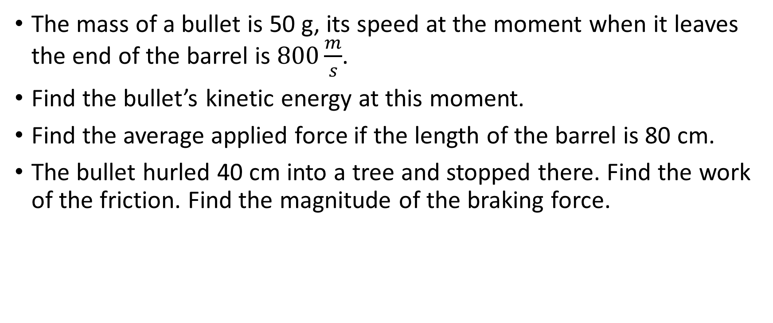
Problem 4
The mass of a bullet is 50 g, its speed at the moment when it leaves the end of the barrel is $800\frac{m}{s}$.
Find the bullet’s kinetic energy at this moment.
Find the average applied force if the length of the barrel is 80 cm.
The bullet hurled 40 cm into a tree and stopped there. Find the work of the friction. Find the magnitude of the braking force.

Slide 15
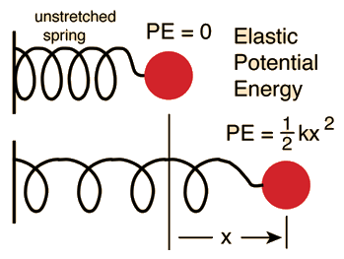
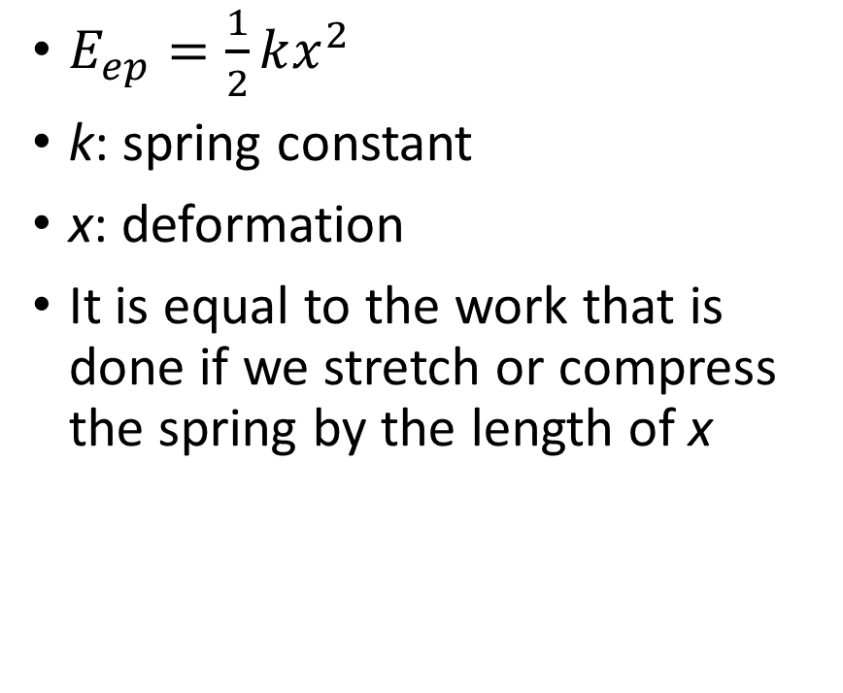
Elastic potential energy
$E_{ep}=\frac{1}{2}kx^{2}$
k: spring constant
x: deformation
It is equal to the work that is done if we stretch or compress the spring by the length of x

Slide 16

Problem 5.
Find the elastic potential energy of a spring with a $500\frac{N}{m}$ spring constant if we compress it by 10 cm?

Slide 17
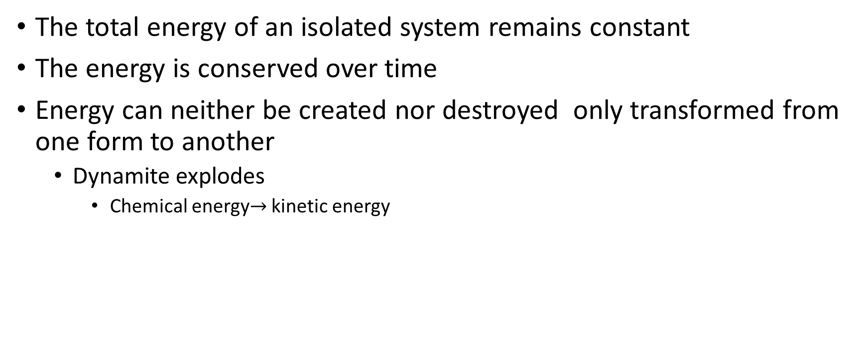
Principle of conservation of energy
The total energy of an isolated system remains constant
The energy is conserved over time
Energy can neither be created nor destroyed only transformed from one form to another
Dynamite explodes
Chemical energy$→$ kinetic energy

Slide 18

Mechanical energy
Kinetic energy
Gravitational potential energy
Elastic potential energy
$E_{TM}=E_{k}+E_{p}$
$E_{TM}=E_{k}+E_{gp}+E_{ep}$

Slide 19
Law of Conservation of Mechanical Energy
The total amount of mechanical energy in a closed system in the absence of dissipative forces (friction, air resistance) remains constant

