Slide 1
Sum of vectors

Slide 2
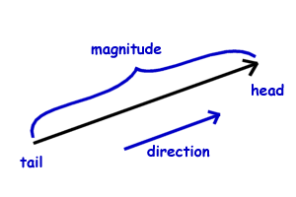
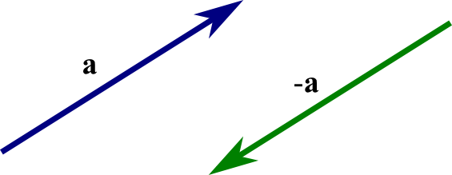
Vector
Magnitude, direction
Head of a vector
Tail of a vector
Parallel vectors: same or opposite directions
Sum of vectors: resultant

Slide 3
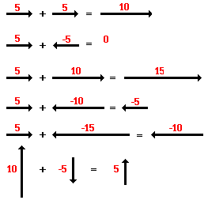
Parallel vectors

Slide 4
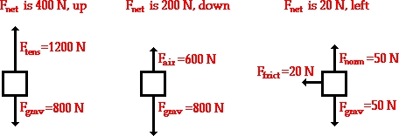

Slide 5
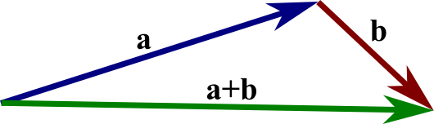
Non-parallel vectors
Head-to tail method
Place the two vectors next to each other such that the head of the one vector is touching the tail of the other vector.

Slide 6
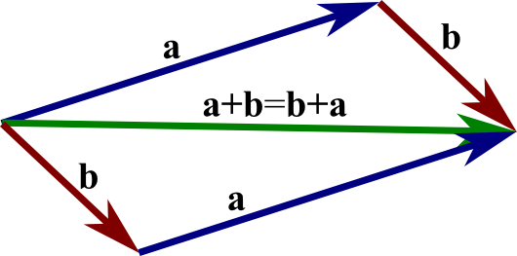
Non-parallel vectors
Parallelogram method
Place the two vectors next to each other such that the tails of the vectors are touching
Draw a parallelogram
The diagonal of the parallelogram will be the resultant

Slide 7
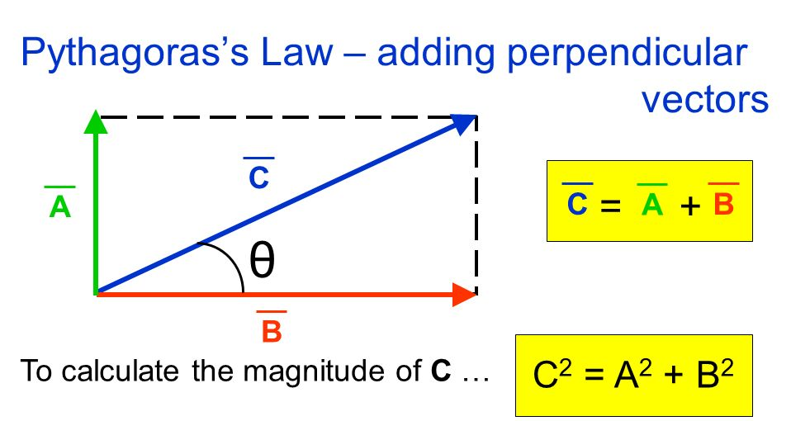
Perpendicular vectors

Slide 8
Problem 1.
Two forces are perpendicular. Their magnitudes are 3 N and 4 N. Calculate the resultant.

Slide 9
Problem 2.
There are two 10 N forces. The angle between them is 120°. Find the resultant.

Slide 10
Problem 3.
There are two forces 2 N and 5 N. The angle between them is 60°. Construct the resultant.

