Slide 1
What is Physics?
https://www.youtube.com/watch?v=ZihywtixUYo

Slide 2
Important ideas
Physics and Mathematics are inseparable! Math is a language of the Physics.
Dark matter and dark energy seem to make up 95% of universe! So all of our physics really describes only 5%. And everything else at the moment is a mystery.
There are things beyond that we don’t even know that we don’t know!

Slide 3
Physics
Ancient Greek word φυσική - knowledge of nature
Main goal of physics is understand how the universe behaves
Makes significant contributions through advances in new technologies

Slide 4
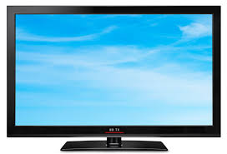

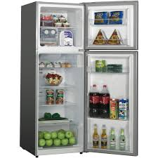


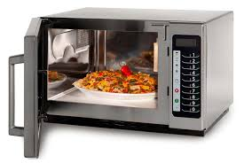
If we hadn’t had physics would we have?

Slide 5
If we hadn’t had physics would we know about
Planets, Sun, Stars, Galaxies
Big Bang

Slide 6
What will we learn?
We want to explain why objects move around the way they do
One-dimensional motion and Two-dimensional motion
We will learn how to precisely describe the motion of objects and predict their motion for some special cases
Forces and Newton’s Laws
We will learn why objects change their motion
Work and Energy
How the motion of a system can change

Slide 7
Next years
Thermal physics
Electricity and Magnetism
Optics
Modern Physics

Slide 8
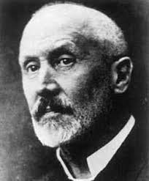
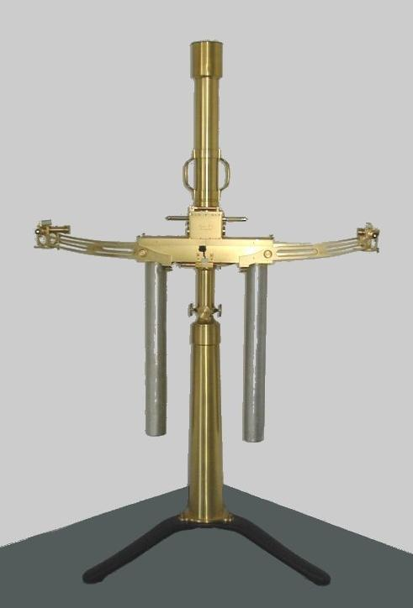
Hungarian physicist
Eötvös Loránd
experimental work on gravity
Gravitational gradient on the Earth’s surface
Torsion balance –Eotvos pendulum
Location of petroleum deposits

Slide 9
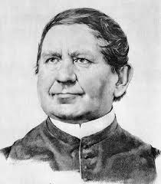
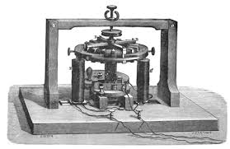
Jedlik Ányos
Principle of
Electric motor
Dynamo
Converts mechanical rotation into electric current by rotating coils of wire and magnetic field

Slide 10
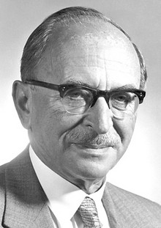
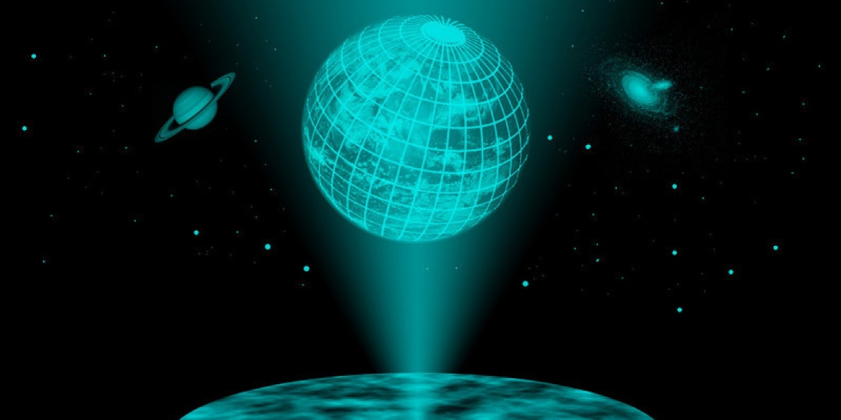
Gábor Dénes (1900)
Invented holography
Nobel Prize 1971

Slide 11
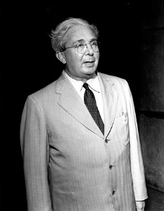
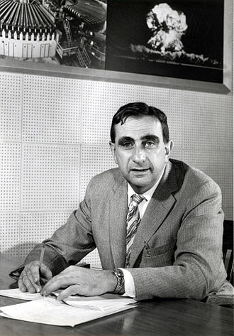
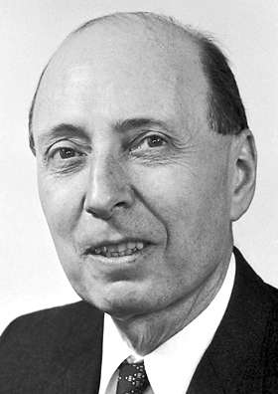
Szilárd Leó (1898)
Teller Ede (1908)
Wigner Jenő (1902)
Half Nobel Prize 1963
Nuclear Physics

