Slide 1
Free fall

Slide 2
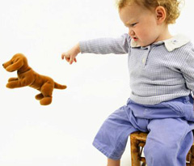
First experience with Physics
If you drop an object it will fall and hit the ground
Why do the objects fall? What is the cause of this motion?
Gravity

Slide 3
Free fall - definition
Free fall is any motion of an object where gravity is the only force acting upon it.
or
The object is falling under the sole influence of gravity.

Slide 4
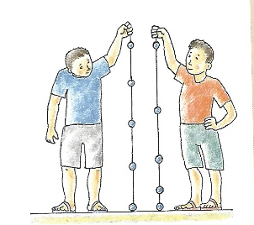
What kind of motion is the free fall?
1. case
We put small metal objects on this string. The distances between the objects are the same.
The knocks followed each other faster and faster.
Same distances were covered in shorter intervals of time
Accelerated motion

Slide 5
What kind of motion is the free fall?
2. case
The distances of the nuts from the first nut were 10 cm, 40 cm, 90 cm, 160 cm.
We could hear the knocks steadily.
The distances
1 – 10 cm
2 – 40 cm
3 – 90 cm
4 – 160 cm

Slide 6
What kind of motion is the free fall?
The distance-time graph is a parabola
Uniformly accelerated motion

Slide 7
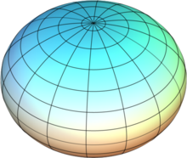
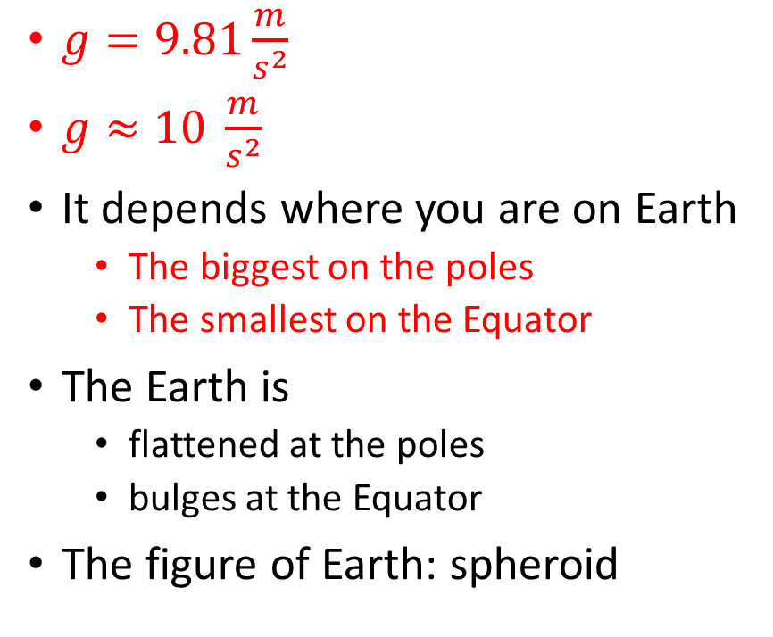
Acceleration of free fall Acceleration of gravity
$g=9.81\frac{m}{s^{2}}$
$g≈10 \frac{m}{s^{2}}$
It depends where you are on Earth
The biggest on the poles
The smallest on the Equator
The Earth is
flattened at the poles
bulges at the Equator
The figure of Earth: spheroid

Slide 8
Iron ball – paper ball
They hit the ground at the same time
The heavier objects don’t fall faster than the lighter ones! (in case of free fall)

Slide 9
Iron ball - paper
They don’t hit the ground at the same time
The ball’s motion is approximately free fall
The paper isn’t falling under the sole influence of gravity
There is another force that is acting upon it: drag (air resistance)
If there was no air (atmosphere) they would hit the ground at the same time!
On the Moon!
In a vacuum tube!

Slide 10
https://www.youtube.com/watch?v=KDp1tiUsZw8

